Slide 1
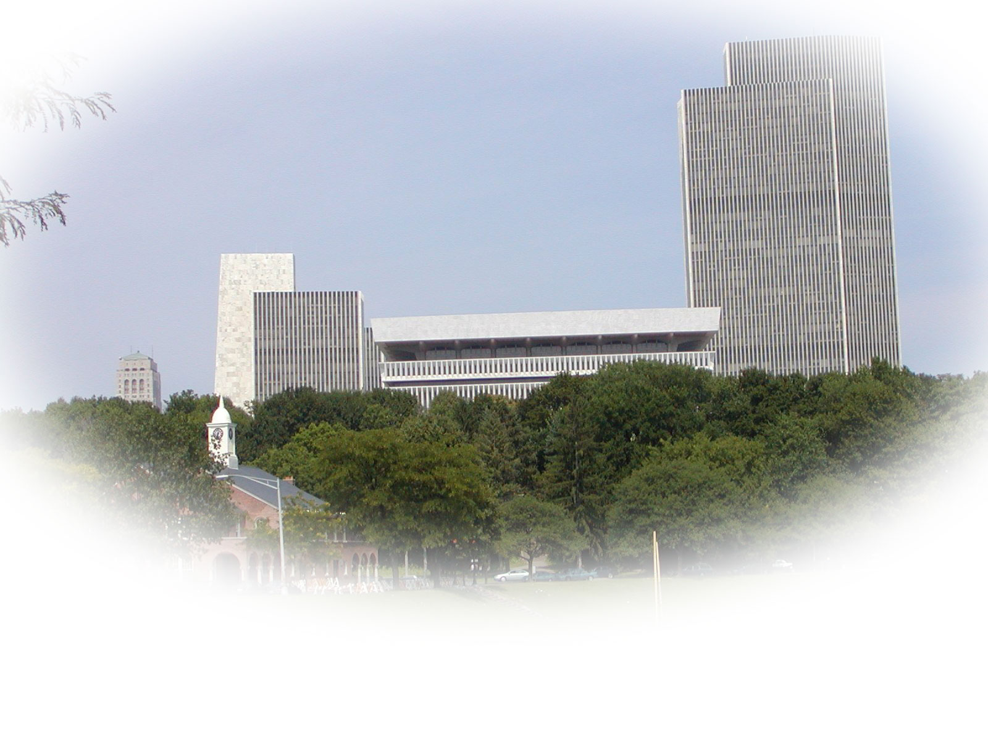
Graduate GIS programs at the University at Albany
James Mower
Department of Geography and Planning
University at Albany

Slide 2
Why Study GIS at UAlbany?
Our faculty, facilities, and location give you unique opportunities to
Learn GIS, Remote Sensing, and Cartographic theory from leading researchers and practitioners
Participate in internship opportunities at state and regional agencies
Prepare for today’s GIS job market

Slide 3
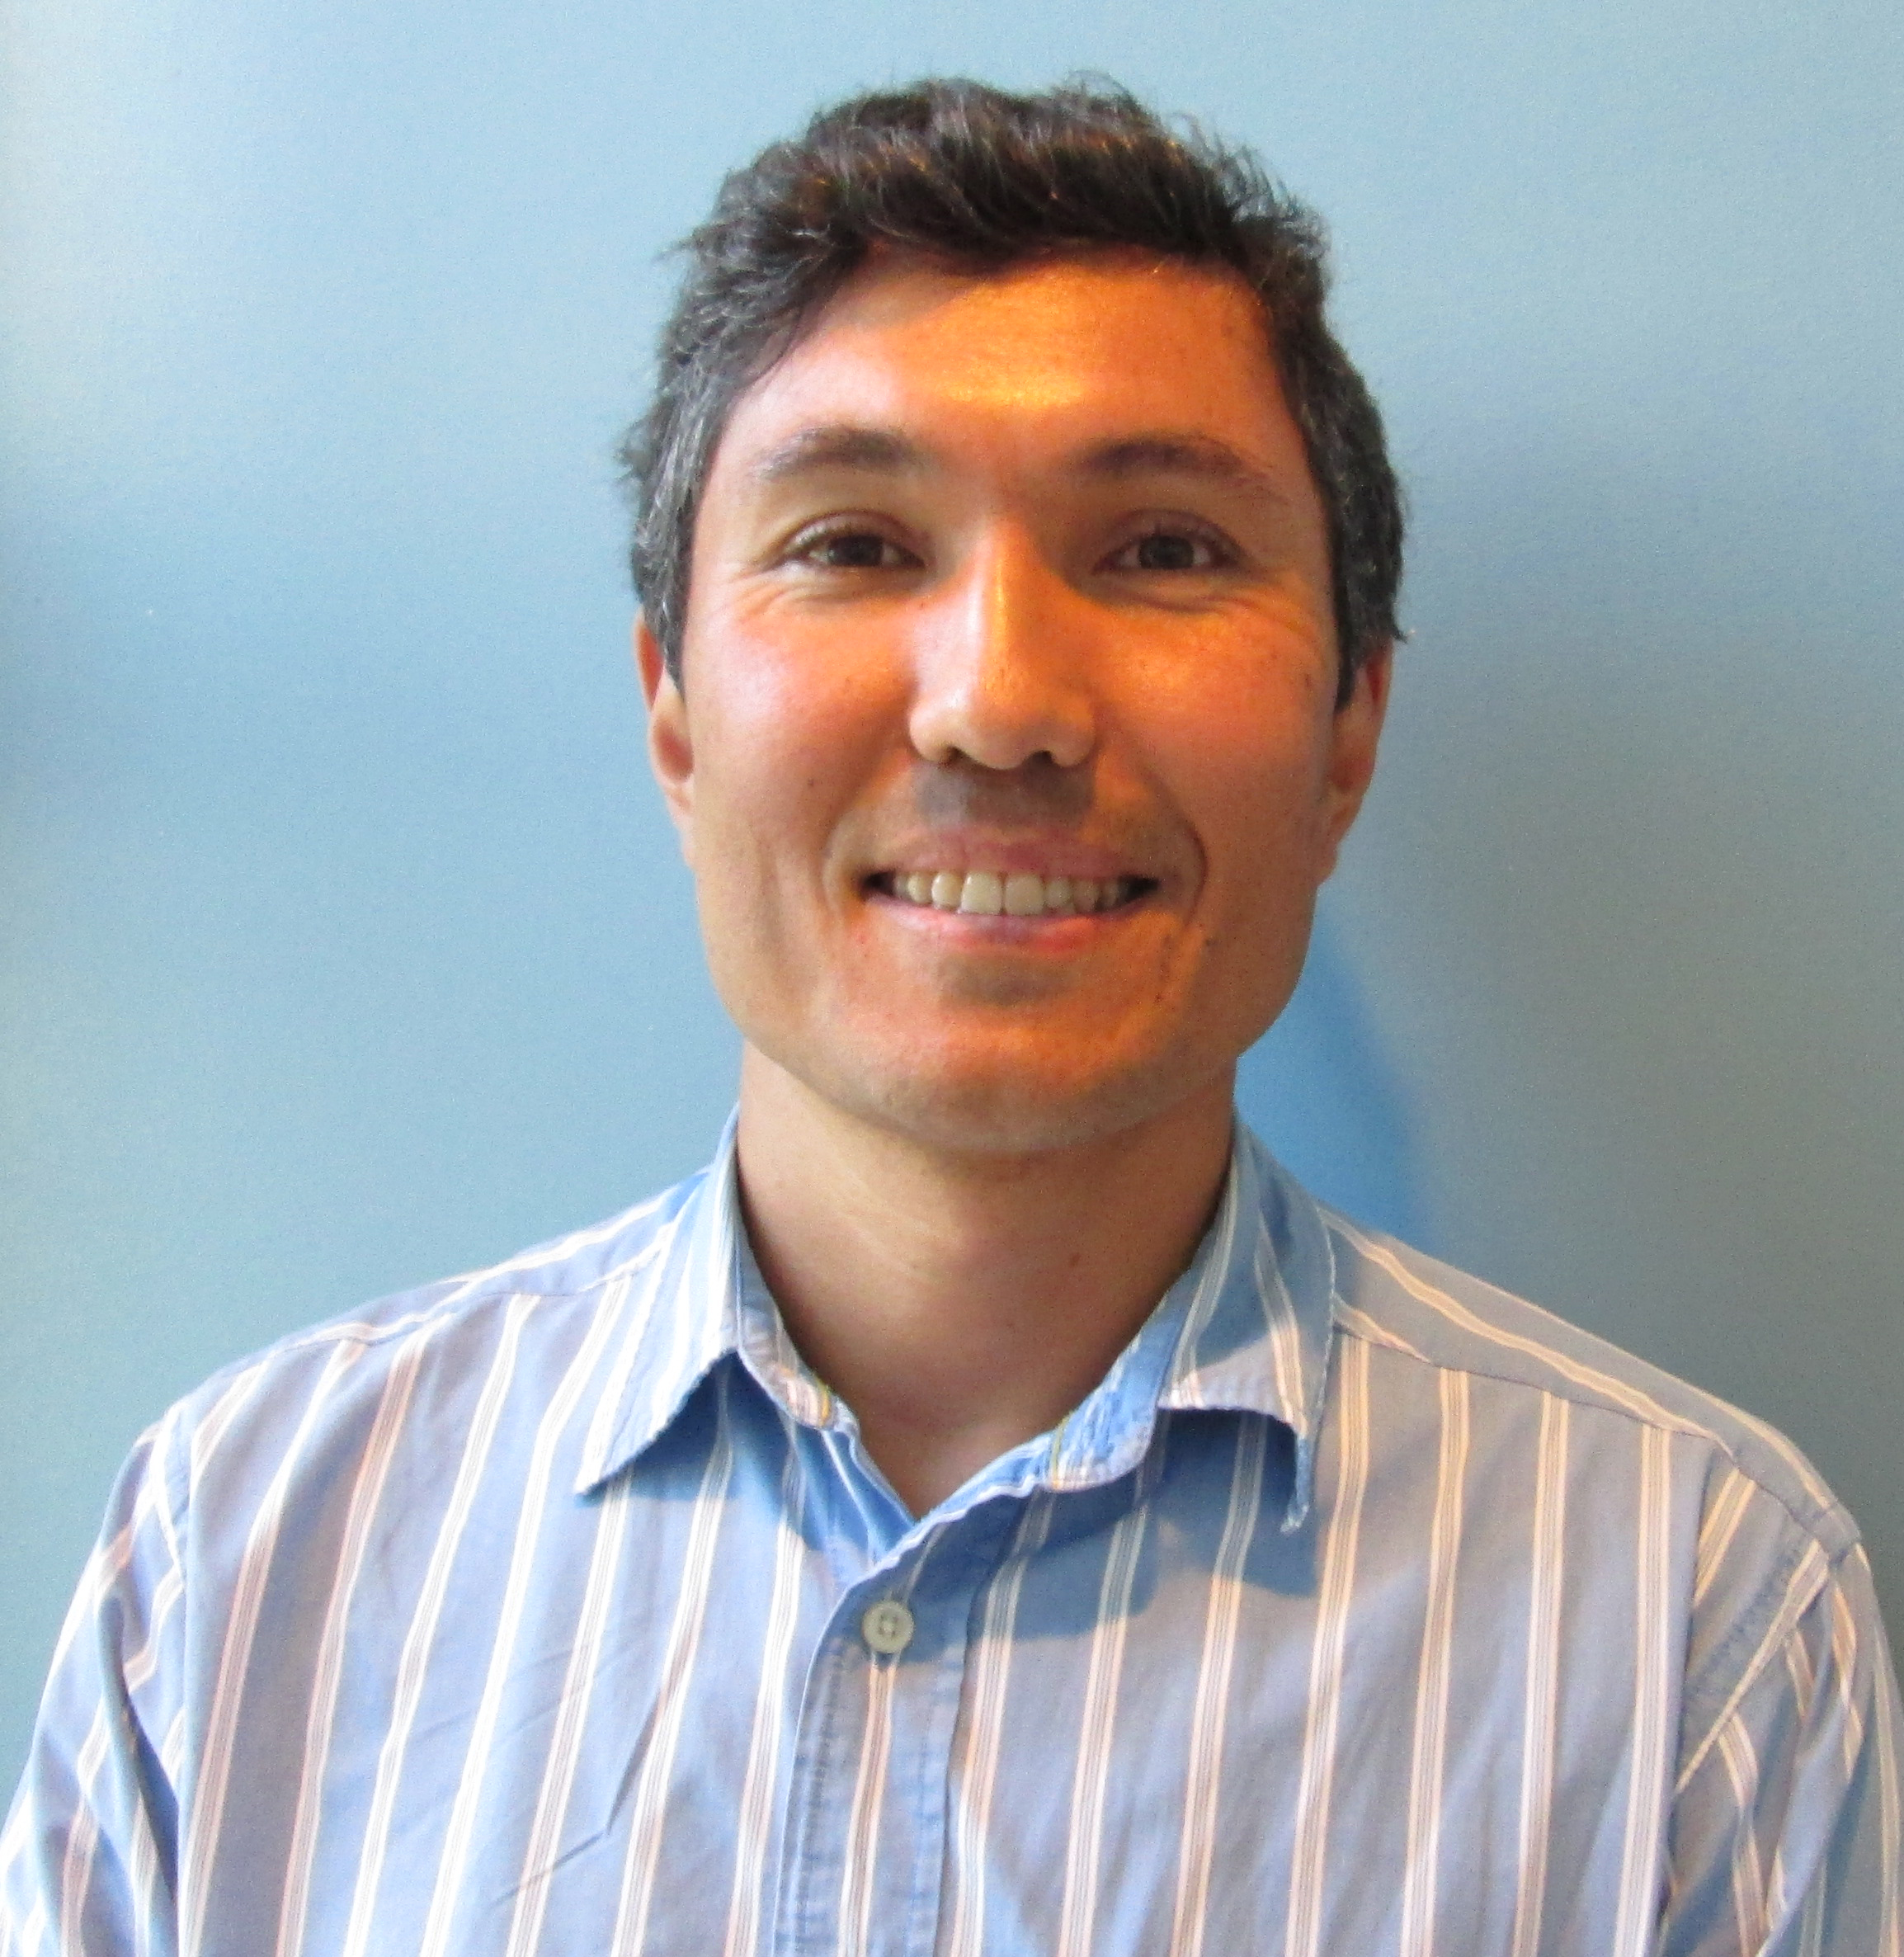
Our Faculty
Alex Buyantuev is a specialist in Remote Sensing
His current work focuses on
Climate change
Urban land use analysis
Vegetation land cover analysis
Novel uses of remote sensing platforms

Slide 4
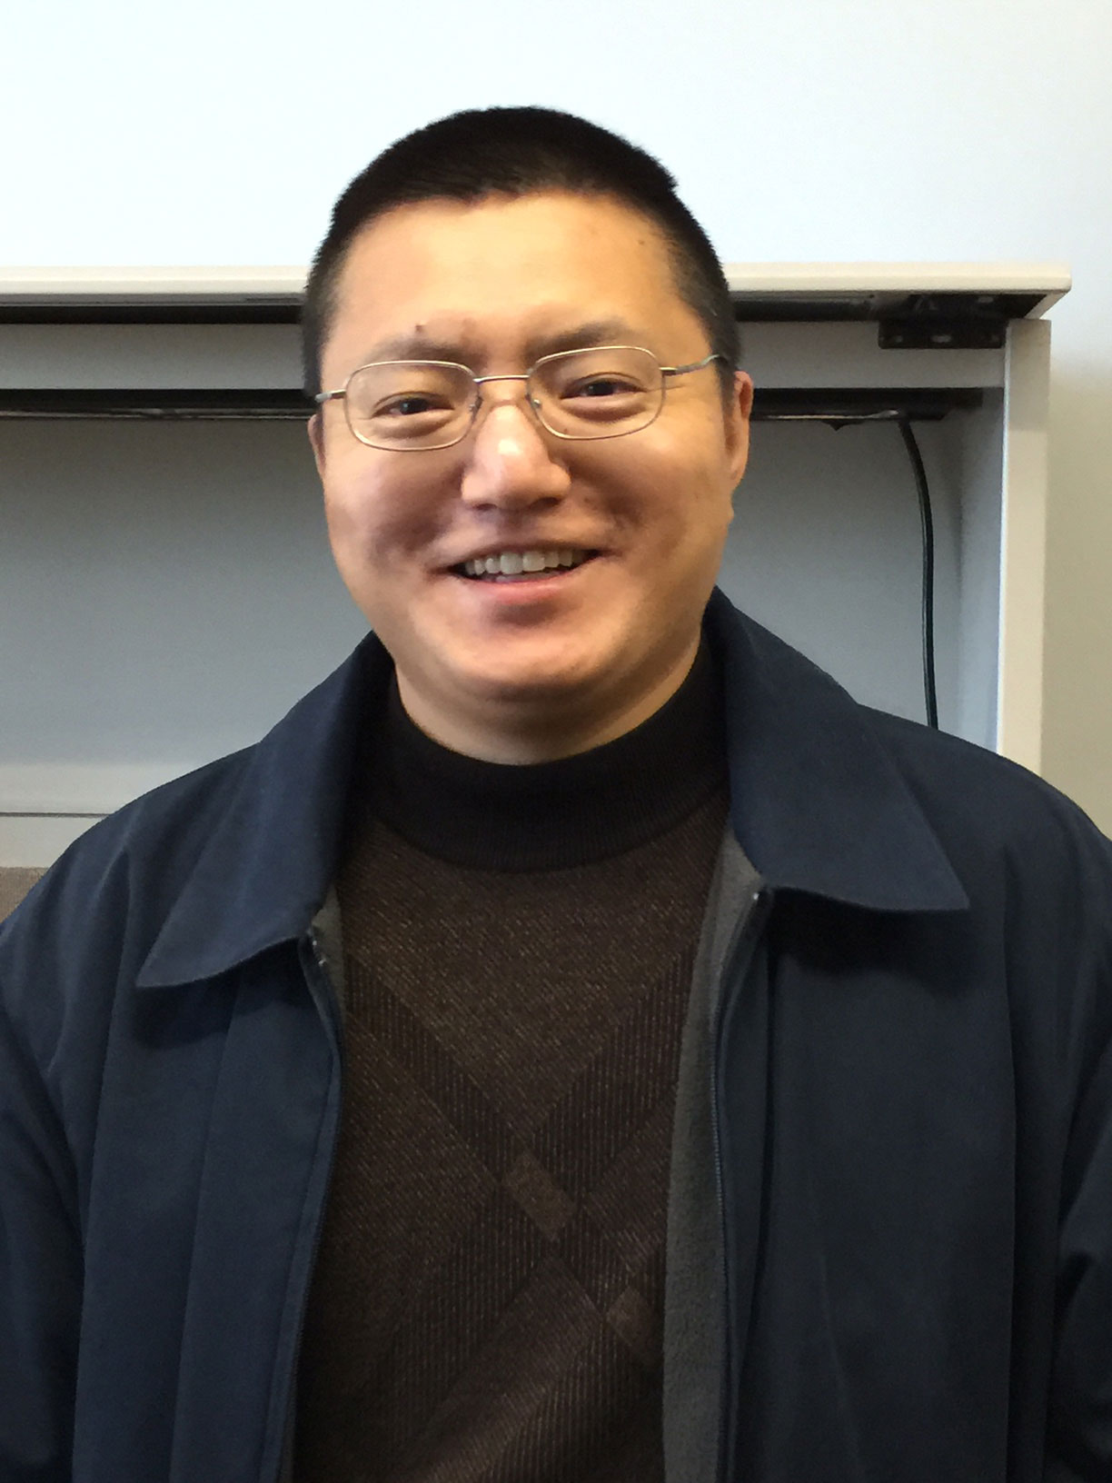
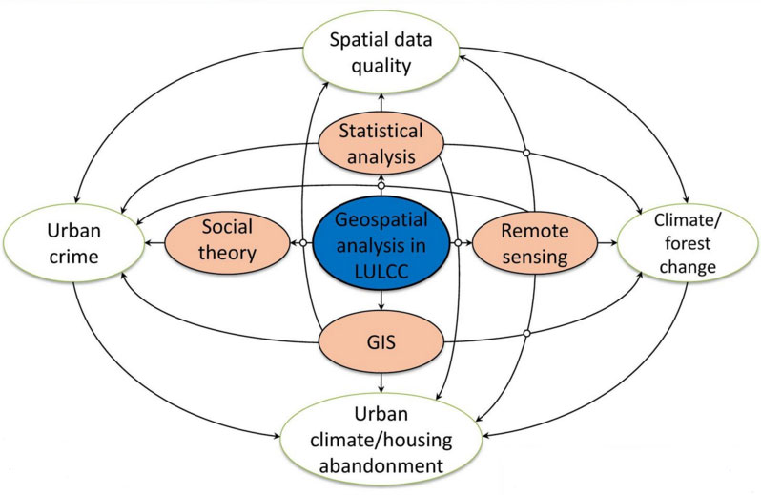
Our Faculty
Shiguo Jiang is another Remote Sensing specialist with interests in
Urban crime
Spatial data quality
Climate change

Slide 5
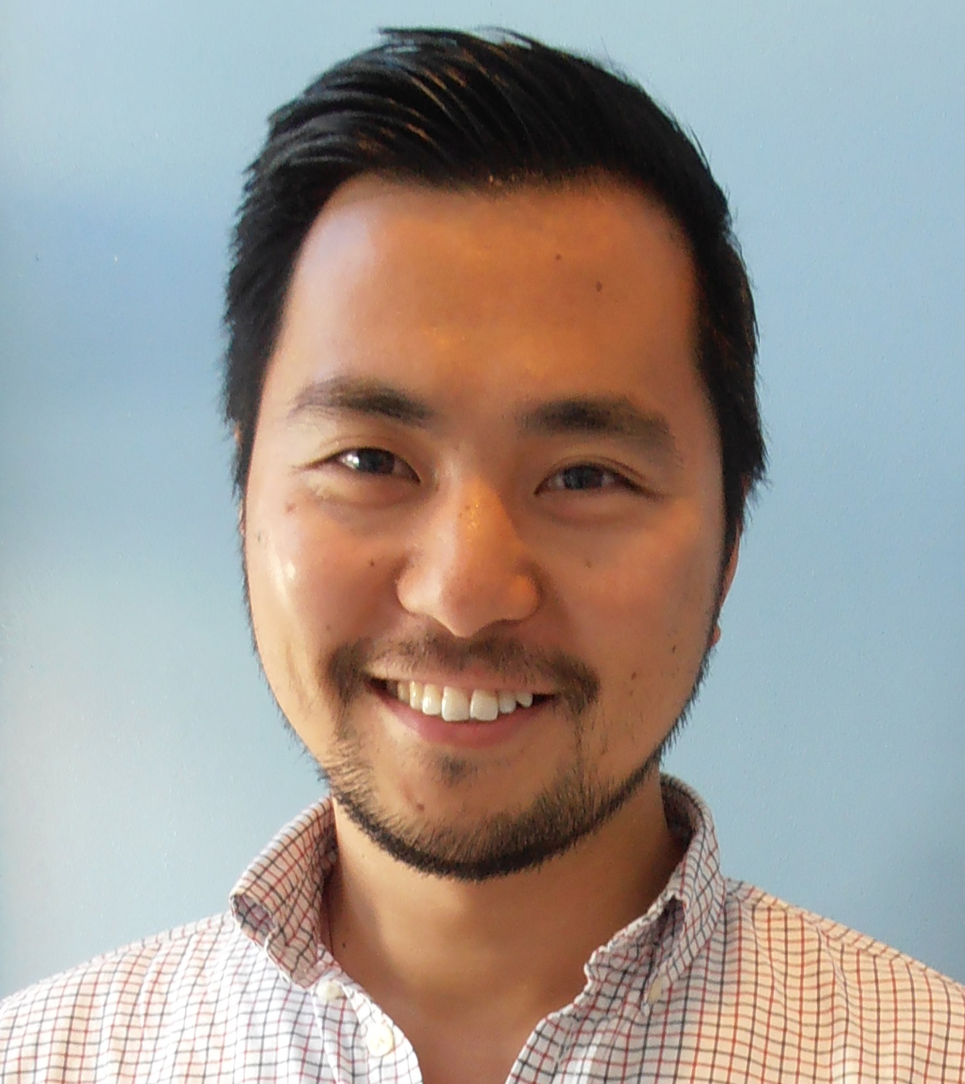
Our Faculty
Rui Li is a specialist in Cartography and GIS
His main interests include
New technologies for wayfinding
Spatial cognition
Human interactions with built environments

Slide 6
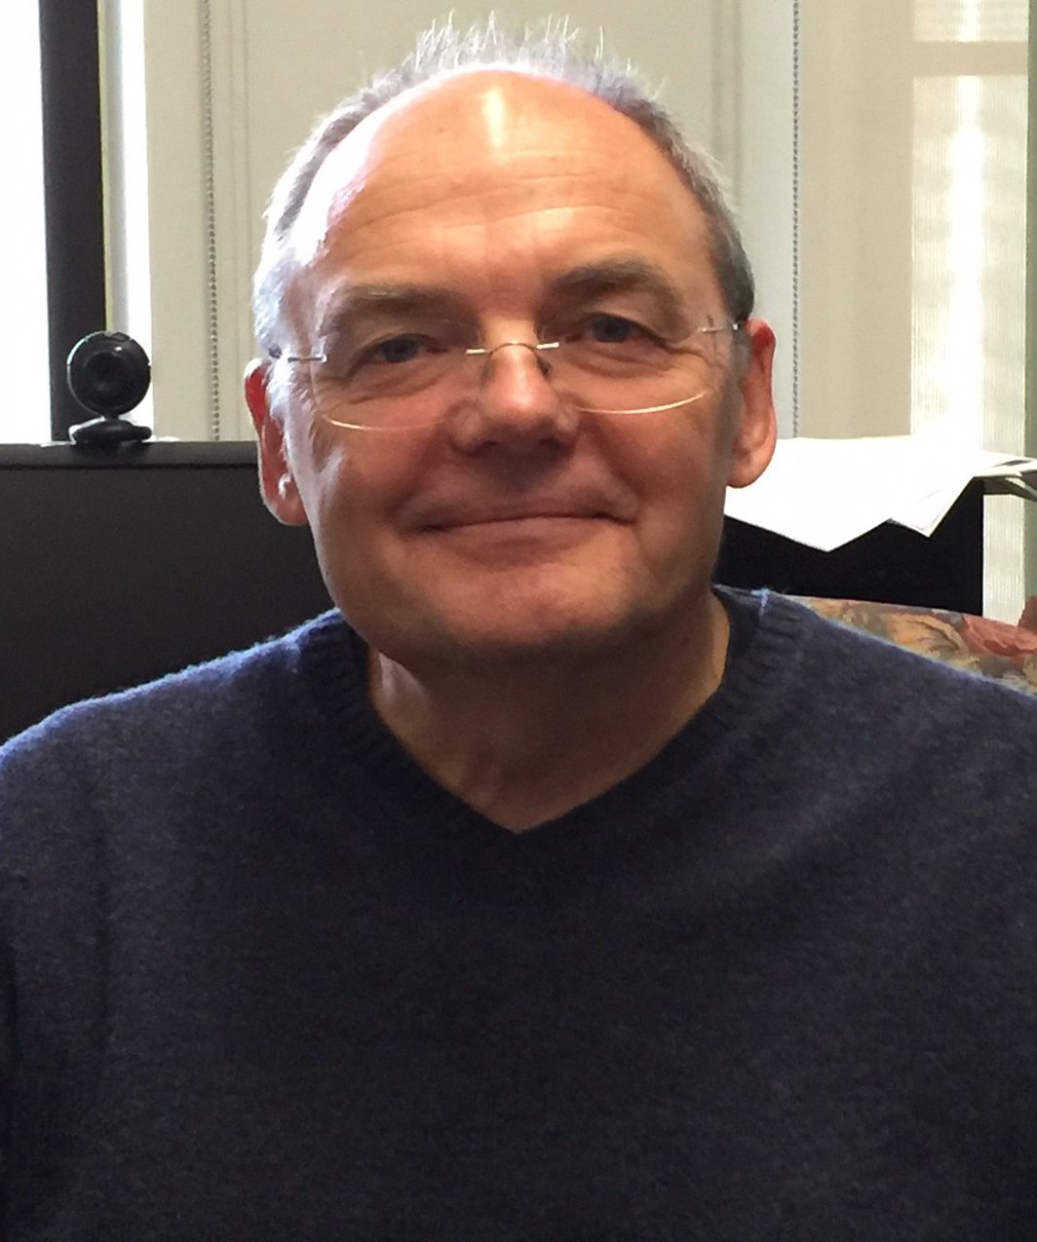
Our Faculty
Andrei Lapenas is a Physical Geographer and Environmental Scientist
His interests include
Forest nutrient cycling
Climate change
Sustainability
Soil science

Slide 7
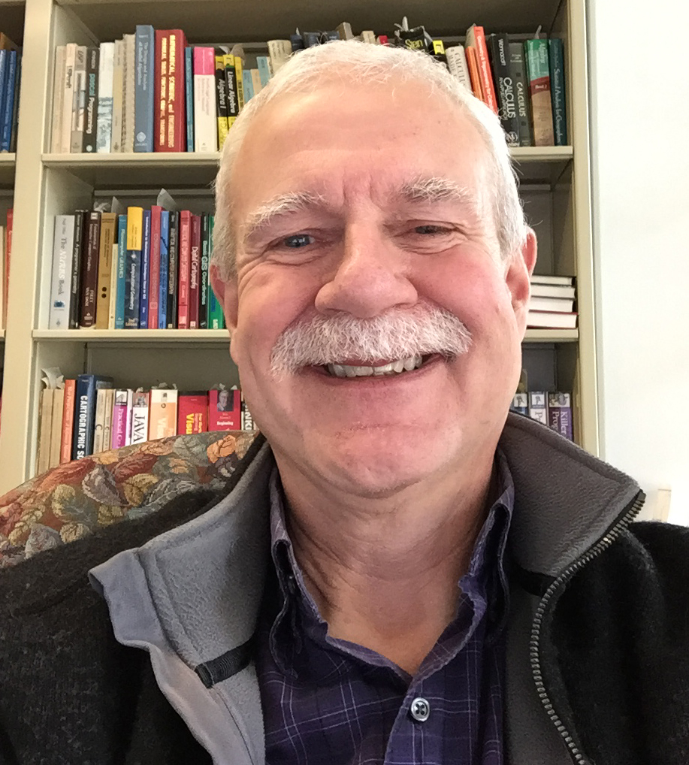
Our Faculty
James Mower has research interests in
3D rendering
Augmented reality
GPU computing

Slide 8
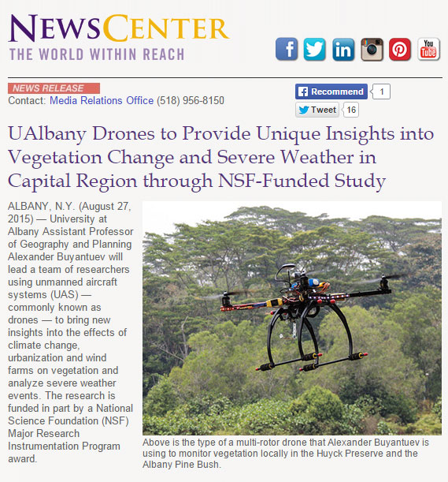
Our Technology
Prof. Alex Buyantuev is PI for an NSF Major Research Instrumentation grant that explores the use of UAVs for environmental analysis

Slide 9
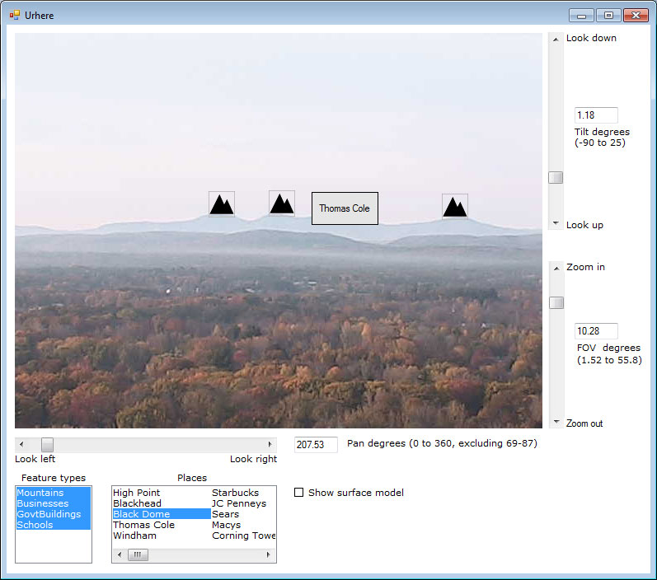
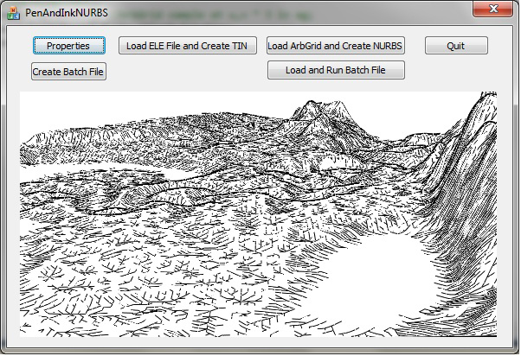
More Technology!
Prof. James Mower uses webcams and GPU computing for augmented reality applications
He also uses large graphics processing units (GPUs) for graphics and data analysis

Slide 10
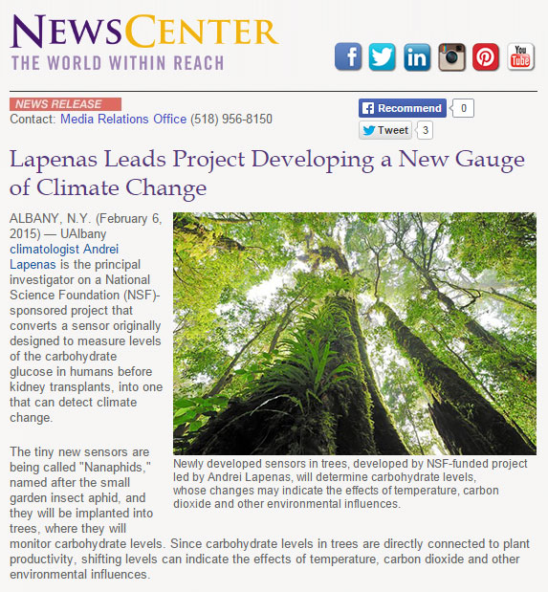
Even More Technology!
Prof. Andrei Lapenas has repurposed human glucose samplers for automated carbohydrate measurement in trees

Slide 11
Our GIS Programs
MA in Geography
30 credits (thesis option)
36 credits (non-thesis)
GIS track
GIS Certificate
15 credits
Can be acquired with or without the MA

Slide 12
Our Proposed MS in GIS
We are currently developing a Master’s of Science program in Geographic Information Science
This will be a 36 credit program focusing on the theory and applications of spatial information
We will be going through an external review of our proposal in the Spring
We’ll keep you posted!

Slide 13
The Informatics PhD Program
What happens after your graduate GIS education?
The Informatics PhD program at UAlbany is a path to further graduate education
Several of our faculty are affiliated with this program

Slide 14
New Colleges and Initiatives at UAlbany
The University at Albany is growing
New School of Computer Engineering and Applied Sciences
New School of Emergency Preparedness and Homeland Security
We expect both schools will link with our GIS programs

Slide 15
Albany is at the Center of NY GIS
Our location gives you unique internship opportunities
We have long-standing relationships with
NY Office of the Attorney General
NY Department of Health
NY Department of Environmental Conservation
And many other governmental, not-for-profit, and for-profit organizations

Slide 16
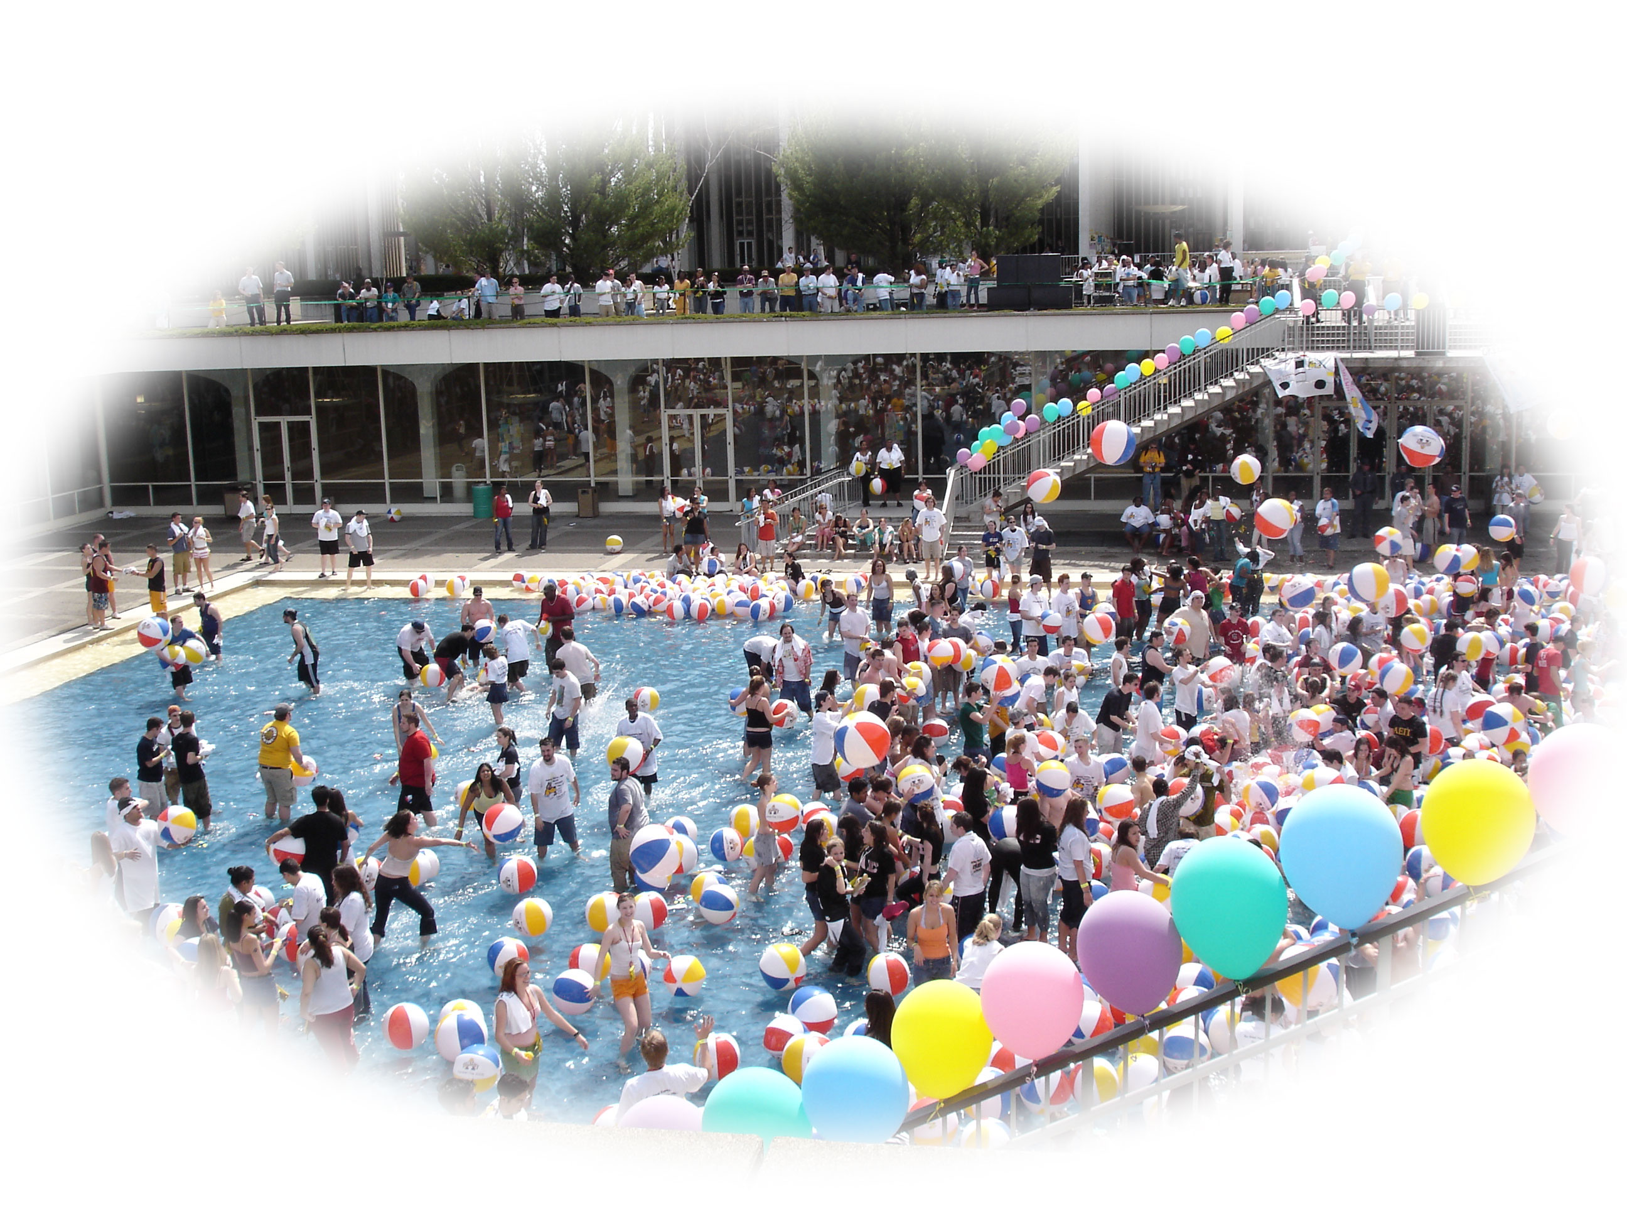
Thank you!
For more information about GIS programs at UAlbany
Go to www.Albany.edu/gp
Contact James Mower
jmower@Albany.edu
www.Albany.edu/faculty/jmower
We wish you all the best in your search for graduate studies!
Photos courtesy of John Pipkin

