Slide 1
GPU Computing for GIS
James Mower
Department of Geography and Planning
University at Albany

Slide 2
What is a GPU?
A GPU is a graphics processing unit
Modern GPUs are composed of multiple processors
Each of these processors can perform operations similar to those of CPUs
Modern GPUs costing under $1000 have thousands of processors
They are essentially parallel computing devices on your desktop or mobile device

Slide 3
The Future of GPU programming in GIS
Still in exploratory stages in GIS
NVIDIA lists several GIS prototype apps

Slide 4
What are GPUs used for?
At the moment, most GPU applications are found in 3D rendering applications
They are gradually finding their way into GIS animations requiring accelerated graphics
But they can do so much more…

Slide 5
What Kinds of Applications Benefit Most from GPU Environments?
Any program that can be computed in small, independent chunks
We don’t want processors waiting around for others to finish their work
Also, the less communication between the chunks, the more efficiency

Slide 6
How GPUs Speed Up Graphics Programs
Modern graphics APIs use the concept of a ‘pipeline’
At each step of the pipeline, a single vertex is operated upon, in sequence, by unique processors for:
Vertex coordinate transformations
The creation of additional geometry
Clipping and primitive generation
Fragment (essentially pixel) color assignment
Each vertex is processed independently

Slide 7
The Programmable Pipeline (for graphics applications)

Slide 8
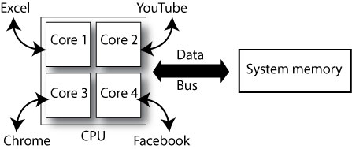
Standard CPU process execution
A 4-core CPU can run up to 4 processes simultaneously
Each of the apps in this example may have many execution threads (processes), but at least 4 can run at the same time
Each process reads and writes information to system memory using the system bus

Slide 9
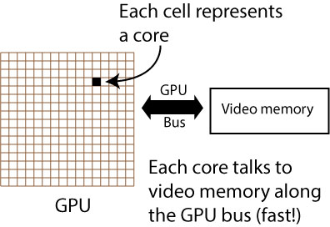
GPU hardware environment
The GPU is massively parallel (possibly thousands of cores)
It has its own memory store and data bus

Slide 10
How Do You Create a Graphics Application on a GPU?
Most graphics applications use 1 of 2 major application programmer interfaces (APIs):
OpenGL (Overseen by the Khronos Group)
GLSL shader language
DirectX (Microsoft)
HLSL shader language
Both GLSL and HLSL look a lot like C

Slide 11
The Dirty Details
A ‘GPU server program’ must be launched by a ‘client program’
Typically, the client program reads the server program code from one or more files
The code is read into simple text strings
The code is compiled, linked, and executed by calls to the API
If all goes well, the GPU now executes your server code

Slide 12
What Language Can You Use to Write the Client Program?
C/C++ is the most straightforward way to work with graphics and numerical applications
There are many bindings for other languages
My Landscape Rendering class is using OpenGL bindings for Java (using the JOGL package)
You can also use multiple programming languages for CUDA host applications
In CUDA, the CPU is the host and the GPU is the device

Slide 13
Compute Shaders
You can use OpenGL ‘compute shader’ programs to process numerical data (no graphics production)
However, other languages designed specifically for these applications are better suited for such work
Very good control for synchronous and asynchronous operation

Slide 14
Some General-Purpose GPU Programming Languages
CUDA (NVIDIA)
OpenCL (from the folks that brought you OpenGL)
OpenCL, CUDA, and other such languages have qualities similar to those expected by numerical programmers in C, C++, FORTRAN, etc.
These programs cannot access the graphics pipeline

Slide 15
Getting Started with GPU Computing
There are many excellent tutorials for graphics applications using OpenGL versions 3 and later
OGLDEV (http://ogldev.atspace.co.uk/)
My first choice for learning new GPU graphics tricks
Useful whatever your programming language but best if you’re using C/C++
http://www.opengl-tutorial.org/
Similar topics; different perspective

Slide 16
Compilers, APIs, IDEs, phew!
When starting out (especially for graphics apps),
Update your graphics drivers for your GPU first!
Decide on an OS, an API and a CPU programming language
I use C++ with OpenGL on Windows 7
Use a decent integrated development environment (IDE)
I use Visual Studio 2010—many other options

Slide 17
What Version???
Use OpenGL version 3.3 or later (‘modern’ OpenGL)
I use the latest version of OpenGL that my GPU supports
Right now that’s 4.3
Good for applications that push limits of practicality
Why wouldn’t you use the latest version?
You may want to write production code for a device
Some devices may not support the latest version
Especially lower power mobile devices

Slide 18
What About Legacy Versions?
Legacy versions of OpenGL do not use the ‘programmable pipeline’
Much easier to learn than modern OpenGL but…
Legacy programs can be very slow in comparison
Impossible to do things like polynomial surface evaluation (B-splines, etc) at reasonable speeds
So, best not to get started with versions preceding 3.3

Slide 19
What to Expect
It’s Rocket Science! Go slowly
It’s not the theory—it’s the details that get you
The tools for building programs are thin
A little like old C programming
You have to do a lot of housekeeping…
Debugging is tough
In OpenGL, no direct way to ‘print’ from the GPU

Slide 20
Why Should You Care?
GPU computing opens new application frontiers
Improvements in CPU clock speeds are slowing
The solution has been to increase the number of processors
If you have applications that combine graphics and analysis and you want animation speed rendering
GPUs are for you!

Slide 21
Thanks for Coming!
Questions?

