Slide 1
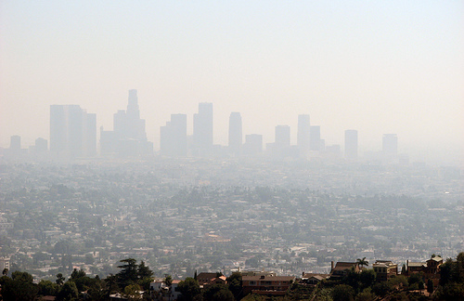
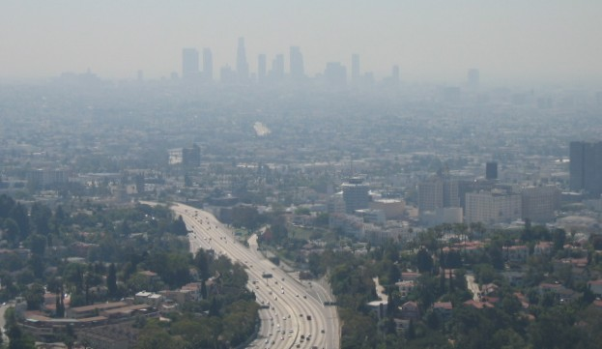
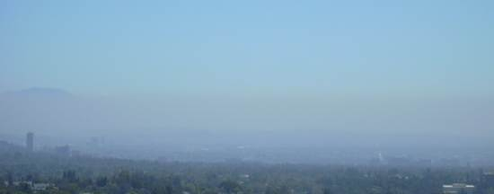

Slide 2
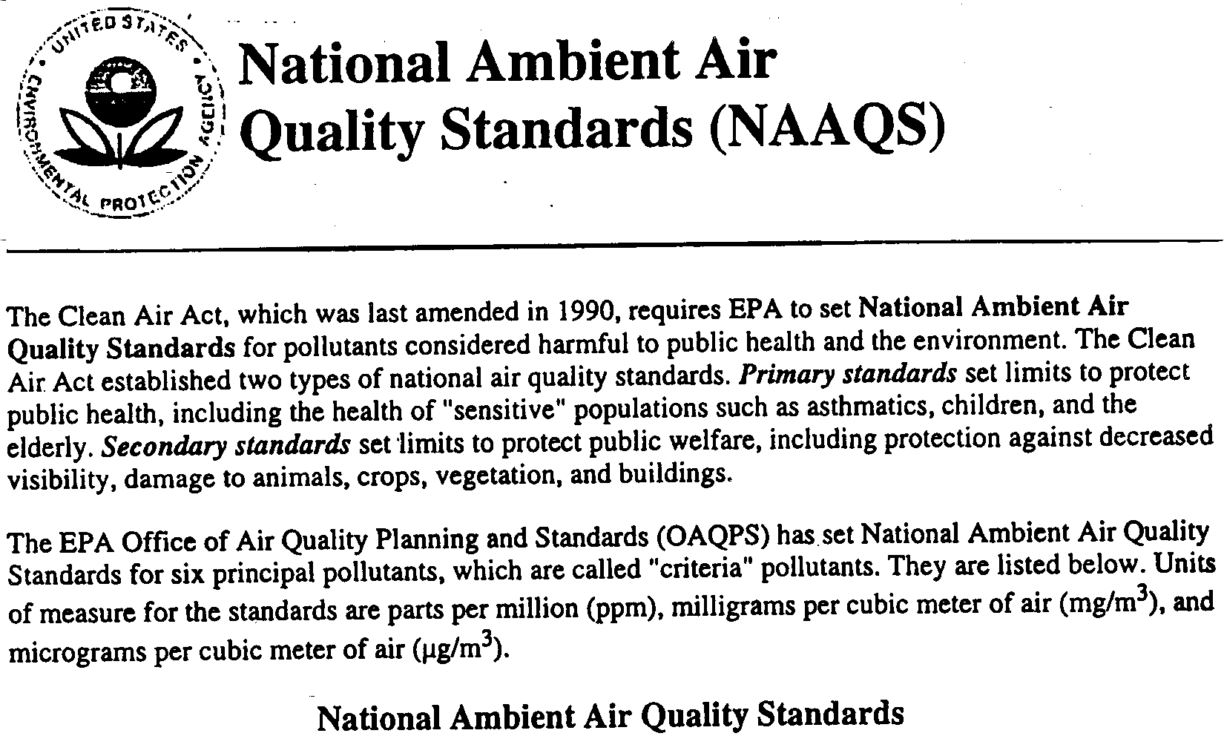
First authorized to be established by the Clean Air Act of 1970

Slide 3
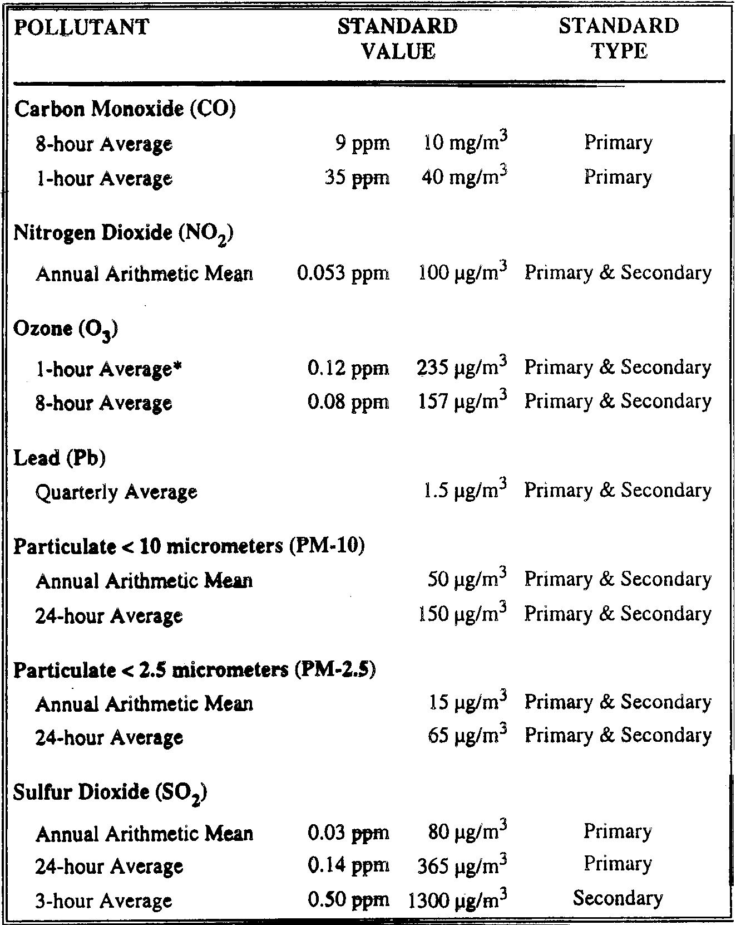
These are the only pollutants that have National Ambient Air Quality Standards.
These pollutants are known as criteria pollutants.
1- hr Average 0.1 ppm
X
0.075
as of Jan 2010
X
0.15
as of March 2008
as of Oct 2008
New standards proposed in Dec 1997
X
35
as of Dec 2006

Slide 4
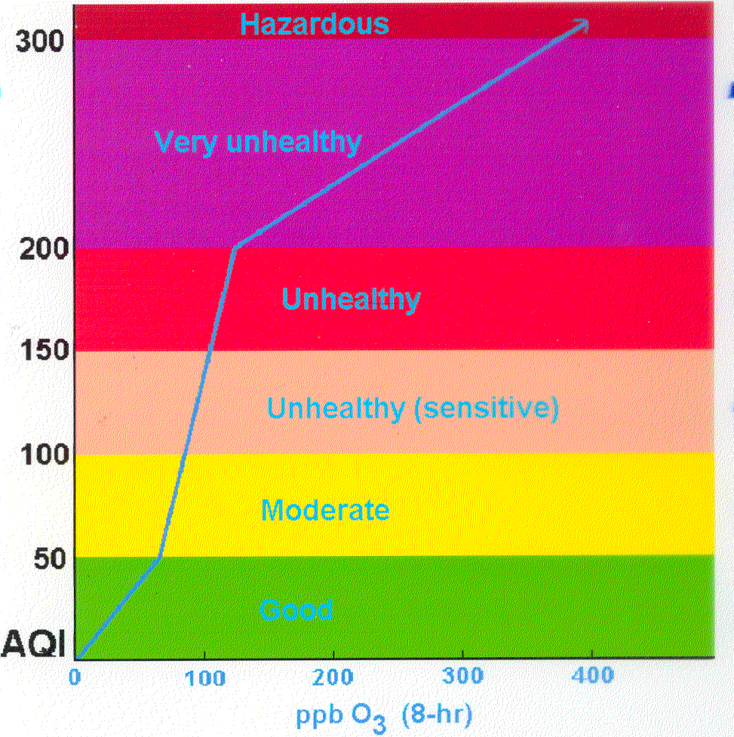
Average of three ozone exceedances per year
⇒ nonattainment
NAAQS ⇒
75

Slide 5
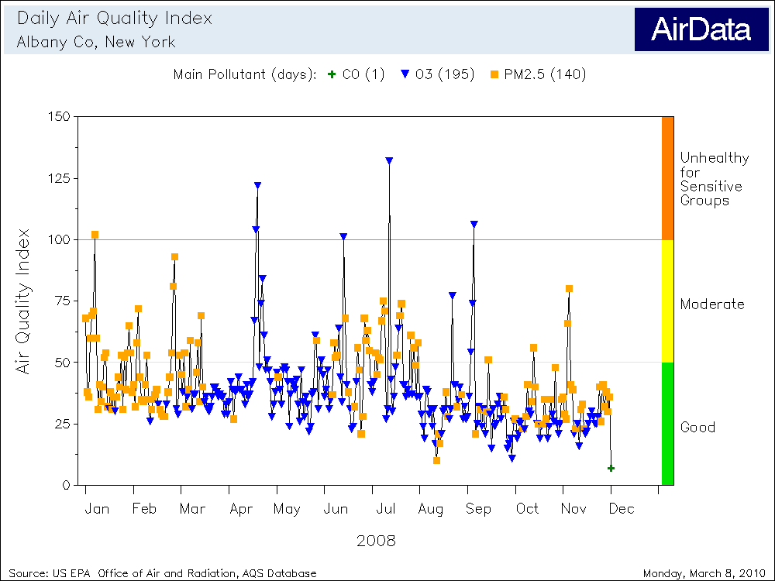
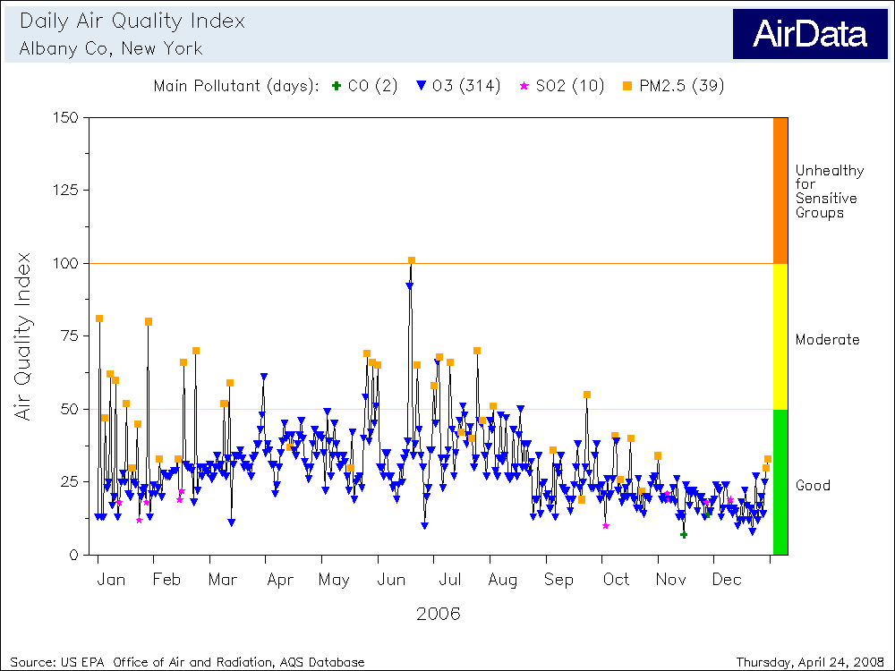
O₃ PM2.5
AQI Values: Maximum 132, Minimum 7, Percentiles... 90th 61, 75th 45, 50th 36, 25th 29 AQI Category: Days Good 269 (80%), Moderate 61 (18%), Unhealthy/Sensitive 6 (2%) Main Pollutant: Days CO 1 (0.3%), O3 195 (58%), PM2.5 140 (42%)
AQI Values: Maximum 101, Minimum 7, Percentiles... 90th 46, 75th 36, 50th 28, 25th 21 AQI Category: Days Good 339 (93%), Moderate 25 (7%), Unhealthy/Sensitive 1 (0.3%) Main Pollutant: Days CO 2 (0.5%), O3 314 (86%), SO2 10 (3%), PM2.5 39 (11%)

Slide 6
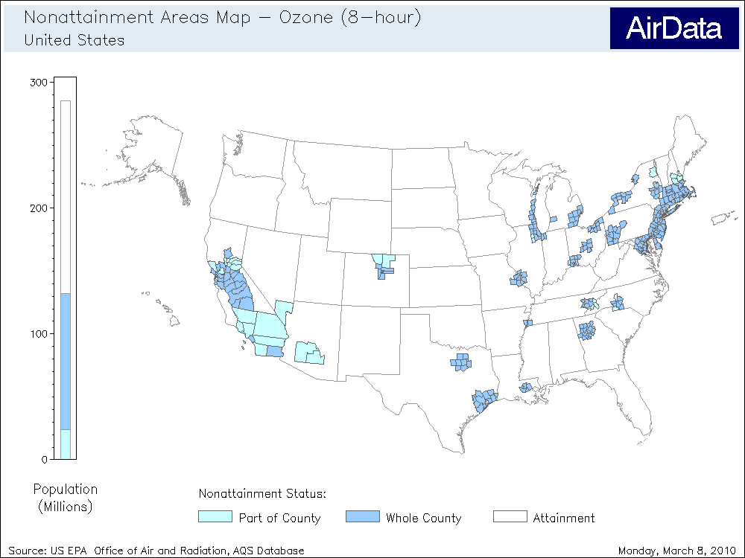
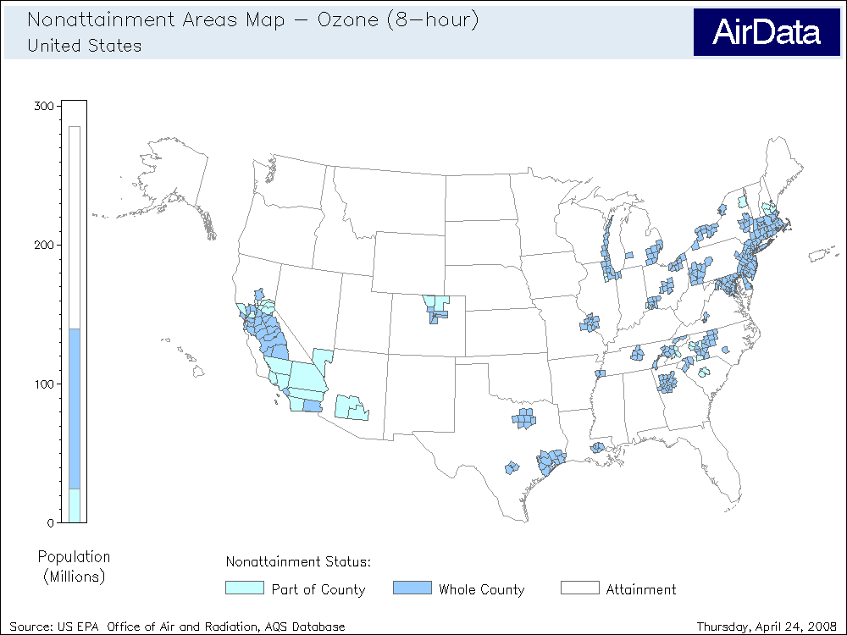
Most Americans living in nonattainment areas live in areas so designated because of ozone

Slide 7
Design Value

Slide 8
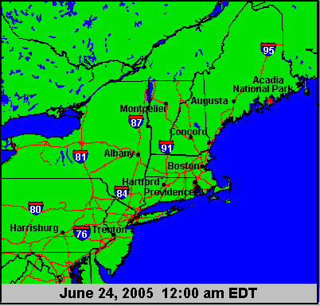
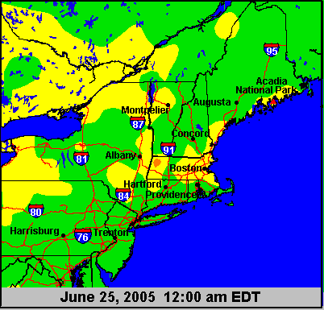
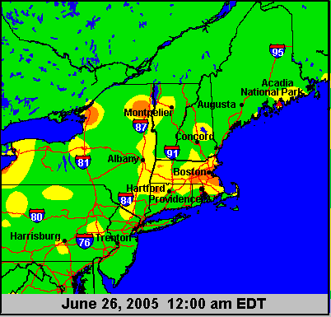

Slide 9
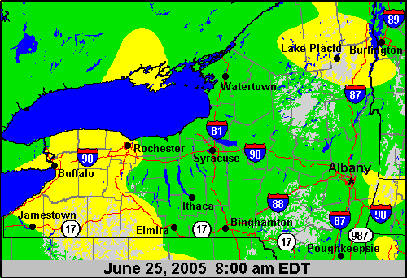

Slide 10
Show skew T – log p diagram
Weather maps
For June 25, 2005

Slide 11
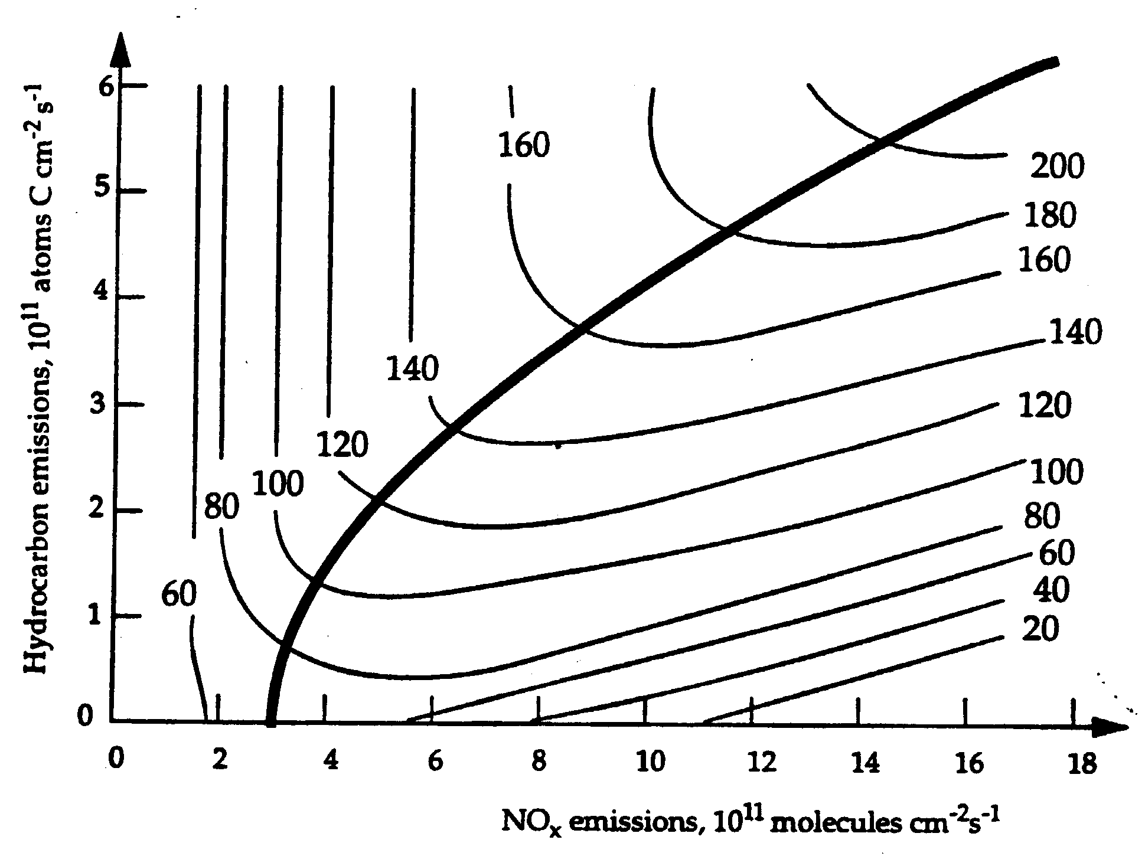
Empirical Kinetic Modeling Approach (EKMA) Diagram
NOx + VOCs + sunlight → “smog”
For a particular weather condition, predicted ozone in parts per billion (ppb)
NOx-limited regime
Reduce NOx emissions
Reduce VOCs
VOC-limited regime

Slide 12
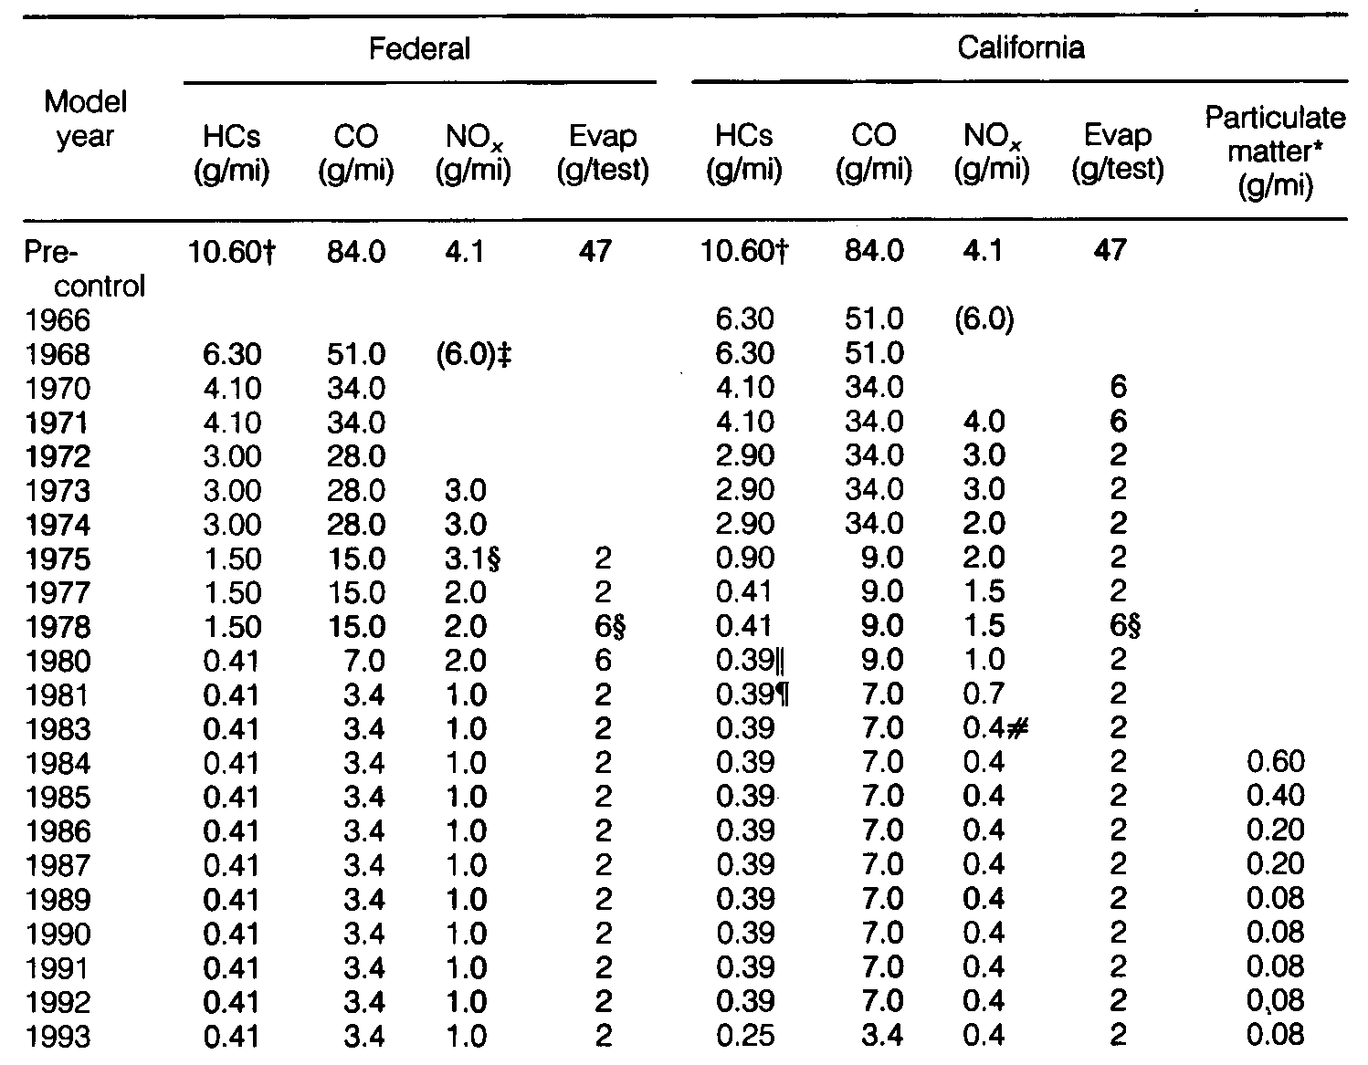
Auto Emission Standards
0.25 3.4 0.4 2
2004 stricter “Tier 2” standards being phased-in

Slide 13
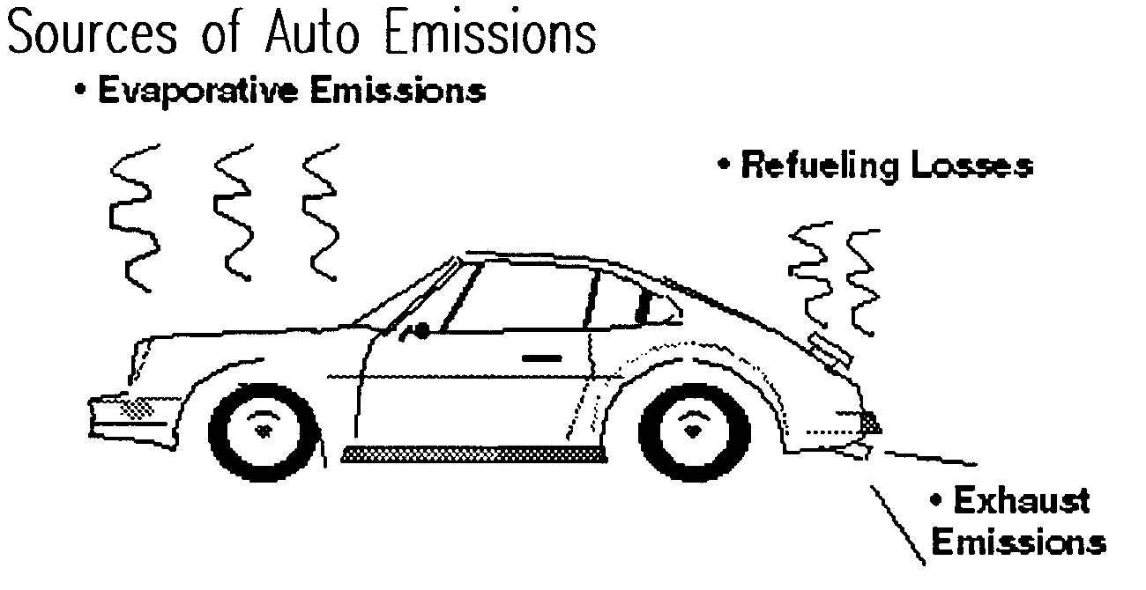

Slide 14
Primary pollutant - a pollutant created as a direct emission from tailpipe, smokestack, etc.
Secondary pollutant - a pollutant created as the result of chemical reactions in the atmosphere

Slide 15
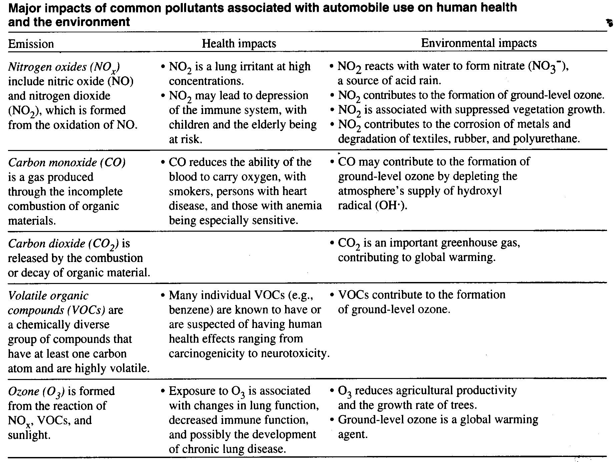
Primary Pollutants
• contribute to particulate formation (haze)
Lead (Pb) from tetraethyl lead, once used as an anti-knock additive.
· anemia, neurological disorders
· bioaccumulative

Slide 16
Secondary Pollutants
Particulate matter (PM-10 and PM-2.5) formed in air by reactions of VOCs
• respiratory diseases
• degrades visibility
• alters cloud properties and rain processes
Peroxyacetyl nitrate (PAN) • eye irritant
Nitric acid (HNO₃) • contributes to acid rain
The components of photochemical smog result from
NOX + VOCs + sunlight
Arie Haagen-Smit (1952)

Slide 17
Auto Emission Standards
0.25 3.4 0.4 2
2004 stricter “Tier 2” standards being phased-in

Slide 18
Auto Pollution Control Measures
Motor vehicle design
Fuel
Inspection & maintainence
Driver education
Transportation controls or alternatives

Slide 19
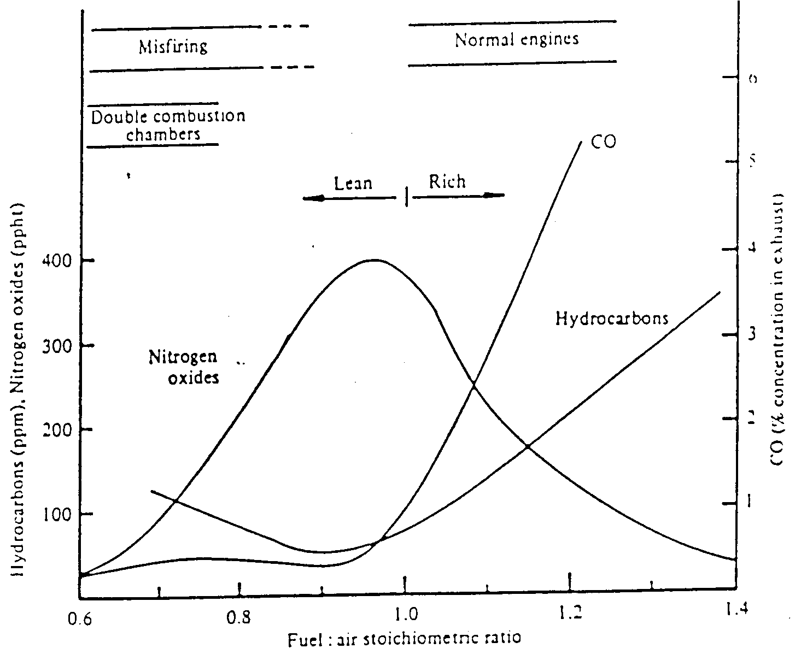
Reduces CO & VOC but increases NOx
0.054
0.068
0.082
Fuel: air mass ratio

Slide 20
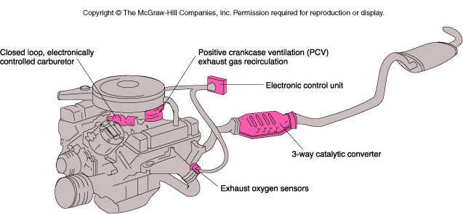
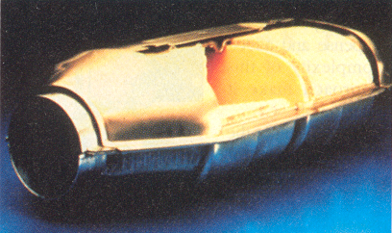
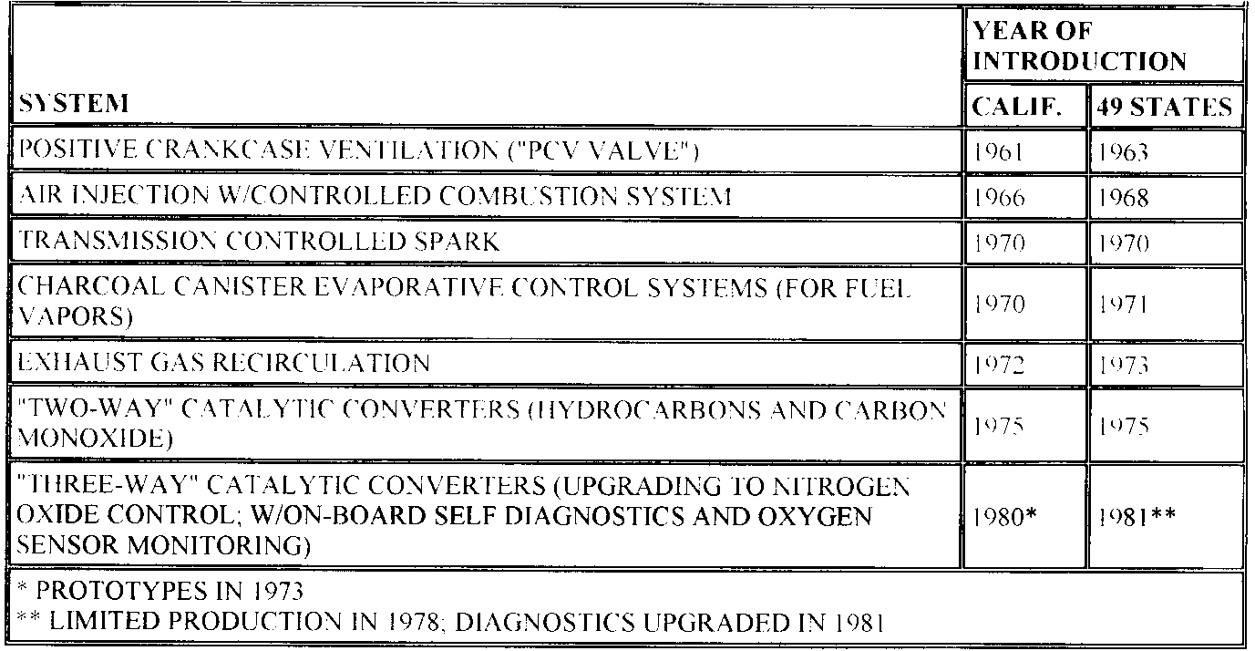
Pollution Controls
Pollution Controls
Fuel injection
CO suicides decreased by over 50% since 1990 !
Notes:
09_28.jpg

Slide 21
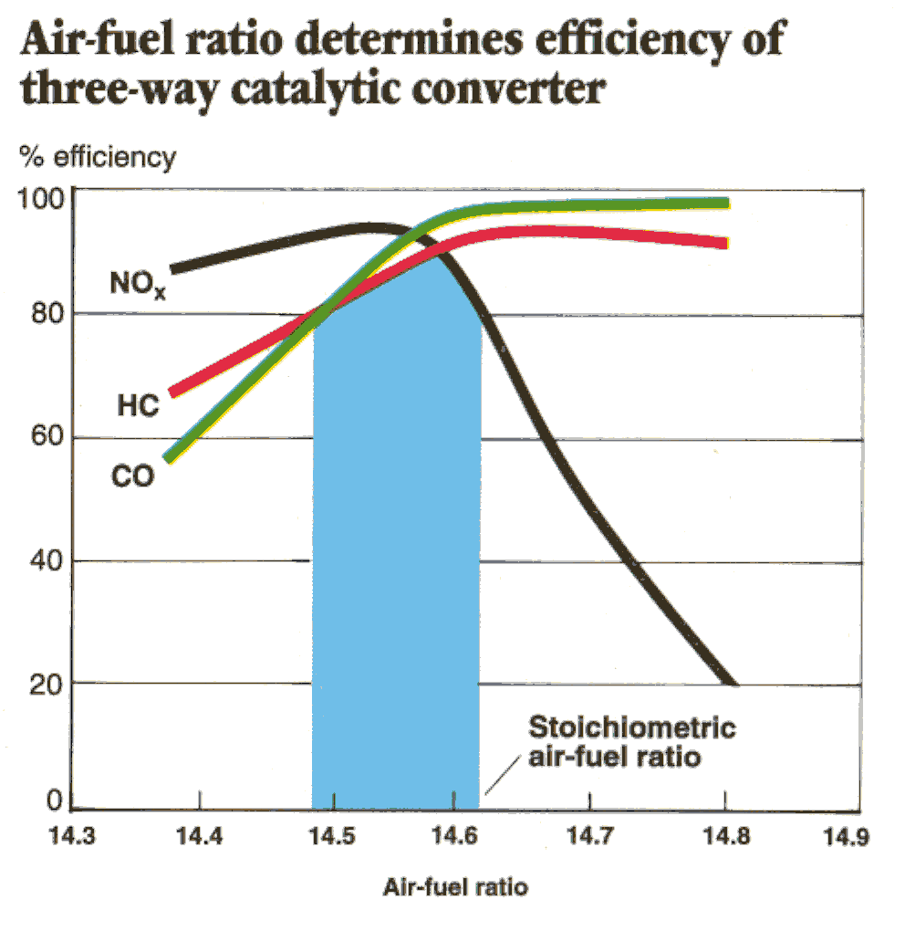
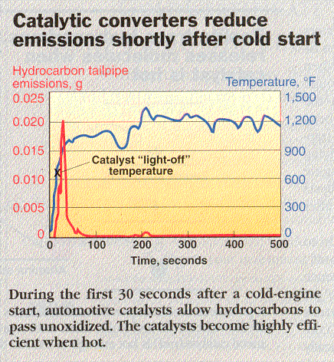
Converter Efficiency

Slide 22
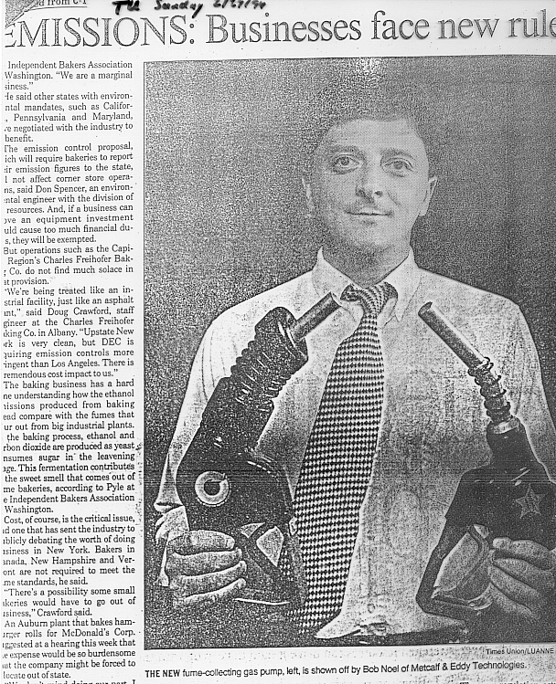
Refueling and
gas tank storage
Pump nozzle
Gas tank caps
Charcoal canister evaporative control systems
PURPOSE:
To reduce automotive VOC emissions

Slide 23
Auto Pollution Control Measures
Motor vehicle design
Fuel
Inspection & maintainence
Driver education
Transportation controls or alternatives

Slide 24
Reformulated Gasoline (RFG)
Unleaded Gasoline - introduced 1975; required for vehicles equipped with catalytic converters
Reduced Sulfur - new 2004 rules to prolong life of catalytic converters
Reduced RVP (volatility) – to reduce VOC evaporation (summer gasoline)
Reduced benzene (aromatics) – to limit carcinogenicity
Oxygenated Fuel - to reduce carbon monoxide pollution (winter gasoline)
methyl tertiary butyl ether (MTBE)
ethanol

Slide 25
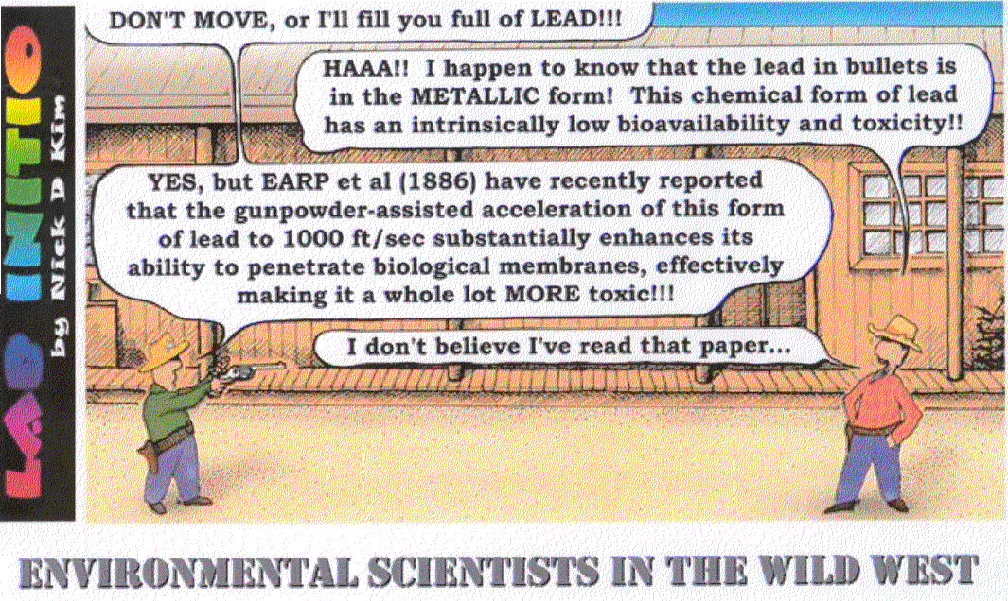
IGNORANCE CAN HURT YOU!

Slide 26
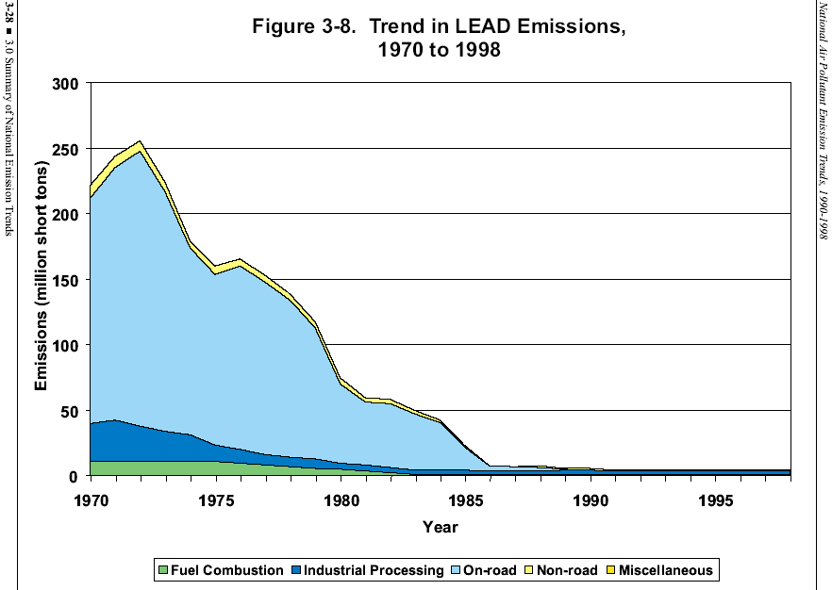

Slide 27
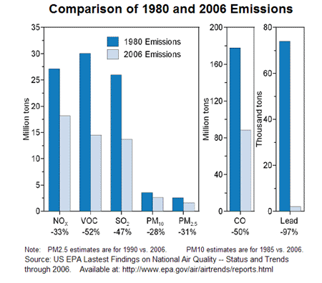
(U.S.)
Billion tons

Slide 28
Reformulated Gasoline (RFG)
Unleaded Gasoline - introduced 1975; required for vehicles equipped with catalytic converters
Reduced Sulfur - new 2004 rules to prolong life of catalytic converters
Reduced RVP (volatility) – to reduce VOC evaporation (summer gasoline)
Reduced benzene (aromatics) – to limit carcinogenicity
Oxygenated Fuel - to reduce carbon monoxide pollution (winter gasoline)
methyl tertiary butyl ether (MTBE)
ethanol

Slide 29
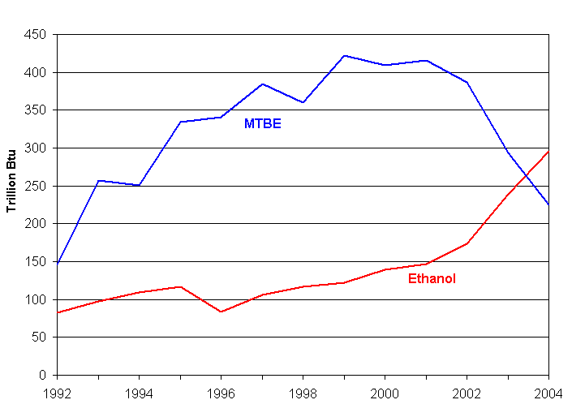

Slide 30
The Energy Independence and Security Act of 2007
Oxygenate rule was dropped but certain use of ethanol required
6 billion gallons annually now
36 billion gallons per year by 2022
As of March 2008,
United States ethanol production capacity: 7.2 billion gallons
an additional 6.2 billion gallons of capacity under construction.
Also currently: 51¢ government subsidy for each gallon of ethanol blended with gasoline

Slide 31
Control Measures
Motor vehicle design
Fuels
Inspection & maintenance
Driver education
driving habits (e.g. gradual starts & stops)
maintenance (e.g. tire air pressure)
Transportation controls or alternatives
speed limits parking restrictions/licensing fees
staggered working hours bicycle / pedestrian accessibility
telecommuting mass transit
timed traffic lights carpooling / HOV lanes
highway design and surfaces urban planning
fuel rationing

