Slide 1
A Brief History of Radon
1879 xs lung cancer rate among underground miners
1896 Henri Becquerel discovers natural radioactivity
1924 link between radon and lung cancer suggested
1956 cause identified as radon progeny (daughters)
1984 Stanley Watras of Limerick, PA, nuclear power plant worker sets off alarm going to work
Indoor pollution

Slide 2
Radon decay
Natural radioactivity (half-life)
in the ground
uranium-238 ⇒ ⇒ radium-226 ⇒
4.5 billion years 1600 years
radon-222 gas has time to leak into the air ⇒⇒
almost 4 days
lead-210 ⇒⇒ lead-206
22 years stable
radon progeny (daughters)
radioactive isotopes of lead, bismuth, and polonium can be inhaled and deposited in the lungs

Slide 3
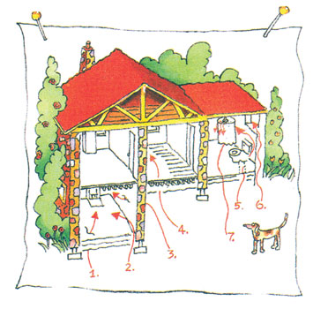
RADON GETS IN THROUGH:
Cracks in solid floors
Construction joints
Cracks in walls
Gaps in suspended floors
Gaps around service pipes
Cavities inside walls
The water supply
Floor drains
BUT DOESN’T GET OUT
of tightly sealed homes
Sources
Soil
Groundwater
Stone building materials
Sinks (for Rn and progeny)
Ventilation
Plate out (as vapor)
Deposition (as particulate matter)

Slide 4
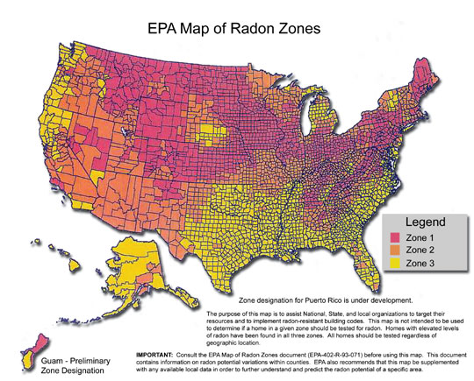
“Potential”
high
low

Slide 5
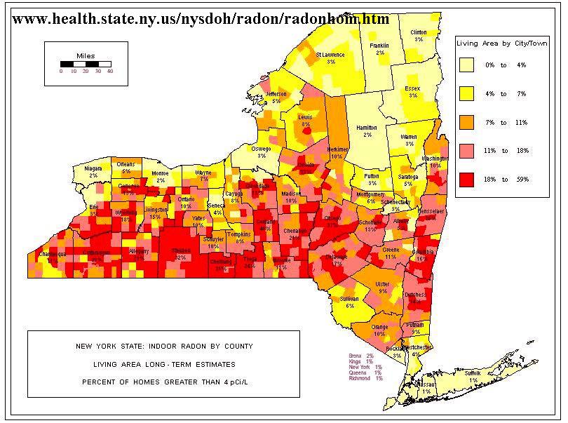

Slide 6
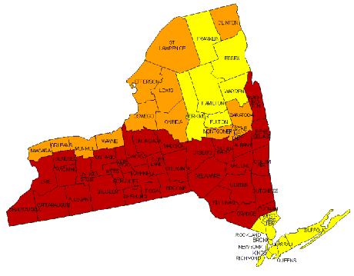
Zone 1
Highest Potential (greater than 4 pCi/L)
Zone 2
Moderate Potential (from 2 to 4 pCi/L)
Zone 3
Low Potential (less than 2 pCi/L)

Slide 7
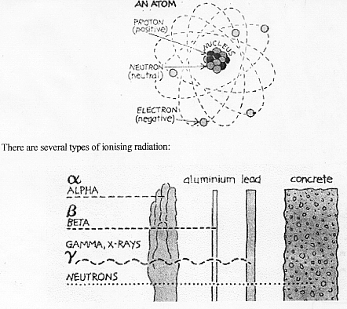
Tissue penetration (1 MeV)
10 µm
0.5 cm
1 m
Helium nucleus
Fast electron
“Light”

Slide 8
Tissue damage and repair ↔ illness → death
Cell death and replacement ↔ illness → death
Disruption of DNA replication → mutation/birth defects
Errors in cell repair/replacement → cancer

Slide 9
A Soup of Radioactivity Units
(Ci)
Becquerel (Bq) = 27 pCi 1 decay per second
Roentgen Absorption Dose
Gray (Gy) = 100 rad
1 Gy = 1 joule/kg
Roentgen Equivalent Man (or Mammal)
alpha particles are more dangerous than beta particles
Sievert (Sv) = 100 rem
ROENTGEN Unit of Ionizing = charge created = 1 statcoul/cm³
Ability in Air in a volume of air

Slide 11
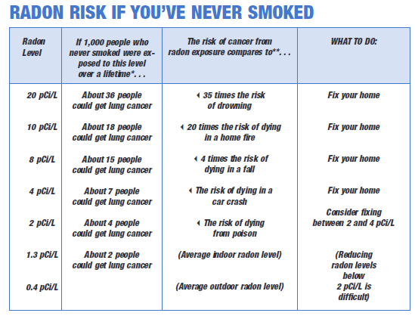
Unit risk (nonsmoker): 1.8 x 10⁻² (pCi/L)⁻¹ [8 x higher for smoker]
1 pCi = 2.2 decays/min = 17,600 Rn atoms
1 pCi/L Rn = 1.9 mSv/yr

Slide 12
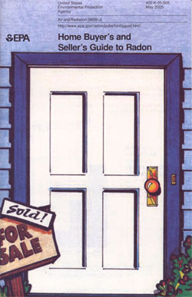
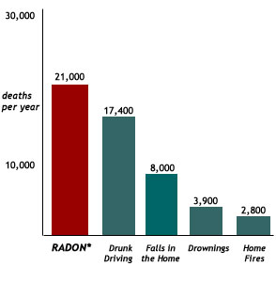
With more tightly constructed homes, indoor air pollutants are trapped inside
Indoor air quality issues: foam blowing insulation, household products, carbon monoxide, molds, vapors from glues and finishes in construction/furniture/fabrics, etc., etc., etc.

Slide 13
RADON GAS MEASUREMENT METHODS
Activated Charcoal Adsorption
Radon is absorbed into a charcoal canister
Short-term detector (equilibration over 2-7 days)
Laboratory analysis by scintillation (gamma-ray)
Alpha Track Detection
A plastic film is exposed (1 to 12 months)
Alpha particles from radon decay produce damage tracks
Number of damage tracks determined
Integrating detector
Continuous Radon Monitoring (Scintillation counter)
Radon decay event causes electric current pulse in device
Real-time detector
Signal can be electronically integrated (pulse counting)
Electret Ion Chamber (Electrostatically charged disk detector)
Radon decay ionizes air
Air conductivity increases, reducing voltage across chamber
Real-time detector
Signal can be electronically integrated
National Radon Safety Board

Slide 14
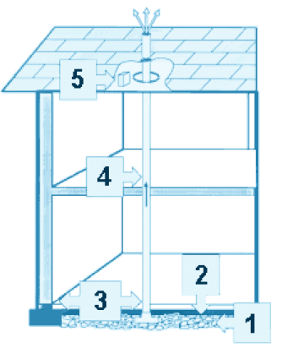
Radon-Resistant Features
The techniques may vary
for different foundations and site requirements,
but the basic elements are:
Gas Permeable Layer This layer is placed beneath the slab or flooring system to allow the soil gas to move freely underneath the house. In many cases, the material used is a 4-inch layer of clean gravel. This gas-permeable layer is used only in homes with casement and slab-on-grade foundations; it is not used in homes with crawlspace foundations.
Plastic Sheeting Plastic sheeting seams sealed is placed on top of the gas permeable layer and under the slab to help prevent the soil gas from entering the home. In crawlspaces, the sheeting is placed over the crawlspace floor.
Sealing and Caulking All below-grade openings in the concrete foundation floor are sealed to reduce soil gas entry into the home.
Vent Pipe A 3- or 4-inch gas-tight or PVC pipe (or other gas-tight pipe) runs from the gas permeable layer through the house to the roof to safely vent radon and other soil gases above the house.
Junction Box An electrical junction box is included in the attic to make the wiring and installation of a vent fan easier. For example, you decide to activate the passive system because your test result showed an elevated radon level (4 pCi/L or more). A separate junction box is placed in the living space to power the vent fan alarm. An alarm is installed along the vent fan to indicate when the vent fan is not operating properly.

