Slide 1
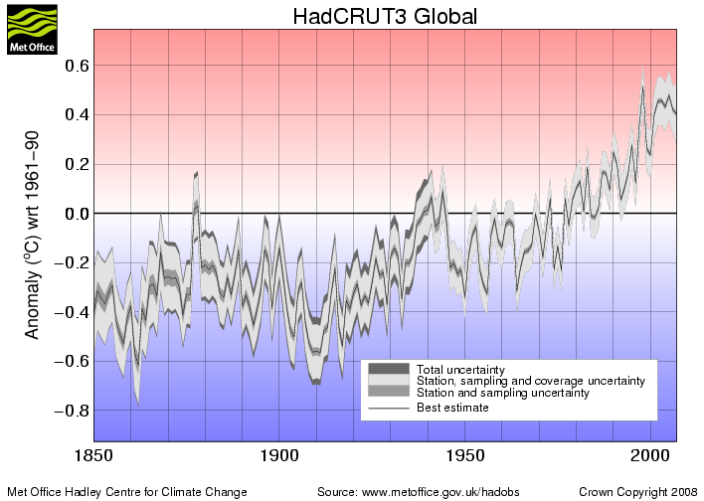
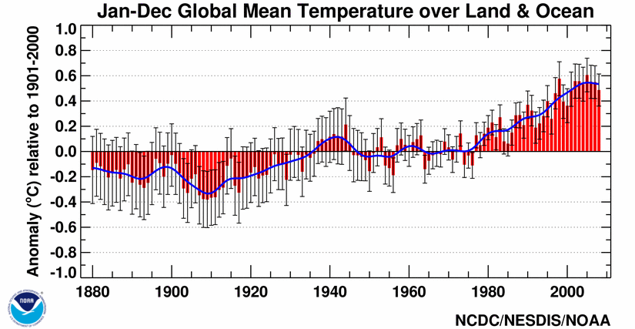

Recent Temperature Trend
Globally averaged annual surface temperature
58F
57F
56F
See also National Climate Data Center (NCDC) Global Analysis

Slide 2
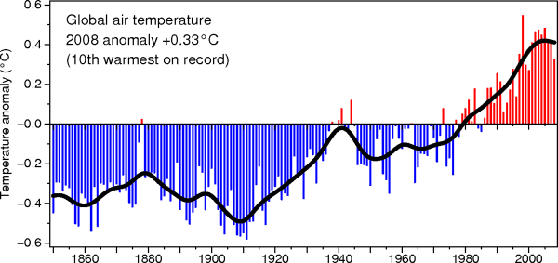
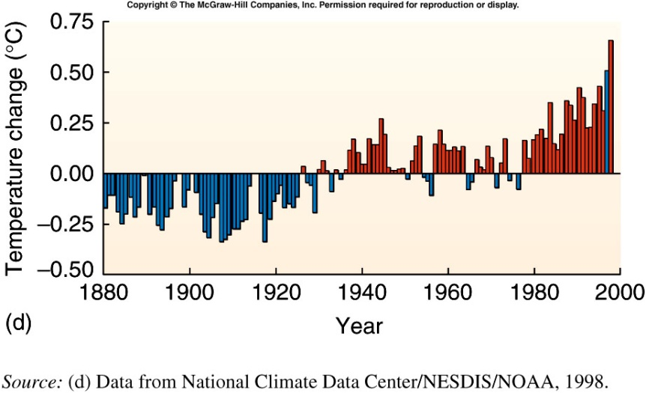
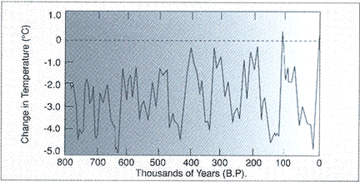
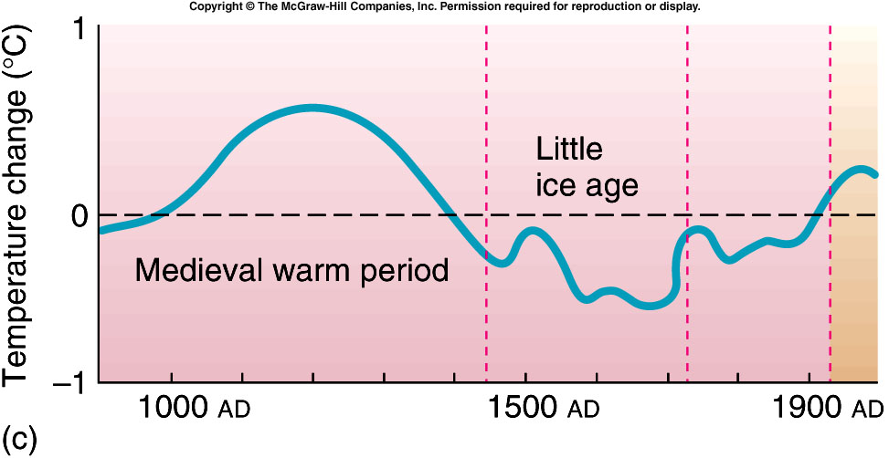
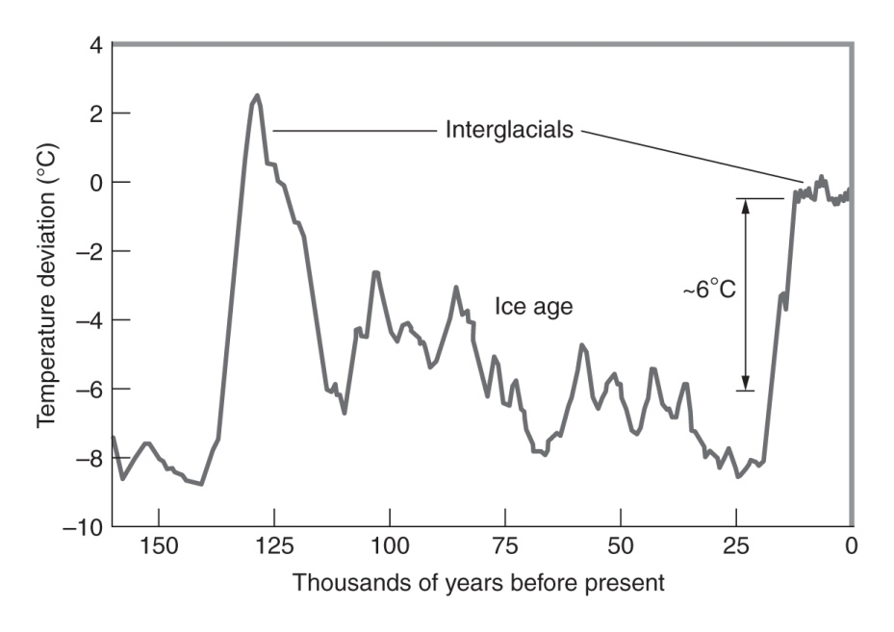
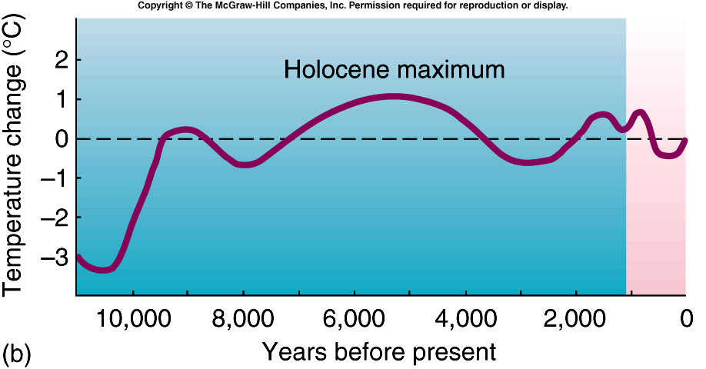
Fig. 9.9
3rd ed
Notes:
09_09.jpg

Slide 3
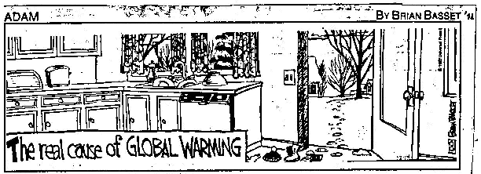

Slide 4
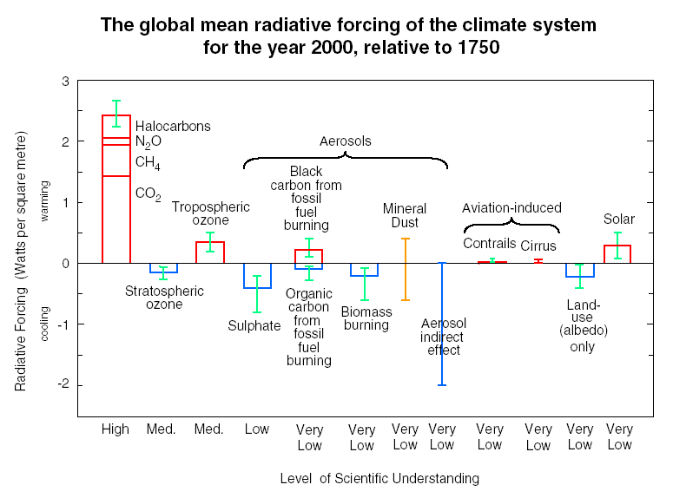
Radiative forcings
The natural greenhouse effect = 151 W/m²
Anthropogenic enhancement = 1.6 +/- 0. 9 W/m²
^{IPCC 2007}
Intergovernmental Panel on Climate Change

Slide 5
Past evidence of CO₂ and Earth’s climate?
Since 1800
up 40%
up 150%
up 50%

Slide 6
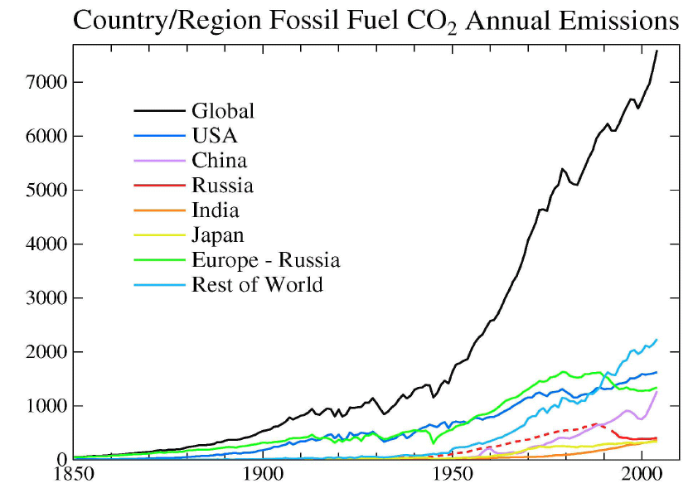

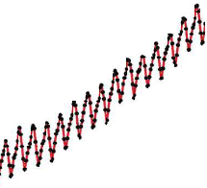
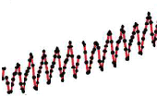
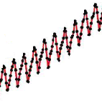
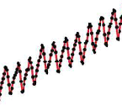
Emissions that would account for observed atmospheric CO₂ increase
millions of tons of carbon
In 2007, China surpassed U.S. as leading emitter of CO₂

Slide 7
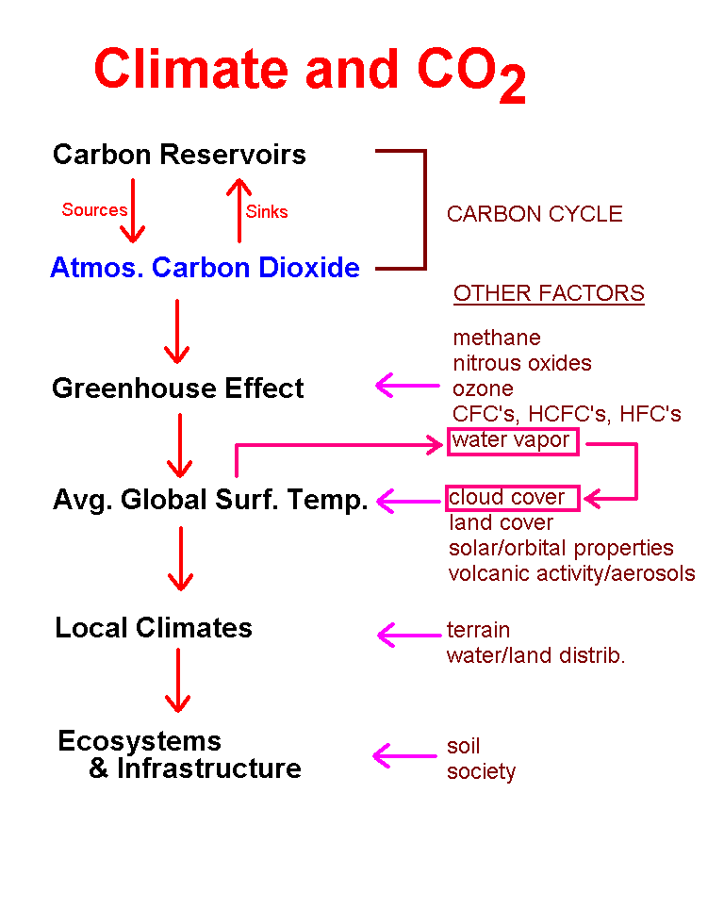
CO2 & Climate
Use of fossil fuels as energy source

Slide 8
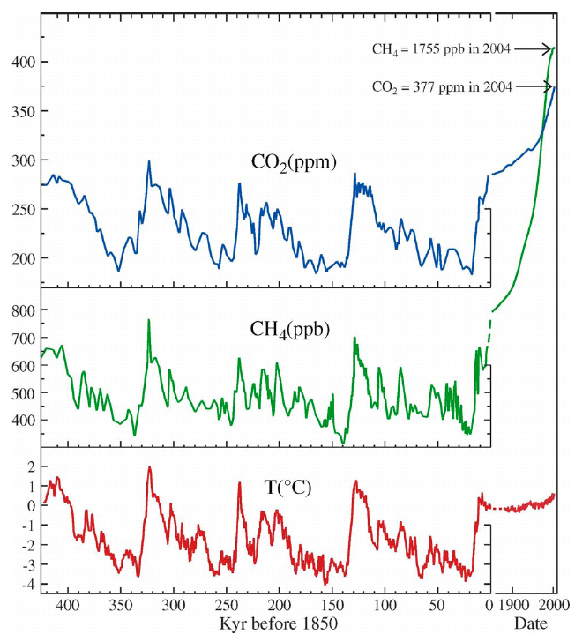
The Past
See Fig 14.9

Slide 9
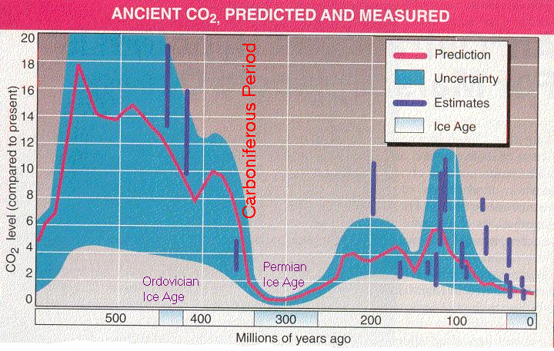
Snowball Earth?

Slide 10


Slide 11
The Stefan-Boltzmann law relates radiant power density (W m⁻²) to temperature (K).
The derivative yields the rate of change in radiant power density with a change in temperature.
Sensitivity = d(σT⁴)/dT = 4 σ T³
= 4 (5.67x10⁻⁸ W m⁻² K⁻⁴) (288 K)³
= 5.4 W m⁻² K⁻¹
i.e., temperature increases by 0.2°C (0.3°F) for a radiative forcing of 1 W m⁻²
But this is for a system in equilibrium

Slide 12
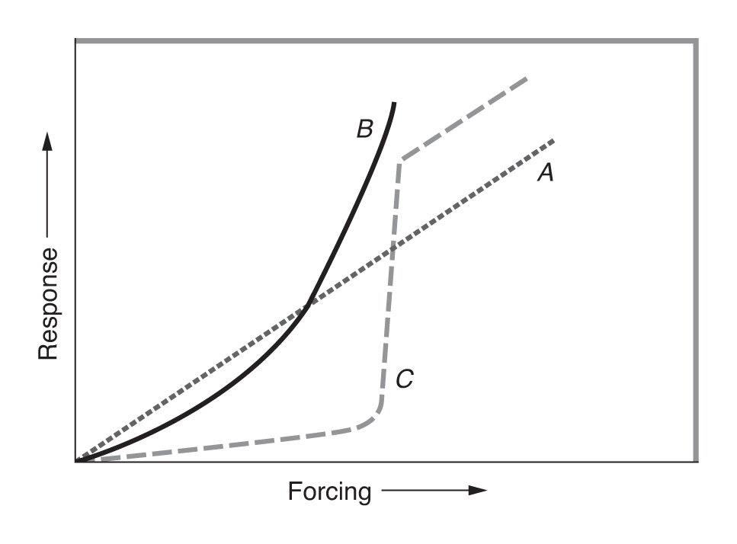
Linear
Non-linear
Abrupt shift of “climate states”
B
The real response (sensitivity) to forcings depends on system inertia and feedbacks

Slide 13
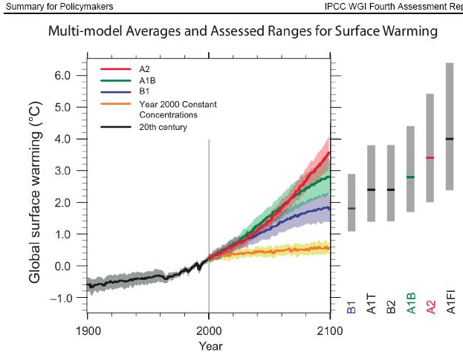
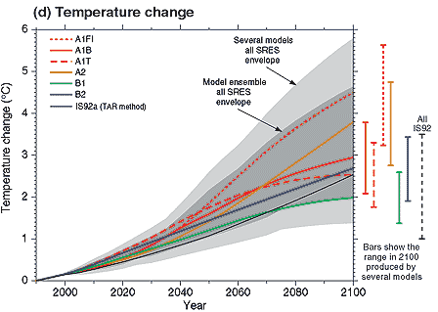
ºF
9
6
3
0
predicted warming by 2100 AD (degrees C)

Slide 14
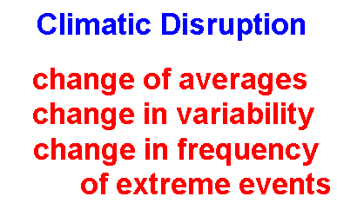
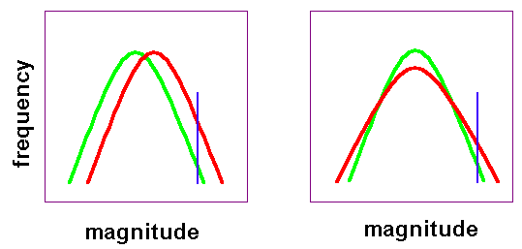
Climate Change

Slide 15
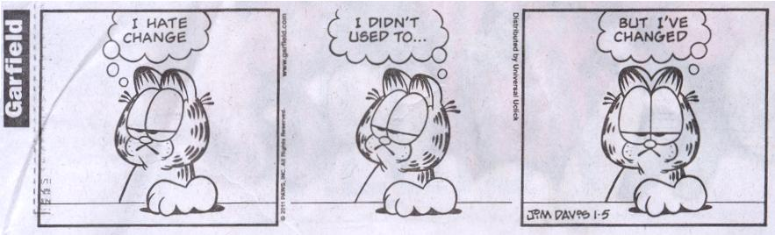

Slide 16
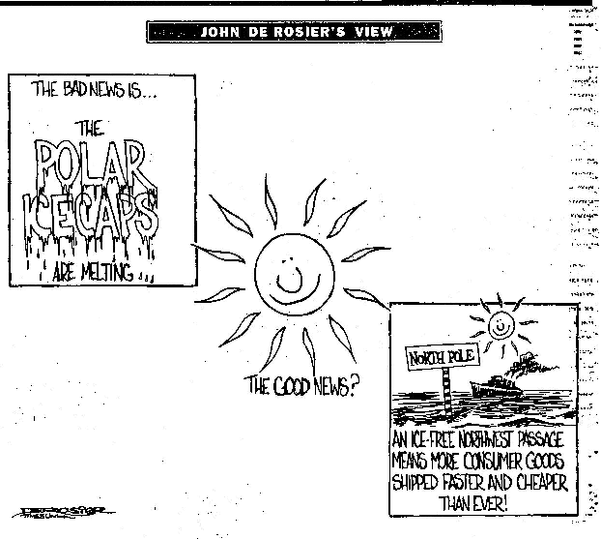

Slide 17
Climate change trends
Climate Change
Globally Averaged Trends
Past 100 years
Temperature: 1 degree F increase
Sea Level: 4 to 10 inch rise
Precipitation: 1% increase on land
Next 100 years (Intergovernmental Panel on Climate Change)
Temperature: 1.6 to 6.3 degrees F
Sea Level: 6 to 39 inches
Precipitation: increase
"we don't know what the consequences are going to be"
Chris Thomas, Univ of York
quoted by E. Kolbert in “Fields Notes from a Catastrophe”, p. 90

Slide 18
Regional scale
Thus far we focused on “Global” averages
Forecasts of Climate Change on
Regional and Local Scales
are
much more uncertain
BUT
THAT’S WHAT MATTERS

Slide 19
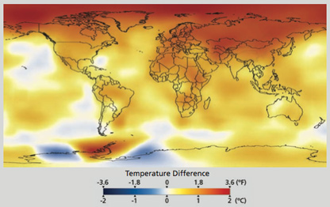
Observed Temperature Increase from 1880 to 2003
See also Fig 14.3

Slide 20
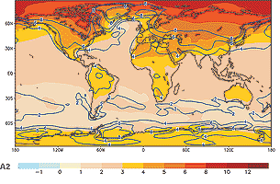
predicted warming by 2100 AD (degrees C)
Fig 15.12

Slide 21
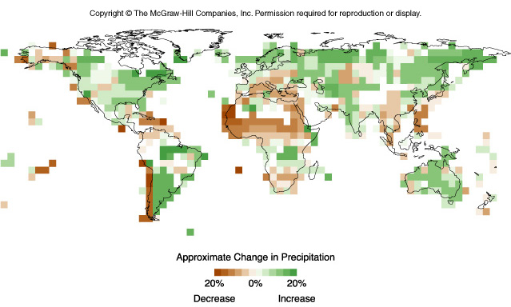
Fig. 9.14 3rd ed
Observed trends 1900-2000
Notes:
09_14.jpg

Slide 22
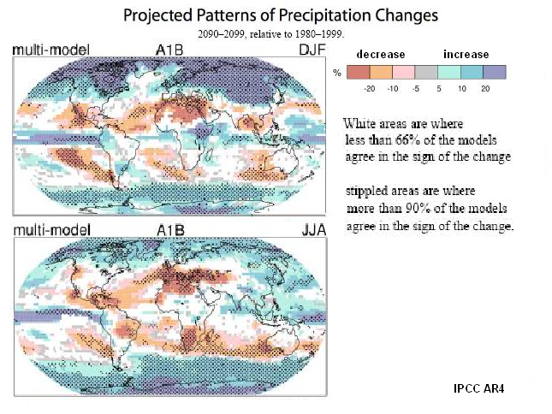

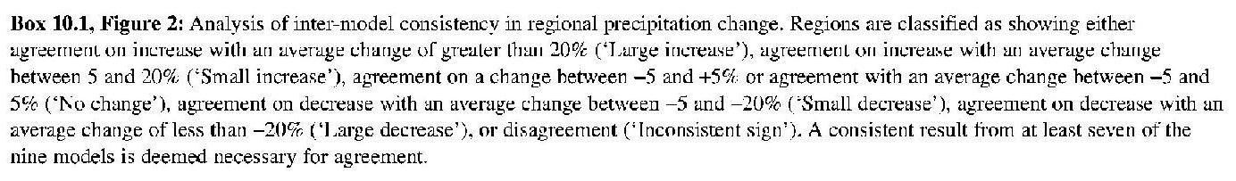
WINTER
SUMMER
Changes to clouds
(cloudiness, precipitation)
is greatest uncertainty
Predicted by 2100

Slide 23
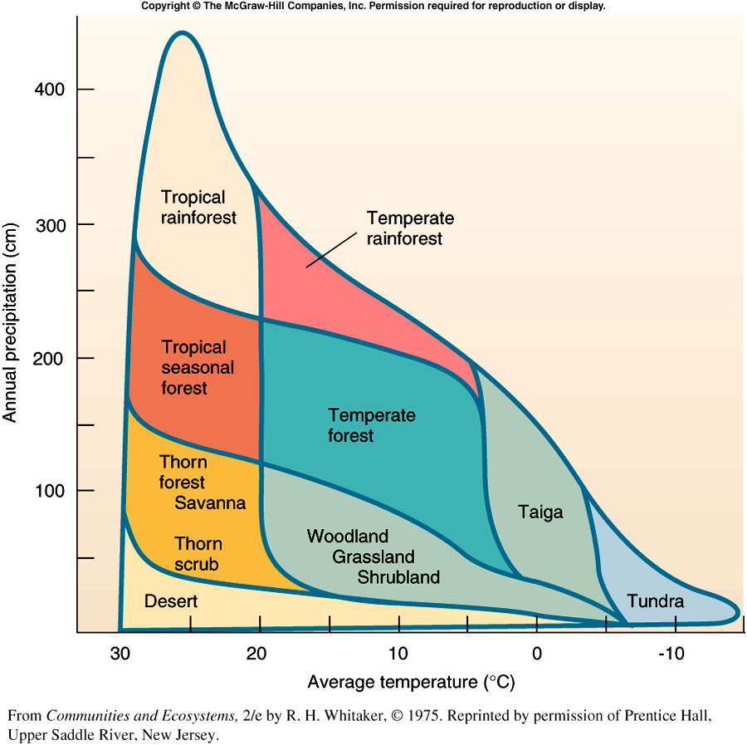
Miami
Albany
Los Angeles
Notes:
05_02.jpg

Slide 24
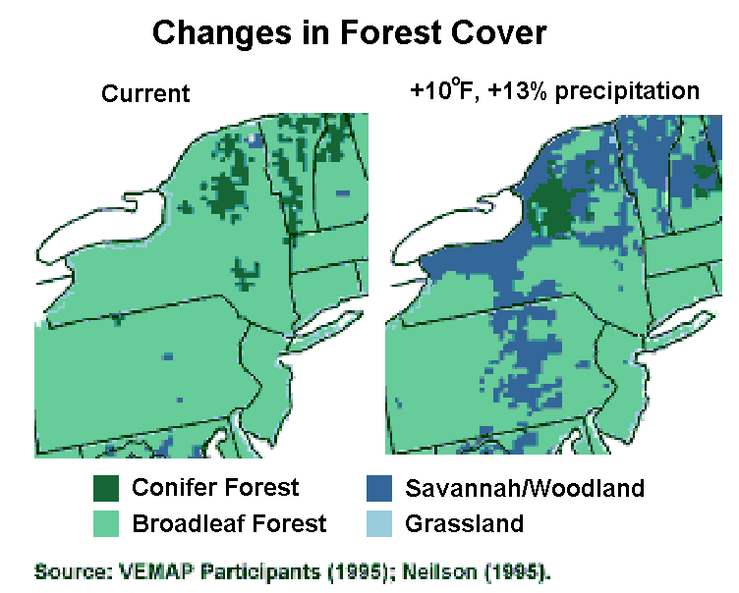

Slide 25
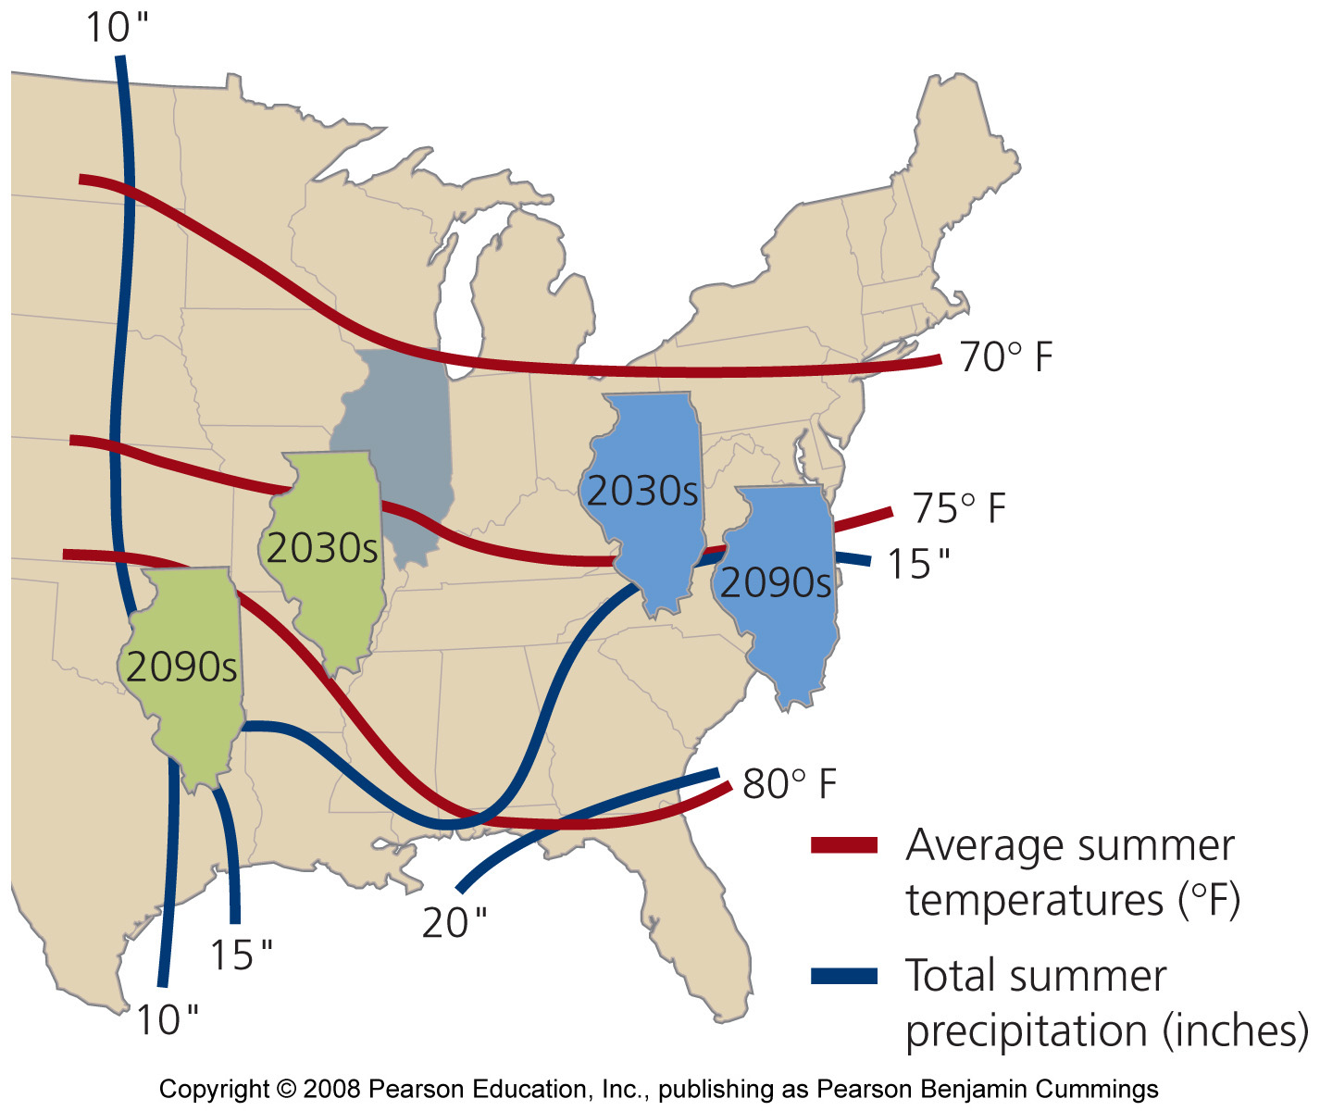
Outcomes of two different climate models
warmer and wetter
warmer and drier

Slide 26
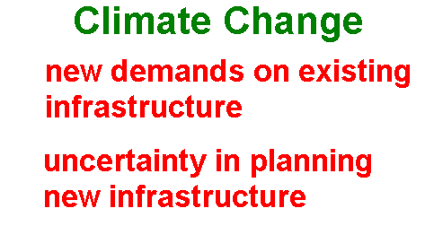
e.g. hydropower dams
e.g. wind farms

Slide 27
Disruptions
Disruptions of Climate Change
Water Resources
Water Supply Water Demand Recreation
Irrigation Hydropower Water Quality
Flood Control Navigation
Agriculture
Crop choice Crop yields Food distribution
Human Health, Safety & Settlement
Diseases/Illnesses Displaced Populations
Unusual weather Air Quality
Ecosystem Resources
Forests Fisheries/Wildlife

Slide 28
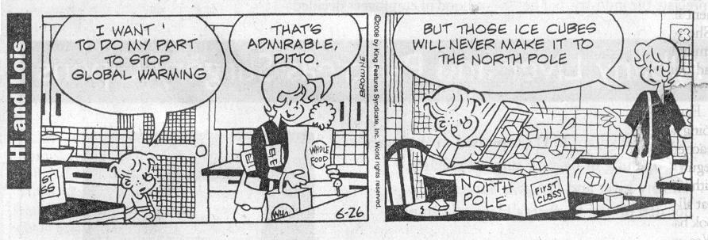
What should/can we do about it?

Slide 29

Response?
Response to Global Warming?
Adaptation [“Deal” with it]
Protect - build sea wall
Retreat/abandon - move inland
Accommodate - change practices to suit new conditions
Venice
Geo-engineering [“Treat” it]
Cause an anthropogenic cooling to offset warming
Augment removal of greenhouse gases (e.g. carbon dioxide)
Mitigation [“Cure” it or at least slow it down]
End (or reduce) anthropogenic GHG emissions

Slide 31
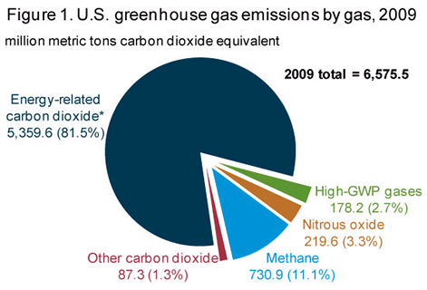
Global Warming Potentials (GWP) see also Table 13.1

Slide 32
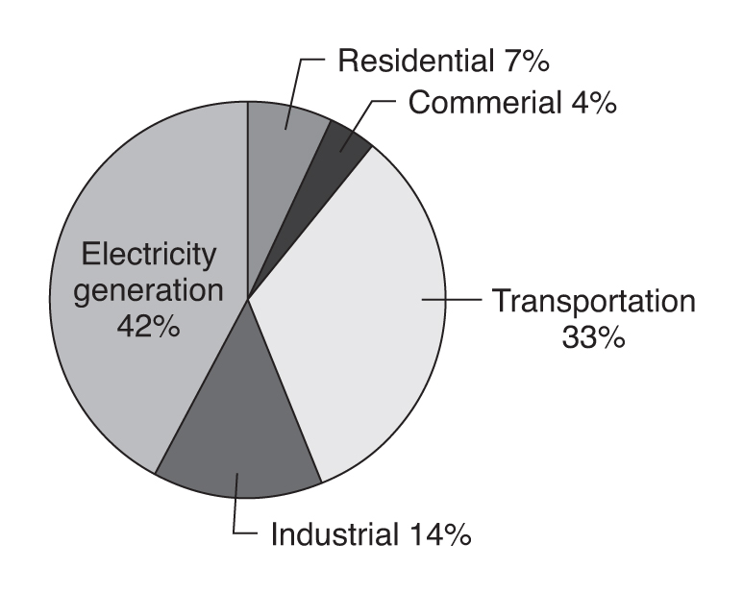
Sources of CO₂ emissions in U.S. (by sector)
Fig. 16.5

Slide 33
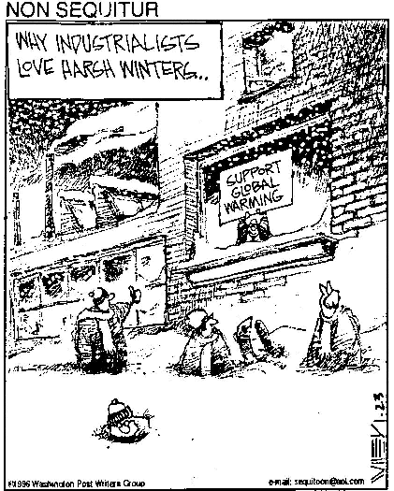
The CO₂ Problem?
1. Don’t Worry

Slide 34
The CO₂ Problem?
1. Don’t Worry
i) won’t be a problem
ii) just adapt to changes, if any
iii) use geoengineering if problems develop

Slide 35
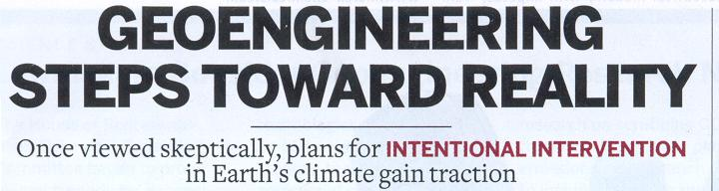
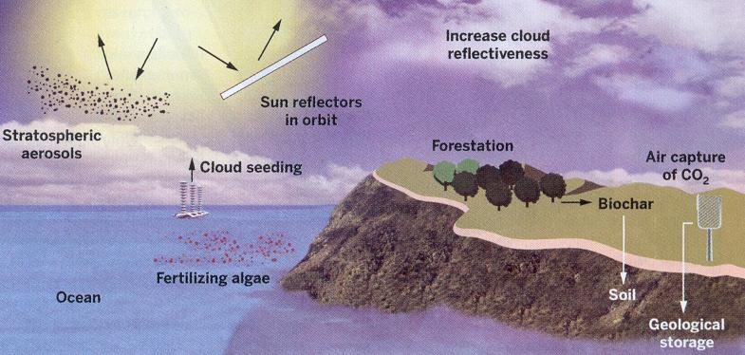
Chemical & Engineering News Nov. 23, 2009

Slide 36
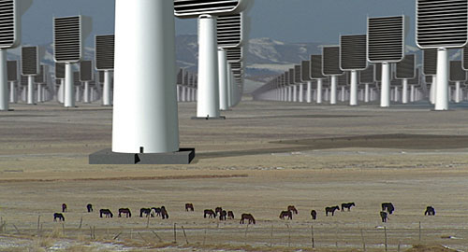
The CO₂ Problem?
2. Increase Uptake (geoengineering)
i) afforestation / reforestation
ii) ocean biomass stimulation (fertilization)
iii) filters

Slide 37
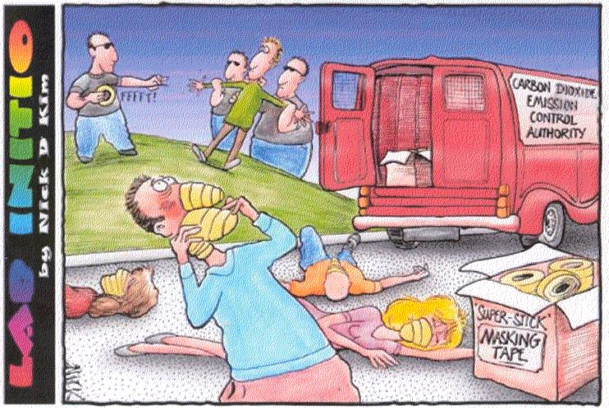
The CO₂ Problem?
Don’t Worry
(adaptation)
(be happy)
2. Increase Uptake (geoengineering)
3. Reduce Emissions (mitigation)

