Slide 1
Testing Dynamic Aspects of Web Applications
Jeff Offutt
Professor, Software Engineering
George Mason University
Fairfax, VA USA
www.cs.gmu.edu/~offutt/
offutt@gmu.edu
Joint research with Blaine Donley, Xiaochen Du, Hong Huang, Upsorn Praphamontripong, Ye Wu, Wuzhi Xu

Slide 2
OUTLINE
How is web software different?
What research challenges does the web offer?
Bypass testing (from the client)
Atomic section modeling (on the server)
Summary

Slide 3
General Web Terminology
Web Page : Data that fits in one browser screen
  Static : HTML exists as a file on a computer
  Dynamic : Created as needed
Web Site : A collection of connected web pages
Web Application : A program that is deployed on the web
  UI is in HTML
  User interacts through HTTP’s request / response cycle
Web Server
J2EE
.Net
PHP
Client
Browser
javascript
network
middleware
middleware
App Server
Java
C#
DB

Slide 4
Software Deployment Methods
Bundled : On your computer when you buy it
Shrink-wrapped : Bought at a store on a CD
  Downloaded from company’s website or OSS site
Contract : Single customer
Embedded : Installed on an electronic device
Web application : On the web through a URL
  Component-based
  Concurrent / distributed
  One copy on the server
  Can be updated at any time (fast update cycle)
  User interactive

Slide 5
Execution Overview
1
8
Incoming request on port 8080
Response back to requestor
Server
HTTP Request
HTTP Response
7
2
Web server
Request / Response Objects
Modified Response Objects
3
6
Container engine
Create thread / call method
Return
5
4
Program component

Slide 6
Web Software Container Engine
Container engine
Web App 1
Web App 2
C1_{a}
C2_{a}
C2_{b}
C1_{b}
C1_{c}
C2_{d}
C2_{c}
Shared memory
Shared memory
Shared memory

Slide 7
Traditional Control Flow
Procedural languages
  Method / function calls
  Decisions – if, while, for, repeat-until, switch, …
  Static includes – other code pulled in before compiling
OO languages
  Dynamic binding via polymorphism
Client / Server
  Message passing

Slide 8
Web App Control Flow
Same as traditional – Software on server and client
Synchronous message passing – Client to server, HTTP
  Also server to other servers
Asynchronous messages passing – Client to server, Ajax
Event handling – on the client
Forward – Transfers control from one server component to another, no return
Redirect – Ask client to send request elsewhere
URL rewriting by users
Dynamic include – Control passes to another component, then returns, no parameters
Dynamic binding – Reflection allows new components

Slide 9
Ramifications
The traditional control flow graph does not model essential parts of web app execution !
UML diagrams do not model many of these
Most developers learn the syntax, but not the concepts behind these new control connections
Lots of poorly designed software …
and lots and lots of poorly understood software faults !

Slide 10
State & Session Tracking
Session :
A series of related interactions between a client and a web server (similar to a use case)
Session tracking refers to keeping data between multiple HTTP requests
This problem is essential to maintaining state, which we understand quite well in the context of traditional procedural programming and object-oriented programming
The Web brings in unique constraints
HTTP is stateless
Distributed

Slide 11
State in Procedural Languages
The C programming language has simple ways to handle state
Global variable
char name [25];
main ()
{
int x, y, z;
.
:
Local variables
We added several layers of scope in OO languages

Slide 12
State in OO Languages (Java)
Class 1
Package
public members
protected members
Class 3
default
private members
inheritance
Class 2
Class 5
Class 4

Slide 13
State in Web Applications
These schemes have two simple, subtle, assumptions :
1. The software components share physical memory
2. The program runs to completion with active memory
But these assumptions are violated in web applications !
  Distributed software components
  Stateless nature of HTTP
To keep state in web applications, we need different ways to store and access variables and objects
Public access and parameter passing are not possible in Web applications!

Slide 14
Sessions—Big Picture
Web Server
Client 1
Client 2
Time
Time
HTTP Request
HTTP Response
HTTP Request
Session ID = 0347
HTTP Response
Session ID = 4403
Server returns a new unique session ID when the request has none
HTTP Request
Session ID = 0347
HTTP Request
HTTP Response
Session ID = 4403
HTTP Response
HTTP Request
Session ID = 0347
HTTP Request
Session ID = 4403
HTTP Response
HTTP Response

Slide 15
Sessions—Big Picture
Web Server
Client 1
Client 2
Time
Time
HTTP Request
HTTP Response
HTTP Request
Session ID = 0347
HTTP Response
Session ID = 4403
HTTP Request
Session ID = 0347
HTTP Request
Client stores the ID and sends it to the server in subsequent requests
Session ID = 4403
HTTP Response
HTTP Response
HTTP Request
Session ID = 0347
HTTP Request
Session ID = 4403
Server recognizes these requests as being from a different client.
Server recognizes all the requests as being from the same client.
This defines a session.
HTTP Response
HTTP Response

Slide 16
Sharing Data : Session Object
Software components share “container” access data
Container engine
session
object
Servlet 1
Servlet 2
Client
JSP 1
JSP 2
JSP 3

Slide 17
Context Scope
Container Engine
session
object 1
session
object 2
Servlet S2
Servlet S1
JSP 3
JSP 1
context
object
JSP 2
Session 1
Context (application)
Session 2

Slide 18
Sharing Data with Scope (JSP)
request
page
forward
request
request
request
Client 1
page
forward
session
request
page
Client 2
application

Slide 19
Control Flow and State Summary
Managing state and control flow is fundamental to any program
These are the most unique aspects of designing and programming web applications
Software vendors are creating new frameworks all the time
  Most introduce additional state handling techniques
Many professional web developers make fundamental mistakes with state and control !
State management is the most common source of software faults in web applications

Slide 20
OUTLINE
How is web software different?
What research challenges does the web offer?
Bypass testing (from the client)
Atomic section modeling (on the server)
Summary

Slide 21
Testing Web Applications
Web applications are heterogeneous, dynamic and must satisfy very high quality attributes
Use of the Web is hindered by low quality Web sites and applications
Web apps need to be built better and tested more
Web site software is extremely loosely coupled
  Coupled through the Internet – separated by space
  Coupled to diverse hardware and software applications
Web software services offer dynamically changing flow of control
  Web pages are created by software on user request
  Finding all screens in a web app is an undecidable problem

Slide 22
Differences in Testing Web Apps
Traditional graphs are not useful
  Control flow graph
  Call graph
State behavior is hard to model and describe
All inputs go through the HTML UI – low controllability
Hard to get access to server-side state (memory, files, database) – low observability
Not clear what logic predicates are useful
No model for mutation operators on web software

Slide 23
OUTLINE
How is web software different?
What research challenges does the web offer?
Bypass testing (from the client)
Atomic section modeling (on the server)
Summary

Slide 24
Validating Inputs
Input Validation
Deciding if input values can be processed by the software
Before starting to process inputs, wisely written programs check that the inputs are valid
  How should a program recognize invalid inputs ?
  What should a program do with invalid inputs ?
Web apps are user input-driven, so input validation is critical to their success
If the input space is described as a grammar, a parser can check for validity automatically
  This is very rare
  It is easy to write input checkers –also easy to make mistakes

Slide 25
Representing Input Domains
Desired inputs (goal domain)
Described inputs (specified domain)
Accepted inputs (implemented domain)

Slide 26
Representing Input Domains
Goal domains are often irregular
Goal domain for credit cards†
  First digit is the Major Industry Identifier
  First 6 digits and length specify the issuer
  Final digit is a “check digit”
  Other digits identify a specific account
Common specified domain
  First digit is in { 3, 4, 5, 6 } (travel and banking)
  Length is between 13 and 16
Common implemented domain
  All digits are numeric
All digits are numeric
† More details are on : http://www.merriampark.com/anatomycc.htm

Slide 27
Representing Input Domains
goal domain
specified domain
This region is a rich source of software errors …
implemented domain

Slide 28
How to Apply to Web Apps?
Web applications encode many of the rules that define the valid input space in the UI
  The UI is implemented in HTML and available in the user’s browser
Users can :
  “view HTML”
  Save HTML
  Modify HTML
  Reload it and run the program with a modified UI

Slide 29
Abbreviated HTML
<FORM >
<INPUT Type=“text” Name=“username” Size=20>
<INPUT Type=“text” Name=“age” Size=3 Maxlength=3>
<P> Version to purchase:
…
<INPUT Type=“radio” Name=“version” Value=“150” Checked>
<INPUT Type=“radio” Name=“version” Value=“250”>
<INPUT Type=“radio” Name=“version” Value=“500”>
<INPUT Type=“submit” onClick=“return checkInfo(this.form)”>
<INPUT Type=“hidden” isLoggedIn=“no”>
</FORM>

Slide 30
Saved & Modified HTML
<FORM >
<INPUT Type=“text” Name=“username” Size=20>
<INPUT Type=“text” Name=“age” Size=3 Maxlength=3>
<P> Version to purchase:
…
<INPUT Type=“radio” Name=“version” Value=“150”>
<INPUT Type=“radio” Name=“version” Value=“250”>
<INPUT Type=“radio” Name=“version” Value=“500” Checked>
<INPUT Type=“submit” onClick=“return checkInfo (this.form)”>
<INPUT Type=“hidden” isLoggedIn= “no” >
</FORM>
Allows an input with arbitrary age, no checking, cost=$25 …
‘<‘ can crash an XML parser
Text fields can have SQL statements
25
yes

Slide 31
Bypass Testing
Validating input data on the client is like asking your opponent to hold your shield in a sword fight
Bypass testing designs tests to violate constraints
  Eases test automation
  Checks robustness
  Evaluates security
Analyze HTML to extract each form element
Model constraints imposed by HTML and JavaScript
Rules for data generation :
  From client-side constraints
  Typical security violations
  Common input mistakes

Slide 32
Types of Client Input Validation
Client side input validation is performed by HTML form controls, their attributes, and client side scripts that access DOM
Validation types are categorized as HTML and scripting
  HTML supports syntactic validation
  Client scripting can perform both syntactic and semantic validation
HTML Constraints | Scripting Constraints
Length (max input characters) Value (preset values) Transfer Mode (GET or POST) Field Element (preset fields) Target URL (links with values) | Data Type (e.g. integer check) Data Format (e.g. ZIP code format) Data Value (e.g. age value range) Inter-Value (e.g. credit # + exp. date) Invalid Characters (e.g. <,../,&)

Slide 33
Example Constraint Rules
Violate size restrictions on strings
Introduce values not included in static choices
  Radio boxes, select (drop-down) lists, hidden fields, …
Violate hard-coded values
Use values that JavaScripts flag as errors
Change “transfer mode” (get, post, …)
Change destination URLs
Invalid data type
Invalid data format
Inter-field constraint validation
Inter-request data fields (cookies, hidden fields)

Slide 34
Output Checking
(V) Valid Responses : invalid inputs are adequately processed by the server
(F) Faults & Failures : invalid inputs that cause abnormal server behavior (typically caught by web server when application fails to handle the error)
(E) Exposure : invalid input is not recognized by the server and abnormal software behavior is exposed to the users
These do not capture whether the valid responses corrupted data on the server
(V1) | Server acknowledges the invalid request and provides an explicit message regarding the violation
(V2) | Server produces a generic error message
(V3) | Server apparently ignores the invalid request and produces an appropriate response
(V4) | Server apparently ignores the request completely

Slide 35
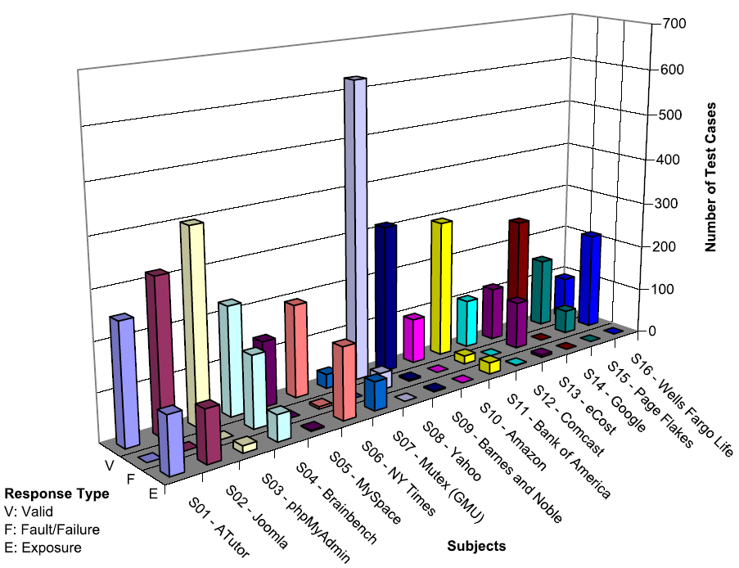
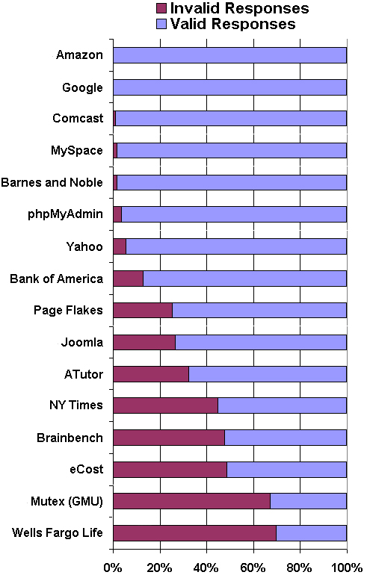
Results From a Practical Study
v

Slide 36
OUTLINE
How is web software different?
What research challenges does the web offer?
Bypass testing (from the client)
Atomic section modeling (on the server)
Summary

Slide 37
Control Flow Graphs in Web Applications
Many testing criteria on non-Web software rely on a static control flow graph
  Edge testing, data flow, logic coverage …
  Also slicing, change impact analysis, …
Static control flow graphs cannot be computed for Web applications!
But all the pieces of the web pages and the programs are contained in the software …
The potential flow of control cannot be known statically

Slide 38
Atomic Sections
PrintWriter out = response.getWriter();
P1 =
out.println (“<HTML>”)
out.println (“<HEAD><TITLE>” + title + “</TITLE></HEAD>”)
out.println (“<BODY>”)
title
if (isUser) {
Atomic
sections
P2 =
out.println (“<CENTER>Welcome!</CENTER>”);
for (int i=0; i<myVector.size(); i++)
if (myVector.elementAt(i).size > 10)
P3 =
out.println (“<p><b>” + myVector.elementAt(i) + “</b></p>”);
myVector.elementAt (i)
else
P4 =
out.println (“<p>" + myVector.elementAt (i) + “</p>”);
myVector.elementAt (i)
Empty
atomic
section
} else
P5 =
{ }
Content
variables
P6 =
out.println (“</BODY></HTML>”);
out.close ();

Slide 39
Atomic Sections Defined
A section of HTML with the property that if any part of the section is sent to a client, the entire section is
  May include JavaScript
  All or nothing property
An HTML file is an atomic section
Content variable : A program variable that provides data to an atomic section
Atomic sections may be empty

Slide 40
Composite Sections
Atomic sections are combined to represent all possible screens the program can generate
  Much like a CFG represents all paths through a unit
Four ways to combine:
  Sequence : p1 • p2
  Selection : (p1 | p2)
  Iteration : p1*
  Aggregation : p1 {p2}
    p2 is included inside of p1
The previous example produces:
  p → p1 • (p2 • (p3 | p4)* | p5) • p6
Composite sections can be generated automatically

Slide 41
Modeling Dynamic Interaction
Three types of transitions
  Link Transition : An HTML link
  Composite Transition : Execution of a software component causes a composite section to be sent to the client
  Operational Transition : A transition out of the software’s control
    Back button
    Refresh button
    User edits the URL (URL rewriting)
    Browser reloads from cache

Slide 42
Inter-Component Modeling Level
A graphical representation of the entire web application
A Web Application Graph (WAG)
  Nodes are web components
  Edges are transitions
Three types of transitions
  Static links
  Dynamic links
  Forwarding links
Annotations on links
  Type of HTTP request
  Data being transmitted as parameters
Current State : static variables and session information

Slide 43
Composite Section Test Criteria
Intra-Component
All productions in the grammar
  Multiple forms for each software component
  Each atomic section used at least once
Each selection used once
  Every form element
Each possible aggregation
MCDC type coverage of conditions on productions
  Based on predicates from the software that separate atomic sections

Slide 44
WAG (Inter-Component) Tests
L1 : Evaluate static link transitions
  One test generated for each form
L2 : L1 with two extensions
  Values entered with URL rewriting
  Multiple tests for each form
L3 : Operational transitions
  Starting on non-initial pages, no subsequent transitions
L4 : Operational transitions
  L1 tests with one operational transition at end
L5 : L4 + tests to traverse every transition out of the final page

Slide 45
STIS Web Application Graph
index.jsp
post (userid, password)
login.jsp
logout.jsp
record_add.jsp
browse.jsp
categories.jsp
post (name, category, content)
post (category, search_name)
post (action, categoryName)
update_search_params.jsp
record_insert.jsp
static link transition
forward link transition
dynamic link transition

Slide 46
Results from Testing STIS
previous web tests
109 tests
Failure Category | L1 | L2 | L3 | L4 | L5
Number of tests | 29 | 21 | 7 | 19 | 33
Pages displayed without authentication | 0 | 0 | 2 | 4 | 4
2. Records added without authentication | 0 | 0 | 1 | 2 | 0
3. Runtime failures (unhandled exceptions) | 0 | 3 | 2 | 5 | 2
Total number of failures | 0 | 3 | 5 | 11 | 6
Found 25 naturally occurring failures

Slide 47
Atomic Sections Summary
Atomic sections fundamentally model Web applications
  Allow the Web app form of CFGs
Can also be used for
  Software evolution
  Design modeling / evaluation
  Change impact analysis (slicing)
  Coupling of Web application components

Slide 48
OUTLINE
How is web software different?
What research challenges does the web offer?
Bypass testing (from the client)
Atomic section modeling (on the server)
Summary

Slide 49
Open Questions
How to define data flow ?
  DU-pairs cannot be determined statically – uses cannot always be found
Testing research issues not addressed yet :
  Session data
  Multiple users
  Concurrency
  Input data
  Output validation

Slide 50
Conclusions
The Web provides a new way to deploy software
The new technologies mean that old testing techniques do not work very well
New tools and techniques are being developed
Most are still in the research stage
Most companies test web software very badly

Slide 51
References and Contact
Modeling Presentation Layers of Web Applications for Testing, Jeff Offutt and Ye Wu, Springer’s Software and Systems Modeling, 9(2), April 2010
Testing Web Services by XML Perturbation, Wuzhi Xu, Jeff Offutt and Juan Luo, ISSRE 2010
Testing Web Applications by Modeling with FSMs, Anneliese Andrews, Jeff Offutt and Roger Alexander, Springer’s Software Systems and Modeling, 4(3):326-345, July 2005.
Bypass Testing of Web Applications, Jeff Offutt, Ye Wu, Xiaochen Du and Hong Huang, ISSRE 2004
Generating Test Cases for Web Services Using Data Perturbation, Jeff Offutt and Wuzhi Xu, TAV-Web, July 2004
Quality Attributes of Web Software Applications, Jeff Offutt, IEEE Software: Special Issue on Software Engineering of Internet Software, March/April 2002
Generating Test Cases for XML-based Web Component Interactions Using Mutation Analysis, Suet Chun Lee and Jeff Offutt, ISSRE 2001
Jeff Offutt
offutt@gmu.edu
http://cs.gmu.edu/~offutt/

