Slide 1
Automatic Test Generation for Web Applications
Jeff Offutt
Professor, Software Engineering
George Mason University
Fairfax, VA USA
www.cs.gmu.edu/~offutt/
offutt@gmu.edu
Joint research with Blaine Donley, Xiaochen Du, Hong Huang, Upsorn Praphamontripong, Ye Wu, Wuzhi Xu

Slide 2
Who Am I
PhD Georgia Institute of Technology, 1988
Professor at George Mason University since 1992
  Fairfax Virginia (near Washington DC)
Lead the Software Engineering MS & PhD programs
  Oldest and largest in USA
Editor-in-Chief of Wiley’s journal of Software Testing, Verification and Reliability (STVR)
Co-Founder of IEEE International Conference on Software Testing, Verification and Validation (ICST)
Co-Author of Introduction to Software Testing (Cambridge University Press)
Published over 120 refereed research papers

Slide 3

Test Design in Context
Test Design is the process of designing input values that will effectively test software
Test design is one of several activities for testing software
  Most mathematical
  Most technically challenging
These ideas are based on my text book with Ammann, Introduction to Software Testing
http://www.cs.gmu.edu/~offutt/softwaretest/

Slide 4
OUTLINE
How is web software different?
What research challenges does the web offer?
Bypass testing (from the client)
Atomic section modeling (on the server)
Summary

Slide 5
General Web Terminology
Web Page : Data that fits in one browser screen
  Static : HTML exists as a file on a computer
  Dynamic : Created as needed
Web Site : A collection of connected web pages
Web Application : A program that is deployed on the web
  UI is in HTML
  User interacts through HTTP’s request / response cycle
Web Server
J2EE
.Net
PHP
Client
Browser
javascript
network
middleware
middleware
App Server
Java
C#
DB

Slide 6
Software Deployment Methods
Bundled : On your computer when you buy it
Shrink-wrapped : Bought at a store on a CD
  Downloaded from company’s website or OSS site
Contract : Single customer
Embedded : Installed on an electronic device
Web application : On the web through a URL
  Component-based
  Concurrent / distributed
  One copy on the server
  Can be updated at any time (fast update cycle)
  User interactive

Slide 7
Execution Overview
1
8
Incoming request on port 8080
Response back to requestor (client)
Server
HTTP Request
HTTP Response
7
2
Web server
Request / Response Objects
Modified Response Objects
3
6
Container engine
Create thread / call method
Return
5
4
Program component

Slide 8
Web Software Container Engine
Container Engine
Web App 1
Web App 2
C1_{a}
C2_{a}
C2_{b}
C1_{b}
C1_{c}
C2_{d}
C2_{c}
Shared memory
Shared memory
Shared memory

Slide 9
Three Issues with Programming Web Apps
Control flow
State management and variable scope
Concurrency

Slide 10
Traditional Control Flow
Procedural languages
  Method / function calls
  Decisions – if, while, for, repeat-until, switch, …
  Static includes – other code pulled in before compiling
OO languages
  Dynamic binding via polymorphism
Client / Server
  Message passing

Slide 11
Web App Control Flow (1)
Traditional Control Flow Mechanisms
Same as traditional – Software on server and client
Synchronous message passing – Client to server, HTTP
  Also server to other servers
Event handling – On the client

Slide 12
Web App Control Flow (2)
New Control Flow Mechanisms
Asynchronous message passing – Client to server, Ajax
Forward – Transfers control from one server component to another, no return
Redirect – Ask client to send request elsewhere
URL rewriting by users
Dynamic include – Control passes to another component, then returns, no parameters
Dynamic binding – Reflection allows new components to be added and used dynamically

Slide 13
Ramifications
The traditional control flow graph does not model essential parts of web app execution !
UML diagrams do not model many of these
Most developers learn the syntax, but not the concepts behind these new control connections
Lots of poorly designed software …
and lots and lots of poorly understood software faults !

Slide 14
Three Issues with Programming Web Apps
Control flow
State management and variable scope
Concurrency

Slide 15
State & Session Tracking
A series of related interactions between a client and a web server
Session :
Session tracking refers to keeping data between multiple HTTP requests
This problem is essential to maintaining state, which we understand quite well in the context of traditional procedural programming and object-oriented programming
The Web brings in unique constraints
HTTP is stateless
Distributed

Slide 16
State in Procedural Languages
The C programming language has simple ways to handle state
Global variable
char name [25];
main ()
{
int x, y, z;
.
:
Local variables
We added several layers of scope in OO languages

Slide 17
State in OO Languages (Java)
Class 1
Package
public members
protected members
Class 3
default
private members
inheritance
Class 2
Class 5
Class 4

Slide 18
State in Web Applications
These schemes make two simple, subtle, assumptions :
1. The software components share physical memory
2. The program runs to completion with active memory
But these assumptions are violated in web applications !
  Distributed software components
  Stateless nature of HTTP
To keep state in web applications, we need different ways to store and access variables and objects
Public access and parameter passing are not possible in Web applications!

Slide 19
Sessions—Big Picture
Web Server
Client 1
Client 2
Time
Time
HTTP Request
HTTP Response
HTTP Request
Session ID = 0347
HTTP Response
Session ID = 4403
Server returns a new unique session ID when the request has none
HTTP Request
Session ID = 0347
HTTP Request
HTTP Response
Session ID = 4403
HTTP Response
HTTP Request
Session ID = 0347
HTTP Request
Session ID = 4403
HTTP Response
HTTP Response

Slide 20
Sessions—Big Picture
Web Server
Client 1
Client 2
Time
Time
HTTP Request
HTTP Response
HTTP Request
Session ID = 0347
HTTP Response
Session ID = 4403
HTTP Request
Session ID = 0347
HTTP Request
Client stores the ID and sends it to the server in subsequent requests
Session ID = 4403
HTTP Response
HTTP Response
HTTP Request
Session ID = 0347
HTTP Request
Session ID = 4403
Server recognizes these requests as being from a different client.
Server recognizes all the requests as being from the same client.
This defines a session.
HTTP Response
HTTP Response

Slide 21
Example
A small J2EE Web app with 5 software components
Servlet S1
Servlet S2
Client
JSP 1
JSP 2
JSP 3
How can the software components share data?

Slide 22
Sharing Data : Session Object
One program component can store a value in the session object
Another component can retrieve, use, and modify the value
Depends on the container engine:
  Software components run as threads, not processes
  Container engine stays resident and can keep shared memory

Slide 23
Sharing Data : Session Object
Software components share “container” access data
Container engine
session
object
Servlet 1
Servlet 2
Client
JSP 1
JSP 2
JSP 3

Slide 24
Context Scope
Container Engine
session
object 1
session
object 2
Servlet S2
Servlet S1
JSP 3
JSP 1
context
object
JSP 2
Session 1
Context (application)
Session 2

Slide 25
JSP Scope & State Management
JSPs formalize this with four separate scopes
  Page : Within the same program component (web page)
  Request : Within the same request
  Session : Within all requests from the same session
  Application : Within all sessions for one application context
Each can be used by different sets of program components
Some exist for different periods of time

Slide 26
Sharing Data with Scope (JSP)
request
page
forward
request
request
request
Client 1
page
forward
session
request
page
Client 2
application

Slide 27
Control Flow and State Summary
Managing state and control flow is fundamental to any program
These are the most unique aspects of designing and programming web applications
Software vendors are creating new frameworks all the time
  Most introduce additional state handling techniques
Many professional web developers make fundamental mistakes with state and control !
State management is the most common source of software faults in web applications

Slide 28
Three Issues with Programming Web Apps
Control flow
State management and variable scope
Concurrency

Slide 29
Concurrency in Web Apps
Multiple users often access the same web app at the same time
Software component objects are run as threads
Threads on the same object share some variables
This can cause problems when storing data into permanent storage
  Servlet thread for user 1 reads a data file into memory
  Servlet thread for user 2 reads the same data file
  Thread 1 changes the data
  Thread 2 changes the data
  Thread 1 writes the file onto disk
  Thread 2 writes the file onto disk …
  Changes from user 1 are lost !
Programmers are responsible for avoiding this problem

Slide 30
Concurrency Example
public class countHellos extends HttpServlet
{
// Number of times the servlet has been executed since
// the servlet object was created
private int visit = 0; // shared among threads
public void doGet (HttpServletRequest req,
HttpServletResponse res)
throws servletException, IOException
{
res.setContentType (“text/html; charset=\”UTF-8\””);
PrintWriter out = res.getWriter ();
visit ++;
out.println (“<HTML>”);
. . .

Slide 31
Concurrency Illustration
Web Server
Servlet thread for User 1
Servlet thread for User 2
Time
Start
visit = 17;
visit++; (18)
Suspend
Start
visit = 18;
To client
visit++; (19)
Complete
Resume
To client
visit = 19;
Complete
oops !!

Slide 32
Concurrency and (Java) Threads
Container engines create separate threads for each HTTP request
Some state is unique to each thread (not shared)
  Next statement to execute
  The call stack :
    Where the current method will return to
    Where the calling method returns to
    Parameter values and local values for each method
Some state is shared among threads
  Instance variable values (declared outside methods)
  Class variables values (declared static outside methods)
  Contents of files and other external resources

Slide 33
Concurrency and Synchronization
The Java “synchronized” command is used to avoid concurrency problems
If a method is synchronized, only one thread can execute the method at a time
  Other threads are blocked until the first thread finishes
synchronized public void doGet ( . . .

Slide 34
Concurrency Illustration
Web Server
Servlet thread for User 1
Servlet thread for User 2
Time
Start
visit = 17;
visit++; (18)
Suspend
Start
BLOCKED
Resume
To client
visit = 18;
yay !!
Complete
Resume
visit = 18;
To client
visit++; (19)
Complete
yay !!

Slide 35
Web Concurrency Summary
Most professional programmers have very little knowledge of concurrency
Most professional programmers have very little experience with concurrency
For many, writing a web app is the first time they use concurrency
  And they often don’t realize the potential concurrency!
Concurrency is a major source of software faults in web applications

Slide 36
OUTLINE
How is web software different?
What research challenges does the web offer?
Bypass testing (from the client)
Atomic section modeling (on the server)
Summary

Slide 37
Testing Web Applications
Web applications are heterogeneous, dynamic and must satisfy very high quality attributes
Use of the Web is hindered by low quality Web sites and applications
Web apps need to be built better and tested more
Web site software is extremely loosely coupled
  Coupled through the Internet – separated by space
  Coupled to diverse hardware and software applications
Web software services offer dynamically changing flow of control
  Web pages are created by software on user request
  Finding all screens in a web app is an undecidable problem

Slide 38
Separation of Concerns
Presentation layer
Data content layer
Data representation layer
Data storage layer
HTML, output and UI
Computation, data access
In-memory data storage
Permanent data storage

Slide 39
Differences in Testing Web Apps
Traditional graphs are not useful
  Control flow graph
  Call graph
State behavior is hard to model and describe
All inputs go through the HTML UI – low controllability
Hard to get access to server-side state (memory, files, database) – low observability
Not clear what logic predicates are useful
No model for mutation operators on web software

Slide 40
New Essential Problems
Web site software is extremely loosely coupled
  Coupled through the Internet – separated by space
  Coupled to diverse hardware and software applications
  Web services will dynamically couple with other services after deployment – without human intervention !
Web software services offer dynamically changing flow of control
  Web pages are created by software on user request
  The interaction points (forms, buttons, etc.) vary depending on state : the user, previous choices, server-side data, even time of day
  Finding all screens in a web app is an undecidable problem

Slide 41
Extremely Loose Coupling
Tight Coupling : Dependencies among the methods are encoded in their logic
  Changes in A may require changing logic in B
Loose Coupling : Dependencies among the methods are encoded in the structure and data flows
  Changes in A may require changing data uses in B
Extremely Loose Coupling (ELC): Dependencies are encoded only in the data contents
  Changes in A only affects the contents of B’s data

Slide 42
Ramifications of ELC
Web applications encourage ELC
  Physical separation of hardware and software makes ELC necessary
  XML supports ELC
ELC has some non-obvious affects
  Software modules can dynamically integrate with others if they use the same data structures
  EJBs can be inserted into Web applications, which can immediately start using them

Slide 43
Dynamic Flow of Control
WebPics
Selamat petang, Penny Tai!
WebPics
Howdy, Paul Ammann!
Search
Search
Recommended Movies
Recommended Movies
Z
ZZ
ZZZ
A
B
C
D
Examine queue
(Warning: Queue empty)
Examine queue
View account
View account
Frequent customer bonus
How can we ensure the reliability of this type of system?

Slide 44
OUTLINE
How is web software different?
What research challenges does the web offer?
Bypass testing (from the client)
Atomic section modeling (on the server)
Summary

Slide 45
Validating Inputs
Input Validation
Deciding if input values can be processed by the software
Before starting to process inputs, wisely written programs check that the inputs are valid
  How should a program recognize invalid inputs ?
  What should a program do with invalid inputs ?
Web apps are user input-driven, so input validation is critical to their success
If the input space is described as a grammar, a parser can check for validity automatically
  This is very rare
  It is easy to write input checkers –also easy to make mistakes

Slide 46
Representing Input Domains
Desired inputs (goal domain)
Described inputs (specified domain)
Accepted inputs (implemented domain)

Slide 47
Representing Input Domains
Goal domains are often irregular
Goal domain for credit cards†
  First digit is the Major Industry Identifier
  First 6 digits and length specify the issuer
  Final digit is a “check digit”
  Other digits identify a specific account
Common specified domain
  First digit is in { 3, 4, 5, 6 } (travel and banking)
  Length is between 13 and 16
Common implemented domain
  All digits are numeric
All digits are numeric
† More details are on : http://www.merriampark.com/anatomycc.htm

Slide 48
Representing Input Domains
goal domain
specified domain
This region is a rich source of software errors …
implemented domain

Slide 49
How to Apply to Web Apps?
Web applications encode many of the rules that define the valid input space in the UI
  The UI is implemented in HTML and available in the user’s browser
Users can :
  “view HTML”
  Save HTML
  Modify HTML
  Reload it and run the program with a modified UI

Slide 50
Abbreviated HTML
<FORM >
<INPUT Type=“text” Name=“username” Size=20>
<INPUT Type=“text” Name=“age” Size=3 Maxlength=3>
<P> Version to purchase:
…
<INPUT Type=“radio” Name=“version” Value=“150” Checked>
<INPUT Type=“radio” Name=“version” Value=“250”>
<INPUT Type=“radio” Name=“version” Value=“500”>
<INPUT Type=“submit” onClick=“return checkInfo(this.form)”>
<INPUT Type=“hidden” isLoggedIn=“no”>
</FORM>

Slide 51
Saved & Modified HTML
<FORM >
<INPUT Type=“text” Name=“username” Size=20>
<INPUT Type=“text” Name=“age” Size=3 Maxlength=3>
<P> Version to purchase:
…
<INPUT Type=“radio” Name=“version” Value=“150”>
<INPUT Type=“radio” Name=“version” Value=“250”>
<INPUT Type=“radio” Name=“version” Value=“500” Checked>
<INPUT Type=“submit” onClick=“return checkInfo (this.form)”>
<INPUT Type=“hidden” isLoggedIn= “no” >
</FORM>
Allows an input with arbitrary age, no checking, cost=$25 …
‘<‘ can crash an XML parser
Text fields can have SQL statements
25
yes

Slide 52
SQL Injection
turing
’ OR ‘1’=‘1
enigma
User Name:
Password:
’ OR ‘1’=‘1
Original SQL:
SELECT username FROM adminuser WHERE username=‘turing’ AND password =‘enigma’
“injected” SQL:
SELECT username FROM adminuser WHERE username=‘turing’ OR ‘1’ = ‘1’ AND password =‘enigma’ OR ‘1’ = ‘1’
OR ‘1’ = ‘1’
OR ‘1’ = ‘1’

Slide 53
Bypass Testing
This example illustrates how users can “bypass” client-side constraint enforcement
Bypass testing constructs tests to intentionally violate constraints
  Eases test automation
  Checks robustness
  Evaluates security
Preliminary results
  Rules for constructing tests
  Successfully found errors in numerous Web apps

Slide 54
Applying Bypass Testing
Validating input data on the client is like asking your opponent to hold your shield in a sword fight
Bypass testing designs tests to violate constraints
  Eases test automation
  Checks robustness
  Evaluates security
Analyze HTML to extract each form element
Model constraints imposed by HTML and JavaScript
Rules for data generation :
  From client-side constraints
  Typical security violations
  Common input mistakes

Slide 55
Real-World Examples
atutor.ca
Atalker
demo.joomla.or
Poll, Users
phpMyAdmin
Main page,
Set Theme,
SQL Query,
DB Stats
brainbench.com
Submit Request Info, New user
myspace.com
Events & Music Search
nytimes.com
Us-markets
mutex.gmu.edu
Login form
yahoo.com
Notepad, Composer,
Search reminder, Weather Search
barnesandnoble.com
Cart manager,
Book search/results
amazon.com
Item dispatch,
Handle buy
bankofamerica.com
ATM locator, Site search
comcast.com
Service availability
ecost.com
Detail submit,
Shopping cart control
google.com
Froogle, Language tools
pageflakes.com
Registration
wellsfargolife.com
Quote search
Pure black-box testing
means
no source (or permission) needed !

Slide 56
Output Checking
(V) Valid Responses : invalid inputs are adequately processed by the server
(F) Faults & Failures : invalid inputs that cause abnormal server behavior (typically caught by web server when application fails to handle the error)
(E) Exposure : invalid input is not recognized by the server and abnormal software behavior is exposed to the users
These do not capture whether the valid responses corrupted data on the server
(V1) | Server acknowledges the invalid request and provides an explicit message regarding the violation
(V2) | Server produces a generic error message
(V3) | Server apparently ignores the invalid request and produces an appropriate response
(V4) | Server apparently ignores the request completely

Slide 57
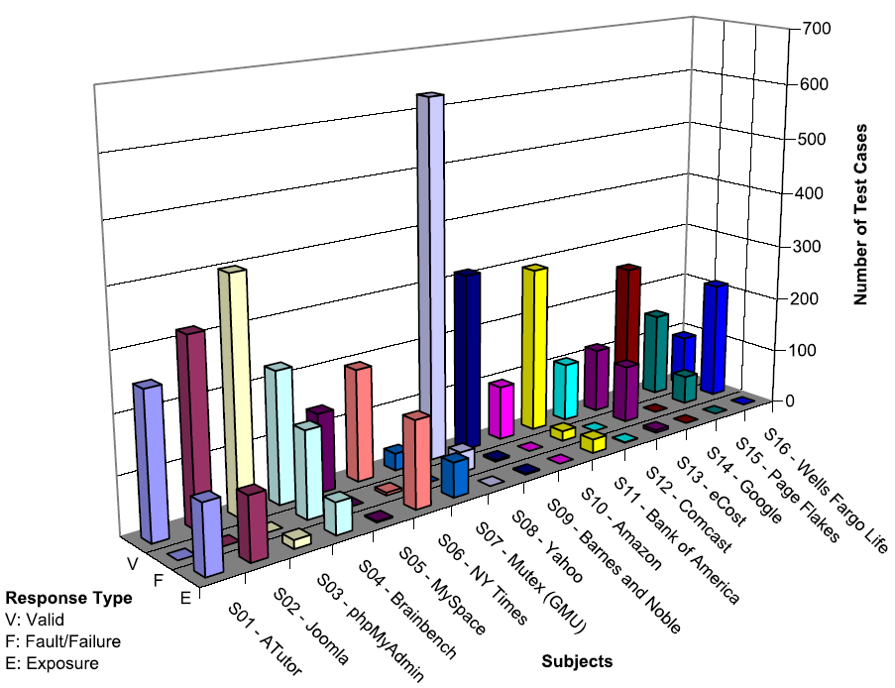
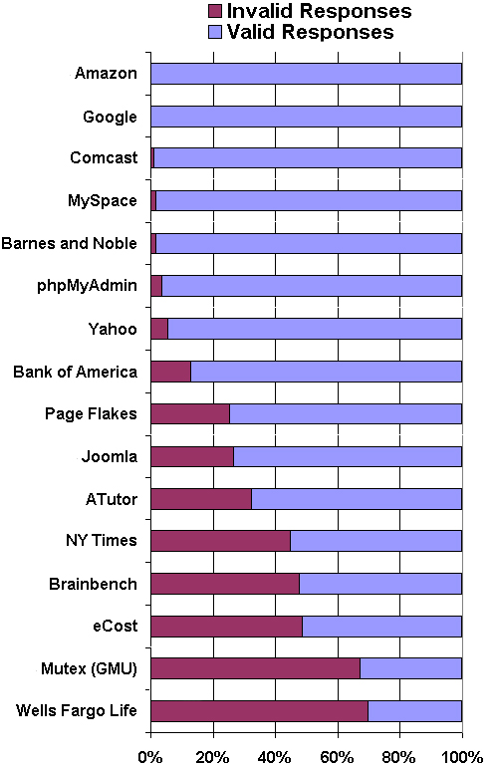
Results
v

Slide 58
OUTLINE
How is web software different?
What research challenges does the web offer?
Bypass testing (from the client)
Atomic section modeling (on the server)
Summary

Slide 59
Dynamic Execution of Web Apps
Parts of the program are generated dynamically
Dynamic web pages are created from user requests
Different users will see different programs !
Users can make unexpected changes to the flow of control
  Operational transitions : Transitions NOT based on an HTML link: back-button, URL rewriting, refresh
Potential flow of control cannot be known statically

Slide 60
Control Flow Graphs in Web Applications
Many testing criteria on non-Web software rely on a static control flow graph
  Edge testing, data flow, logic coverage …
  Also slicing, change impact analysis, …
Static control flow graphs cannot be computed for Web applications!
But all the pieces of the web pages and the programs are contained in the software …
Potential flow of control cannot be known statically

Slide 61
Atomic Sections
PrintWriter out = response.getWriter();
P1 =
out.println (“<HTML>”)
out.println (“<HEAD><TITLE>” + title + “</TITLE></HEAD>”)
out.println (“<BODY>”)
title
if (isUser) {
Atomic
sections
P2 =
out.println (“<CENTER>Welcome!</CENTER>”);
for (int i=0; i<myVector.size(); i++)
if (myVector.elementAt(i).size > 10)
P3 =
out.println (“<p><b>” + myVector.elementAt(i) + “</b></p>”);
myVector.elementAt (i)
else
P4 =
out.println (“<p>" + myVector.elementAt (i) + “</p>”);
myVector.elementAt (i)
Empty
atomic
section
} else
P5 =
{ }
Content
variables
P6 =
out.println (“</BODY></HTML>”);
out.close ();

Slide 62
Atomic Sections Defined
A section of HTML with the property that if any part of the section is sent to a client, the entire section is
  May include JavaScript
  All or nothing property
An HTML file is an atomic section
Content variable : A program variable that provides data to an atomic section
Atomic sections may be empty

Slide 63
Composite Sections
Atomic sections are combined to represent all possible screens the program can generate
  Much like a CFG represents all paths through a unit
Four ways to combine:
  Sequence : p1 • p2
  Selection : (p1 | p2)
  Iteration : p1*
  Aggregation : p1 {p2}
    p2 is included inside of p1
The previous example produces:
  p → p1 • (p2 • (p3 | p4)* | p5) • p6
Composite sections can be generated automatically

Slide 64
Modeling Dynamic Interaction
Three types of transitions
  Link Transition : An HTML link
  Composite Transition : Execution of a software component causes a composite section to be sent to the client
  Operational Transition : A transition out of the software’s control
    Back button
    Refresh button
    User edits the URL (URL rewriting)
    Browser reloads from cache

Slide 65
Inter-Component Modeling
A graphical representation of the entire web application
A Web Application Graph (WAG)
  Nodes are web components
  Edges are transitions
Three types of transitions
  Static links
  Dynamic links
  Forwarding links
Information on links
  Type of HTTP request
  Data being transmitted as parameters
Current State : Static variables and session information

Slide 66
Test Criteria
Tests can be applied at intra- and inter-component level
Tests are created by deriving sequences of transitions among the Web software components and composite sections

Slide 67
WAG (Inter-Component) Tests
L1 : Evaluate static link transitions
  One test generated for each form
  Typical tests from previous test criteria
L2 : L1 with two extensions
  Values entered with URL rewriting
  Multiple tests for each form
L3 : Operational transitions
  Starting on non-initial pages, no subsequent transitions
L4 : Operational transitions
  L1 tests with one operational transition at end
L5 : L4 + tests to traverse every transition out of the final page

Slide 68
Empirical Evaluation
Testing STIS
STIS helps users keep track of arbitrary textual information
18 JSPs, 5 Java classes, database
Atomic sections derived automatically
  Parser works on Java servlets, JSPs, Java classes
WAG derived by hand
Form data chosen by hand
109 total tests

Slide 69
STIS Web Application Graph
index.jsp
post (userid, password)
login.jsp
logout.jsp
record_add.jsp
browse.jsp
categories.jsp
post (name, category, content)
post (category, search_name)
post (action, categoryName)
update_search_params.jsp
record_insert.jsp
static link transition
forward link transition
dynamic link transition

Slide 70
Results from Testing STIS
previous web tests
109 tests
Failure Category | L1 | L2 | L3 | L4 | L5
Number of tests | 29 | 21 | 7 | 19 | 33
Pages displayed without authentication | 0 | 0 | 2 | 4 | 4
2. Records added without authentication | 0 | 0 | 1 | 2 | 0
3. Runtime failures (unhandled exceptions) | 0 | 3 | 2 | 5 | 2
Total number of failures | 0 | 3 | 5 | 11 | 6
Found 25 naturally occurring failures

Slide 71
Atomic Sections Summary
Atomic sections fundamentally model Web applications
  Allow the Web app form of CFGs
Can also be used for
  Software evolution
  Design modeling / evaluation
  Change impact analysis (slicing)
  Coupling of Web application components

Slide 72
OUTLINE
How is web software different?
What research challenges does the web offer?
Bypass testing (from the client)
Atomic section modeling (on the server)
Summary

Slide 73
Cost of Late Testing
Assume $1000 unit cost, per fault, 100 faults
$250K
$360K
$20K
$100K
$13K
$6K
Software Engineering Institute; Carnegie Mellon University; Handbook CMU/SEI-96-HB-002

Slide 74
Advantages of Criteria-Based Test Design
Criteria maximize the “bang for the buck”
  Fewer tests that are more effective at finding faults
Comprehensive test set with minimal overlap
Traceability from software artifacts to tests
  The “why” for each test is answered
  Built-in support for regression testing
A “stopping rule” for testing—advance knowledge of how many tests are needed
Natural to automate

Slide 75
Criteria Summary
Many companies still use “monkey testing”
  A human sits at the keyboard, wiggles the mouse and bangs the keyboard
  No automation
  Minimal training required
Some companies automate human-designed tests
But companies that also use automation and criteria-based testing
Save money
Find more faults
Build better software

Slide 76
Open Questions
How to define data flow ?
  DU-pairs cannot be determined statically – uses cannot always be found
Testing research issues not addressed yet :
  Session data
  Multiple users
  Concurrency
  Input data
  Output validation
  AJax

Slide 77
Conclusions
The Web provides a new way to deploy software
The new technologies mean that old testing techniques do not work very well
New tools and techniques are being developed
Most are still in the research stage
Most companies test web software very badly

Slide 78
References and Contact
Modeling Presentation Layers of Web Applications for Testing, Jeff Offutt and Ye Wu, Springer’s Software and Systems Modeling, 9(2), April 2010
Testing Web Services by XML Perturbation, Wuzhi Xu, Jeff Offutt and Juan Luo, ISSRE 2010
Testing Web Applications by Modeling with FSMs, Anneliese Andrews, Jeff Offutt and Roger Alexander, Springer’s Software Systems and Modeling, 4(3):326-345, July 2005.
Bypass Testing of Web Applications, Jeff Offutt, Ye Wu, Xiaochen Du and Hong Huang, ISSRE 2004
Generating Test Cases for Web Services Using Data Perturbation, Jeff Offutt and Wuzhi Xu, TAV-Web, July 2004
Quality Attributes of Web Software Applications, Jeff Offutt, IEEE Software: Special Issue on Software Engineering of Internet Software, March/April 2002
Generating Test Cases for XML-based Web Component Interactions Using Mutation Analysis, Suet Chun Lee and Jeff Offutt, ISSRE 2001
Jeff Offutt
offutt@gmu.edu
http://cs.gmu.edu/~offutt/

