Slide 1
Using Collaborative Learning and Divergent Thinking to Teach Software Engineering
Jeff Offutt
Software Engineering
George Mason University
Fairfax, VA USA
www.cs.gmu.edu/~offutt/
offutt@gmu.edu

Slide 2
Engineers and Scientists
Science is about adding to the knowledge base
Engineering uses the knowledge to solve problems
Science is discovery
Engineering is invention
Society needs a lot more engineers than scientists

Slide 3
Goals of Science and Engineering
Behaviors
observe
achieve
Science
Engineering
find and
describe
design and
develop
Structures

Slide 4
Computing is Different
Behaviors
Behaviors
observe
achieve
Science
Engineering
find and
describe
design and
develop
achieve
Structures
Computing
design and
develop
imagine
model
Emphasizes abstract thinking and creativity
Structures

Slide 5
Physics “Fissioned” into Engineering(1890-1940)
Mechanical Engineering
Civil Engineering
Electrical Engineering
Physics
Aerospace Engineering
Environmental Engineering
Industrial
Engineering

Slide 6
Fissioning of Computing (2025?)
Software Engineering
programming, algorithms,
analysis, design, teams
programming,
algorithms, creativity
Artificial Intelligence
Games & Graphics
math, programming,
algorithms
Computer Science
theory, algorithms,
programming
Information Technology
Information Systems
little math
little programming
Networking
analysis, design,
programming
analysis, problem
solving, design

Slide 7
Computer Science and
Software Engineering
Computer Science is about fundamentally understanding what we can do with computing devices
Software engineering is about building high quality computing solutions to real-life problems

Slide 8
Important Quality Attributes
Reliability
Maintainability
Scalability
Building High Quality Software
specifying, modeling, designing, implementing, evaluating, deploying, maintaining, …
Usability
Security
Availability
etc. ...
Fact: Engineering software is distinct from the science of computing
Goal: Give UG students a coherent treatment of engineering software

Slide 9
Three Broad Principles for Teaching Software Engineering
Divergent thinking
Collaborative learning
Multi-faceted evaluation

Slide 10
(1) Divergent Thinking
A creative thought process that generates more than one solution to the same problem
Typical CS projects have one right solution
The software industry needs creative problem solvers
Software engineering classes should assign open-ended problems
  Allowing diverse solutions
  Encouraging top students to go beyond the minimum
  Rewarding creative designs

Slide 11
(2) Collaborative Learning
Two or more people try to learn something together
Many CS instructors are paranoid about cheating
  Giving to or stealing from other students
  Buying solutions from the interweb
  Students working together, and only one learning the material
But all industry software engineers work in teams !
In the 21st century, students learn from each other as much as they from us
Software engineering classes should encourage students to work, learn, and solve together

Slide 12
(3) Multi-Faceted Evaluation
Using two or more criteria to evaluate a solution or idea
Many CS classes emphasize efficiency
  Efficiency of execution : Running time, faster algorithms
  Efficiency of production : Getting a program running quickly
In industry, efficiency is only one of many criteria
  Reliability, usability, security, maintainability, scalability, availability
  And efficiency is seldom the most important !!
Software engineering classes should measure student programs by these other criteria
  And we must teach students how to achieve them

Slide 13
Examples
Three sample case studies for how
  Divergent thinking
  Collaborative learning
  Multi-faceted evaluation
Are integrated into
  A second year course
  A fourth year course
  A research seminar

Slide 14
SWE 205
Software Usability Analysis and Design
Sophomore course, principles but no programming
  Norman, Design of Every Day Things
  Krug, Don’t Make Me Think
Usability provides an ideal vehicle for divergent thinking
  No single “correct” solution
  Every solution will look very different (cheating is impossible)
Usability is naturally collaborative
  Few people can design good UIs by themselves
Usability is a habit that is best developed early
Plenty of in-class and online discussion encourages collaborative learning and going beyond the minimum

Slide 15
SWE 432
Software for the Web
Three distinct topics
  One part usability
  Three parts building web applications
  One part designing web applications
Explicitly emphasizes non-efficiency quality attributes
Teaches J2EE technologies, plus PHP, JS, XML, JDBC
A very active discussion board
  All questions must be posted publicly
Six or more programming assignments
  Graded on multiple criteria
  Defined to be “open-ended”

Slide 16
SWE 432 Assignment Wording
For example
You can format the two screens as you wish as long as you follow the usability guidelines from class. Get creative and have fun!
As before, you can work with a partner or alone. You can work with the same partner as the previous assignment, or a different partner.
Within the above constraints, feel free to format the output web page any way you like and include extra functionality if you like. Your program will be graded on correctness, and also on the readability and maintainability of the Java and the HTML that it produces.
Post questions on the discussion board. Extra points for answering other students questions!

Slide 17
A New Distributed Class
Software Engineering Experimentation is a unique and innovative international collaborative learning opportunity.
Lectures and discussions are asynchronous and the class virtually merges students from three universities, one in the US and two in Sweden.
This is a new kind of class specifically designed to support
  Divergent thinking
  Collaborative learning
  Multi-faceted evaluation
In a research educational environment
http://www.cs.gmu.edu/~offutt/classes/see/

Slide 18
SWE Experimentation Structure
An initial “kick-off” meeting at each university
Three weeks of lectures
  Recorded with powerpoint + audio, posted online
  Concepts of science and of experimentation
Reading and discussing 18 papers
  Each paper presents results from an experiment
  Two students summarize each paper – post online
  One student “dissents” each paper – post online
  Other students join the discussion – online
Each student designs & conducts a complete experiment
  Classmates comment on experimental design and reviews paper
  Writes and presents a paper, “conference style”
  Presentations are “synchronous” in the classroom

Slide 19
Students (Spring 2012)
14 students from George Mason University (Fairfax, VA)
  8 PhD students
  5 MS students (1 CS & 4 Software Engineering)
  1 visitor from Brazil
6 students from Linköping University (Linköping, Sweden)
2 students from Skövde University (Skövde, Sweden)
Origin country :
  6 Americans
  5 Swedes
  3 Indian
  2 Chinese
  1 each from Brazil, Argentina, Pakistan, France, Russia, Iraq

Slide 20
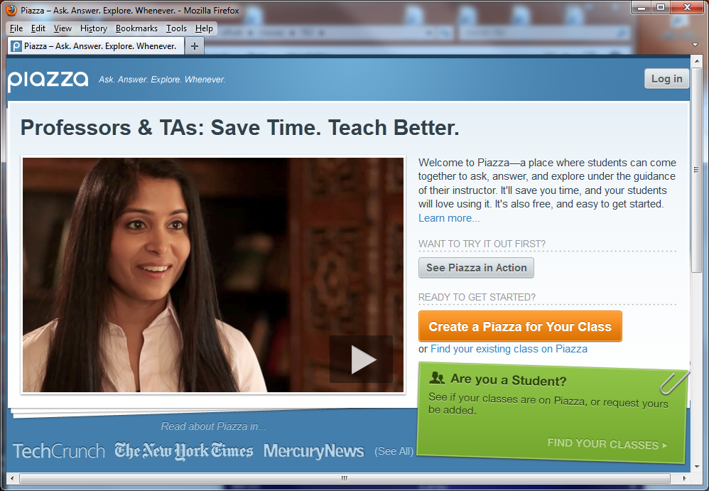
Technological Support—Piazza

Slide 21
Piazza Discussion Board
Most discussion boards are “top down” … the moderator defines and controls the discussion
Piazza works “bottom up” … students can define new “tags” at any time
  Students self-direct the conversation
  Encouraging collaborative learning and divergent thinking
Piazza was created by Pooja Nath Sankar
  MBA at Stanford, MS-CS at U Maryland, BS-CS at IIT Kanpur
All our discussions and postings are hosted on Piazza
  This international collaborative tool is indispensable to this class

Slide 22
Principles in SEE Class
Divergent thinking
  Over a dozen projects suggested to students, all open-ended
  Students explicitly encouraged to explore all sides of each paper we study
Collaborative learning
  Constant discussion is required in the class
  Students review each other’s experimental designs and papers
Multi-faceted evaluation
  Quality and quantity of postings
  Answers to questions posted by the instructor
  Quality of paper summaries
  Quality of experimental design, writing of paper, presentation

Slide 23
Midterm Assessment
We are only part way through the semester
but
I have never before seen a group of students so excited about a class

Slide 24
Summary
We are in a time of dramatic change
The field of computing is in the midst of fissioning into many subfields
  With traditional CS as the core
  Just as traditional Physics is the core of mechanical, civil, aerospace, and electrical engineering
Industry will always need Computer Scientists
But industry needs a lot more Software Engineers !

Slide 25
Contact
Jeff Offutt
offutt@gmu.edu
http://cs.gmu.edu/~offutt/
George Mason University
Remember
If you don’t care for them, they won’t care what you say

