Slide 1
How the Web Brought Evolution Back Into Design
Jeff Offutt
Software Engineering
George Mason University
Fairfax, VA USA
www.cs.gmu.edu/~offutt/
offutt@gmu.edu
Keynote talk at the 2013 Brazilian Symposium on Software Engineering

Slide 2
Engineers and Scientists
Science is about adding to the knowledge base
Engineering uses the knowledge to solve problems
Science is discovery
Engineering is invention
Society needs a lot more engineers than scientists

Slide 3
Science and Engineering Goals
Behaviors
observe
achieve
Science
Engineering
find and
describe
design and
develop
Structures

Slide 4
Computing is Different
Behaviors
Behaviors
observe
achieve
Science
Engineering
find and
describe
design and
develop
achieve
Structures
Computing
design and
develop
imagine
model
Emphasizes abstract thinking and creativity
Structures

Slide 5
Physics “Fissioned” into Engineering (1890-1940)
Mechanical Engineering
Civil Engineering
Electrical Engineering
Physics
Aerospace Engineering
Environmental Engineering
Industrial
Engineering

Slide 6
Fissioning of Computing
Software Engineering
Artificial Intelligence
Games & Graphics
Computer Science
Information Technology
Information Systems
Networking

Slide 7
We Are Engineers
We imagine new functionality …
We create models …
We build things that help real people …
I believe the focus on computer science stifles our field

Slide 8
Some Engineering Historical Perspective
Building new technology incurs several costs
In this talk I will separate costs into four areas
  Design
  Production
  Distribution
  Support
Over time, the relative amount of these costs have continuously changed
We started with the ability evolve our designs slowly

Slide 9
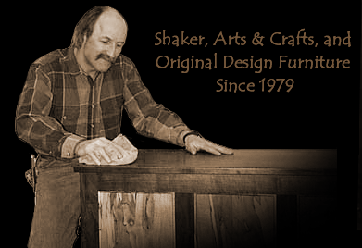
Pre-1850 : Hand-crafting
Design evolved over time, each new object better than the last
  Low design costs
Very high production cost—weeks of labor
Low distribution cost—customers walked into the shop
Little or no support cost

Slide 10
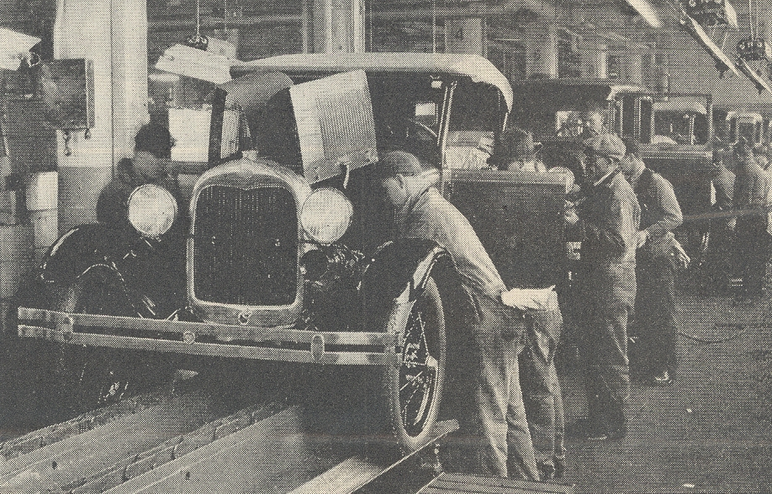
1850s : Assembly Line
Manufacturing started to change this equation
The same design quickly put into thousands of products
  Very low production cost
Much higher design costs
Distribution costs started to increase
Support costs increased—but were outsourced

Slide 11
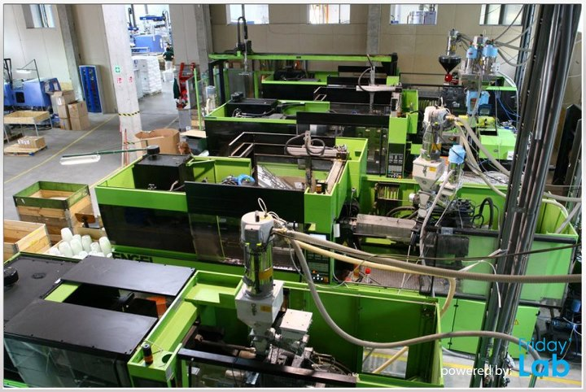
1900s: Automated Manufacturing
Robots increased the speed and efficiency of production
Production cost continued to decline
Instead of training people, design costs now included creating expensive robots
Distribution costs continued to increase

Slide 12


Post-WWII
Worldwide Distribution
Distribution capabilities increased exponentially
Production costs continued to decline
Design costs continued to escalate
Support started to become “replace”

Slide 13
2000s : Free Trade
This process has continued …
  Free trade agreements
  Cheap oil
  Decreases in shipping costs
  Decreases in production costs
The ultimate effect ?
Manufacturing defeated evolutionary design !
We now emphasize quantity over quality

Slide 14
Losing Evolutionary Design
Thousands of products are incredibly cheap
Many products are very low quality
Designed to last a few months or years, instead of decades
Instead of evolution, we have
  Maintenance
  Or replacement
We have lost something wonderful
Craftsmanship

Slide 15

Where is Software Engineering?
Ummm ... Excuse me, Professor ...
What does this have to do with SOFTWARE ENGINEERING ???

Slide 16
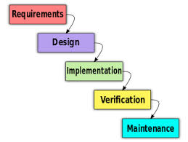
Traditional Software Development
Production cost for software is very low
Distribution cost is substantial
  Includes marketing, sales, shipping
Support costs escalated
Software splits design into design and implementation
  Both very expensive !
Instead of one design for each artifact, software has one design for many artifacts

Slide 17
1900s Software Costs
Millions of customers skewed costs to the back end
  High support costs
  High distribution costs
New versions shipped every 4 to 6 years
  MS Office,CAD, compilers, operating systems
Software needs to be “perfect out of the box”
  Very expensive design
  Very expensive implementation—including testing up to 50% of the cost
Software evolution was very slow!

Slide 18
Research Agenda
The need to be “perfect out of the box” has heavily influenced decades of SE research
  Formal methods
  Modeling the entire system at once
  Process
  Testing finished products
  Maintenance in terms of years
Most of our research focus and results assume :
  High support costs
  High distribution costs
  High design costs
  High implementation costs

Slide 19
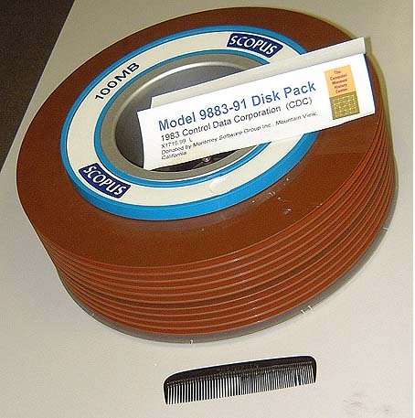
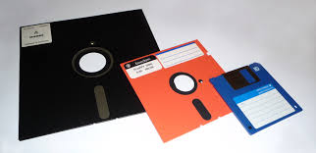

Distribution Costs
In the 1980s, technology started driving down the distribution costs for software …

Slide 20
Usability and Support
As usability started to increase …
The need for support decreased
Then the World Wide Web changed everything

Slide 21
2000s : The Web
The web rearranged the importance of quality criteria, including making usability crucial
(1)
The web created a new way to deploy software
(2)
The web dramatically changed the way we distribute software
(3)

Slide 22
Formation of the WWW
The World Wide Web is a result of the confluence of three developments
Fast Computers
Internet
World Wide Web
Hypertext Theory

Slide 23
Important Quality Attributes for Web Software
Reliability
Usability
Security
Customers have little “site loyalty” and will switch quickly, thus time to market is much less important than in other application areas.
(but still important!)
Availability
Scalability
Maintainability
Performance & Time to Market
Based on an informal survey of around a dozen software development managers, Quality Attributes of Web Software Applications, Offutt, IEEE Software March 2002

Slide 24
Why Usability ?
More users …
Providing support is prohibitively expensive
The answer ?
Better usability !

Slide 25
Web Deployment
Traditional software deployment methods
Bundle
Shrink-wrap
Embed
Contract
5. Web Deployment

Slide 26
Web Software Distribution
Desktop software can be distributed across the web
  Zero-cost distribution
  Instantaneous distribution
  This allows more frequent updates
Web applications are not distributed at all in any meaningful sense
  Software resides on the servers
  Updates can be made weekly … daily … hourly … continuously!
Mobile applications allow the artisan to come into your “home” to improve that rocking chair

Slide 27
Evolutionary Design
Near-zero production costs …
Immediate distribution ….
Near-zero support costs …
We have resuscitated evolutionary design !

Slide 28
Evolutionary Software Design
Pre-Web software design & production
  Strive for a perfect design, expensive development
  Deploy a new version ever 4 to 6 years
  Evolution was very slow
Post-Web software production
  Initial “pretty good” design and development
  Slowly make it bigger and better
  Faster evolution
  Immediate changes to web applications
    Automatic updates of desktop applications
    Software upgrades pushed out to mobile devices
    Replacing chips in cars during oil changes
This changes all of software engineering !!

Slide 29
Industry Impacts
How often is Google mail updated?
  Daily … sometimes hourly
Piazza class support system
  The first day I used it I reported a bug
  It was fixed before I met class that afternoon
Sarah Allen invented youtube
  She advises people with 5-year ideas to think about how they can get 1 idea in 6 months, and grow to the 5-year goal
Photoshopper is now rented, not bought
  Customers are told to expect continuous improvements.

Slide 30
Research Agendas
Software will not be designed and built
Software grows
Software needs to take responsibility for its own behavior
Waterfall is now, finally, thankfully, completely dead
Testing must focus on evolution, not new software
Yes, the web really does change EVERYTHING

Slide 31
Software Process
We have already seen process changes that are a direct result of web deployment & distribution
Agile processes goals :
  Have a working, preliminary, version as fast as possible
  Continue growing the software to have more functionality and better behavior
  Easy and fast to modify
  Adapt to sudden and frequent changes in planned behavior
Agile processes are widely used
Results are mixed, but use is growing quickly
How does your research relate to agile processes ?

Slide 32
Specifications / Modeling
The UML diagrams do not even support all of the control flow mechanisms in web applications
  Modeling Presentation Layers of Web Applications for Testing, Offutt and Wu, SOSYM, April 2010
Must easily adapt to frequent changes and additions
Must shift from a “get it right out of the box” posture to “start small and grow” posture
I am honestly not sure how formal methods fit in
Does your research reflect evolutionary design ?

Slide 33
Architecture
Software architects often assume their high level design will not change throughout development
  And the lifetime of the system
It is not clear how this supports software growth, rapid deployment, and instantaneous distribution
Is this attitude compatible with agile processes ?
How does architecture design interact with refactoring ?
Does your research reflect evolutionary design ?

Slide 34
Software Self-Responsibility
Evolutionary design means we cannot know everything software will ever do
Self-management means the software adapts behavior to runtime changes—crucial for evolutionary design
  Check out tomorrow’s talk by Prof. Malek
Fault localization tries debug automatically, which can dramatically cut the human effort required to fix software after testing
Automated defect repair goes one step further, and attempts to automatically fix faults
Can your research make software adaptive or responsible ?

Slide 35
Software Testing
Test-driven design uses tests to drive requirements
  Every step is evolutionary
We must stop thinking of regression testing as something special done “late in the process”
  Virtually all testing is now regression testing
Model-based testing allows test design to quickly and easily adapt to changes
Test automation is the key to running tests as quickly as software is now changed
  Model to implementation ?
  Test oracle strategy ?
Does your research support evolutionary design ?

Slide 36
Test Automation
As an example, let’s look at two results from my research into test automation
Joint work with Nan Li

Slide 37
Test Automation
Model Test Designs to Automated Tests
2
Abstract Test
[ 1, 2, 3, 2, 4 ]
[ 1, 3, 4, 2 ]
…
1
3
4
Model level
Implementation level
public class underTest()
{
private int X, Y;
public m1 (int a) { … };
public m2 (int s, int t) { … };
}
Concrete Test
ut = new underTest();
ut.m1 (14);
ut.m2 (5, 7);
ut.m2 (1, 3);
ut.m1 (13);
ut.m1 (23);

Slide 38
Test Automation
Model Test Designs to Automated Tests
Model
Test Criterion
Test Requirements
Test values
Test oracle
Other values
Abstract Tests
Concrete Tests
Test Execution
Test Reports

Slide 39
Test Automation
Model Test Designs to Automated Tests
Coin
Abstract Tests
1. [ 1, 3, 4, 1, 2, 4 ]
2. [ 1, 2, 4, 1, 2, 4 ]
3. [ 1, 2, 4, 3, 4 ]
4. [ 1, 2, 4, 1, 3, 4 ]
5. [ 1, 3, 4, 1, 3, 4 ]
1
Coin
2
GetChoc
AddChoc
AddChoc
@Test public class test1()
{
vm.addChoc (“MM”);
vm.coin (100);
vm.getChoc (choc);
vm.coin (10);
vm.addChoc (“MM”);
assertEquals (1, vm.getStock().size();
}
3
Coin
4
GetChoc
AddChoc
Coin / AddChoc

Slide 40
Test Automation
Model Test Designs to Automated Tests
Two kinds of mappings
Element mappings define transitions that may be used in many tests
Mapping vMachineInit Transition initialize
{ vendingMachine vm = new vendingMachine(); }
Object mappings define values that can be used for parameters
Mapping cForCoin Class int Object c
{ 10, 25, 100 }
Mappings are used to piece together tests
Each mapping defined once, used many times

Slide 41
Test Automation
Model Test Designs to Automated Tests
We empirically compared automated with hand process
Subjects :
  9 testers
  17 programs (one tester per program)
Automated
  Find test code for each element from model
  Enter mappings into test automation tool
  Generate concrete (automated) tests; correct errors
Hand process
  Find test code for each element from model
  Write automated tests
  Correct errors

Slide 42
Test Automation
Model Test Designs to Automated Tests
Statistic | Size
FSM Nodes | 742
FSM Edges | 33,983
LOC | 232
Num Mappings | 196
Num Mapping Appearances | 2325
Num Tests | 240
Task | Automatic (seconds) | Manual (seconds)
Mapping Creation | 8364 | N/A
Test Generation | 344 | 39,670
Total | 8708 | 39,670
Errors | 0 | 48
75% time savings

Slide 43
Test Automation
Automate tests are not complete without test oracles
Joint work with Nan Li

Slide 44
Test Automation
Test Oracle Strategies
Test Oracle : Verifies if a test passes
  For example, JUnit assertions
Test Oracle Strategy (OS) : Specifies what parts of the program state the oracle should check
  Weak, or less precise, oracles might miss some failures
Observability : How easy it is to see program states
  An OS with more precision effectively increases observability

Slide 45
Test Automation
Test Oracle Strategies
We view tests as implementing transitions in FSMs
  Each transition calls one or more methods
We defined four elements of the program state to check
  State invariants : Check the state invariants in the model
  Object members : Member variables of objects if a method was called in a transition (deep check)
  Return values : After a method is invoked
  Parameter members : Member variables of objects that were passed to a method call as parameters (deep check)

Slide 46
Test Automation
Test Oracle Strategies
Checks object members, parameter members,
& return values
OS5
Checks parameter members & return values
OS4
OS3
Checks object members & return values
OS2
OS1
Checks return values
Checks object members
SIOS
Checks state invariants in FSM
NOS
Just checks for exceptions

Slide 47
Test Automation
Test Oracle Strategies
We empirically compared the seven oracle strategies
16 programs with FSMs
  52 .. 14,155 LOC
  24 .. 273 transitions
250 tests to satisfy edge coverage on the FSM
9627 faults generated by muJava mutation engine
  Equivalent mutants removed by hand
Each set of tests run against all faulty versions of its program

Slide 48
Test Automation
Test Oracle Strategies
OS | % Faults Detected | Assertions Created (Cost)
OS5 | 61% | 3,455
OS4 | 58% | 472
OS3 | 61% | 3,375
OS2 | 58% | 402
OS1 | 60% | 3,298
SIOS | 54% | 114
NOS | 34% | 0

Slide 49
Test Automation
Test Oracle Strategies
OS | % Faults Detected | Assertions Created (Cost)
OS5 | 61% | 3,455
OS4 | 58% | 472
OS3 | 61% | 3,375
OS2 | 58% | 402
OS1 | 60% | 3,298
SIOS | 54% | 114
NOS | 34% | 0
Slightly more expensive, only misses 5% of failures
Inexpensive, only misses 12% of failures
Free, but misses 45% of failures!

Slide 50
Test Automation Summary
A general-purpose language to convert abstract (model-level) tests to concrete (implementation-level) tests
  Requires minimal input from tester
The common industrial practice of just checking for runtime exceptions misses almost half the failures
  A tremendous waste of testing resources
Increasing the precision of the test oracle only has a small impact on the quality of the testing
Automated testing is essential to supporting evolutionary design

Slide 51
Software Cost Distribution
Old
New
Design : High
Design : Medium
Implementation : High
Implementation : Medium
Production : Low
Production : Zero
Distribution : High
Distribution : Zero
Support : High
Support : Low

Slide 52
Long Term Impact of Evolutionary Design
The end-result of large scale manufacturing was a heavy emphasis on quantity over quality
The web enables evolutionary design, which can allow us to focus on quality over quantity
What engineer would NOT love that !

Slide 53
Contact
Jeff Offutt
offutt@gmu.edu
http://cs.gmu.edu/~offutt/
George Mason University
Evolutionary design is resuscitating our research

