Slide 1
Cutting Edge Research in Engineering of Web Applications Part 3 What are the Research Problems in Engineering Web Applications?
Jeff Offutt
Professor of Software Engineering George Mason University http://www.cs.gmu.edu/~offutt/
offutt@gmu.edu

Slide 2
General Problem
Web applications are heterogeneous, dynamic and must satisfy very high quality attributes
Use of the Web is hindered by low quality Web sites and applications
Web applications need to be built better and tested more

Slide 3
Major Issues in Engineering Web Apps
How to secure web apps?
Design modeling for web applications?
Which design patterns and frameworks work, and when?
How to testing web applications?
How to maintain and evolve web applications?
What is the best software development process for the web?
.

Slide 4
Outline
Who am I ?
Who are you ?
Part1 (13:00-15:00)
Web Apps Overview
How the Interweb Works
Web Software (Servlets)
Part 2 (19:00-21:00)
Control Flow & State Handling is Different
State Handling in JSP
Part 3 (Friday13:00-15:00)
Web Software Security
Modeling Web Apps
Testing Web Apps
Engineering Process

Slide 5
Security Through Time
100 BC Rome : magic charms
1400s Europe : not much worth stealing, armed guards for the rich
1600s American colonies : no doors
1800s USA : doors
1900s USA : better lock than your neighbor
21st Century : keys, PINs, passwords, biometrics, …

Slide 6
Usability and Passwords
When users are forced to change their passwords frequently, they must come up with schemes to remember
If change is too frequent, users’ schemes subvert security, making it easier to crack their passwords
The dividing line is about six months
When users have to change their passwords more than twice a year, security goes down
Designing memorable passwords is easy
Designing secure passwords is easy
It is very hard to design passwords that are both easy to remember and secure !

Slide 7
Security Requirements for Web Apps
Authentication
Verify the identity of the parties involved
Authorization
Limit access to resources to users
Confidentiality
Ensure that information is given only to authenticated parties
Integrity
Ensure that information is not changed or tampered with

Slide 8
Where to Apply?
Security can be applied at three levels :
Web server (Apache)
Web container (Tomcat)
Web application (your software)
If implemented in a Web application, that is sometimes considered being through the container

Slide 9
Security Application Methods
1. Secure web applications using a Web server
HTTP authentication
Authorization of users/groups
Authorization of domains
Secure HTTP, an extension of HTTP
SSL capabilities
2. Secure web applications using a servlet container
HTTP authentication (basic, digest)
Form-based authentication
Authorization of users/groups
SSL capabilities
Securing web applications by programming
Authorization of users
User information kept on the server in a session

Slide 10
Secure Servers
Browser
TLS/ SSL
I’d like to talk securely to you (over port 443)
TLS/ SSL
Web
Server
HTTP
Requests
Here’s my certificate and encryption data
HTTP
Requests
Here’s an encrypted HTTP request
Here’s an encrypted HTTP response
Here’s an encrypted HTTP request
HTTP
Responses
HTTP
Responses
Here’s an encrypted HTTP response

Slide 11
Secure Servers Man-in-the-Middle Attack
Fake
DNS
Server
Fake
www.example.org
100.1.1.1
What’s IP
address for
www.example.org?
100.1.1.1
My credit card number is…
Browser
Real
www.example.org

Slide 12
Secure Servers Preventing M-in-M Attacks
Fake
DNS
Server
Fake
www.example.org
100.1.1.1
What’s IP
address for
www.example.org?
100.1.1.1
?? Send me a certificate of identity ??
Browser
Real
www.example.org

Slide 13
Security Over the Years
Web applications open up new security threats
In the 1980s, security was all math …
In the 1990s, security revolved around the database …
In the 2000s, security moved to the network …
Now most security vulnerabilities are due to software faults
The area of software security is quickly growing
Research, education, and employment
In 2007, Symantec reported that most security vulnerabilities were due to software faults

Slide 14
Outline
Who am I ?
Who are you ?
Part1 (13:00-15:00)
Web Apps Overview
How the Interweb Works
Web Software (Servlets)
Part 2 (19:00-21:00)
Control Flow & State Handling is Different
State Handling in JSP
Part 3 (Friday13:00-15:00)
Web Software Security
Modeling Web Apps
Testing Web Apps
Engineering Process

Slide 15
Dynamic Execution of Web Apps
Parts of the program are generated dynamically
Dynamic web pages are created from user requests
Different users will see different programs !
Users can make unexpected changes to the flow of control
Operational transitions : Transitions NOT based on an HTML link: back-button, URL rewriting, refresh
The potential flow of control cannot be known statically

Slide 16
Control Flow Graphs in Web Applications
Many analysis techniques on non-Web software rely on a static control flow graph
Slicing, change impact analysis, …
Edge testing, data flow, logic coverage …
Static control flow graphs cannot be computed for Web applications!
But all the pieces of the web pages and the programs are contained in the software …

Slide 17
Atomic Sections
PrintWriter out = response.getWriter();
P1 =
out.println (“<HTML>”)
out.println (“<HEAD><TITLE>” + title + “</TITLE></HEAD>”)
out.println (“<BODY>”)
title
if (isUser) {
Atomic
sections
P2 =
out.println (“<CENTER>Welcome!</CENTER>”);
for (int i=0; i<myVector.size(); i++)
if (myVector.elementAt(i).size > 10)
P3 =
out.println (“<p><b>” + myVector.elementAt(i) + “</b></p>”);
myVector.elementAt (i)
else
P4 =
out.println (“<p>" + myVector.elementAt (i) + “</p>”);
myVector.elementAt (i)
Empty
atomic
section
} else
P5 =
{ }
Content
variables
P6 =
out.println (“</BODY></HTML>”);
out.close ();

Slide 18
Atomic Sections Defined
A section of HTML with the property that if any part of the section is sent to a client, the entire section is
May include JavaScript
All or nothing property
An HTML file is an atomic section
Content variable : A program variable that provides data to an atomic section
Atomic sections may be empty

Slide 19
Composite Sections
Atomic sections are combined to create dynamically generated web pages
Four ways to combine:
Sequence : p1 • p2
Selection : (p1 | p2)
Iteration : p1*
Aggregation : p1 {p2}
p2 is included inside of p1
The previous example produces:
p → p1 • ((p2 • (p3 | p4)*) | p5) • p6
Composite sections can be generated automatically

Slide 20
Modeling Dynamic Interaction
Interactions are classified into three types of transitions:
Link Transition : An HTML link
Composite Transition : Execution of a software component causes a composite section to be sent to the client
Operational Transition : A transition out of the software’s control
Back button
Refresh button
User edits the URL (URL rewriting)
Browser reloads from cache

Slide 21
Modeling Web Applications
Intra-component Level : Abstract description of each component in the Web application
Inter-component Level : A graphical representation of the entire Web application

Slide 22
Inter-Component Level
A Web Application Graph (WAG)
Nodes are web components
Edges are transitions
Three types of transitions
Static links
Dynamic links
Forwarding links
Annotations on links
Type of HTTP request
Data being transmitted as parameters
Current State : static variables and session information

Slide 23
STIS Web Application Graph
Small Textual Information System
index.jsp
post (userid, password)
login.jsp
logout.jsp
record_add.jsp
browse.jsp
categories.jsp
post (name, category, content)
post (category, search_name)
post (action, categoryName)
update_search_params.jsp
record_insert.jsp
static link transition
forward link transition
dynamic link transition

Slide 24
Uses of Atomic Section Modeling
Atomic sections fundamentally model Web applications
Allow the Web app form of CFGs
Can be used for
Design modeling / evaluation
Maintenance, evolving the design
Change impact analysis (slicing)
Coupling of Web application components
Testing
Jeff Offutt and Ye Wu. Modeling Presentation Layers of Web Applications for Testing. Springer’s Software and Systems Modeling, 9(2):257-280, April 2010

Slide 25
Outline
Who am I ?
Who are you ?
Part1 (13:00-15:00)
Web Apps Overview
How the Interweb Works
Web Software (Servlets)
Part 2 (19:00-21:00)
Control Flow & State Handling is Different
State Handling in JSP
Part 3 (Friday13:00-15:00)
Web Software Security
Modeling Web Apps
Testing Web Apps
Engineering Process

Slide 26
Testing Web Apps
Software differences that effect testing
Atomic section-based testing
Bypass testing

Slide 27
Differences in Testing Web Software
Traditional graphs do not apply
Control flow graph
Call graph
State behavior is hard to model and describe
All inputs go through the HTML UI – low controllability
Hard to get access to server-side state (memory, files, database) – low observability
Not clear what logic predicates can be effectively used
No model for mutation operators on web software

Slide 28
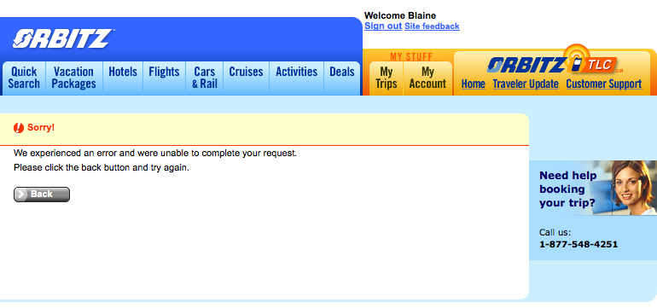
Example Problem 1
Why should I trust you enough to try again?

Slide 29
New Essential Problems of Web Software
Web site software is extremely loosely coupled
Coupled through the Internet – separated by space
Coupled to diverse hardware and software applications
Web services will dynamically couple with other services after deployment – without human intervention !
Web software services offer dynamically changing flow of control
Web pages are created by software on user request
The interaction points (forms, buttons, etc.) vary depending on state: user, previous choices, server-side data, even time of day
Examples : amazon.com, netflix.com, washingtonpost.com
Finding all screens in a web app is an undecidable problem

Slide 30
Ramifications of ELC
Web applications encourage ELC
Physical separation of hardware and software makes ELC necessary
XML supports ELC
ELC has some non-obvious affects
Software modules can dynamically integrate with other modules if they use the same data structures
EJBs can be inserted into Web applications, which can immediately start using them

Slide 31
Dynamic Flow of Control
WebPics
¿Hola!, Lionel Messi!
WebPics
Howdy there, Paul Ammann!
Search
Search
Recommended Movies
Recommended Movies
X
XX
XXX
A
B
C
D
Examine queue
(Warning: Queue empty)
Examine queue
View account
View account
Frequent customer bonus
How can we ensure the reliability of this type of system?

Slide 32
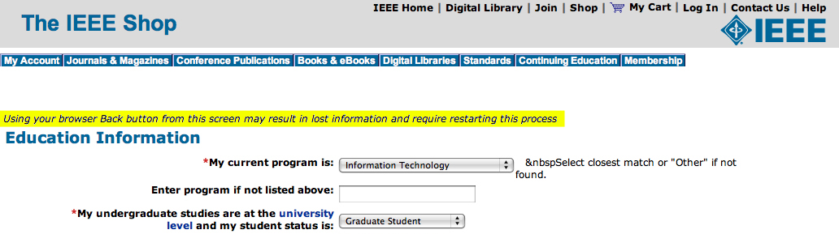
Example Problem 2
Oh yeah?? I’m definitely pushing BACK button !

Slide 33
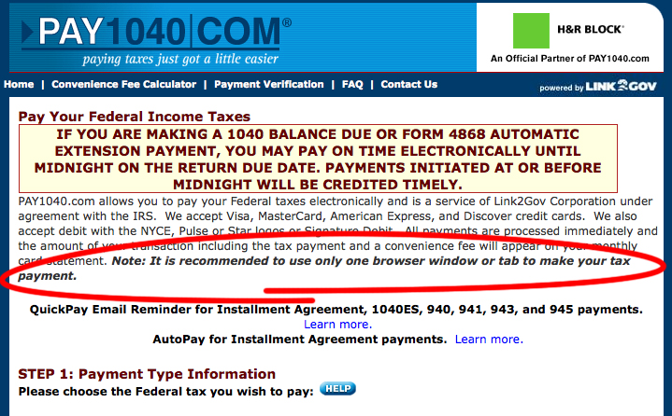
Example Problem 3
Doh!!! Shoot the designer!

Slide 34
Testing Web Apps
Software differences that effect testing
Atomic section-based testing
Bypass testing

Slide 35
Test Criteria
Tests can be designed at two levels
Intra-component level : Atomic sections
Inter-component level : The web application graph
Tests are created by deriving sequences of transitions among the web software components and composite sections

Slide 36
Composite Section Test Criteria Intra-Component
All productions in the grammar
Multiple forms for each software component
Each atomic section used at least once
Each selection used once
Every form element
Each possible aggregation
MCDC type coverage of conditions on productions
Based on predicates define the atomic sections

Slide 37
WAG (Inter-Component) Tests
L1 : Evaluate static link transitions
One test generated for each form
L2 : L1 with two extensions
Values entered with URL rewriting
Multiple tests for each form
L3 : Operational transitions
Starting on non-initial pages, no subsequent transitions
L4 : Operational transitions
L1 tests with one operational transition at end
L5 : L4 + tests to traverse every transition out of the final page

Slide 38
Results from Testing STIS
previous web tests
109 tests
Failure Category | L1 | L2 | L3 | L4 | L5
Number of tests | 29 | 21 | 7 | 19 | 33
Pages displayed without authentication | 0 | 0 | 2 | 4 | 4
2. Records added without authentication | 0 | 0 | 1 | 2 | 0
3. Runtime failures (unhandled exceptions) | 0 | 3 | 2 | 5 | 2
Total number of failures | 0 | 3 | 5 | 11 | 6
Found 25 naturally occurring failures

Slide 39
Testing Web Apps
Software differences that effect testing
Atomic section-based testing
Bypass testing

Slide 40
Abbreviated HTML
<FORM >
<INPUT Type=“text” Name=“username” Size=20>
<INPUT Type=“text” Name=“age” Size=3 Maxlength=3>
<P> Version to purchase:
…
<INPUT Type=“radio” Name=“version” Value=“150” Checked>
<INPUT Type=“radio” Name=“version” Value=“250”>
<INPUT Type=“radio” Name=“version” Value=“500”>
<INPUT Type=“submit” onClick=“return checkInfo (this.form)”>
<INPUT Type=“hidden” isLoggedIn=“no”>
</FORM>

Slide 41
Bypass Behavior
Extremely loose coupling …
combined with the stateless protocol …
allows users to easily bypass client-side checking :
Users can save and modify the HTML

Slide 42
Saved & Modified HTML
<FORM >
<INPUT Type=“text” Name=“username” Size=20>
<INPUT Type=“text” Name=“age” Size=3 Maxlength=3>
<P> Version to purchase:
…
<INPUT Type=“radio” Name=“version” Value=“150”>
<INPUT Type=“radio” Name=“version” Value=“250”>
<INPUT Type=“radio” Name=“version” Value=“500” Checked>
<INPUT Type=“submit” onClick=“return checkInfo (this.form)”>
<INPUT Type=“hidden” isLoggedIn= “no” >
</FORM>
Allows an input with arbitrary age, no checking, cost=$25 …
‘<‘ can crash an XML parser
Text fields can have SQL statements
25
yes

Slide 43
Bypass Testing
This example illustrates how users can “bypass” client-side constraint enforcement
Bypass testing constructs tests to intentionally violate constraints
Eases test automation
Checks robustness
Evaluates security
Preliminary results
Rules for constructing tests
Successfully found errors in numerous Web apps

Slide 44
Client-Side Constraint Rules
Violate size restrictions on strings
Introduce values not included in static choices
Radio boxes
Select (drop-down) lists
Violate hard-coded values
Use values that JavaScripts flag as errors
Change “transfer mode” (get, post, …)
Change destination URLs

Slide 45
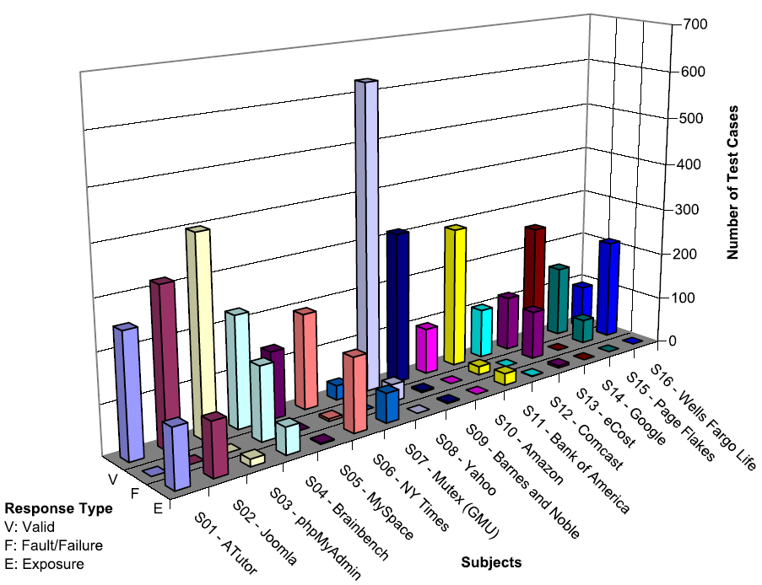
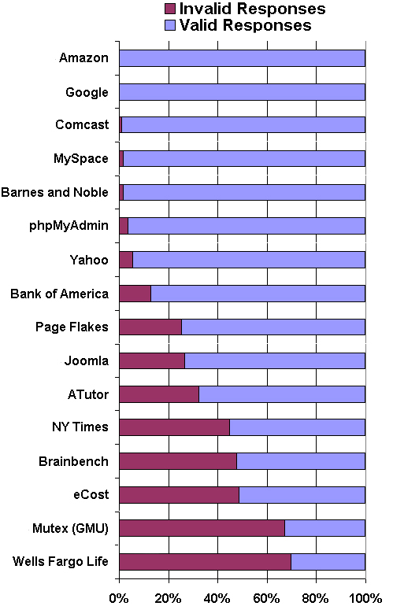
Results on 16 Web Apps
v

Slide 46
References
Jeff Offutt, Vasileios Papadimitriou, and Upsorn Praphamontripong. A Case Study on Bypass Testing of Web Applications. Springer’s Empirical Software Engineering journal, July 2012
Mouelhi, Le Traon, Abgrall, Baudry, and Gombault. Tailored Shielding and Bypass Testing of Web Applications. Fourth International Conference on Software Testing, Verification and Validation (ICST), March 2011, pp 210-219
Jeff Offutt, Qingxiang Wang and Joann J. Ordille. An Industrial Case Study of Bypass Testing on Web Applications. 1st IEEE International Conference on Software Testing, Verification and Validation , pages 465-474, April 2008, Lillehammer, Norway
Jeff Offutt, Ye Wu, Xiaochen Du and Hong Huang. Bypass Testing of Web Applications. IEEE International Symposium on Software Reliability Engineering, pages 187-197, November 2004, Bretagne France

Slide 47
Outline
Who am I ?
Who are you ?
Part1 (13:00-15:00)
Web Apps Overview
How the Interweb Works
Web Software (Servlets)
Part 2 (19:00-21:00)
Control Flow & State Handling is Different
State Handling in JSP
Part 3 (Friday13:00-15:00)
Web Software Security
Modeling Web Apps
Testing Web Apps
Engineering Process

Slide 48
Losing Evolutionary Design
Pre-1850 : Hand-crafted objects
Design evolved over time, each new object better than the last
Very high production cost
1850s-1900 : Early manufacturing
Assembly line separated design from manufacturing
Put emphasis on quantity instead of quality
1900s-1950s : Large-scale manufacturing
The same (flawed?) design is put into thousands of products
Very low development cost
1950s-2000s : Global distribution
Distribution costs first dominate, then are steadily reduced
Manufacturing defeated evolutionary design!

Slide 49
Terms
Design : Deciding the internal structure and external functionalities of a technological artifact
Development : Creating a technological artifact from a design
Manufacturing : Creating technological artifacts ready for users or customers
Distribution : Providing a technological artifact to users

Slide 50
Software Manufacturing
1960s : Designers were users
Most developers used their own software
Little distribution, personal “tinkering”
1970s-1990 : Seeking perfection
Software has very high design & development cost
Software has very near-zero manufacturing cost
1990-2000 : Improved development
Better software tools reduced development costs
With manufacturing and development costs near zero, design & development costs ballooned
Software had to be perfect “out of the box”

Slide 51
Software Distribution
2000-2010 : Global distribution
Distribution costs steadily decreased—disks, diskettes, CDs, the Internet, the Web …
With near-zero costs for manufacturing and distribution, design and development became paramount
Our research emphasized early-stage activities :
Formal methods
Process
Testing the finished product
Maintenance in terms of years
But humans aren’t good at being perfect !

Slide 52
Distribution Undercurrent
Driving distribution costs down to near-zero created a subtle, but powerful change
From 1990-2005, we got new versions of MS-Office every four or five years
Took years for maintenance changes to reach users
But how often do we get new versions of web apps?
Google mail
Amazon
Pandora
Monthly … daily … hourly !

Slide 53
Evolutionary Software Design
Pre-Web software design & production
Strive for a perfect design, expensive development
Deploy a new version ever 4 to 6 years
Evolution was very slow
Post-Web software production
Initial “pretty good” design and development
Faster evolution
Automatic updates of desktop applications
Software upgrades pushed out to mobile devices
Replacing chips in cars during oil changes
The Web has resuscitated evolutionary design !

Slide 54
Software Research
Our entire research agenda is changing
No more “getting it right out of the box”
How do we support evolutionary design?
Process
Agile methods, scrum, TDD
Design / modeling
Primary criterion is the ability to make many changes quickly
The point of many architectural frameworks
Testing
Forget system testing, we need better unit & integration testing
Measurement
We need to quickly measure the impact of changes

Slide 55
Think Short Term
If you have a 5-year plan
How can you design, develop, and distribute ONE idea in 3 months ?
And then grow it over the next 4.5 years

Slide 56
Summary
Without a doubt
the Web
changes everything

Slide 57
Research Issues
How to secure web apps?
Design modeling for web applications?
Which design patterns and frameworks work, and when?
How to testing web applications?
How to maintain and evolve web applications?
What is the best software development process for the web?
.

