Slide 1
Software engineers don't care about models but they want automated tests
Jeff Offutt
George Mason University
cs.gmu.edu/~offutt
33rd International Conference on Software Engineering & Knowledge Engineering

Slide 2
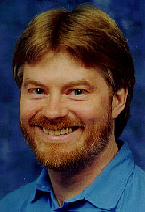
A story about a young guy
Way back in the late 1990s, this young guy
scored a fun research project with Rockwell-Collins Aviation
Generating Test Cases From Requirements Specifications
Project goals:
Derive tests from formal specifications (Z, SCR)
Develop a tool to measure code coverage of spec-based tests
Using formal methods to derive test frames in category-partition testing, Ammann and Offutt, Computer Assurance Conference, 1994
Criteria for generating specification-based tests, Offutt, Xiong, and Liu, ICECCS 1999
Evaluation of Three Specification-based Testing Criteria, Abdurazik, Ammann, Ding, and Offutt, ICECCS 2000
Generating Test Data From State-based Specifications, Offutt, Liu, Abdurazik, and Ammann, STVR 2003

Slide 3
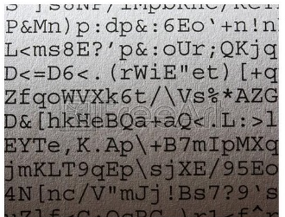
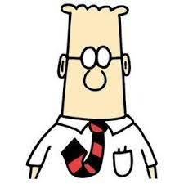
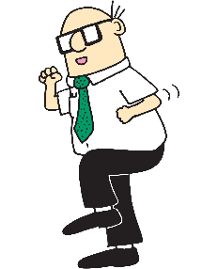
Story of a site visit
A two-day visit to Rockwell-Collins’ facility in Iowa
Met with research group, managers, project leads, developers, and testers
“We use formal specs!”
“See our specs?”
“We ain’t mathematicians.”
We make formal specifications after the software is finished.
But we use UML diagrams.
“We read code and user manuals to write tests”

Slide 4
Results from visit
Brainwave
We can design tests to cover (informal) graphs like UML
Managers didn’t believe me
Managers hated the idea
I lost the funding
But, published the first MBT papers—creating the model-based testing field!
Generating tests from UML specifications, Offutt and Abdurazik, UML 1999
(Finite state machines; edge coverage, predicate testing, edge-pair; 651 citations)
Using UML collaboration diagrams for static checking and test generation, Abdurazik and Offutt, UML 2000 (354 citations)
Sort of …
An approach to program testing, J C Huang, ACM Computing Surveys, 1975 (edge coverage on flowcharts)

Slide 5
We ain’t mathematicians
Software engineering research is at its best when our results help real software engineers create real software,
better, faster, and cheaper

Slide 6
That project was a long time ago
When software was based on an 1800s-style assembly line manufacturing process
Before the web changed everything

Slide 7
1980s waterfall process
Requirements
Based on the century old assembly line model
Specifications
Design
Code
Test
Deploy
spec all → design all → code all → test all → deploy
spec all → design all → code all → test all → deploy

Slide 8
Waterfall assumptions
Front-end effort can yield software that is “perfect out of the box”
High distribution cost: Release cycles measured in years
Very high design costs: Design must be perfect
Usability was poor: High support costs

Slide 9
Late 1990s changes
Storage became cheaper and smaller
driving down distribution costs
Usability got better
driving down support costs
Unit testing became common
driving down testing costs
Then the web changed everything

Slide 10
Assumptions no longer hold water
Front-end effort can yield software that is “perfect out of the box”
High distribution cost: Release cycles measured in years
Very high design costs: Design must be perfect
Usability was poor: High support costs
Humans are really bad at
“perfect out of the box”

Slide 11
Agile processes
Spec some → design some → code some → test some → deploy early → repeat
Distribution is free (web!)
Don’t design until it’s needed—fewer bad decisions
Good usability means no support needed

Slide 12
Test driven development (TDD)
Test fails
Design emerges during refactoring
Tests define functionality
Test passes
Refactor
Green means software is correct relative to tests

Slide 13
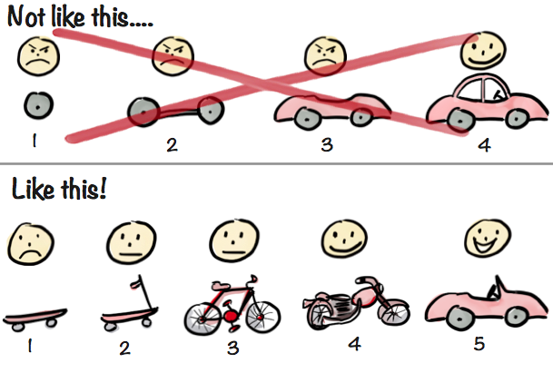
Minimum viable product (MVP)
Sarah Allen (Flash)
“If you have a 5-year idea, achieve 1 idea in 3 months, then grow steadily to the 5-year goal”
Short release cycles
Each release does something new

Slide 14
But
. . .
Where’s the model ?

Slide 15
Models and agile methods
Major research question:
Where do models fit into agile?
Do the models emerge during refactoring?
Are they created after the software is “finished”?
… automatically or by hand?
Are models created just for testing and verification?
… is that cost-effective?
Modern software changes continually … how can we keep the models current?
Practitioners need automatically generated test oracles

Slide 16
Traditional teaching is also top-down, waterfall model, assembly line based

Slide 17
Assembly line teaching is dated
Design entire 15-week course
How much is wrong?
How much do they retain?
Talk at students for an hour
They look up what they didn’t hear in class
Give a homework assignment
Forget ... cram … forget again
Exam at the end

Slide 18
Our teaching model is wrong
Our teaching model is from the 1800s
Developed to teach student facts
Computing is a problem-solving field!!
Problem-solving needs just-in-time teaching

Slide 19
Agile teaching
Assign a weekly problem
Talk about how for 10-15 minutes
Practice small piece in class
Show a good solution
Refactor
Collaboratively finish out of class

Slide 20
Pandemic agile online teaching
Software engineers don’t care about models but they want automated tests
Students don’t care about pedagogy but they want to learn
Flexible assignment deadlines
5% “by due-date” bonus
Can submit for full credit until final exams start
Participation points (15%)
Check-in each class meeting
In-class group exercises
Q & A on discussion board
Flexible weekly quizzes
1 point “during class” bonus
Can submit up until midnight
Open web exams
Problem-solving (design or coding)
Divergent thinking (multiple solutions)
24 hours to submit
All submissions through dropbox submit

Slide 21
Agile teaching results
>95% online attendance
Higher grades across the board
High student satisfaction
Each exam was clearly unique—students worked individually
With careful design, exams were quick to grade
Most assignments on time
A few students submitted at the last minute … and were very grateful

Slide 22
What’s a “divergent thinking” exam?
Divergent thinking: Many possible solutions
A programming final exam
Choose the language
Design your own UI
Optional elements: Implement 3 of 5 options
Design software structure yourself
Software testing final exam
Test 3 of 5 program components
Use 3 of 5 test criteria
Automate one set of tests (your choice)
Format your tests any way you want

Slide 23
Why do we need models?
Model to solve problems
Don’t solve problems to model
Let’s talk for awhile.
I’ll take any questions about:
modeling
research
teaching
baseball
Jeff Offutt
cs.gmu.edu/~offutt

