Slide 1
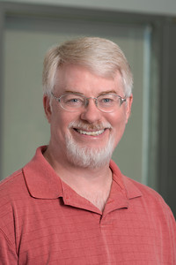
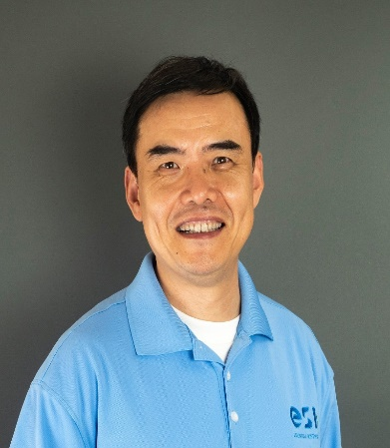
George Mason U.
Essential Software, inc.
SoSyM, April 2010

Slide 2
One of my favorite papers
It was rejected 4 times
Multiple attempts … never got NSF funding
Our tech report had more than 50 citations before the paper was accepted
We were accused of plagiarizing … from a paper that plagiarized from our technical report

Slide 3
Almost 10 years to publication
Reject: ISSRE March 2003
Reject: FSE May 2003
Reject: ICSE December 2003
Reject: TSE submit Feb 2004, Reject July 2005
Submit: SoSyM January 2006
Major revision: July 2006
Completely redid experiments
Resubmit: July 2008
Minor revision: March 2009
Resubmit: June 2009
Accept: November 2009

Slide 4
Lessons learned
Don’t give up !
If you believe in your research, ‘reject’ means ‘try again’ !
Innovation bias : Truly innovative work can be harder to get accepted

Slide 5
Summary of the paper
Web software technologies introduce new
control flow mechanisms
state management mechanisms (“variable” scoping)
Resulting problems
Novel modeling techniques
Application to testing
Two fundamental differences
HTTP is connectionless
Web apps are distributed

Slide 6
Novel control flows
Traditional control flow
1—6 : Calls, decisions, static includes, dynamic binding, message passing (http), reflection
Novel control flow in web
Event handling—client-side (from GUIs)
Asynchronous message passing—Client to server (Ajax)
Dynamic includes—control passes to another component, then returns, with no parameters being passed
Forward—Control passes from one server component to another, no return (same physical server)
Redirect—Server asks client to send to another server, no return
Operational transitions—Controlled by users and browsers
( back button, forward, URL rewriting, history, caching )

Slide 7
Novel scoping
Software components do NOT share physical memory
Requests handled by THREADS on object instances
request
OO scopes
method
private (class)
default (package)
protected
public (global)
request
page
forward
Client 1
request
request
page
forward
request
session
page
Client 2
application

Slide 8
Web control flow and scope
CFGs only model loops and branches
UML diagrams only model traditional control flow
Many programmers do not understand web control
They are often used inappropriately
Poorly designed software
Software faults that are not found or fixed

Slide 9
Modeling web applications
atomic sections
composite sections
dynamic interactions
web application graph
using the WAG for model-based testing

Slide 10
Atomic sections
PrintWriter out = response.getWriter();
P1 =
out.println ("<HTML>")
out.println ("<HEAD><TITLE>" + title + "</TITLE></HEAD>)"
out.println ("<BODY>")
title
if (isUser) {
Atomic
sections
P2 =
out.println <CENTER> Welcome!</CENTER>");
for (int i=0; i<myVector.size(); i++)
if (myVector.elementAt(i).size > 10)
P3 =
out.println(“<p><b>" + myVector.elementAt(i) + "</b></p>");
myVector.elementAt(i)
else
P4 =
out.println(“<p>" + myVector.elementAt(i) + "</p>");
myVector.elementAt(i)
} else
P5 =
{ }
Content
variables
P6 =
out.println(“</BODY></HTML>");
out.close ();

Slide 11
Composite sections
Atomic sections are combined to model dynamically generated web pages
Four ways to combine:
Sequence : p1 • p2
Selection : (p1 | p2)
Iteration : p1*
Aggregation : p1 {p2}
p2 is included inside of p1
The previous example models all web screens that can be produced by that code:
p → p1 • (p2 • (p3 | p4)* | p5) • p6

Slide 12
Dynamic interaction
Three types of transitions:
Link transition : An HTML link
Composite transition : Execution of a software component causes a composite section to be sent to the client
Operational transition : A transition out of the software’s control
Back button
Refresh button
User edits the URL
Browser reloads from cache
Previous research only handled link transitions

Slide 13
Web application graph
Intra-component model:
p → p1 • (p2 • (p3 | p4)* | p5)
Inter-component model
index
post (userid, password)
login
logout
record_add
browse
categories
post (name, category, content)
post (category, search_name)
post (action, categoryName)
update_search_params
record_insert
static link transition
forward link transition
dynamic link transition

Slide 14
Using the WAG for MBT
A test is modeled as a sequence of transitions through the WAG
Level 1 : Evaluate static link transitions
One test per form
This was state-of-the-art at the time
Level 2 .. Level 5 added:
Values entered with URL rewriting
Multiple tests for each form
Operational transitions
Additional transitions
L1 tests found no faults
L2..L5 found multiple faults in every web app tested

Slide 15
Novelty
Fundamental techniques to model Web apps
Atomic sections (roughly analogous to basic blocks)
Web application graph (roughly analogous to CFG)
First research to address:
Novel control flow mechanisms
Dynamically created transitions
Operational transitions

Slide 16
What’s happened since?
163 citations (google scholar)
~40% related work “casual” mentions
~25% directly used one or more concepts
~20% used the model for other purposes
other testing technique
refactoring
analyzing usage patterns
support regression testing
~15% used problem definition to go further
bypass testing
model state
extremely loose coupling

Slide 17
Education & practice
I’ve been teaching this model in classes for 15 years
I found more than 20 courses that used one or more of my slides
More than a dozen presentations at companies and universities
Several consulting jobs
Spotted WAGs on whiteboards at 2 companies last year

Slide 18
What is left? A LOT!
Model does not support modern client-side JS frameworks
Design evaluation
They are particularly vulnerable to security and privacy breaches
Modeling data flow
Asynchronous (Ajax) interactions need to be modeled
Concurrency
Programming languages that simplify the use of these techniques as first-class entities
Refactoring and optimization
Change impact analysis

Slide 19
Lessons learned
Lesson 1:
True impact takes hard work, time, & resilience
Lesson 2:
Fundamental, impactful work is not compatible with
the tenure & promotion process
Lesson 3:
Complex research requires journals, not conferences
Lesson 4:
There is no impact without a good presentation,
including motivation, examples, and good writing
Lesson 5:
In 1999 I heard “the web changes everything”
We’ve barely scratched the surface
Getting this work published was painful
This award is my greatest honor

