Slide 1
VIDEO LIST
SLIDE # VIDEO URL
3 Coke Happiness http://www.youtube.com/watch?v=lqT_dPApj9U
14 Esquire/Downey http://www.youtube.com/watch?v=LGwHQwgBzSI
20 Coke/Mean Joe http://www.youtube.com/watch?v=xffOCZYX6F8
20 ABC/Now is the Time 81 http://www.youtube.com/watch?v=bIEFWKmHg9c
20 Apple/Mac 1984 http://www.youtube.com/watch?v=HhsWzJo2sN4
21 Sytrash/Booty Call http://www.youtube.com/watch?v=HprHZFnfrPg
23 Archetype https://www.archetypeme.com/
34 Is Social Media a Fad http://www.youtube.com/watch?v=ibojpnYR7VY
00 House of Cards/Short http://www.youtube.com/watch?v=VVC0fgmuJ8g
00 House Of Cards/Long http://www.youtube.com/watch?v=ULwUzF1q5w4
00 Understanding Media http://www.youtube.com/watch?v=x4vVZG9SZeE

Slide 2
Networking and Other Career Skills for the Entrepreneur and the “Intrapreneur” (most everyone else)
Lecture B MGT 341
UAlbany
Bill Sobel

Slide 3
Video: What is Happiness?
HAPPINESS VIDEO

Slide 4
Trivia Time?
What is a Polymath?
A marketing professional who specializes in demographic analysis in multiple countries.
A computer language optimized to do scientific calculations.
An accountant who specializes in economic analysis.
None of the above.
Q1

Slide 5
What is a Polymath?
polymath \POLL-ee-math\, noun: A person of great or varied learning; one acquainted with various subjects of study.

Slide 6
Which company did Bill Sobel NOT work for
A. NBC Television
B. ABC Television
C. Paramount Television
D. MTV Networks
E. The Walt Disney Studios
Q2

Slide 7
Got my feet wet at big, well established places…

Slide 8
Learned how to manage at a small company while providing services to big clients

Slide 9
Why did I go “On My Own”?
To become a charter member of the “Free Agent Nation,” I…
Learned how big companies work
Got a chance to meet lots of people
Worked with smaller companies to provide services to the larger companies
Was able to adapt that and form my own consulting company

Slide 10
According to Daniel Pink in Free Agent Nation, ______ .
A. You should always avoid low-hanging fruitB. The new “free agency” is a temporary phenomenonC. The new “free agency” appeals only to people under 40D. All the aboveE. None of the above
Q3

Slide 11
Partial Client List

Slide 12
Recent Projects

Slide 13
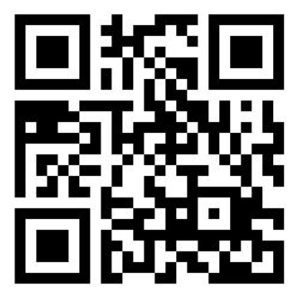
WHAT THE HECK IS THIS?
A. A computer animation code
B. A new form of art
C. A QR Code
D. None of the Above
Q4

Slide 14
Esquire Augmented Reality
Show Clip

Slide 15
are you responsible for what you market?
Seth Godin:
Let's assert that marketing works.
The money and time and effort we put into marketing goods and services actually works. It gets people to change their minds. It cajoles some people into buying and using and voting for things that they otherwise wouldn't have chosen. (If it doesn't work, save your money).
If it works, then, are you responsible for what happens after that?
If you market cigarettes aggressively, are you responsible for people dying of lung cancer?

Slide 16
Who Is Sarah Palin?
A. The former Governor of Alaska
B. The former Mayor of Wasilla
C. The Republican Party nominee for Vice President in the 2008 election
D. A former TV Reality TV Celebrity
E. All of the above
Q5

Slide 17
Sarah Palin's Alaska for TLC/Discovery Networks
Show Clip

Slide 18
Quote of the Day
“The biggest mistake we can make is to think we are working for someone else.” …source unknown

Slide 19
Always Looking for New Stuff
Lots of research on the internet
Attend many industry functions
Network like crazy!
“Related” to Levitan’s New Rules
Always stay in contact with people in the industry
Become the center your own networking system
The Growth and Feeding of my events

Slide 20
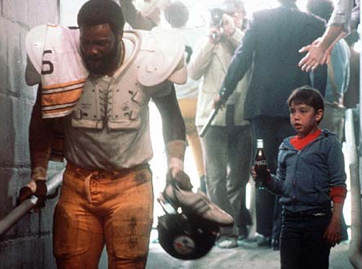
Personal Branding
Coke Mean Joe Greene 1979
Now is the Time...ABC is the Place 1981
Apple Macintosh Launch 1984

Slide 21
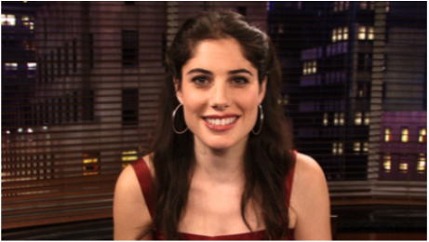
A New and Rising Talent
Andrea Syrtash asks:
What is a booty call?
VIDEO

Slide 22
Managing Target’s Credit Disaster
Some examples of what reactive and proactive the company has done since the breach
Can your “personal brand” suffer a setback like this one?
How can a company or individual prepare for something like this?
What general lessons can we learn about “image damage” control from Target’s reaction?

Slide 23
WHAT IS AN ARCHETYPE?
A. A type of Architecture
B. a specific pattern of behavior
C. The study of Arches
D. A division of Vandelay Industries
E. A specific method of construction

Slide 24
What is your Archetype?
An archetype is a universally understood symbol, term, statement, or pattern of behavior, a prototype upon which others are copied, patterned, or emulated.
The twelve archetypes used in personal branding are: the caregiver, the creator, the explorer, the hero, the innocent, the jester, the lover, the magician, the ordinary guy, the outlaw, the ruler and the sage. Once you identify your main archetype, your task is to evoke it through the way you speak, write, dress and behave. If you evoke your main archetype consistently, people will understand immediately how you work.
ARCHETYPE ME: https://www.archetypeme.com/

Slide 25
What is NOT one of Steven Covey's 7 Rules
A. Sharpen the Saw
B. Synergize
C. Start with the beginning in mind, not the end.
D. Think Win/Win
E. Be Proactive
Q6

Slide 26
Stephen Covey: 7 Habits of Highly Effective People
1. Be Proactive
2. Begin with the end in mind
3. Put First Things First
4. Think “Win/Win”
5. Seek to understand, then to be
understood
6. Synergize
7. Sharpen the Saw
(see slide notes for detail)
Notes:
The Seven Habits
From: The Seven Habits Of Highly Effective People: Restoring the Character Ethic, by Stephen R. Covey, Simon and Schuster, 1989.
BE PROACTIVE. Between stimulus and response in human beings lies the power to choose. Productivity, then, means that we are solely responsible for what happens in our lives. No fair blaming anyone or anything else.
BEGIN WITH THE END IN MIND. Imagine your funeral and listen to what you would like the eulogists to say about you. This should reveal exactly what matters most to you in your life. Use this frame of reference to make all your day-to-day decisions so that you are working toward your most meaningful life goals.
PUT FIRST THINGS FIRST. To manage our lives effectively, we must keep our mission in mind, understand what's important as well as urgent, and maintain a balance between what we produce each day and our ability to produce in the future. Think of the former as putting out fires and the latter as personal development.
THINK WIN/WIN. Agreements or solutions among people can be mutually beneficial if all parties cooperate and begin with a belief in the "third alternative": a better way that hasn't been thought of yet.
SEEK FIRST TO BE UNDERSTANDING, THEN TO BE UNDERSTOOD. Most people don't listen. Not really. They listen long enough to devise a solution to the speaker's problem or a rejoinder to what's being said. Then they dive into the conversation. You'll be more effective in your relationships with people if you sincerely try to understand them fully before you try to make them understand your point of view.
SYNERGIZE. Just what it sounds like. The whole is greater than the sum of its parts. In practice, this means you must use "creative cooperation" in social interactions. Value differences because it is often the clash between them that leads to creative solutions.
SHARPEN THE SAW. This is the habit of self-renewal, which has four elements. The first is mental, which includes reading, visualizing, planning and writing. The second is spiritual, which means value clarification and commitment, study and meditation. Third is social/emotional, which includes service, empathy, synergy and intrinsic security. Finally, the physical element includes exercise, nutrition and stress management.

Slide 27
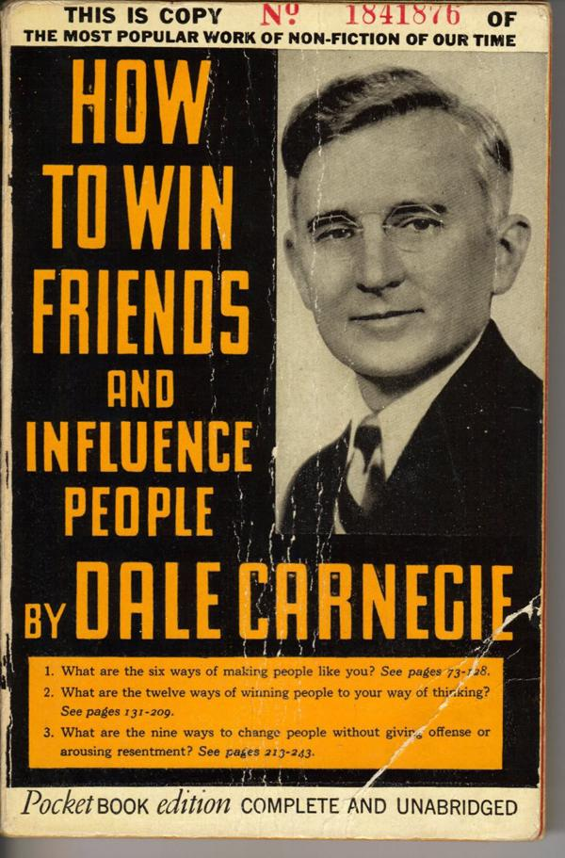
Who was Dale Carnegie?
Adubato: Decades later, Dale Carnegie's work still resonates
http://bit.ly/WdSd3g
Notes:
The Seven Habits
From: The Seven Habits Of Highly Effective People: Restoring the Character Ethic, by Stephen R. Covey, Simon and Schuster, 1989.
BE PROACTIVE. Between stimulus and response in human beings lies the power to choose. Productivity, then, means that we are solely responsible for what happens in our lives. No fair blaming anyone or anything else.
BEGIN WITH THE END IN MIND. Imagine your funeral and listen to what you would like the eulogists to say about you. This should reveal exactly what matters most to you in your life. Use this frame of reference to make all your day-to-day decisions so that you are working toward your most meaningful life goals.
PUT FIRST THINGS FIRST. To manage our lives effectively, we must keep our mission in mind, understand what's important as well as urgent, and maintain a balance between what we produce each day and our ability to produce in the future. Think of the former as putting out fires and the latter as personal development.
THINK WIN/WIN. Agreements or solutions among people can be mutually beneficial if all parties cooperate and begin with a belief in the "third alternative": a better way that hasn't been thought of yet.
SEEK FIRST TO BE UNDERSTANDING, THEN TO BE UNDERSTOOD. Most people don't listen. Not really. They listen long enough to devise a solution to the speaker's problem or a rejoinder to what's being said. Then they dive into the conversation. You'll be more effective in your relationships with people if you sincerely try to understand them fully before you try to make them understand your point of view.
SYNERGIZE. Just what it sounds like. The whole is greater than the sum of its parts. In practice, this means you must use "creative cooperation" in social interactions. Value differences because it is often the clash between them that leads to creative solutions.
SHARPEN THE SAW. This is the habit of self-renewal, which has four elements. The first is mental, which includes reading, visualizing, planning and writing. The second is spiritual, which means value clarification and commitment, study and meditation. Third is social/emotional, which includes service, empathy, synergy and intrinsic security. Finally, the physical element includes exercise, nutrition and stress management.

Slide 28
In our context, USP means
Universal Product Code
United Entrepreneurs of America
United States Proprietors
Unique Selling Proposition
Underwater Sabotage Pirates
Q7

Slide 29
Bill Sobel: My Three Simple Rules
1. Find the USP
2. Don’t Burn Bridges
3. Look for the Low Hanging Fruit

Slide 30
Entrepreneurship: The Promise and Perils of Starting Your Own Business
Opportunity for fulfillment
Opportunity for wealth
Flexibility of being in charge of your career
The personal fulfillment of “being the best” (Gitomer)

Slide 31
Management as an Entrepreneur
You are responsible for everything, including the “life-molding” task of personal development (see Gitomer)
Your compensation is based on the profits of the business
You are your own boss

Slide 32
Being able to hire anyone you want
Can be an advantage of working for yourself
Can be a disadvantage of working for yourself
Will never affect your bottom line
All the above are true
Both A and B are true
Q8

Slide 33
Advantages of Working for Yourself
You have complete responsibility for all phases of your company’s operation – you can do everything the way you want
You manage all aspects of the business and have the variety of working in many functional areas.
You can hire anyone you want to work with, including friends and family
Your compensation is based entirely on your own accomplishments
You are your own boss

Slide 34
On the other hand…
What are the Challenges
(or disadvantages)?

Slide 35
What is NOT a challenge of working for yourself?
A. Making Financial Decisions
B. Managing Employees
C. Deciding on what to serve employees for lunch
D. Managing Yourself and Your Time
E. None of the above
Q9

Slide 36
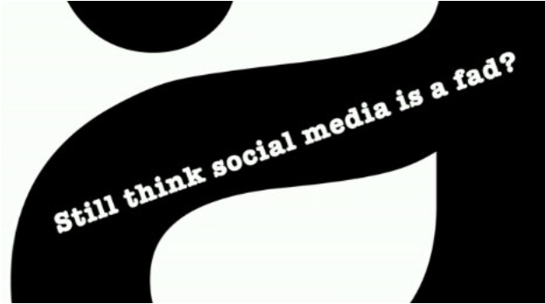
Will Social Media Change Everything?
IS SOCIALMEDIA A FAD?

Slide 37
What is NOT a social media platform?
A. Facebook
B. Linked In
C. Twitter
D. Apple iOS
E. Pinterest
Q10

Slide 38
Social Networking, Influence, and Your Own Business Success
33 million people in the room
Social capital, cultural capital, and financial capital
Virality, communities, and distribution opportunities
Crowdsourcing, co-creating, and production opportunities
Our continuing relationship?

Slide 39
Common Challenges of Running Your Own Business
Financial challenges (money to get started, generating enough revenue to pay your bills and yourself)
Managing different functional areas requiring different skills
Managing employees
Managing yourself (there is no one else to do this job)
Time is limited (drain on family, social life, other interests)

Slide 40
For additional Information Books of Interest
"At Your Service: How to Attract New Customers, Increase Sales, and Grow Your Business Using Simple Customer Service Techniques"
Frank Eliason
"The End of Business As Usual: Rewire the Way You Work to Succeed in the Consumer Revolution"
Brian Solis
"The Comeback: How Innovation Will Restore the American Dream
Gary Shapiro
"The Network is Your Customer: Five Strategies to Thrive in a Digital Age"
David Rogers
"Digital Diet: The 4-Step Plan to Break Your Tech Addiction and Regain Balance in your Life
Daniel Sieberg

Slide 41
My Contact Information
Bill Sobel
bill@sobel.com
646-714-2415
Facebook: bsobel
Twitter: bsobel226
LinkedIn: Bill Sobel
www.sobelmedia.com

