Slide 1
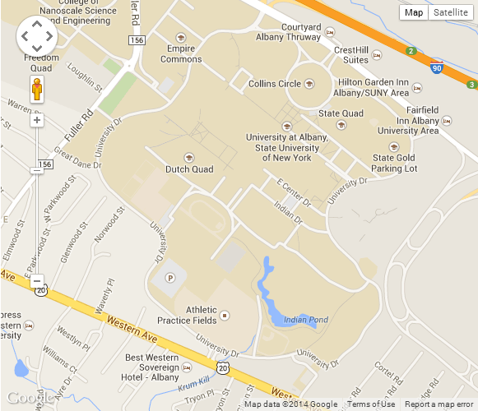


Alumni House
BEST WESTERN
Sovereign Hotel

Slide 2
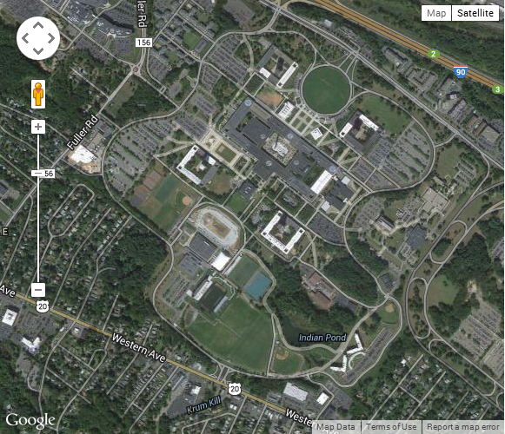
Alumni House
BEST WESTERN
Sovereign Hotel

