Slide 1
XPath

Slide 2
XPath
XPath, the XML Path Language, is a query language for selecting nodes from an XML document.
The XPath language is based on a tree representation of the XML document,
It provides the ability to navigate around the tree, selecting nodes by a variety of criteria.
In popular use an XPath expression is often referred to simply as "an XPath".

Slide 3
XPath
XPath is not itself written as XML, but is used heavily in XSLT
XPath is almost a small programming language; it has functions, tests, and expressions
XPath is always used in conjunction with XSLT

Slide 4
Refresher about XSLT
XSLT is XML, so it needs an XML declaration like this:
<?xml version="1.0"?>
This XML implements the XSLT namespace:
<xsl:stylesheet xmlns:xsl="http://www.w3.org/19 99/XSL/Transform" version="1.0">

Slide 5
Parts of XSLT File
The XML text document is read into the parser and stored as a tree of nodes
In the first step of this transformation, the XSLT processor analyzes the XML document and converts it into a node tree.
The Root Template is written as such: <xsl:template match="/"> and selects the entire tree of nodes

Slide 6
Xpath
Everything in the document tree is a node, and is accessible via XPath
XPath is a language for locating nodes in an XML document
Locate nodes
Root
Element
Text
Attribute
And more

Slide 7
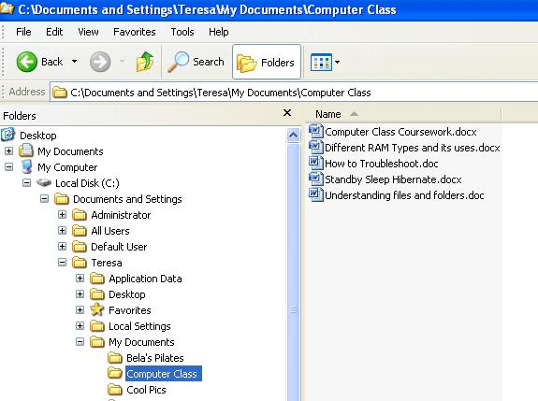
XPath Like Computer Directories
C:\Documents and Settings\Teresa\My Documents\Computer Class

Slide 8
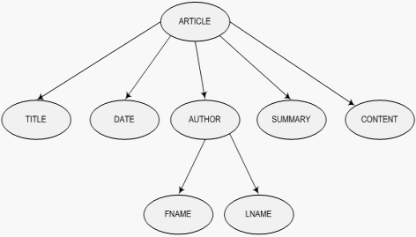
XML Node Tree

Slide 9
<xsl:template match="/">
<xsl:template match="/">
This statement matches the entire XML document
It matches the root node
It brings the entire document tree into the processors memory

Slide 10
Forward and backward Slashes
The “/” is used frequently in Unix like command interface or “Shell”
The forward slash is a way to select what level to search in the file system
If you are using Windows Explorer, you would use a “\” (backward slash) for designating where in the file system.
For us, the “/” let’s us easily navigate the tree of nodes in an XML document

Slide 11
Ways to Locate Nodes
XPath is a language for selecting nodes and node sets
As with the name, XPath creates paths to nodes
Paths may be: Relative or Absolute

Slide 12
Absolute Paths
<tr bgcolor="Goldenrod">
<td>
<xsl:value-of select="directory/employee/first_name"/></td>
<td>
<xsl:value-of select="directory/employee/last_name"/>
</td>
<td>
<xsl:value-of select="directory/employee/title"/>
</td>….</tr>

Slide 13
Relative Paths

Slide 14
Determining the “Current Node”
A relative path is based on its current node
A forward slash or “/” is used to designate each node “level” in the path
Whatever the current template is in the xsl document, is the current node
<xsl:template match=“/”> will make the root node of the xml document the current node

Slide 15
Current or Context node cont.
A shortcut to getting current node or context node “.” Just type a period rather than typing in the path that you need
You can type “..” two periods to get the current node’s parent nodes.
“/” Selects the root node (entire document)
“//” Selects children nodes from the current node
“@” Selects attribute nodes

Slide 16
XPath Nodes
Root Node
Element Node
Attribute Node
Text Node
Comment Node
Processing Instruction Node
Namespace Node

Slide 17
Example / Traversing the Tree of Nodes
<xsl:template match="/">
<xsl:for-each select=“ARTICLE/AUTHOR">
Context
Node
<xsl:value-of select=“/FNAME"/>
<xsl:value-of select=“/LNAME"/>

Slide 18
Current Node
“.” Prints the value of name if its attribute is not equal to English
<xsl:template match=
"name[@language!='English']">
(<em>
<xsl:value-of select="."/></em>)
</xsl:template>

Slide 19
Path Result
bookstore Selects all nodes with the name "bookstore"
/bookstore Selects the root element bookstore
Note: If the path starts with a slash ( / ) it always represents an absolute path to an element!
bookstore/book Selects all book elements that are children of bookstore
//book Selects all book elements no matter where they are in the document

Slide 20
Predicates
Predicates are used to find a specific node or a node that contains a specific value.

Slide 21
XSL “functions” Review
These are all written in xml that allow us to manipulate and move around the document
xsl:value-of
xsl:for-each
xsl:choose
xsl:sort
xsl:if

Slide 22
XPath Functions
Besides selecting nodes, can do other types of processing.
These are real functions just like ones used in other general programming languages
The functions are used to basic processing to nodes and their values
But, it also built in functions that make our lives easier

Slide 23
Functions and Operators
count()
sum()
round()
format number()
div division
* multiplication
+ addition
and more…

Slide 24
count()
Of these wonders,
<xsl:value-of select="
count(ancient_wonders/wonder/
history/how_destroyed[. =
'earthquake'])" />
were destroyed by earthquake,
<xsl:value-of select="
count(//how_destroyed[. = 'fire'])"/>
were destroyed by fire, and
<xsl:value-of select="
count(//wonder) -
count(//how_destroyed)" />
is still standing.
‘//’ Selects all Descendants of
the Context Node

Slide 25
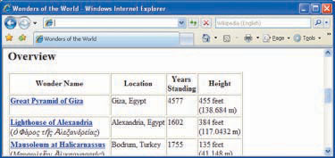
* for Multiplication
<xsl:when test="height != 0">
<xsl:value-of select=
"height"/> feet<br />
(<xsl:value-of select=
"height * 0.3048"/> m)

Slide 26
round()
XML Doc
<sales>20500.55</sales>
<td><xsl:value-of select="round(sales)"/></td>
XSLT doc
<tr bgcolor="F0EB49"> <td>Robert</td> <td>King</td> <td>London</td> <td>Overseas</td> <td>80500</td> <td>20501</td>
</tr>
HTML doc

Slide 27
sum()
Value of
Current node
<tr>
<td>
<xsl:value-of select=“ format-number(
sum(/ancient_wonders/wonder/height)
div
count(/ancient_wonders/wonder/height[.!=0]),'##0.0')" />
ft </td>
</tr>

Slide 28
format-number()
<tr>
<td>
<xsl:value-of select=“ format-number(
sum(/ancient_wonders/wonder/height)
div
count(/ancient_wonders/wonder/height[.!=0]),'##0.0')" />
ft </td>
</tr>

Slide 29
current()
Displays current node
<xsl:for-each select="/directory/employee"> Current node: <xsl:value-of select="current()"/> <br /> <br /> </xsl:for-each>

