Slide 1
Introduction to DTDs

Slide 2
Introduction
We learned:
how to make our own tags
how to structure information using the rules and grammar of XML
what “well-formed”/legal XML
How can we systematize how our XML documents are created?

Slide 3
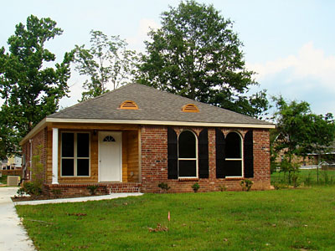
Building XML Documents
We need blueprints or schema to design our XML documents
DTDs are like blueprints for XML
DTDs give us a plan for how to build XML
DTDs is a technology that allows us to build XML documents that won't “fall down”
Notes:
-We need blueprints or schema to design our XML documents
-DTDs are like blueprints for XML
-DTDs give us a plan for how an XML
-DTDs is a technology that allows us to build XML documents that won't “fall down”

Slide 4
Document Type Definitions
Document Type Definitions or DTDs will allow us to control how we mark up our XML documents
They are a blueprint or schema for how to design an XML document
Most importantly, it allows us to design our own markup languages
Similar to “data dictionaries” as with database technologies

Slide 5
Document Type Definitions
Document Type Definitions allows you to constrain and control the content of your XML documents
Dictates what will appear in your documents
Controls what, where, and how many instances of a certain XML tags may appear
Notes:
-Why use this?
-If your documents are being used by other people and organizations, you need to consider what agreed upon rules are you going to follow.
-DTDs allow us to develop Mark-Up languages as we’ve discussed before. It allows you the ability to dictate what type of content is allowable in you XML documents

Slide 6
DTD can do many things
It can specify the document “grammar” like language
Specifies:
Elements
Attributes
Nesting
Ordering
Number of occurrences (cardinality)

Slide 7
Document Type Definitions
DTD can be declared within the XML document, but are most often written as a separate document
DTDs allow organizations a way to develop an agreed upon language and information structures
For our assignments, we will use external DTDs

Slide 8
Disadvantages of DTDs
DTDs are older XML technology, and have certain limitations
They lack some flexibility
Not written using XML syntax, they are NOT XML
No data typing (can’t limit to string or integer)
Limited ability to dictate structure of doc
No support for namespaces

Slide 9
Advantages of DTDs
Compact and easy to use
Can be defined within the XML document
Can define entities
Widely accepted and supported by most parsers
DTDs are mature technology

Slide 10
DTDs Enable Standards
enforce how XML is written
DTD itself is a standard that communities can rely on
The library, archives, museum, and literature communities all have DTDs that regulate how their XML is created

Slide 11
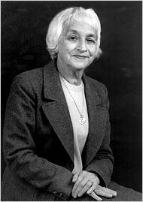
MARC to MARC XML
Henriette Avram
Roy Tennant
-Mark up standards have been around long before XML came along
-MARC became a national standard in 1971 (NOT XML!)
-In mid 1990s a DTD was developed to move MARC to MARCXML
-Eventually, the Standard was moved to XML Schema
Notes:
-Mark up standards have been around long before XML came along
-MARC became a national standard in 1971.
-In mid 1990s a DTD was developed to move MARC to XML
-Eventually, the Standard was moved to XML Schema

Slide 12
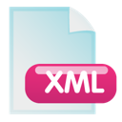
Organizations and Communities May Exchange Data
Notes:
-DTDs ensure consistency of XML data shared between different organizations.
You can use a DTD to validate that the XML documents you receive from others are in the proper format before using them.

Slide 13
All kinds of data exchange
Encoded Archival Description (EAD), used by archivists
MARC XML, used by librarians
Keyhole Markup Language (KML) used by Google Earth
Really Simple Syndication (RSS) used for publishing blog updates
Election Markup Language (EML)

Slide 14
Validation
Using the process known as Validation, various communities can ensure that their XML complies with a standard data format
Ensures consistency in the XML we create and share
Goldberg talks about Validation in Chapter 8
Validation is the method for verifying whether or not your XML document has followed a given DTD’s rules correctly

Slide 15
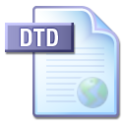
Validation
Invalid XML

Slide 16
Quick DTD notes
DTDs are not really XML, so your editor will not display them in an XML like fashion
Don’t confuse them with Doctype Declarations, sound similar but not the same.
They are fading in popularity, but are still used widely

Slide 17
Limitations of DTDs
Non-XML syntax -Although DTDs do have the angled bracket syntax (for example, <!ELEMENT …>), this is quite different from the basic XML syntax.
We cannot use multiple DTDs to validate one XML document. We can include only one DTD reference inside an XML document. Although parameter entities make things slightly more flexible, their syntax is quite cryptic.
No DOM (Document Object Model) support

