Slide 1
20th Century
American Women Artists

Slide 2
Georgia O’Keeffe

Slide 3
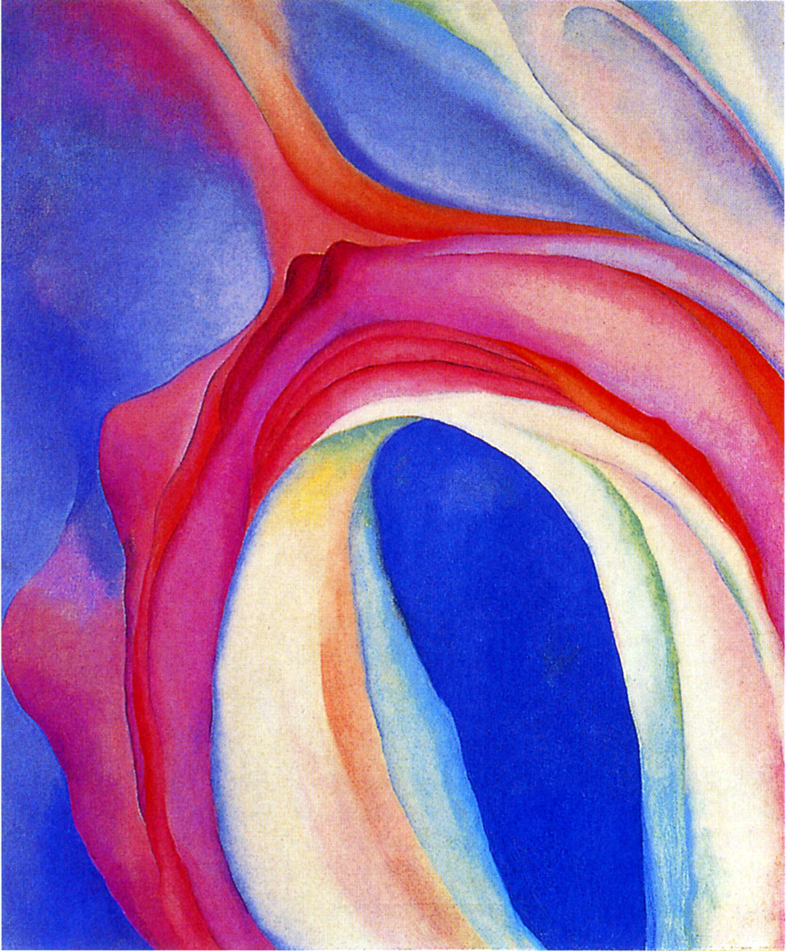
Georgia O’Keeffe
Music---Pink and Blue II
1919
Oil on canvas
36x29”
Whitney Museum of American Art
New York

Slide 4
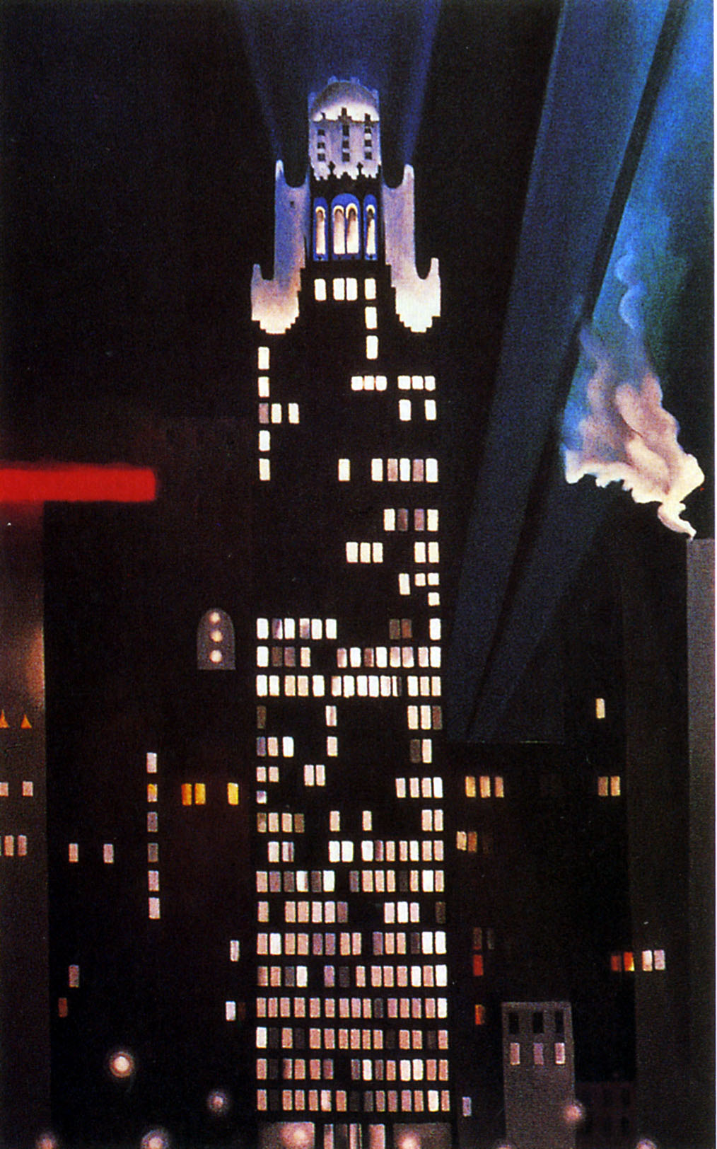
Georgia O’Keefe
Radiator Building---Night, New York
1927
Oil on canvas
48x30”
Carl van Vechten Gallery of Fine Arts, Fisk University, Nashville, Tenessee

Slide 5
Pictorialism

Slide 6
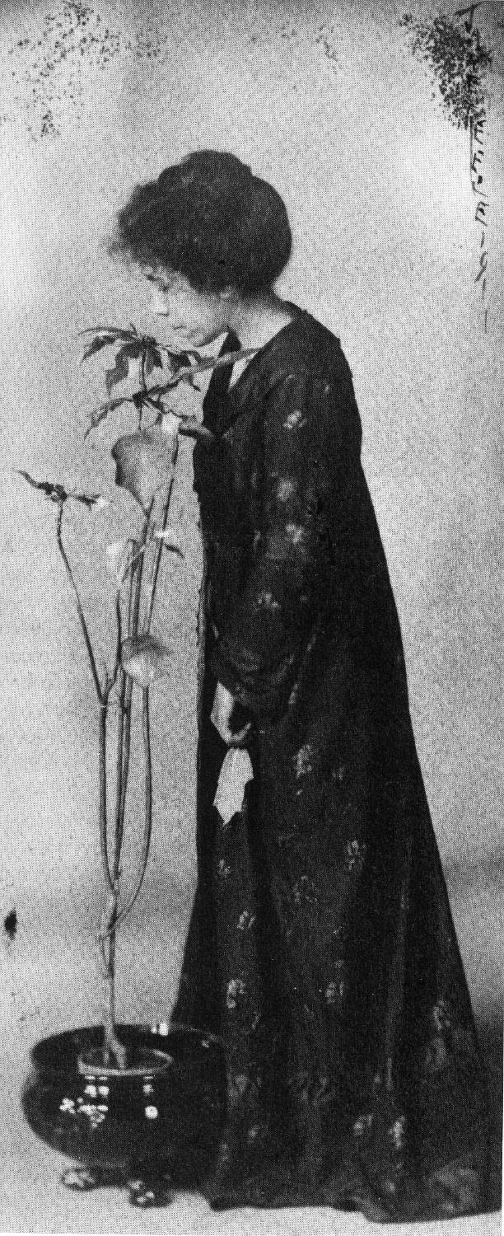
Jane Reece
The Poinsettia Girl (Self-portrait)
1907 sepia-toned gelatin silver print

Slide 7
Harlem Renaissance

Slide 8
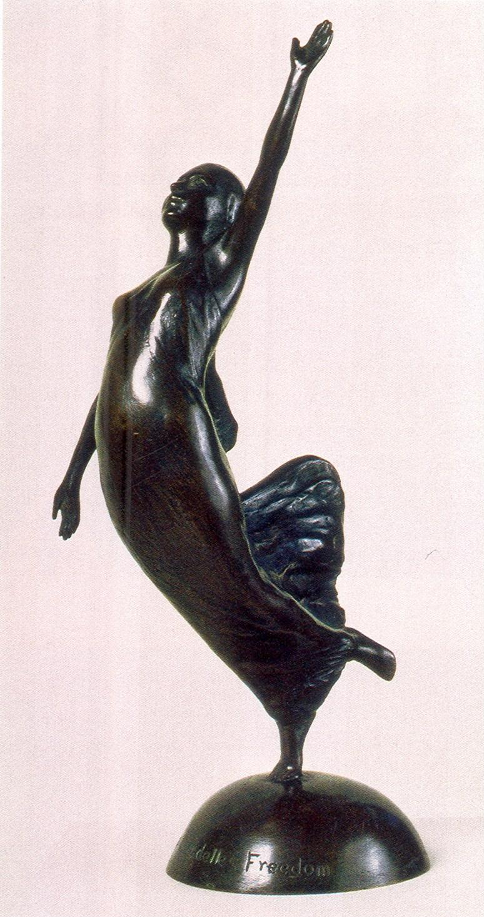
Augusta Savage
La Citadelle: Freedom
1930
Bronze
14.5x7x6”
Howard University Art Collection, Washington, D.C.

Slide 9
Barbara Morgan

Slide 10
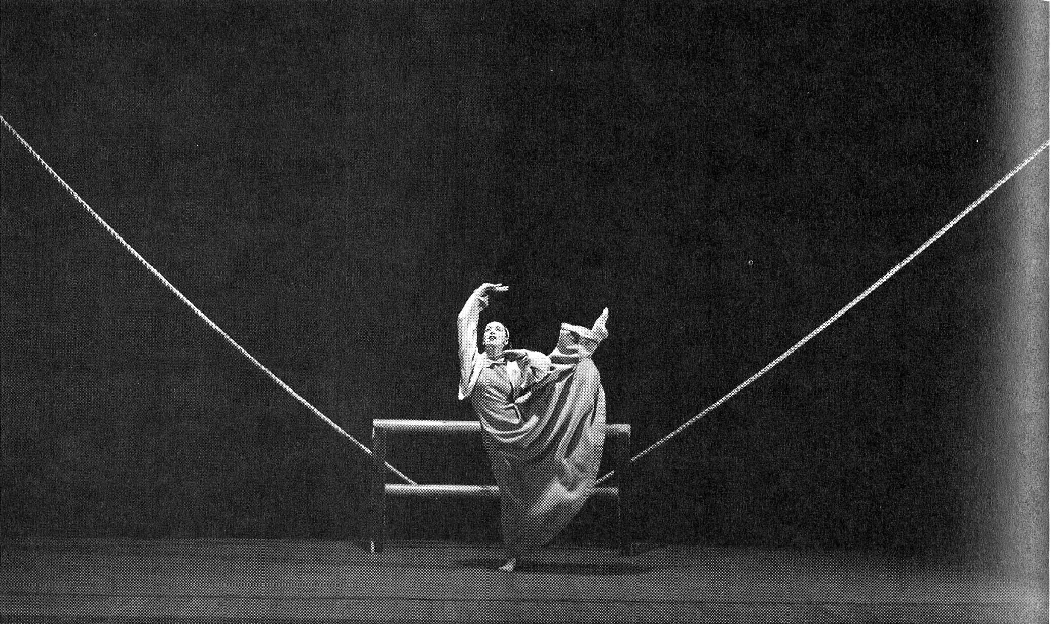
Martha Graham, Frontier, 1935
Set by Isamu Noguchi; photograph by Barbara Morgan

Slide 11
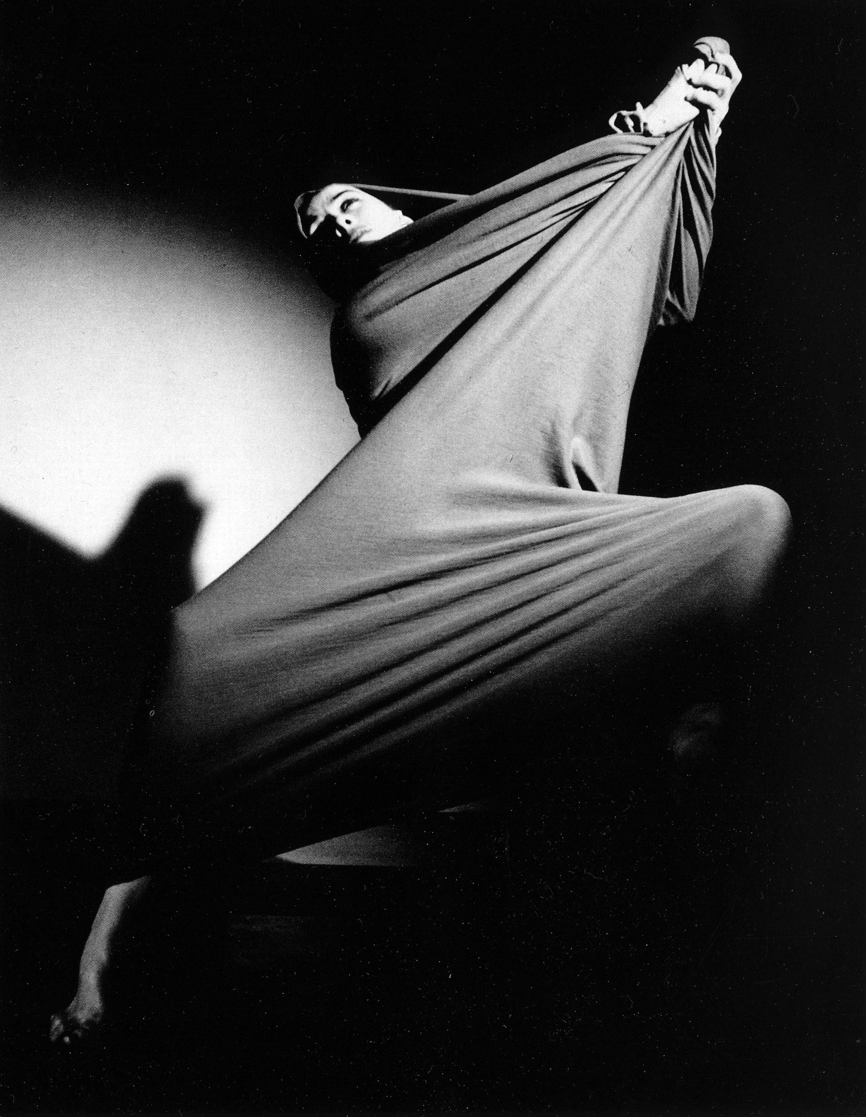
Barbara Morgan
Martha Graham “Lamentation”
1935

Slide 12
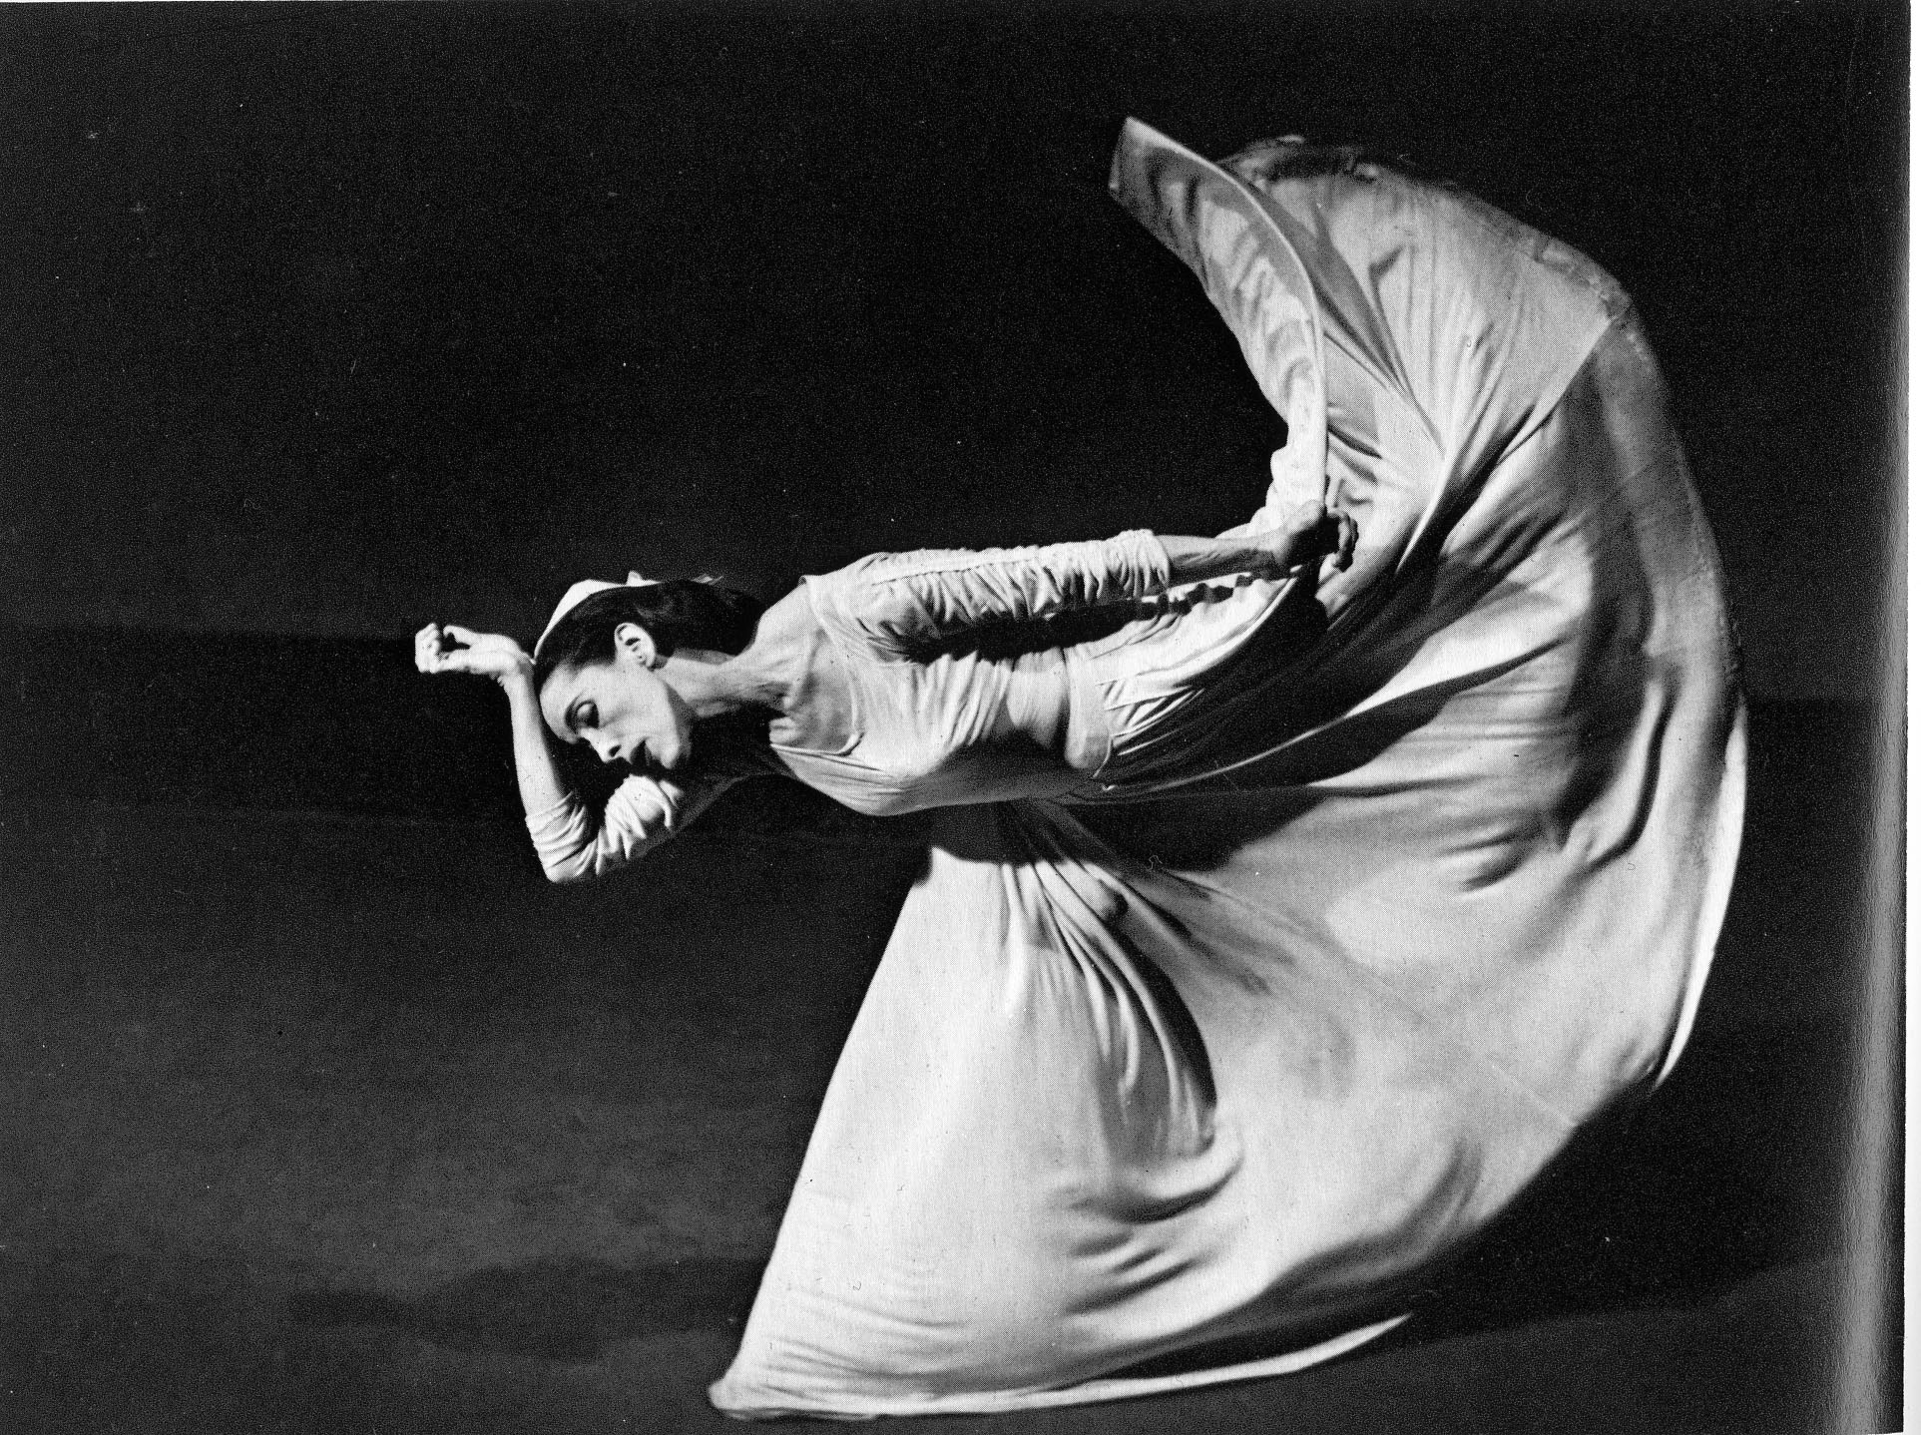
Barbara Morgan Martha Graham in “Letter to the World” 1944

Slide 13
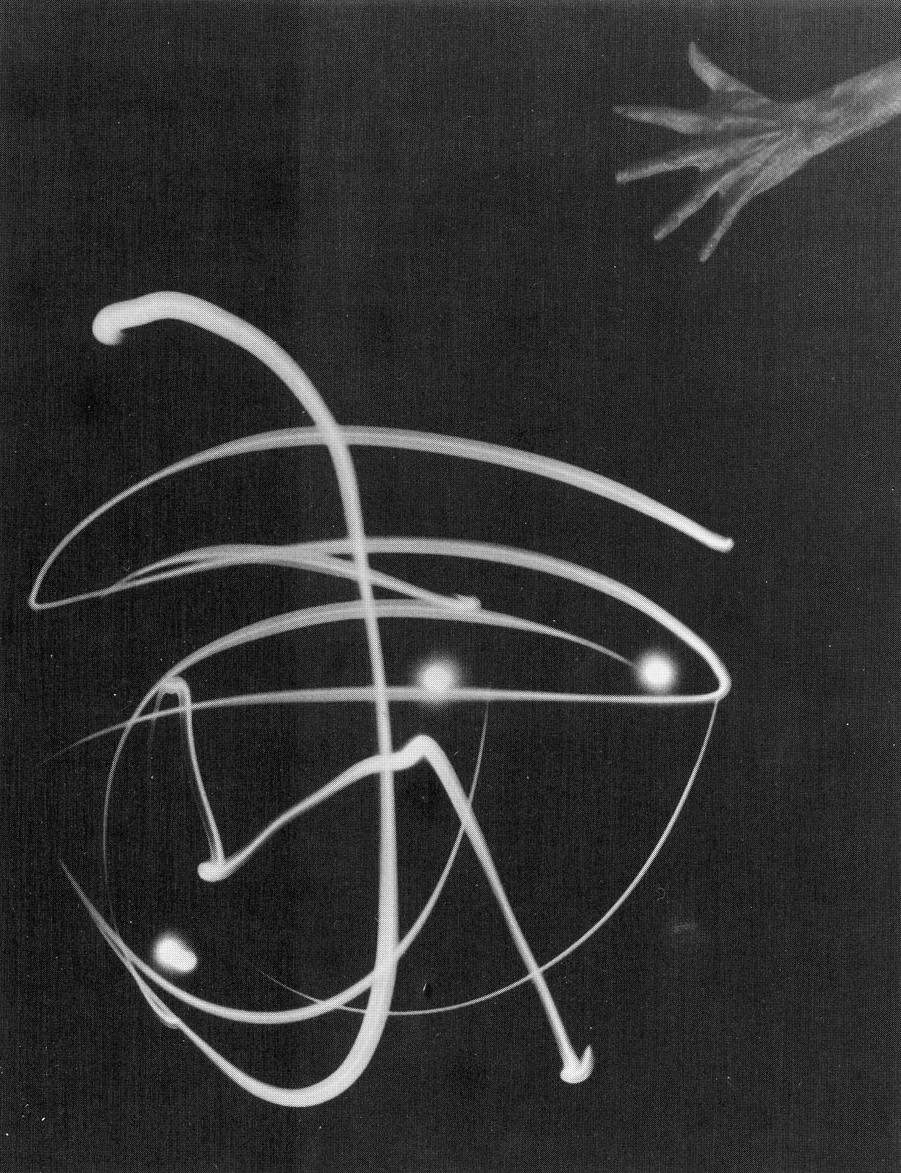
Barbara Morgan
Pure Energy and Neurotic Man
1941/71
20x15”

Slide 14
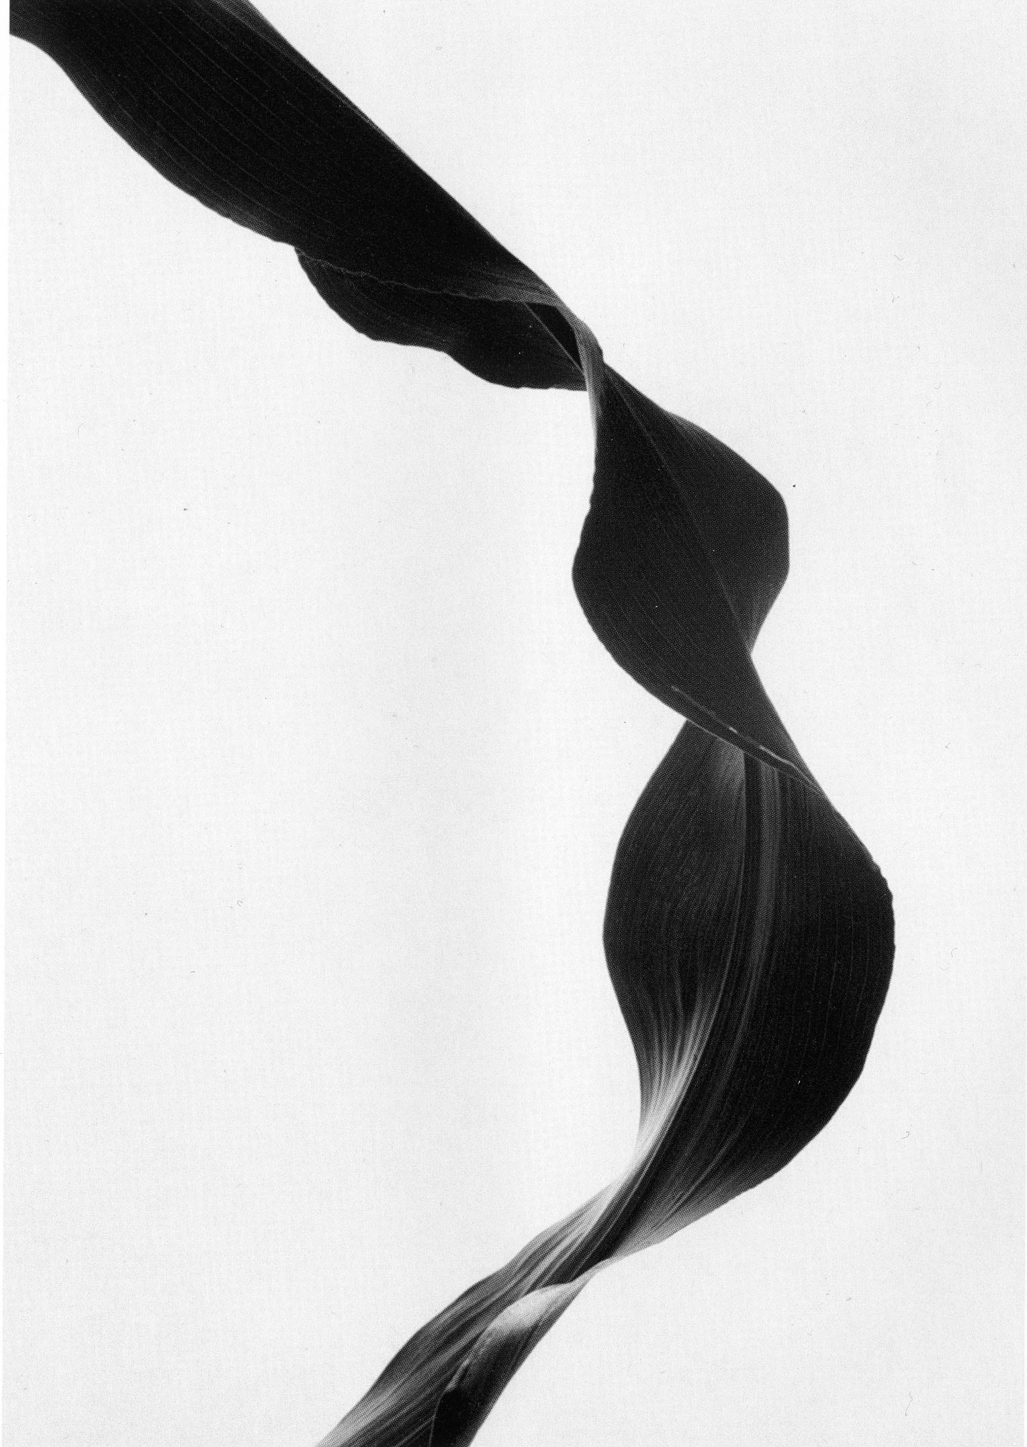
Barbara Morgan
Corn Leaf Rhythm
1945

Slide 15
Abstract Expressionism

Slide 16
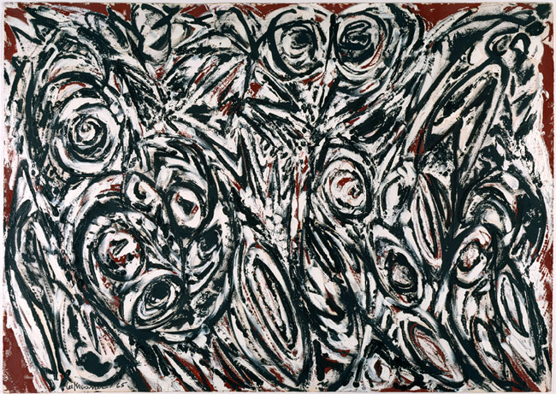
Lee Krasner Night Creatures 1965
Acrylic on paper; 30 x 42 1/2 in, MET, NYC

Slide 17
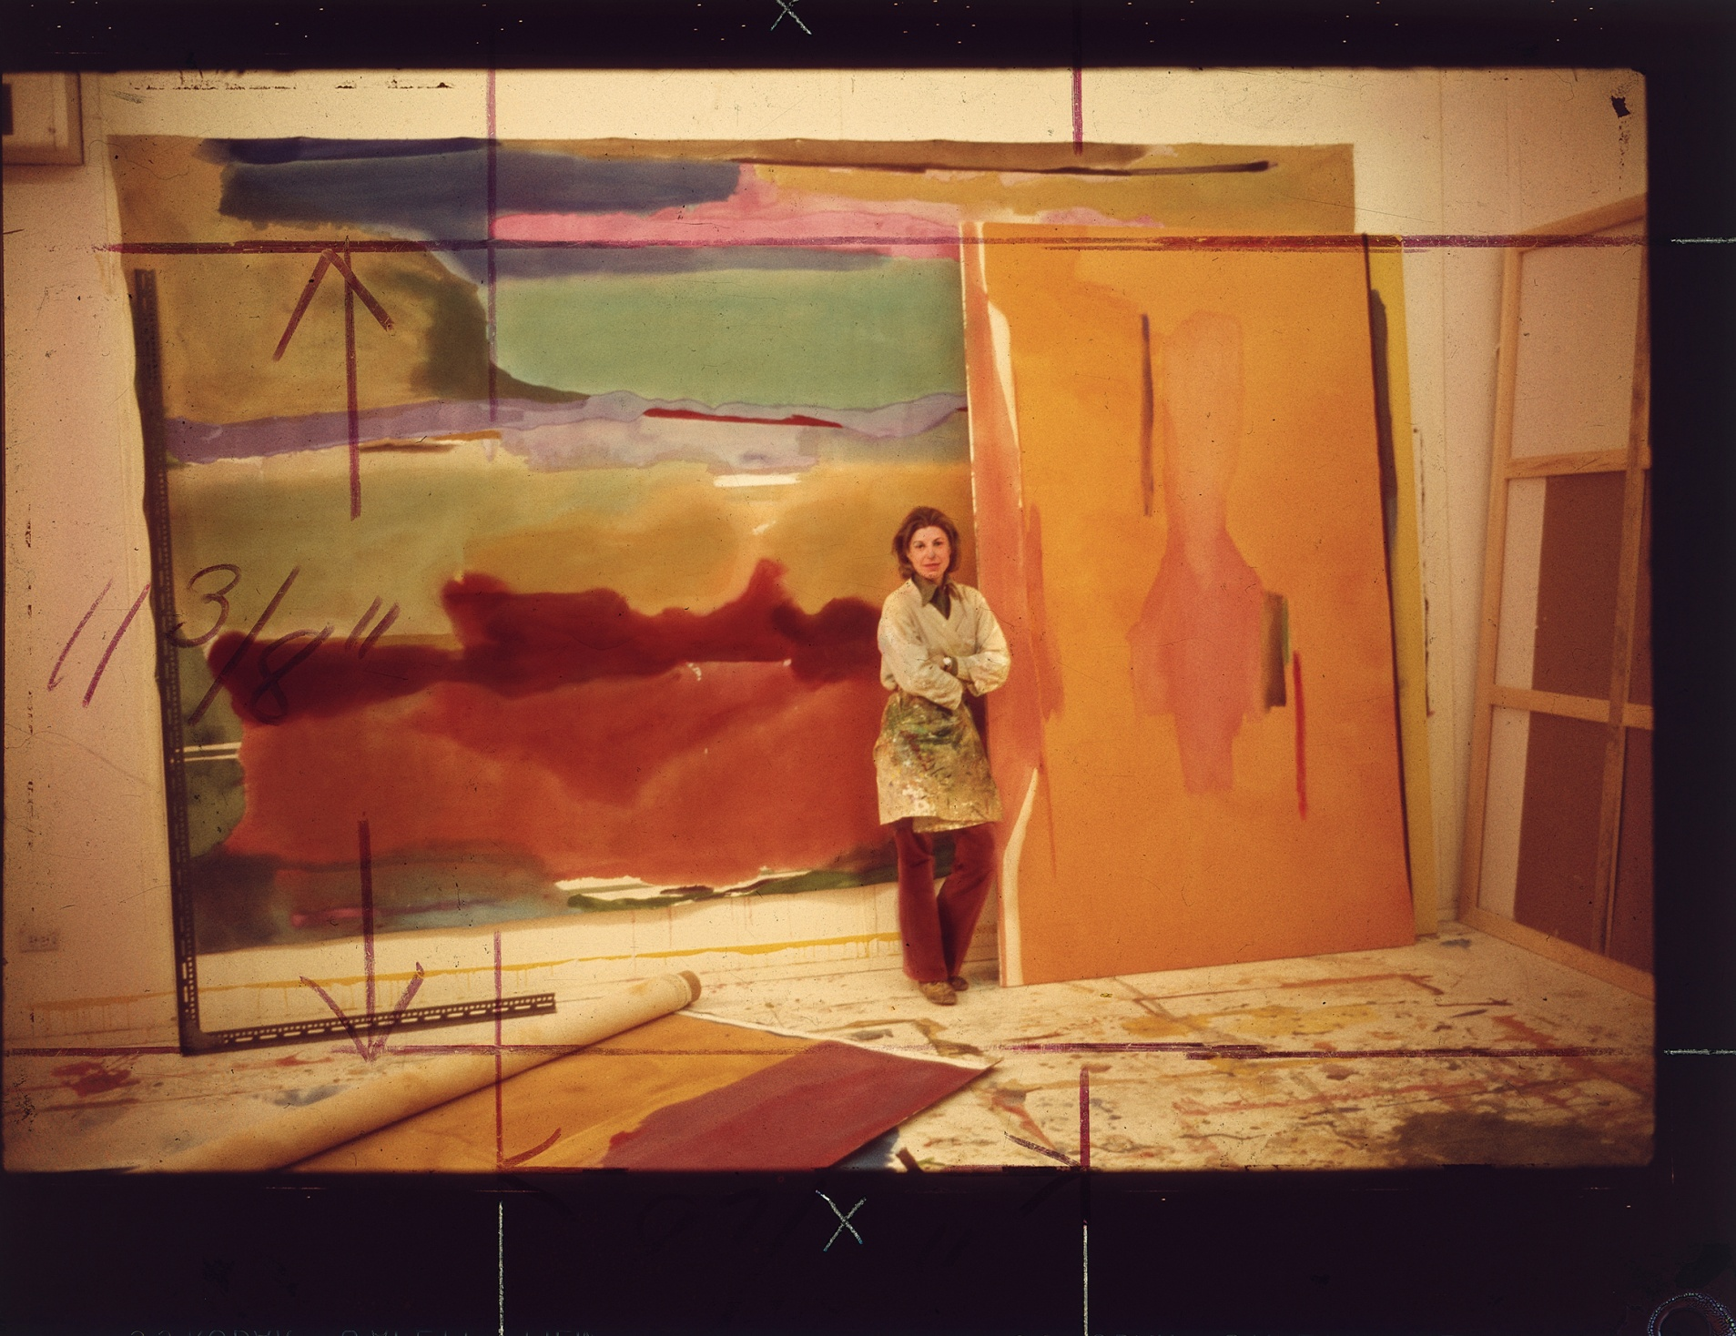
Helen Frankethaler in the studio 1975

Slide 18
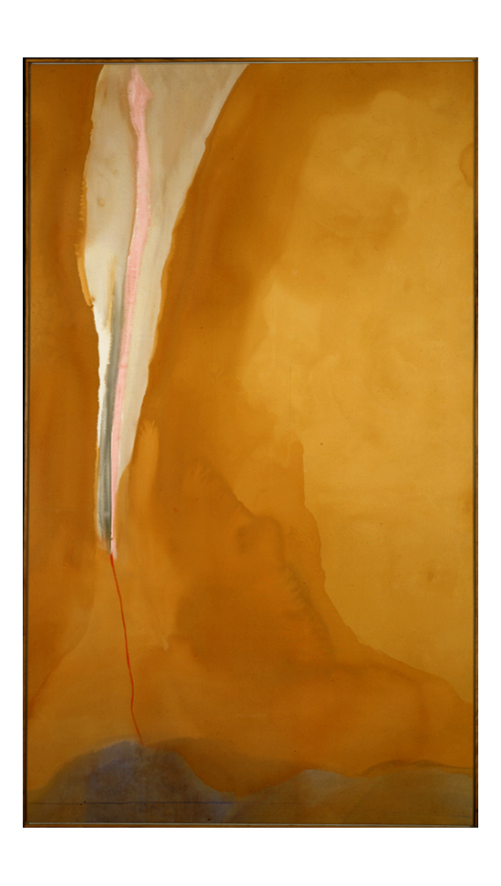
Helen Frankenthaler
Coral Wedge
1972, acrylic on canvas
81 1/2 x 46 1/2 inches, Kemper Museum of Contemporary Art, Kansas City, MO

Slide 19
Agnes Martin

Slide 20
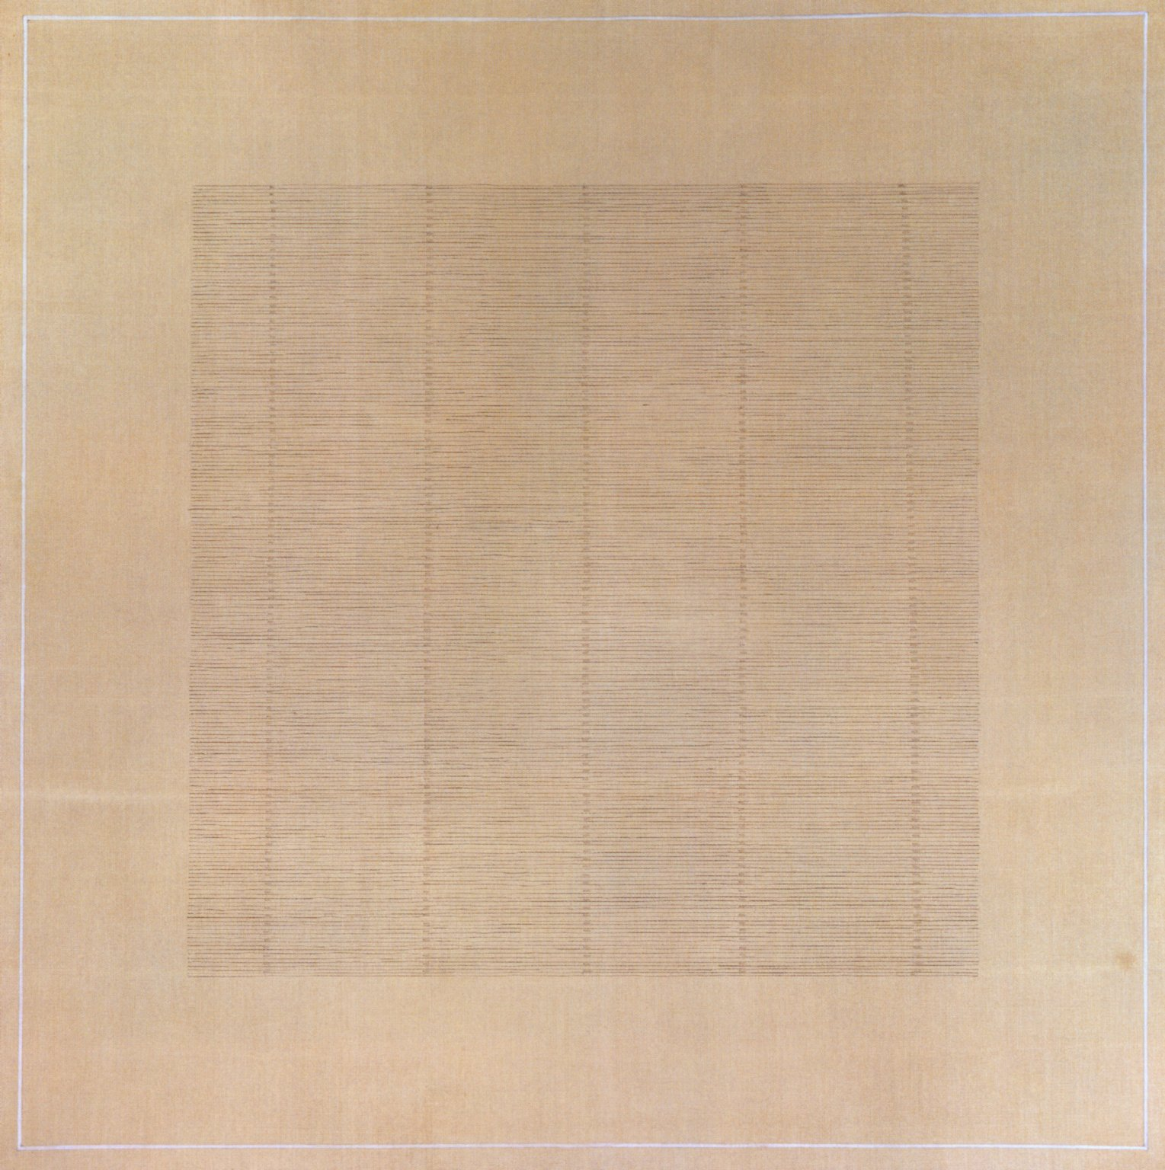
Agnes Martin, Dark River, 1961, oil on canvas, 190.5x190.5cm, Collection Francois Pinault

Slide 21
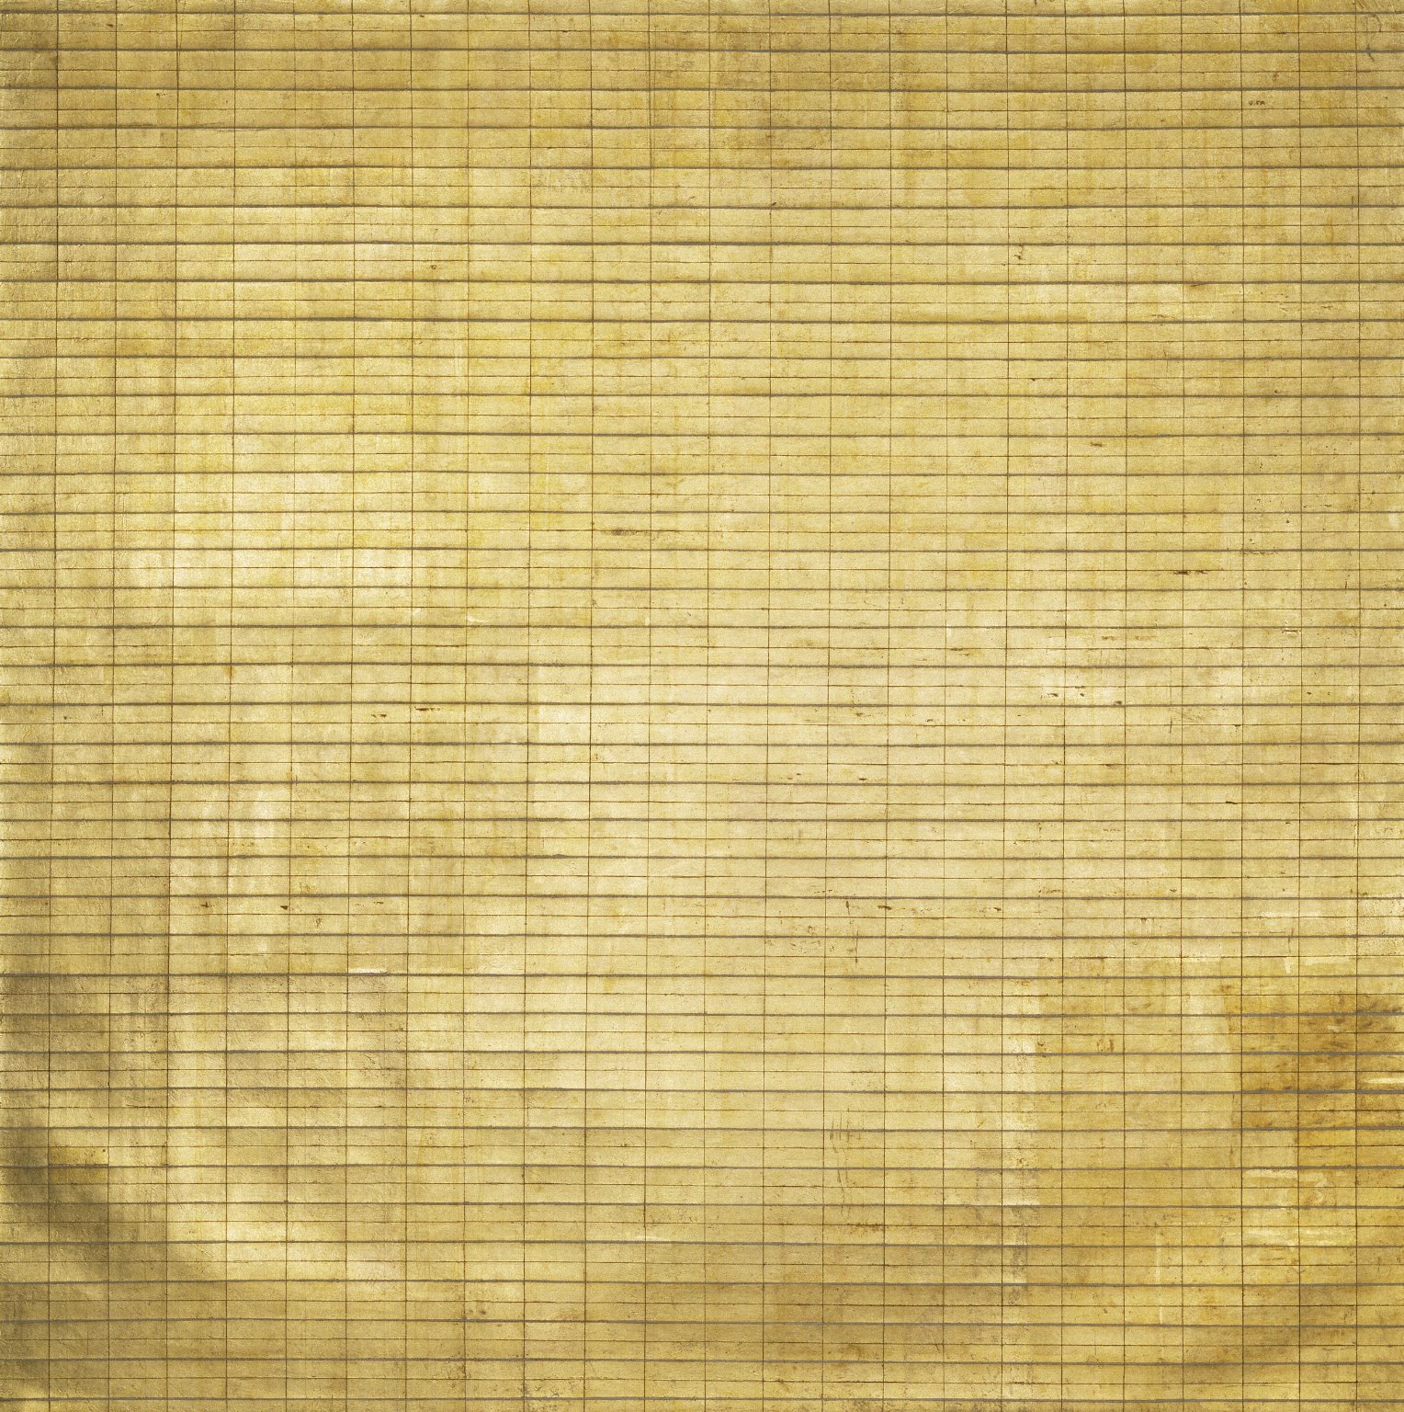
Agnes Martin
Friendship
1963 gold leaf and gesso on canvas
191x191cm
Museum of Modern Art, New York

Slide 22
Fluxus (performance art)

Slide 23
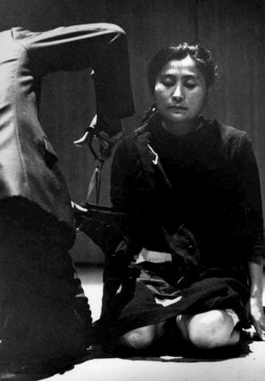
Yoko Ono
Cut Piece
Carnegie Recital Hall, New York
March 21, 1965

Slide 24
Ana Mendieta

Slide 25
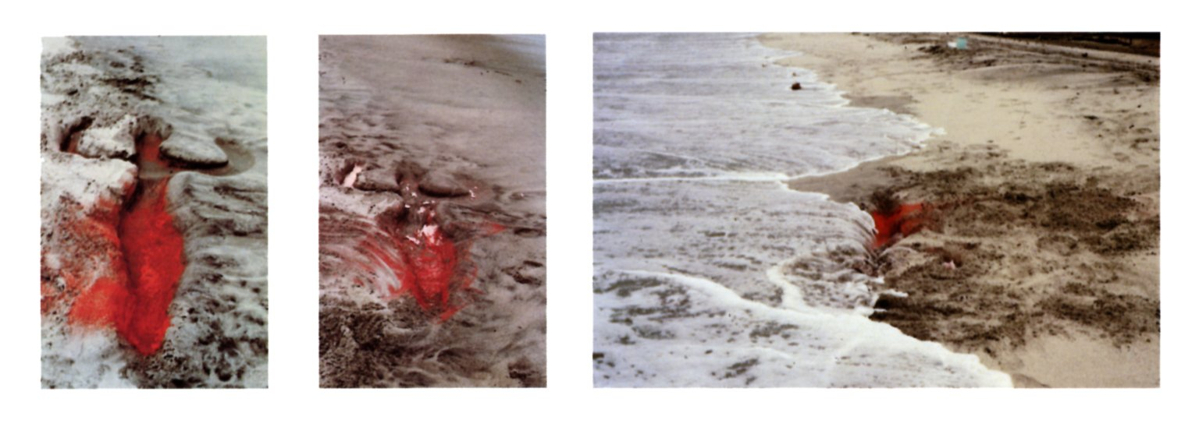
Ana Mendieta, Untitled, from Silueta series, 1976 red pigment on sand

Slide 26
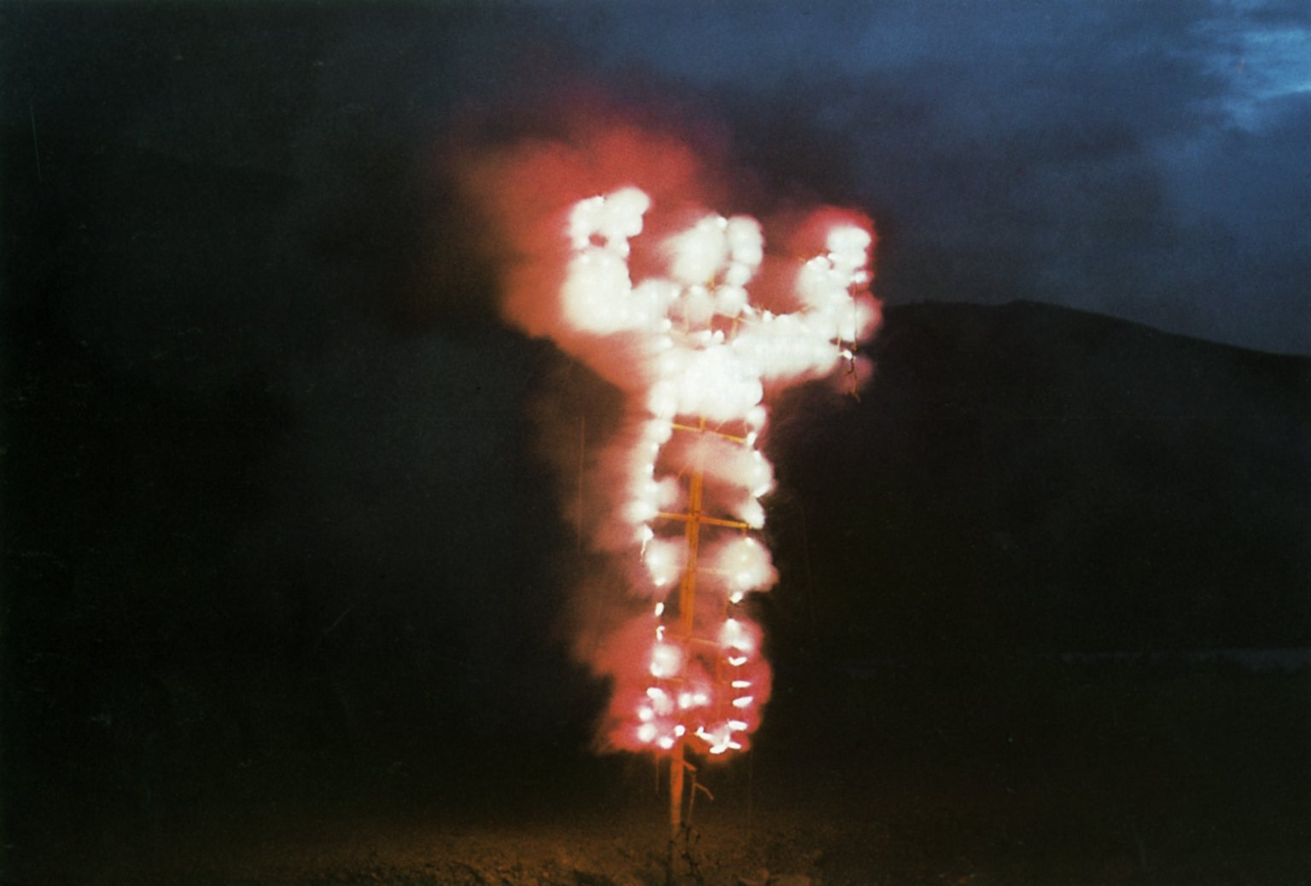
Ana Mendieta, Anima (Alma/Soul) from Silueta series, 1976, Oaxaca, Mexico; documentation of earth-body work performance with fireworks and bamboo armature

Slide 27
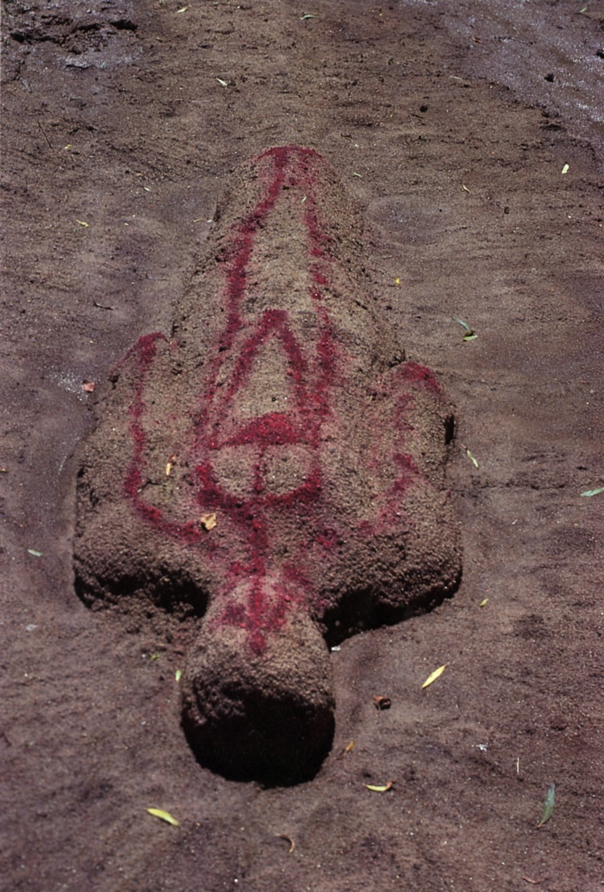
Ana Mendieta
Untitled from the Fetish Series earth-body work of sand and blood executed at Old Man's Creek, Iowa City, Iowa
1977
-------------
Image1
-------------
Field Data
Filename AnaMendieta_009.tif
Creation Date 1977
Dimensions 20 x 13 1/4 in.
Title Untitled from the Fetish Series
Material-Technique chromogenic print
Description earth-body work of sand and blood executed at Old Man's Creek, Iowa City, Iowa
Work Type color photographs
Classification photographs
Names-Search List Mendieta, Ana
Name Ana Mendieta
Lifetime 1948-1985
Nationality American
Gender female
Corporate personal
Vocabulary Sources ULAN
Style Period international post-1945 styles and movements
Museum City New York, New York
Museum Name Whitney Museum of American Art
Museum Country United States
Tag Words environmental art
OriginalDocumentID xmp.did:FF7F1174072068118083F6A4E115F1AC
ModifyDate 2014-03-24T12:51:27-04:00
MetadataDate 2014-03-24T12:51:27-04:00
InstanceID xmp.iid:00801174072068118083F6A4E115F1AC
ICCProfile EPSON Standard RGB - Gamma 1.8
History[2]/stEvt:when 2014-03-24T12:51:27-04:00
History[2]/stEvt:softwareAgent Adobe Photoshop CS6 (Macintosh)
History[2]/stEvt:instanceID xmp.iid:00801174072068118083F6A4E115F1AC
History[2]/stEvt:changed /
History[2]/stEvt:action saved
History[2] type=Struct
History[1]/stEvt:when 2014-03-20T11:52-04:00
History[1]/stEvt:softwareAgent Adobe Photoshop CS6 (Macintosh)
History[1]/stEvt:instanceID xmp.iid:FF7F1174072068118083F6A4E115F1AC
History[1]/stEvt:action created
History[1] type=Struct
History type=Seq
format image/tiff
DocumentID xmp.did:FF7F1174072068118083F6A4E115F1AC
CreateDate 2014-03-20T11:52-04:00
ColorMode 3

Slide 28
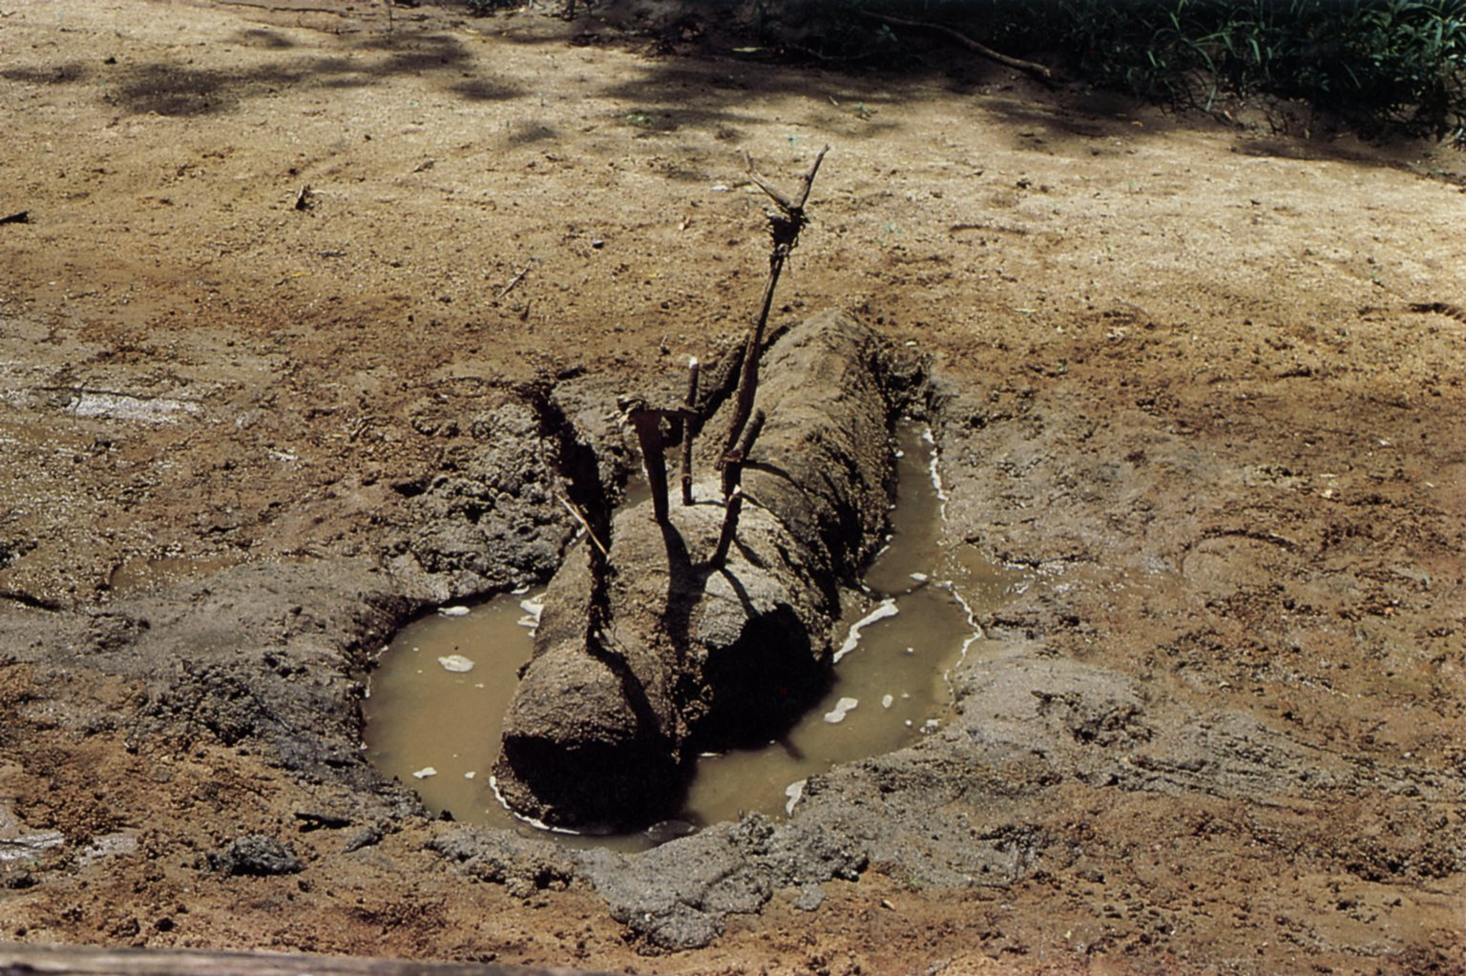
Ana Mendieta, Untitled from the Fetish Series, 1977 earth-body work of sand, sticks, and water executed at Old Man's Creek, Iowa City, Iowa
-------------
Image1
-------------
Field Data
Filename AnaMendieta_010.tif
Creation Date 1977
Dimensions 20 x 13 1/4 in.
Title Untitled from the Fetish Series
Material-Technique chromogenic print
Description eath-body work of sand, sticks, and water executed at Old Man's Creek, Iowa City, Iowa
Work Type color photographs
Classification photographs
Names-Search List Mendieta, Ana
Name Ana Mendieta
Lifetime 1948-1985
Nationality American
Gender female
Corporate personal
Vocabulary Sources ULAN
Style Period international post-1945 styles and movements
Museum City New York, New York
Museum Name Whitney Museum of American Art
Museum Country United States
Tag Words environmental art
OriginalDocumentID xmp.did:FE7F1174072068118083F6A4E115F1AC
ModifyDate 2014-03-24T12:50:06-04:00
MetadataDate 2014-03-24T12:50:06-04:00
InstanceID xmp.iid:FE7F1174072068118083F6A4E115F1AC
ICCProfile EPSON Standard RGB - Gamma 1.8
History[1]/stEvt:when 2014-03-20T11:55:38-04:00
History[1]/stEvt:softwareAgent Adobe Photoshop CS6 (Macintosh)
History[1]/stEvt:instanceID xmp.iid:FE7F1174072068118083F6A4E115F1AC
History[1]/stEvt:action created
History[1] type=Struct
History type=Seq
format image/tiff
DocumentID xmp.did:FE7F1174072068118083F6A4E115F1AC
CreateDate 2014-03-20T11:55:38-04:00
ColorMode 3

Slide 29
Post-minimalism

Slide 30
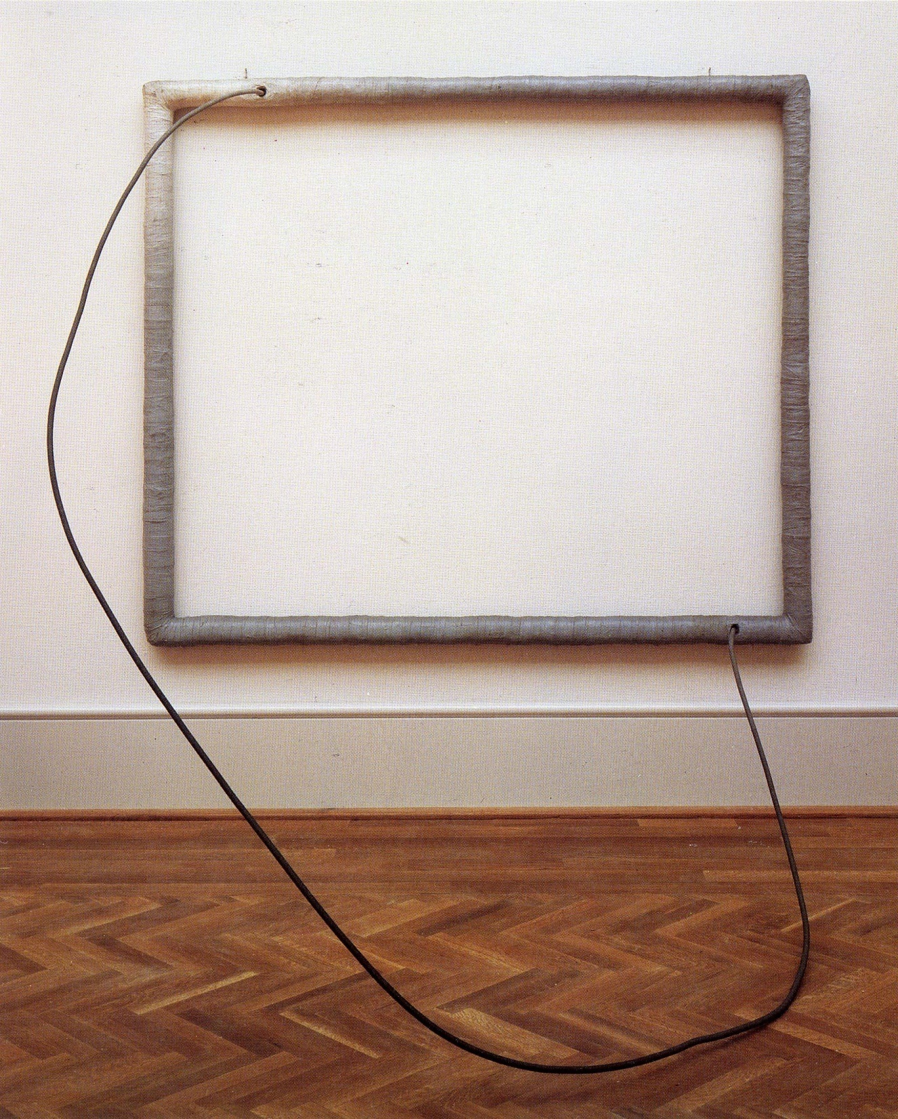
Eva HESSE
Hang-up
1966 acrylic on cloth over wood and steel
72x84x78”
Art Institute, Chicago

Slide 31
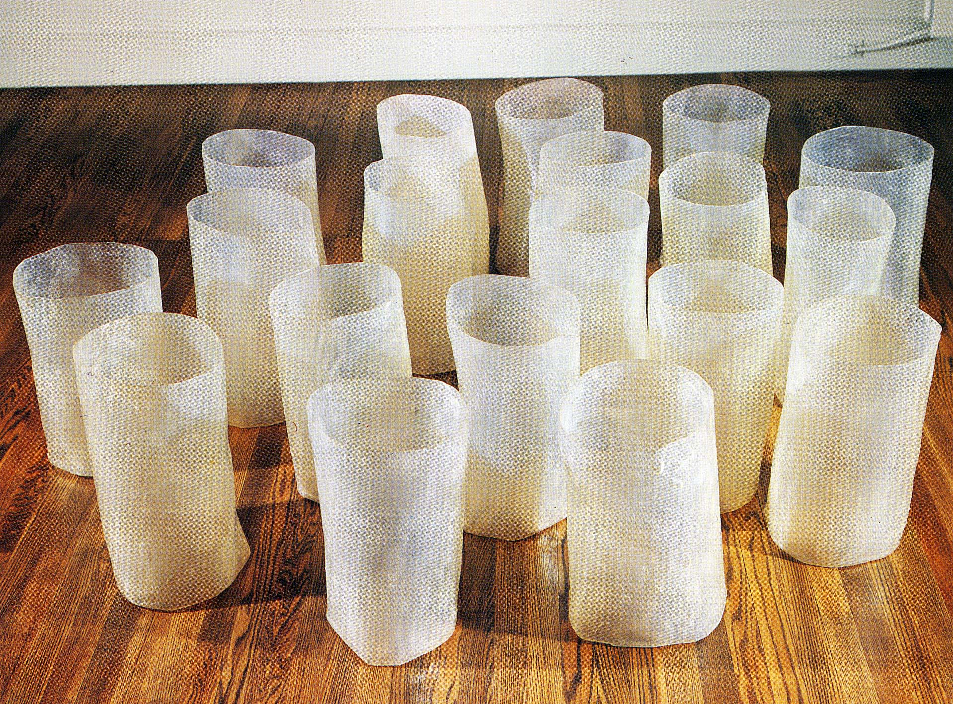
Eva HESSE, Repetition 19, III, 1968
19 tubular fiberglass units, each approx 20”x12”,
MoMA, New York

Slide 32
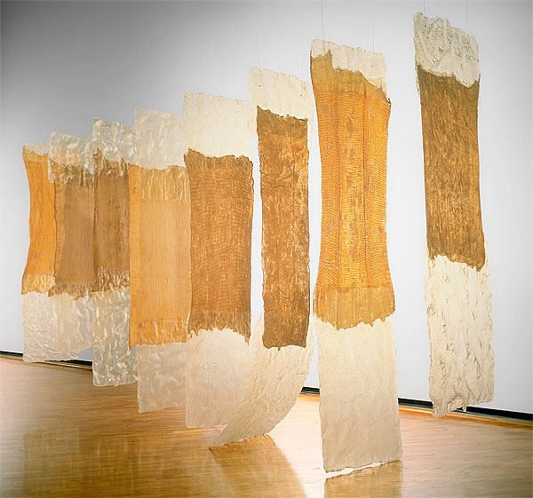
Eva Hesse, Contingent, 1969 cheesecloth, latex, fiberglass, 8-panel installation, 137x248x43”, Australian National Gallery, Canberra

Slide 33
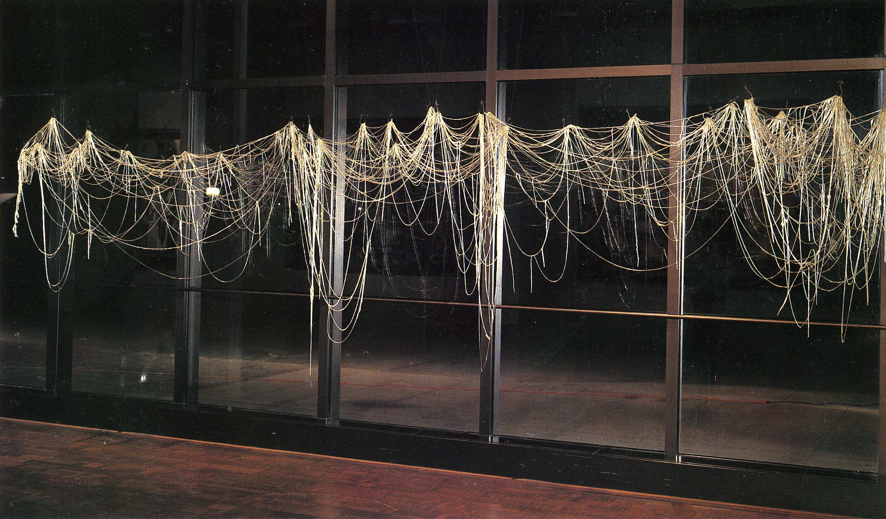
Eva HESSE, Right After, 1969 fiberglass, 5x18x4’, Milwaukee Art Museum

Slide 34
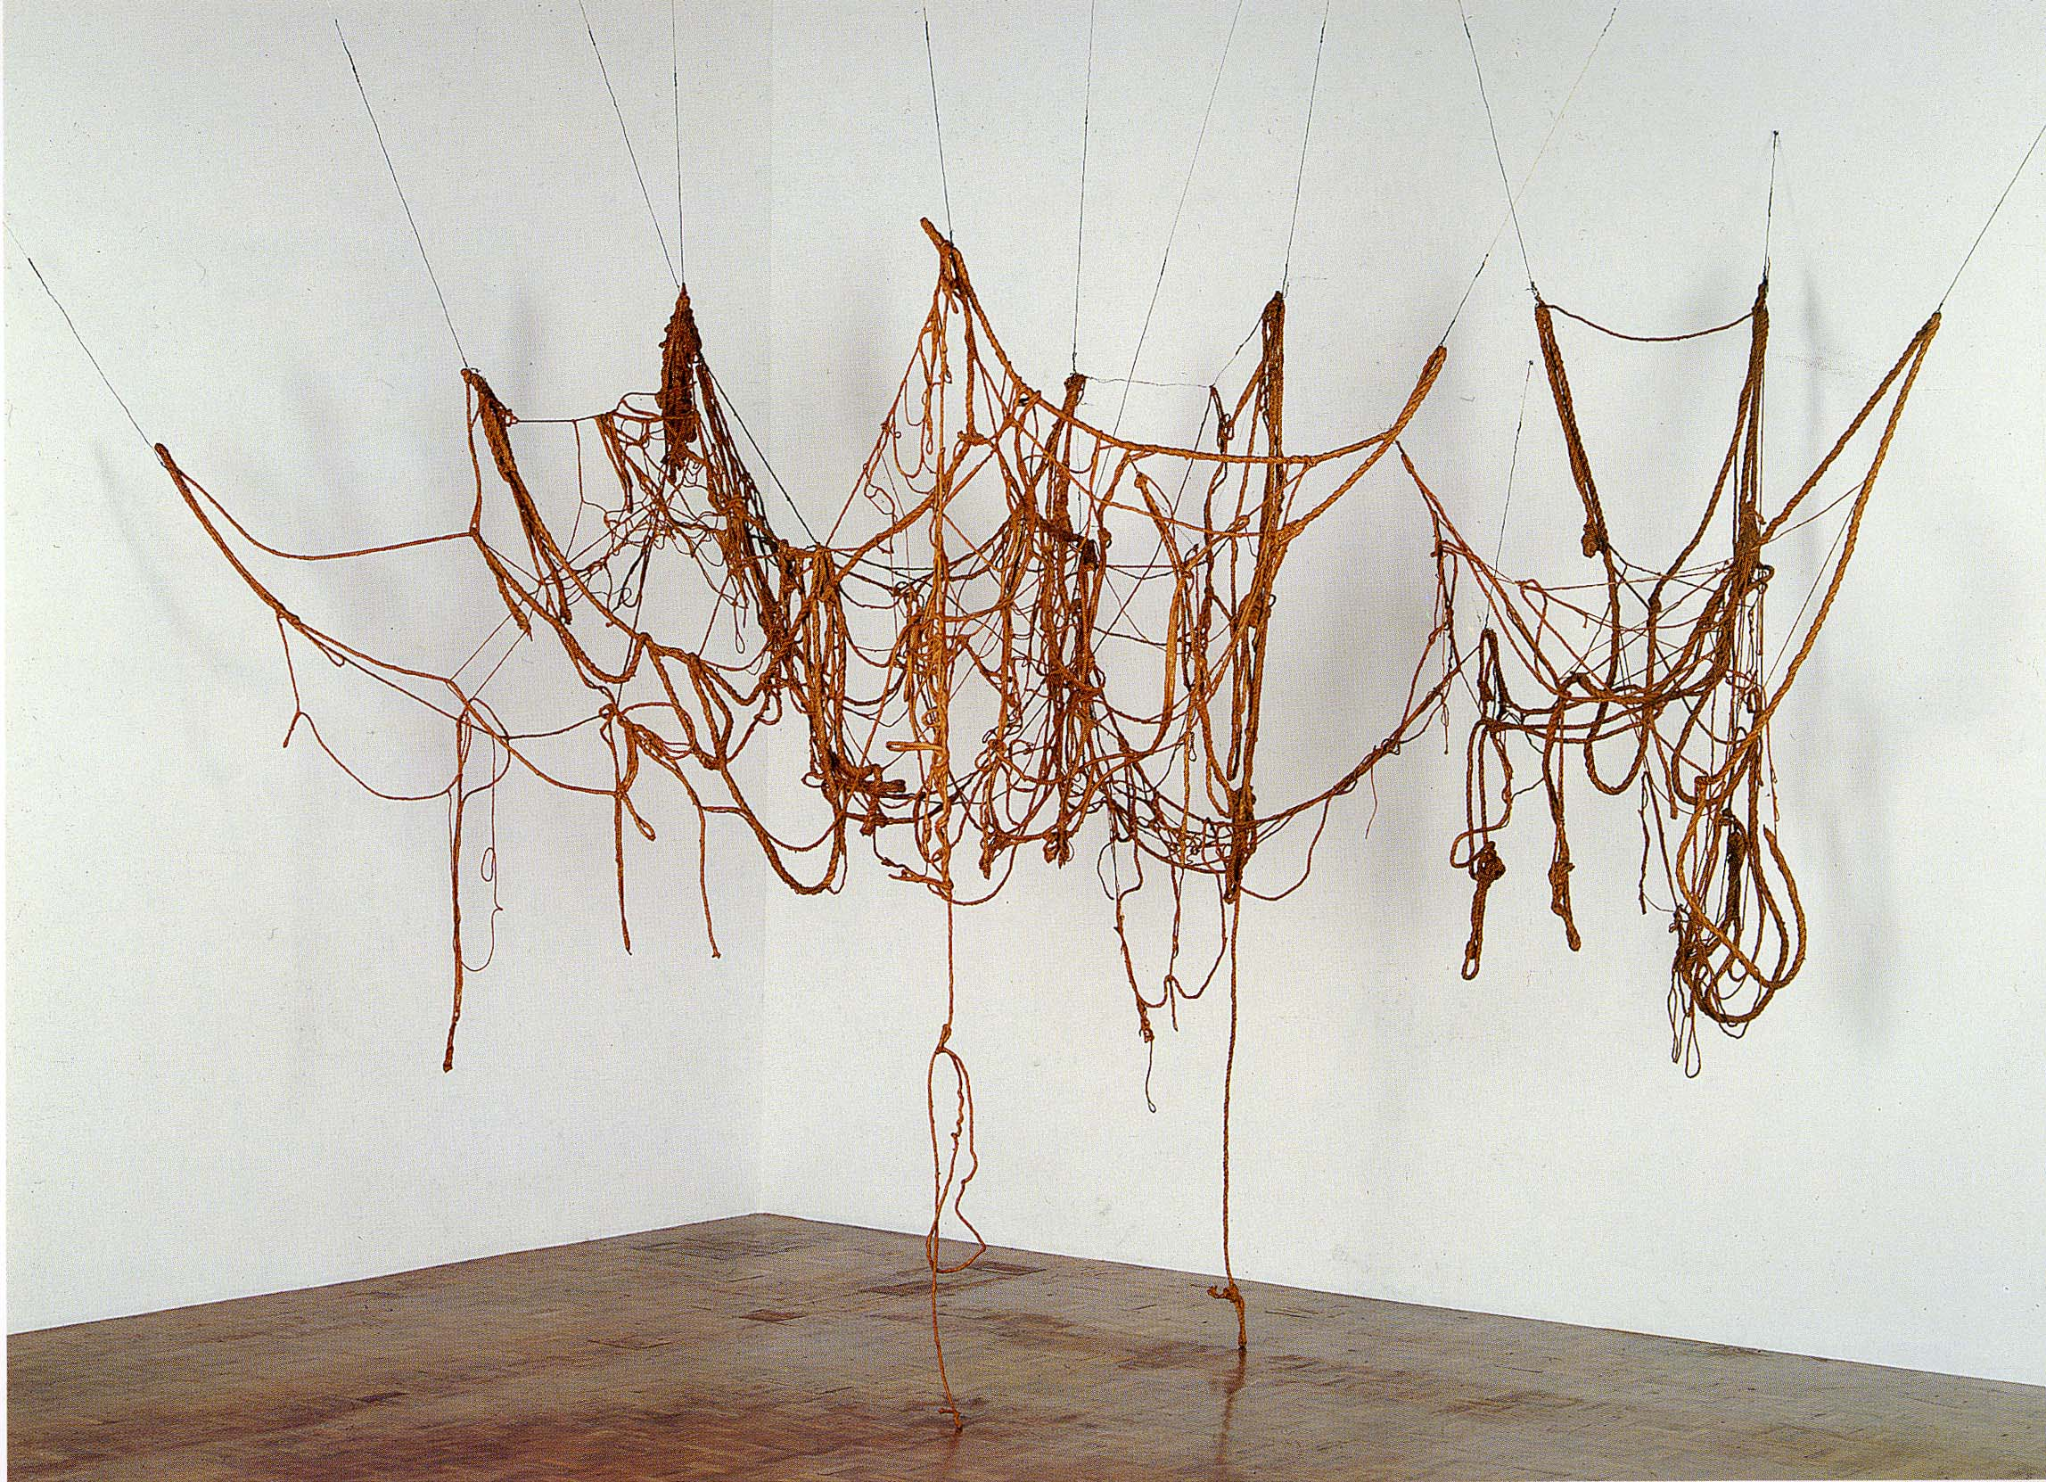
Eva HESSE, Untitled (Rope piece), 1970 latex over rope, string and wire, two strands, dimensions vaiable, Whitney Museum of American Art, New York

Slide 35
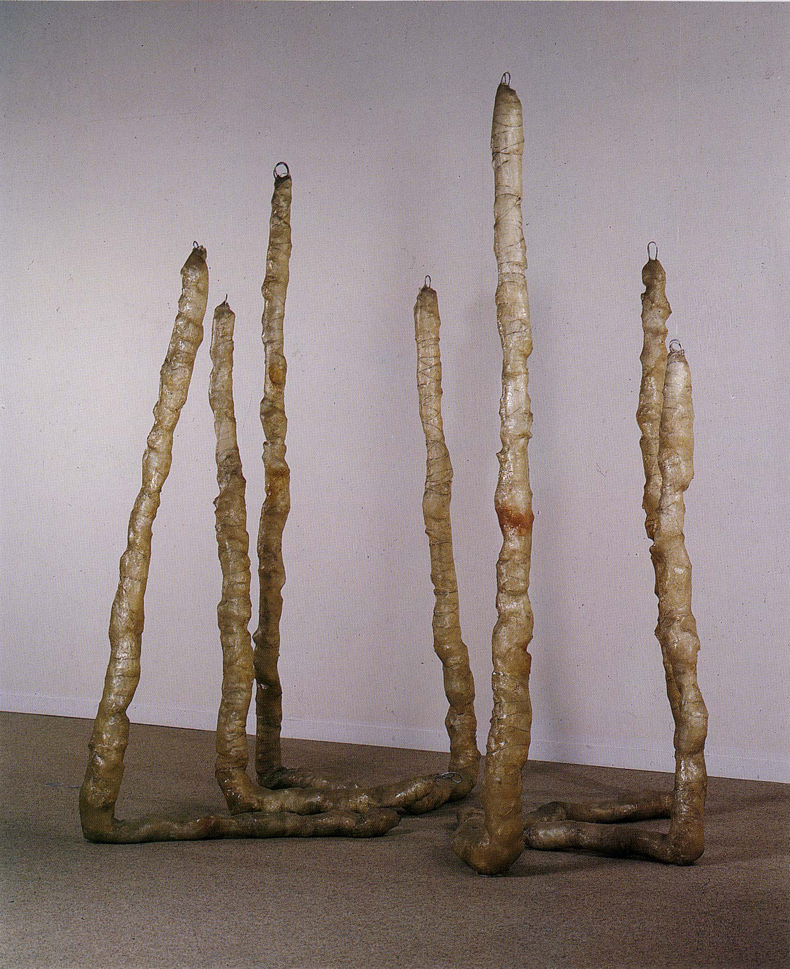
Eva HESSE
Untitled (7 poles)
1970 fiberglass over polyethylene over aluminum wire
7 units each 74-111” high and 10-16” in circumference

Slide 36
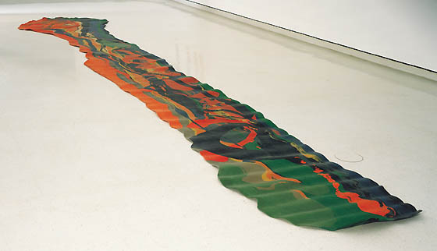
Lynda Benglis, Fallen Painting, 1968
Pigmented latex rubber

Slide 37
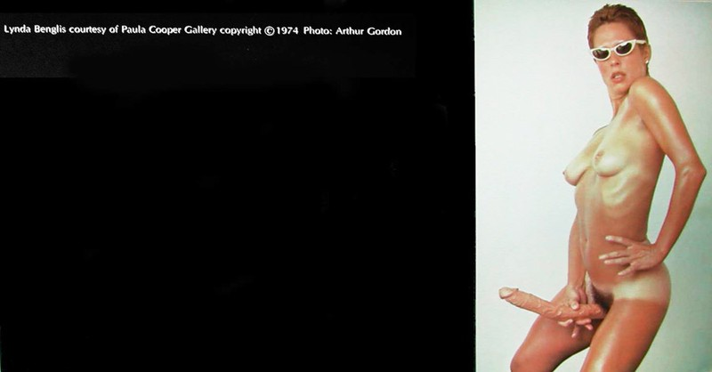
Lynda Benglis, self-portrait ad in Art Forum
November 1974

Slide 38
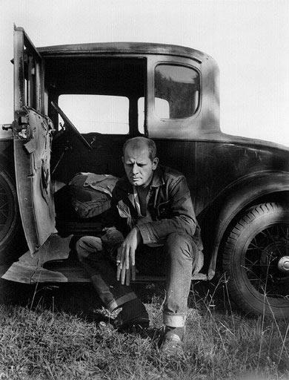
Pollock photograph by
Hans Namuth
1950

Slide 39
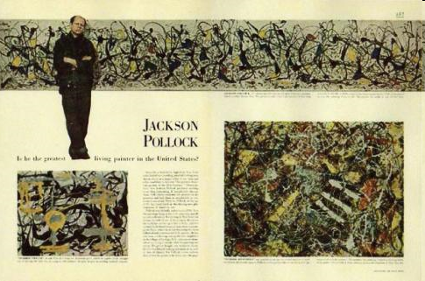
“Jackson Pollock: Is he the greatest living painter in the United States?” Life Magazine (1949)

Slide 40
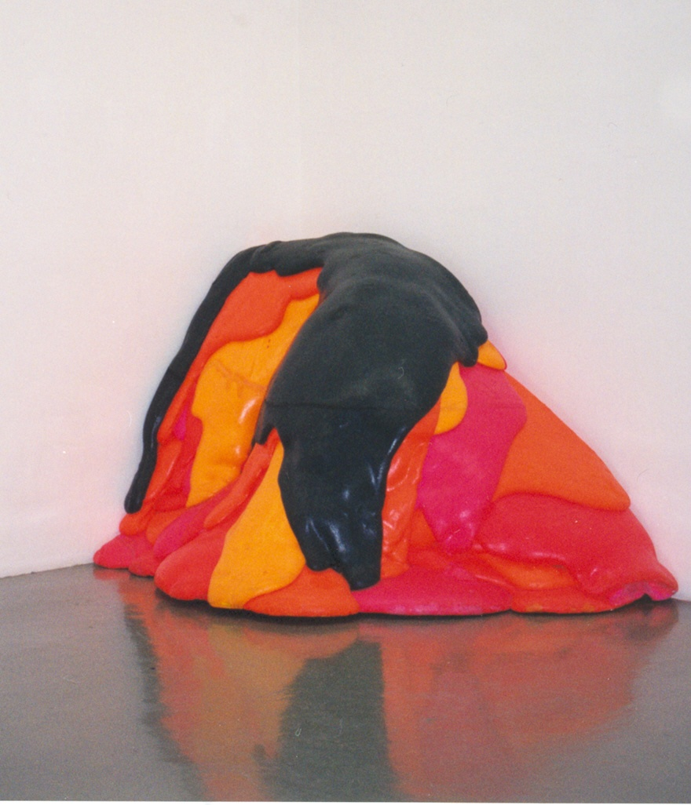
Lynda Benglis
Untitled
1970 poured pigmented polyurethane
122 x 176 x 106 cm

Slide 41
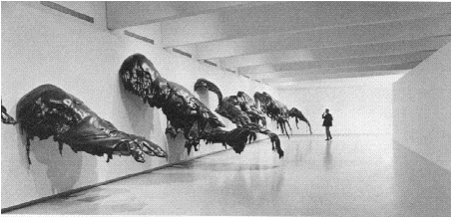
BENGLIS, Pinto, 1971
Polyurethane foam, 10x60x11’

Slide 42
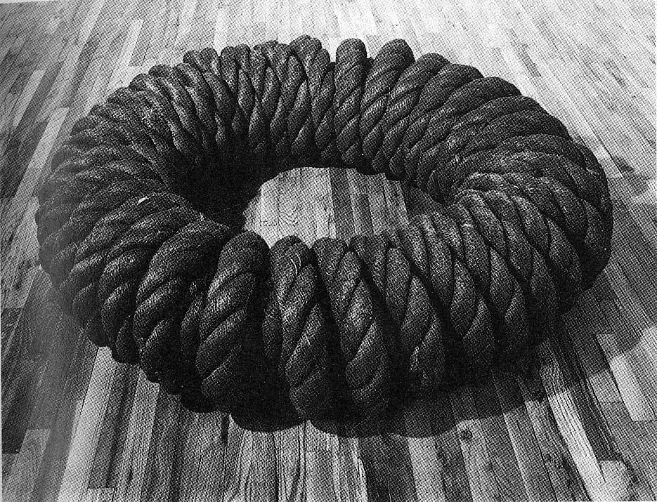
Jackie WINSOR, Double Bound Circle, 1971 hemp, 16x61”, High Museum of Art, Atlanta

Slide 43
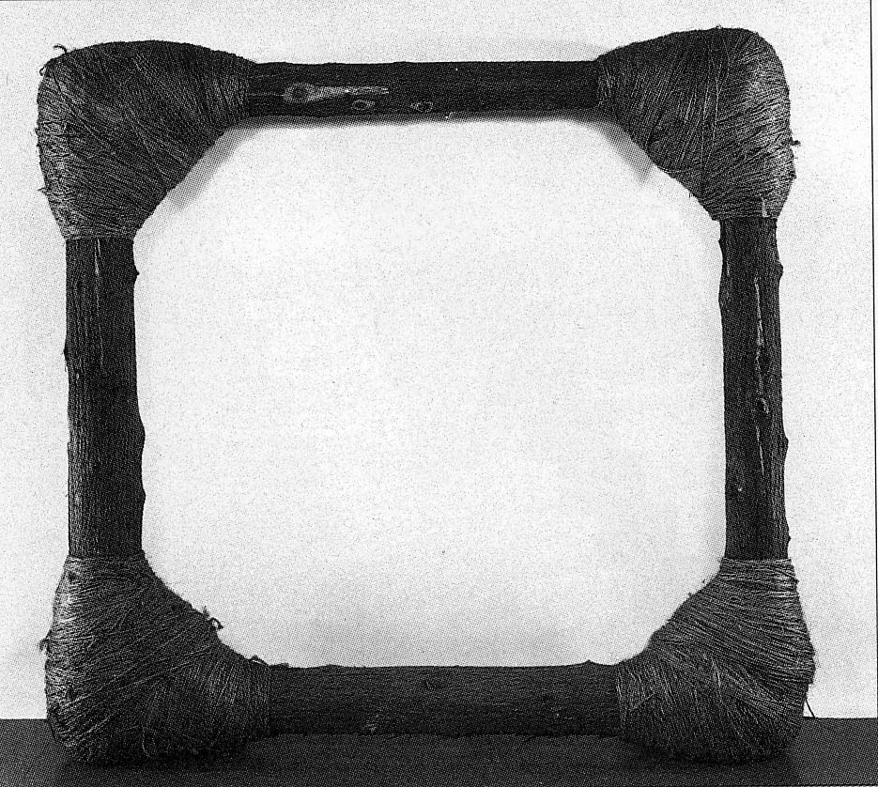
Jackie WINSOR, Bound Square, 1972 wood and twine, 6’3”x6’4”x14”, MoMA, New York

Slide 44
Land Art (Earthworks)

Slide 45
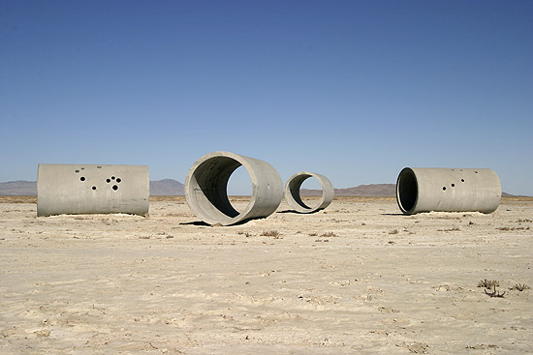
Nancy HOLT, Sun Tunnels, 1973-76, NW Utah Desert, 86ft long, Tunnel 18ft

Slide 46
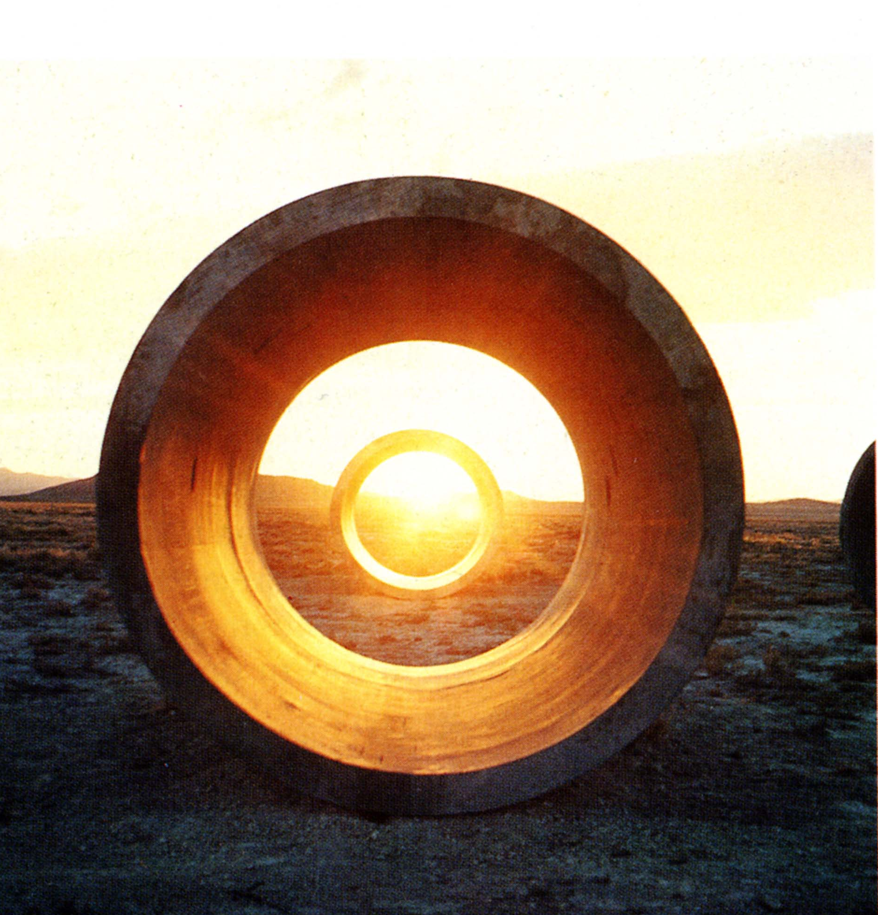
Nancy HOLT, Sun Tunnels, 1973-76, NW Utah Desert, 86ft long, Tunnel 18ft

Slide 47
Feminist Art of the 1970s:
First Generation Feminism

Slide 48
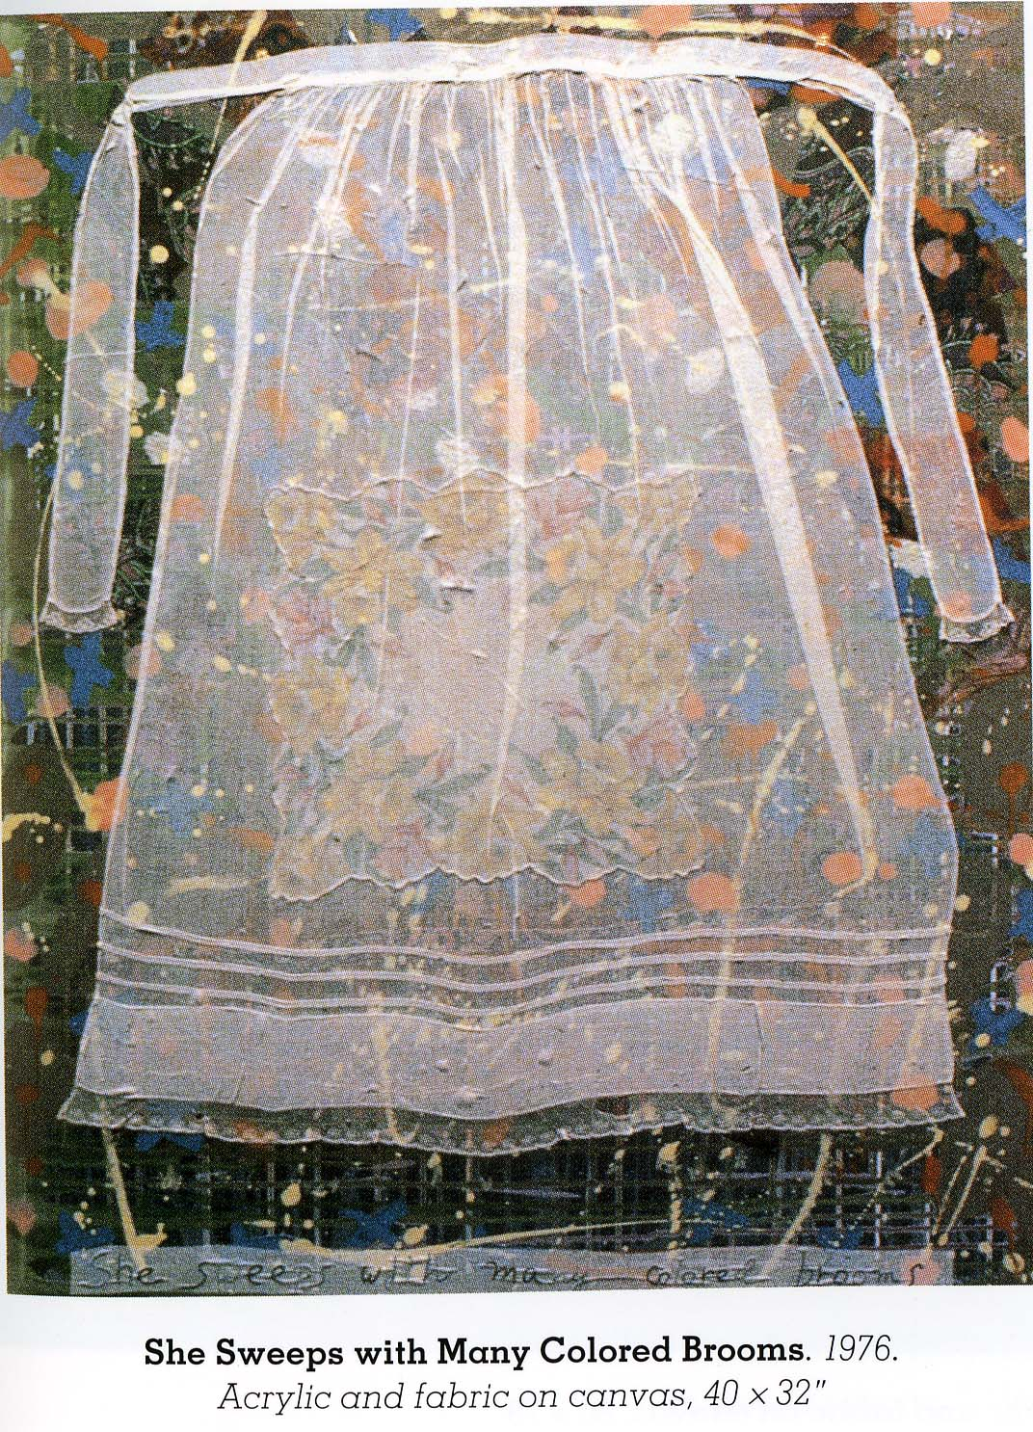
Miriam SCHAPIRO She Sweeps with Many Colored Brooms
1976 acrylic and fabric on canvas
40x32”

Slide 49
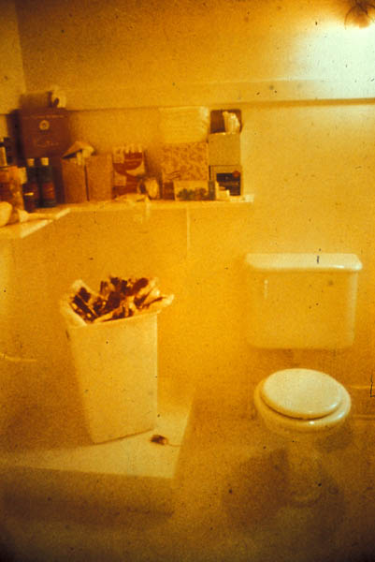
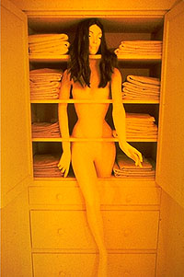
Feminist Art Program, organized by Miriam Schapiro and Judy Chicago, Woman House (1971)
“Menstruation Bathroom” / Sandy Orgel “Linen Closet”

Slide 50
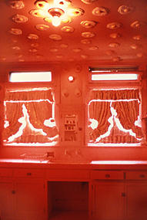
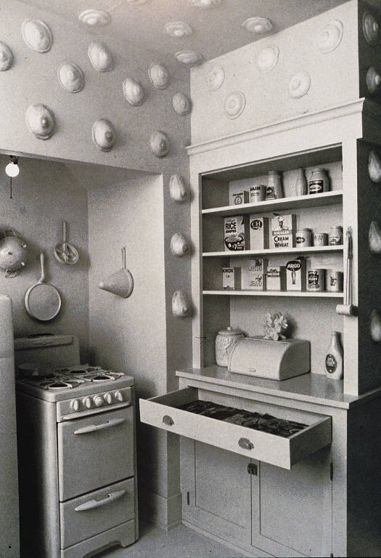
Feminist Art Program, organized by Miriam Schapiro and Judy Chicago, Woman House (1971)
“Nutrurant Kitchen”

Slide 51
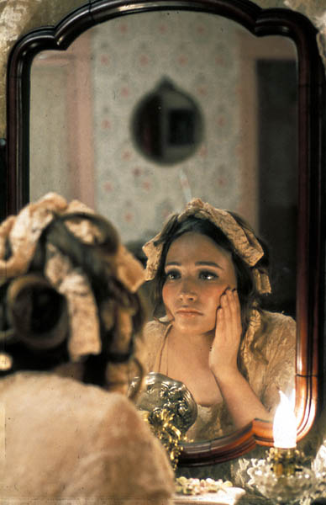
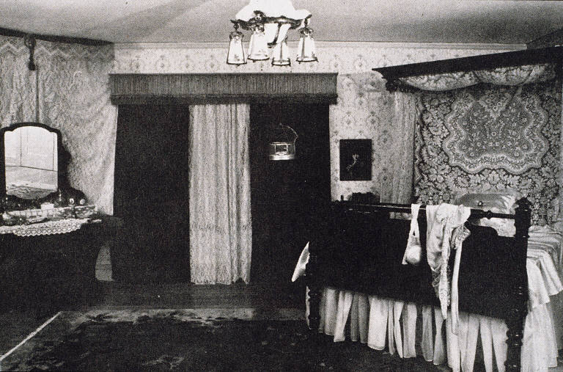
Feminist Art Program, organized by Miriam Schapiro and Judy Chicago, Woman House (1971)
“Leah’s Room”

Slide 52
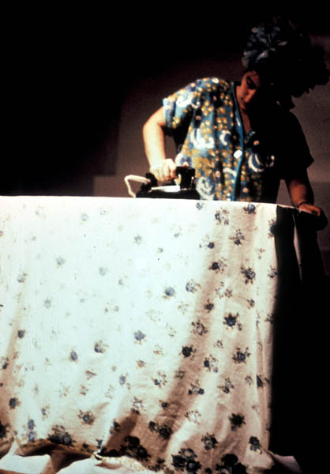
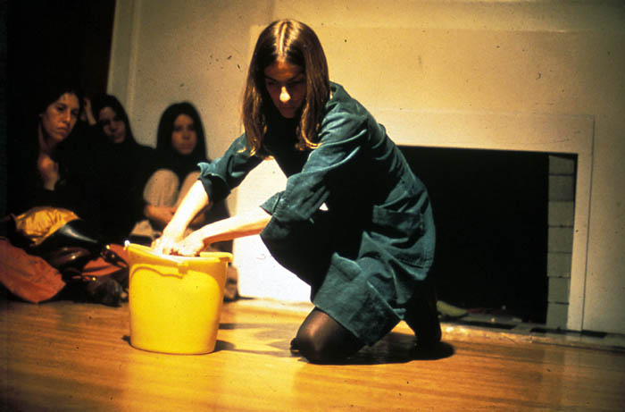
Feminist Art Program, organized by Miriam Schapiro and Judy Chicago, Woman House (1971)
Performances: “Ironing” / “Scrubbing”

Slide 53
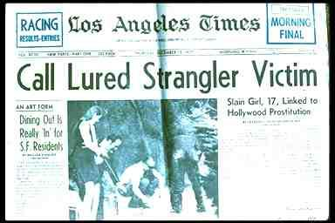
Newspaper coverage of the 1977 serial rapes and murders by the “Hillside Strangler”

Slide 54
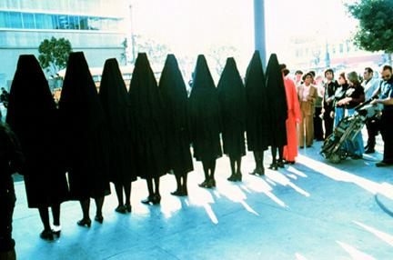
Suzanne Lacy and Leslie Labowitz
In Mourning and in Rage
Media event memorial for Victims of Hillside Strangler
Los Angeles, CA, 1977

Slide 55
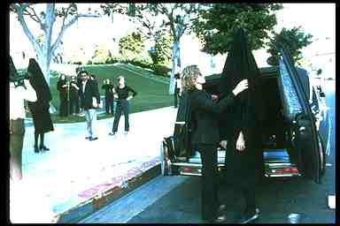
Suzanne Lacy and Leslie Labowitz
In Mourning and in Rage
Media event memorial for Victims of Hillside Strangler
Los Angeles, CA, 1977

Slide 56
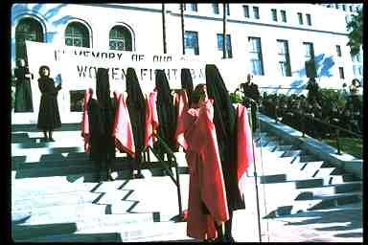
Suzanne Lacy and Leslie Labowitz
In Mourning and in Rage
Media event memorial for Victims of Hillside Strangler
Los Angeles, CA, 1977

Slide 57
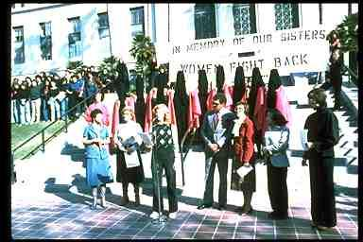
Suzanne Lacy and Leslie Labowitz
In Mourning and in Rage
Media event memorial for Victims of Hillside Strangler
Los Angeles, CA, 1977

Slide 58
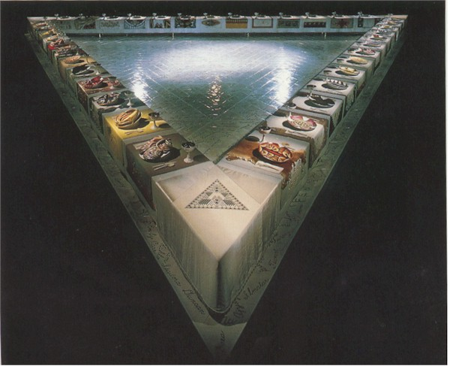
Judy Chicago, The Dinner Party, 1979 mixed media, 48x42x3ft, Collection of the Dinner Party Trust

Slide 59


Slide 60


Judy Chicago, The Dinner Party, 1979

Slide 61

Judy Chicago, The Dinner Party, 1979

Slide 62


Nancy Spero, Family Group 1953-1954 oil on canvas, 39 x 27 in
Nancy Spero, Ferocious Mother, 1962 oil on canvas, 64.25 x 51 in

Slide 63

Nancy Spero, Miss Liberty, Victims 1966 gouache and ink on paper, 24 x w: 36 in

Slide 64

Nancy Spero, Torture of Women, 1985-1989 handprinting and typewriter collage on paper, 64 x 200 in

Slide 65
Martha Rosler, Red Stripe Kitchen (from the series Bringing the War Home: House Beautiful), 1967–72. Photomontage, printed as a color photograph, edition 8/10, image: 23 1/4 x 17 3/4 inches (59.1 x 45.1 cm). Solomon R. Guggenheim Museum, New York
Rosler "Semiotics of the Kitchen" (1975) video
https://www.youtube.com/watch?v=Vm5vZaE8Ysc

Slide 66


Carolee Schneemann
Eye Body
1963
36 transformative actions for the camera

Slide 67


Slide 68


Carolee Schneemann
Meat Joy
Paris 1964

Slide 69

Carolee Schneemann Interior Scroll, 1975

Slide 70


Carolee Schneemann Interior Scroll, 1975

Slide 71

Hannah Willke, S.O.S. Starification Object Series, 1974-82, Mixed media, 40x58”

Slide 72

Hannah Willke
S.O.S. Starification Object Series
1974-82
Mixed media
40x58”

Slide 73
Eleanor Antin, The King of Solana Beach, 1974, one of a series of eight 6x9” photographs of a performance, San Diego, California.

Slide 74
Mary Kelly, Post Partum Documentation VI, 1978, Perspex unit, white card, resin, slate. 1 of the 15 units, 20x25.5cm each.

Slide 75
Postmodernism

Slide 76

SHERMAN Untitled #92 ,1981

Slide 77


Cindy SHERMAN Untitled #2, 1977
SHERMAN Untitled #11, 1978

Slide 78


SHERMAN Untitled # 13, 1978
SHERMAN Untitled # 52, 1979

Slide 79


SHERMAN Untitled # 35, 1979
SHERMAN Untitled # 56, 1980

Slide 80
SHERMAN Untitled #92 ,1981

Slide 81

SHERMAN Untitled #93, 1981

Slide 82


SHERMAN Untitled # 114 1982
SHERMAN Untitled # 153 1985

Slide 83


KRUGER, I shop, therefore I am, 1987
Photographic silkscreen on vinyl, 111 x 113 inches, Mary Boone Gallery
Tote Bag, 14x17”, Mary Boone Gallery

Slide 84


KRUGER

Slide 85


KRUGER You Body is a Battleground postcard, 6x4”
KRUGER It’s a small world, but not if you have to clean it, note cube 2x2x2”

Slide 86


KRUGER, You rule by pathetic display, 1982, photograph
KRUGER, Your Gaze hits the side of my face, 1981, 60x40”

Slide 87

KRUGER
We Won’t Play Nature to
Your Culture
1984 photograph
72x48”
Mary Boone Gallery, New York

Slide 88

Sherrie LEVINE, Fountain, "After Marcel Duchamp," bronze, 1991

Slide 89


LEVINE, After Walker Evans #2
LEVINE, After Edward Weston 1981

Slide 90

HOLZER Truisms series 1982 Times Square, Organized by the Public Art Fund of New York

Slide 91

HOLZER
Truisms series
1982
Times Square
Organized by the Public Art Fund of New York

Slide 92


HOLZER Truisms 1987 Candlestick Park, San Francisco
HOLZER Living Series 1980-1982

Slide 93

GUERRILLA GIRLS, Do women have to be naked to get into the Met. Museum? 1989, Poster 11x28”

Slide 94

GUERRILLA GIRLS, The Advantages of Being a Woman Artist, 1988

Slide 95
Postcolonial art

Slide 96

Lorna Simpson, Guarded Conditions, 1989, 18 color polaroid prints, 21 engraved plastic, plaques,, and plastic letters, Museum of Contemporary Art, San Diego

Slide 97

Lorna Simpson, Wigs II, 1994-2006, waterless lithograph on felt, Walker Art Center, Minneapolis

Slide 98


Picaninny images 1900-1930s

Slide 99


Picaninny images 1900-1930s

Slide 100


Kara Walker The End of Uncle Tom and the Grand Allegorical Tableau of Eva in Heaven , 1995, cut paper

Slide 102

WALKER
Look Away! Look Away! Look Away!
1995

Slide 103


WALKER, Insurrection! (Our Tools Were Rudimentary, Yet We Pressed On), detail, 2000. Cut paper silhouettes and light projections, dimensions vary with installation. Solomon R. Guggenheim Museum

Slide 104
WALKER, Insurrection! (Our Tools Were Rudimentary, Yet We Pressed On), detail, 2000
Cut paper silhouettes and light projections, dimensions vary with installation
Solomon R. Guggenheim Museum

Slide 105
WALKER, Insurrection! (Our Tools Were Rudimentary, Yet We Pressed On), detail, 2000
Cut paper silhouettes and light projections, dimensions vary with installation
Solomon R. Guggenheim Museum

Slide 106

Carrie Mae Weems
Ain’t Jokin series
1987-1988
20x16”

Slide 107

WEEMS
American Icons Series
1988-1989
15x15”

Slide 108

WEEMS
American Icons Series
1988-1989
15x15”

Slide 109

WEEMS, Colored People Series, 1989-1990, 16x48”

Slide 110

WEEMS, Colored People Series, 1989-1990, 16x48”

Slide 111

Carrie Mae Weems, Kitchen Table Series, 1990, 27x27”

Slide 113


Slide 114

Carrie Mae Weems, Kitchen Table Series, 1990, 27x27”

Slide 115

WEEMS
Kitchen Table Series
1990
27x27”

Slide 116


WEEMS, From Here I Saw What Happened and I Cried
1995-96, C-print with sandblasted text on glass, 42 x 31 in.

Slide 117


WEEMS, From Here I Saw What Happened and I Cried
1995-96, C-print with sandblasted text on glass, 42 x 31 in.

Slide 118



Slide 119


WEEMS, From Here I Saw What Happened and I Cried
1995-96, C-print with sandblasted text on glass, 42 x 31 in.

Slide 120

Carrie Mae WEEMS, The Hampton Project, 2000, digital photographs printed with pigmented inks on muslin and canvas, Courtesy of the artist and Pilkington Olsoff Fine Arts, Inc., New York; all photos by Arthur Evans

Slide 121


Slide 122


Slide 123

Carrie Mae Weems
Not Manet’s Type
2001

Slide 125
Louise Bourgeois

Slide 126

Robert Mapplethorpe Louise Bourgeois with “Filette”
1982

Slide 127

Bourgeois
Femme Maison
1945-47

Slide 128

Bourgeois
Femme Maison
1946-47 oil and ink on canvas
91x36cm

Slide 129

Bourgeois, He disappeared into complete silence, 1947 plate #5

Slide 130

Bourgeois, He disappeared into complete silence, 1947 plate #7

Slide 131

Bourgeois, Lair, 1963, latex 10x17x14

Slide 132

Bourgeois, Le Regard, 1966, latex fabric 5x16x15in

Slide 133

Bourgeois
Filette
1968 latex
24x11x8in

Slide 134

Brancusi
Princess X
1913

Slide 135

Bourgeois Janus Fleuri 1968

Slide 136

Bourgeois
Fragile Goddess
1970
10x6x6in

Slide 137

Venus of Willendorf
Austria
28,000-25,000BC

Slide 138


Bourgeois, Trani Episode, 1971-72 marble (left), plaster latex (right), 23x23x17in

Slide 139


Bourgeois, Destruction of the Father, 1974 latex plaster wood fabric, 94x143x98in

Slide 140


Bourgeois, Untitled,1989, pink marble, 79x78x53cm
Bourgeois, Cell III, 1991, mixed media

Slide 141

Louise Bourgeois, Maman, 1999, bronze and steel, height 30’5”, Guggenheim Museum Bilbao, Spain

Slide 142
Abject art

Slide 143


Kiki Smith Untitled (male and female), 1991

Slide 144


Smith, Mother and Child, 1993
Smith, Untitled, 1992

Slide 145


Smith, Pee Body, 1992, wax, glass, beads
Smith, Lilith, 1993

Slide 146


Smith, The Sitter, 1992, wax, pigment, paper mache

Slide 147


Smith, Bloodpool, 1992
Smith, A Man,1988, ink, gampi paper

Slide 148


Smith, untitled , paper, 1995
Smith, Wild Woman, Mary Magdalene

Slide 149

Kiki Smith, Tale, 1992

Slide 150

Smith, Born, bronze, 2002

Slide 151

Smith, Moon on Crutches, 2002

