Slide 1
The Real Life Science Guest Speaker Series
Atmospheric Chemistry, Environmental Science and Nanoscience
Prof. Robert Keesee
Department of Atmospheric and Environmental Sciences
Monday, March 12th
2:35 – 3:10
Room 305

Slide 2
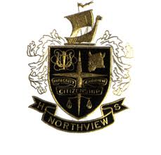
Pomona, CA
10th grade bailed on advanced Spanish for Chemistry
Covina, CA
Switched into AP chemistry
Lab prep assistant in 11th and 12th grades

Slide 3
First paid chemistry job:
Analyzed collected airborne dust for sulfate, nitrate, and ammonium ions
Part of a project to investigate affect of copper mining on air quality in southeast Arizona

Slide 4
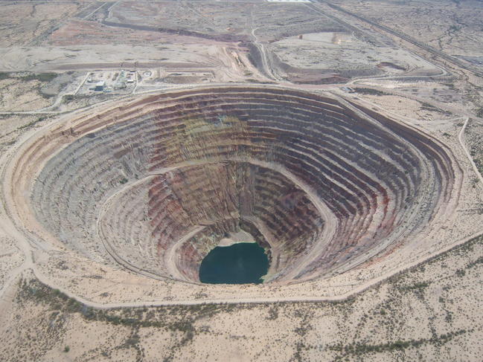
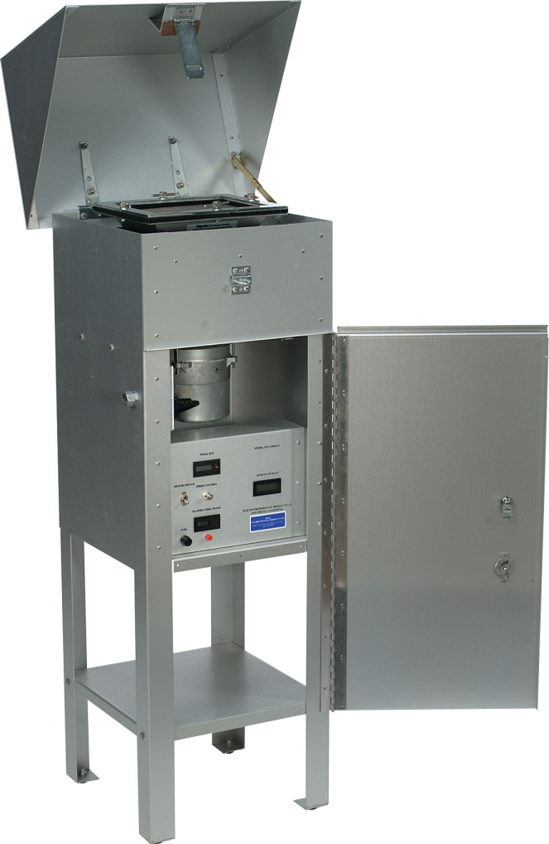
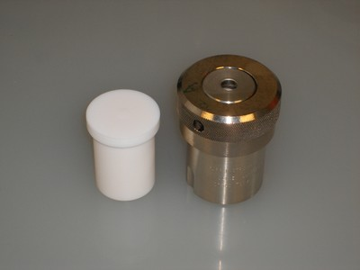
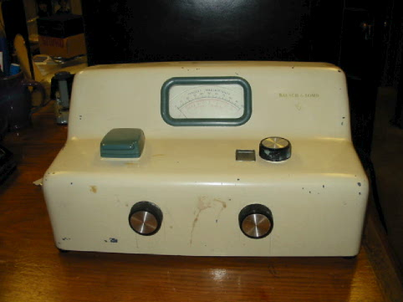
Hi-vol sampler
Open-pit mine
Sulfate is precipitated as barium sulfate by reaction with barium chloride in acidic medium. The turbidity is proportional to the concentration of sulfate:
(SO₄)²⁻ + Ba²⁺ → BaSO₄
spectrophotometer
Teflon “bomb” digester

Slide 5
Graduate School
Gas-phase clusters, which are weakly bound aggregates comprised of either atoms or molecules, often display properties that lie between those of the gaseous and condensed states.
Atmospheric ions attract water molecules to form water clusters or “mini-droplets” of just a handful of water molecules

Slide 6
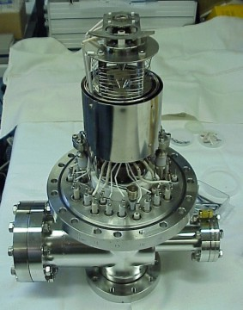
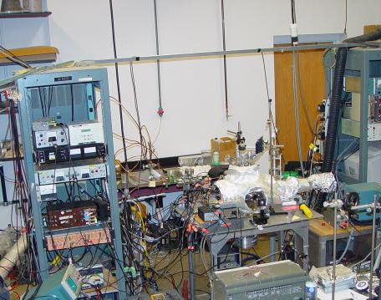
Plumber, mechanic, electrician, and chemist
Mass Spectrometer

Slide 7
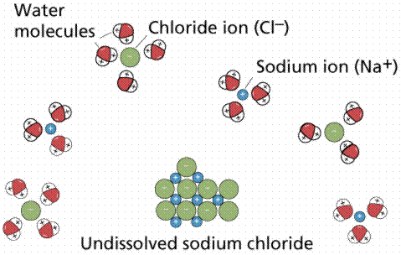

Slide 8
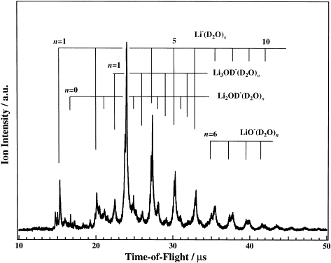

Slide 9
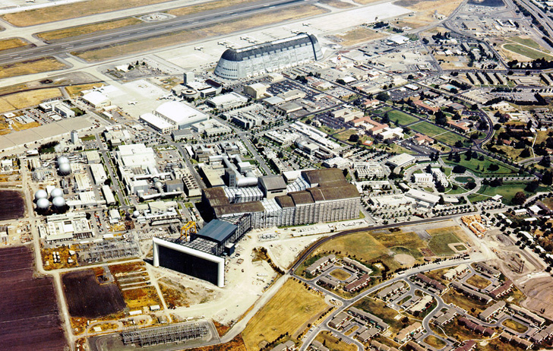
Space Science and Astrobiology at Ames Research Center

Slide 10
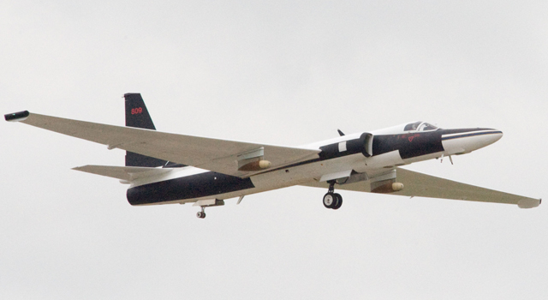
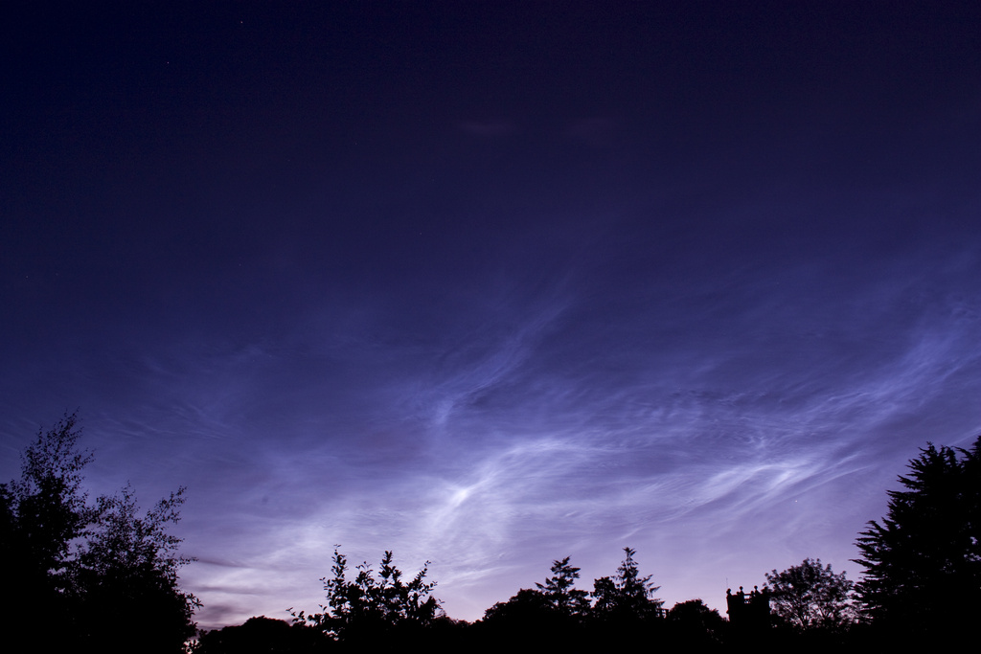
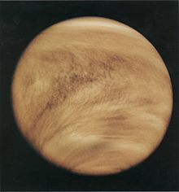
Stratospheric Aerosol Layer (Junge Layer) about 15 miles above surface of the Earth
Venus clouds
Noctilucent clouds about 50 miles high

Slide 11
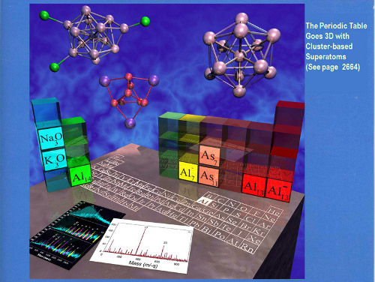

Slide 12
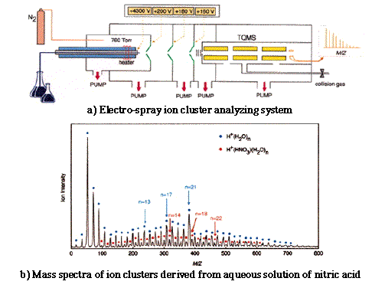
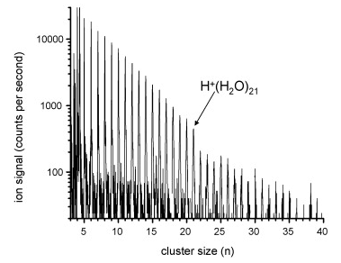

Slide 13
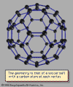
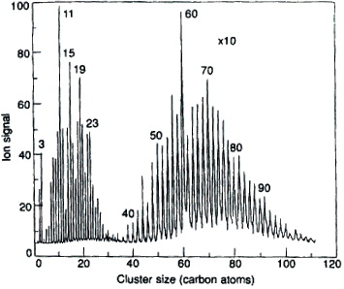
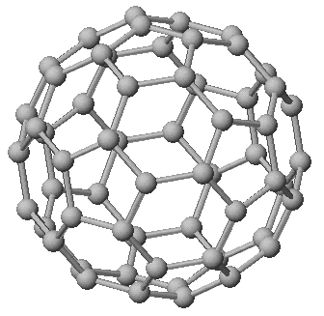
From clusters to Nanoscience

Slide 14
From clusters to Nanoscience
In 1985 Robert F. Curl, Jr., Harold W. Kroto, and Richard E. Smalley
discovered the first fullerene, the third known form of pure carbon
(after diamond and graphite). They named their discovery buckminsterfullerene (“buckyball”) for its resemblance to the geodesic domes promoted by the American architect R. Buckminster Fuller.
Technically called C₆₀ for the 60 carbon atoms that form their hollow spherical structure, buckyballs resemble a football one nanometer in diameter.
In 1991 Sumio Iijima made carbon nanotubes, in which the carbon ring-like structures are extended from spheres into long tubes of varying diameter.
Taken together, these new structures surprised and excited the imaginations of scientists about the possibilities of forming well-defined nanostructures with unexpected new properties.

Slide 15
Research emphasis shifting to materials such as titanium , molybdenum, aluminum and lead and away from systems of more atmospheric relevance …
but I was more interested in learning about our atmosphere and environment.
Another opportunity knocks

Slide 16
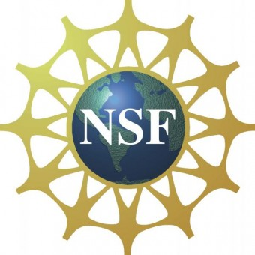
Atmospheric Chemistry Program
Supports research to measure and model the concentration and distribution of gases and aerosols in the lower and middle atmosphere. Also supports research on the chemical reactions among atmospheric species; the sources and sinks of important trace gases and aerosols; the aqueous-phase atmospheric chemistry; the transport of gases and aerosols throughout the atmosphere; and the improved methods for measuring the concentrations of trace species and their fluxes into and out of the atmosphere.
Science Funding $ $ $

Slide 17
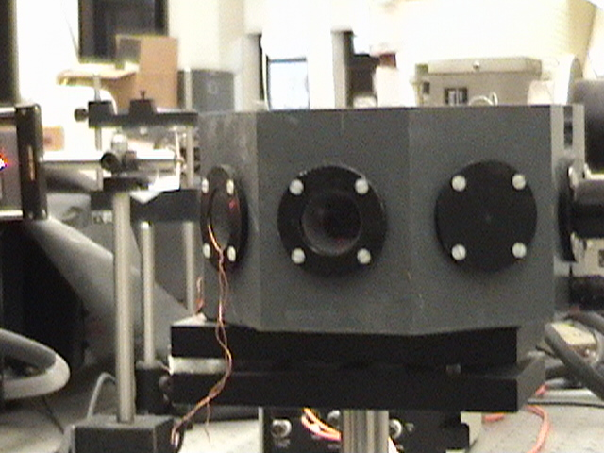
Department of Atmospheric and Environmental Sciences
Research areas:
Aerosol particles
Administration:
Graduate admissions
Teaching areas:
Air Quality
Atmospheric Chemistry
The Upper Atmosphere
Energy, Sustainability and Climate

