Slide 1
Beyond Test Automation
(Why Are My Tests Dumb?)
Jeff Offutt
Software Engineering
George Mason University
Fairfax, VA USA
www.cs.gmu.edu/~offutt/
offutt@gmu.edu

Slide 2
Outline
Why do we have so many dumb things?
Simple tests
Automated tests
Quality of test oracles
Smart tests

Slide 3

I Want Smart Things
Why doesn’t my door open itself ?

Slide 4
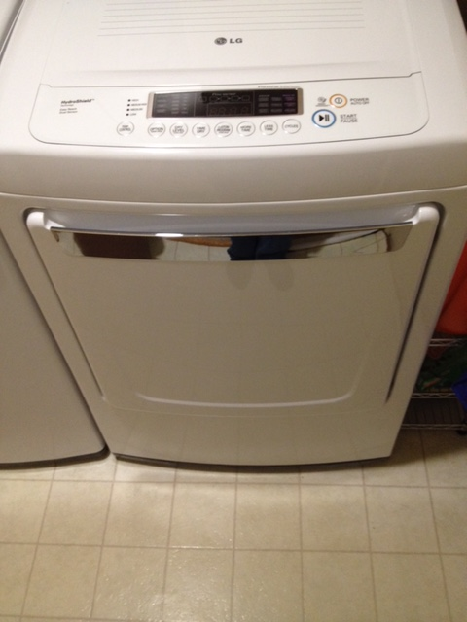
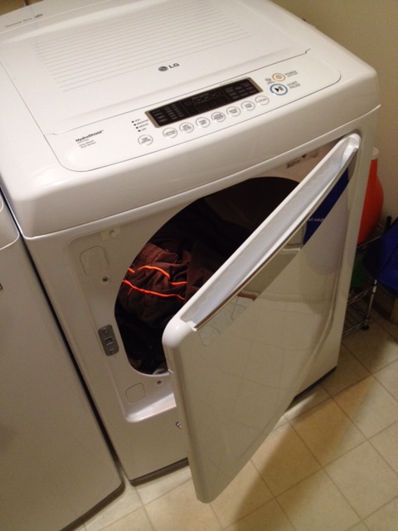
This Door Even Lies
Which way do you pull to open?

Slide 5
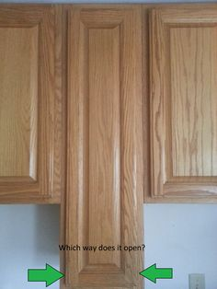
This Door Sits There Like a Dummy
Shhh … it’s a secret !

Slide 6
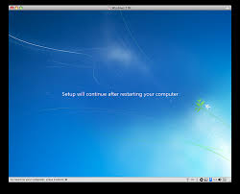
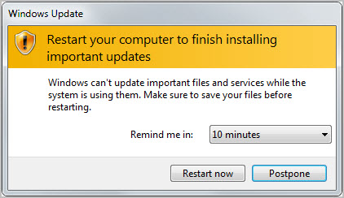

Even Our Computers Are Stupid !

Slide 7

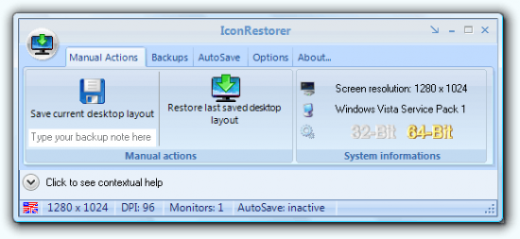
Baby Sitting Service
We even have baby sitting services to take care of computers who are too stupid to take care of themselves !

Slide 8
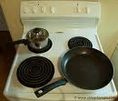

Dumb Stove
Smarter design
How can we remember which control maps to which burner ?

Slide 9
Dumb Calendar
Sun | Mon | Tue | Wed | Thu | Fri | Sat
31 | 1 | 2 | 3 | 4 | 5 | 6
7 | 8 | 9 | 10 | 11 | 12 | 13
14 | 15 | 16 | 17 | 18 | 19 | 20
21 | 22 | 23 | 24 | 25 | 26 | 27
28 | 1 | 2 | 3 | 4 | 5 | 6
This makes sense … for a paper calendar

Slide 10
Smarter Calendar
Sun | Mon | Tue | Wed | Thu | Fri | Sat
17 | 18 | 19 | 20 | 21 | 22 | 23
24 | 25 | 26 | 27 | 28 | 29 | 30
31 | Feb 1 | 2 | 3 | 4 | 5 | 6
7 | 8 | 9 | 10 | 11 | 12 | 13
14 | 15 | 16 | 17 | 18 | 19 | 20
scroll
Month divisions are arbitrary

Slide 11
Outline
Why do we have so many dumb things?
Simple dumb tests
Automated tests
Quality of test oracles
Smart tests

Slide 12
I want tests to be smart too!

Slide 13
Old Style Tests
Values invented by humans
Scripts were pieces of paper with steps
Simple directions to humans
Slow!
Error prone!
1. Turn on computer
2. Type : “Run myProgram”
3. Enter name :
“George P. Burdell”
Limited repeatability!
4. Enter age : “-25”
Very hard to use with test criteria
These are as dumb as single-cell organisms !!

Slide 14
Limitations of Single-Cell Tests
Expensive
Test suites tend to grow unbounded
Requires lots of human care
  Running tests
  Adding new tests
  Deleting out-of-date tests
  Evolving tests

Slide 15
Outline
Why do we have so many dumb things?
Simple tests
Automated tests
Quality of test oracles
Smart tests

Slide 16
Modern Dumb Tests
Test values
  Created by a mix of humans and test data generators
  Satisfy well-documented goals, test criteria, or specialized domain needs
Integrated into automated test scripts (eg, JUnit)
Includes a small amount of brain power … these tests know what results to expect (eg, JUnit assertions)
Fast to run and repeatable …
These multi-cellular tests show the first signs of intelligence!

Slide 17
The RIPR Model
Test
Final Program State
Reachability
Infection
Propagation
Revealability
Observed Final Program State
Reaches
Observed Final Program State
Fault
Incorrect Final State
Infects
Incorrect Program State
Propagates
Reveals
Test Oracles

Slide 18
Controllability and Observability
Controllability
How easy it is to give a program the inputs needed
Its input values, operations, environment variables, external data stores, etc.
Observability
How easy it is to see the program’s behavior
Its outputs, effects on the environment, and other hardware and software components

Slide 19
Test Automation—Model-Based Tests
2
Abstract Tests
[ 1, 2, 3, 2, 1 ]
[ 1, 3, 4, 1 ]
…
1
3
4
Model level
Implementation level
public class underTest()
{
private int X, Y;
public m1 (int a) { … };
public m2 (int s, int t) { … };
}
Concrete Test
ut = new underTest();
ut.m1 (14);
ut.m2 (5, 7);
ut.m2 (1, 3);
ut.m1 (13);
ut.m1 (23);

Slide 20
The Mapping Problem
Transform abstract tests to concrete tests
First abstract test:
  AddChoc, Coin, GetChoc, Coin, AddChoc
Nine abstract tests use :
  15 “AddChoc” transitions
  16 “Coin” transitions
  6 “getChoc” transitions
Testers often convert abstract to concrete tests by hand
Solution?
Coin
[1, 3, 4, 1, 2, 4]
1
Coin
2
GetChoc
AddChoc
AddChoc
Coin
3
4
GetChoc
AddChoc
AddChoc / Coin
1: credit = 0 & #stock = 0
2: credit > 0 & #stock = 0
Automate the transformation
3: credit = 0 & #stock > 0
4: credit > 0 & #stock > 0

Slide 21
Model-Based Test Components
Test components
Test 1
Test 2
C1
C1
C1
C2
C2
C3
C3
Each abstract test component must be mapped to real code in concrete tests
Test 3
C4
C4
C4
many times
C5
C5
C5
C6
C6
C7
C7
Joint with Nan Li, Test Automation Language Framework for Behavioral Models, AMOST 2015

Slide 22
Automating Model-Based Test Designs
Implementation
Model
Test Criterion
Test Components
Test values
Test oracles
Other values
Test Requirements
Abstract Tests
Concrete Tests

Slide 23
Automating Model-Based Test Designs
Coin
Abstract Tests
1. [ 1, 3, 4, 1, 2, 4 ]
2. [ 1, 2, 4, 1, 2, 4 ]
3. [ 1, 2, 4, 3, 4 ]
4. [ 1, 2, 4, 1, 3, 4 ]
5. [ 1, 3, 4, 1, 3, 4 ]
1
Coin
2
GetChoc
AddChoc
AddChoc
@Test public class test1()
{
vm.addChoc (“MM”);
vm.coin (100);
vm.getChoc (choc);
vm.coin (10);
vm.addChoc (“MM”);
assertEquals (1, vm.getStock().size());
}
3
Coin
4
GetChoc
AddChoc
Coin / AddChoc

Slide 24
Empirical Evaluation
Compared assembly with hand process
Subjects
9 testers
17 programs
(each tester created tests for one program)
Assembly Process
  Find test code for each element from model
  Enter mappings into test automation tool
  Create concrete (automated) tests; correct errors
Hand Process
  Find test code for each element from model
  Write automated tests
  Correct errors

Slide 25
Empirical Results
Statistic | Size
FSM Nodes | 742
FSM Edges | 33,983
LOC | 232
Num Test Components | 196
Num Test Components | 2325
Num Tests | 240
Task | Automatic (seconds) | Manual (seconds)
Mapping Creation | 8364 | N/A
Test Generation | 344 | 39,670
Total | 8708 | 39,670
Errors | 0 | 48
75% time savings
(4-1 speedup)

Slide 26
Outline
Why do we have so many dumb things?
Simple tests
Automated tests
Quality of test oracles
Smart tests

Slide 27
Test Oracles
An automated test must include the expected (correct) result

Slide 28
Initial Test Oracle Observations
Testers wrote pretty bad test oracles
Type of tester | % of propagated failures that were revealed
Undergraduate students | 79%
Full-time graduate students | 74%
Full-time software engineers | 63%
Full-time testers | 61%

Slide 29
Test Oracle Strategies
Test Oracle
Verifies if a test passes
  For example, JUnit assertions
Test Oracle Strategy (OS)
Specifies what parts of the program state the oracle should check
Weak, or less precise, oracles might miss some failures
A more precise OS effectively increases observability

Slide 30
Output Elements for Test Oracles to Check
1. State invariants
Check the state invariants as defined in the model
2. Object Members
Member variables of objects if a method was called in a transition
3. Return values
After a method is invoked
4. Parameter members
Member variables of objects that were passed to a method call as parameters

Slide 31
Test Oracle Strategies
Checks object members, parameter members,
& return values
OS5
Checks parameter members & return values
OS4
OS3
Checks object members & return values
OS2
OS1
Checks return values
Checks object members
SIOS
Checks state invariants in FSM
NOS
Just checks for exceptions

Slide 32
Test Oracle Strategies Evaluation
Subjects
16 programs with FSMs
  52 .. 14,155 LOC
  24 .. 273 transitions
250 tests to satisfy edge coverage on the FSMs
9627 faults generated as mutants (muJava)
  Equivalent mutants removed by hand
Each test set run against all faulty versions of its program

Slide 33
Percent Faults Detected by Strategies
Reached, infected, propagated, and revealed
OS | % Faults detected | Assertions created (cost)
OS5 | 61% | 3,455
OS4 | 58% | 472
OS3 | 61% | 3,375
OS2 | 58% | 402
OS1 | 60% | 3,298
SIOS | 54% | 114
NOS | 34% | 0
% of propagated that were also revealed
100%
95%
100%
95%
98%
89%
56%
Nan Li & Jeff Offutt, Empirical Analysis of Test Oracle Strategies for Model-based Testing, ICST 2014
Nan LI & Jeff Offutt, Test Oracle Strategies for Model-based Testing, TSE 2017

Slide 34
Percent Faults Detected by Strategies
Reached, infected, propagated, and revealed
Tests found 61% of the faults
OS | % Faults detected | Assertions created (cost)
OS5 | 61% | 3,455
OS4 | 58% | 472
OS3 | 61% | 3,375
OS2 | 58% | 402
OS1 | 60% | 3,298
SIOS | 54% | 114
NOS | 34% | 0
% revealed
100%
95%
100%
95%
98%
89%
56%
Slightly more expensive, only misses 5% of failures
Inexpensive, only misses 11% of failures
Free, but doesn’t see 44% of failures!

Slide 35
Outline
Why do we have so many dumb things?
Simple tests
Automated tests
Quality of test oracles
Smart tests

Slide 36
Multicellular Tests
Composing tests from parts has advantages
Before values
Test Values
After values
Parts can be recombined to form new tests
Expected results
Tests can be changed
Automation is much easier

Slide 37
Multicellular Tests are Still Dumb
But multicellular tests do not know …
Before values
Why do they exist?
Test Values
After values
When should they run?
Expected results
When do they need to evolve?
When should they die?

Slide 38
Intelligent Tests
Intelligent tests
need
self-awareness
and
self-determination!

Slide 39
Self-Aware Tests
Documents why the test exists and when to run.
But for the tester.
The test needs to know this.
public class calcTest
{
// Test 14
// Test path 8: [1, 2, 4, 5, 4, 5, 6, 8]
// Edges covered: (1,2), (2,4), (4,5), (5,4), (5,6), (6,8)
@Test public void testAdd1 ()
{
. . .
}

Slide 40
Self-Deterministic Tests
public class calcTest
{
// Test 28
// Requirement: Divide by zero returns undefined
@Test public void testDivide3 ()
{
. . .
}
If the requirement changes, the test can be removed.
How can the test recognize the change and delete itself?

Slide 41
What Do We Need for Multicellular Tests to Evolve Intelligence?
Every test must encode its purpose
Meaning
Before values
Why is it there?
What is it trying to check?
Test Values
After values
What test requirement?
Functional requirement
Criterion (eg, graph edge)
Expected results
Purpose
We need a language to describe why a test exists

Slide 42
What Do We Need for Multicellular Tests to Evolve Intelligence?
Tests must exist in a habitat and a society
Habitat
Meaning
Before values
Habitat
An execution framework that allows tests to run themselves
Test Values
After values
Expected results
Purpose
Society
Ability to query the environment and other tests about status and changes
Society

Slide 43


Getting Intelligent Tests
Habitat
Meaning
Before values
Self aware
Test Values
After values
Expected results
Purpose
Society
Self determination

Slide 44
What Can an Intelligent Test Do?
Proactively run on its own
Proactively alert engineer when a test fails
When software changes ...
Decide whether test should run, change, die, or do nothing
When the test changes ...
Take initiative, but ask for help when necessary ( e.g., values, expected results )

Slide 45
Summary
“Intelligent” tests can save enormous amounts of time for software engineers
Pre-requisites to developing intelligent tests
Test automation
Traceability from software artifacts to test ( criteria )
Technical needs
Language for describing purpose ( effectiveness & usability )
Rule set for tests to choose actions
Execution environment for tests to run in
Ability to query the source library
Framework for test development
Tests should think so testers don’t have to

Slide 46
Contact
Jeff Offutt
offutt@gmu.edu
http://cs.gmu.edu/~offutt/
George Mason University
We need significant research in test automation

