Slide 1
Understanding How Elementary Teachers Respond to a Model of Professional Development for Integrating Computer Science Into Instruction
Jeff Offutt, George Mason University
cs.gmu.edu/~offutt
with: Amy Hutchison, Anya Evmenova, Margaret Gross (GMU)
and: Jamie Colwell, Kristie Gutierrez (Old Dominion University)

Slide 2
Project needs & goals
Elementary students (K-5) need to learn computational thinking (CT) and computer science (CS)
Teachers need to learn how to teach CT and CS
CT and CS education integrated into existing classes
CT and CS knowledge should be available to all, including those with high-incidence disabilities
Develop online, self-paced, asynchronous professional development (PD) modules for teachers

Slide 3
Context
Coding has become a communication medium that is essential for success in our society
Educational standards for CT, CS, and coding are becoming increasingly common
CT, CS, and coding are required for a steadily increasing percentage of occupations
Every student has a right to learn about computing

Slide 4
A PD model
Online modules
Provided lesson plans:
integrate w/ existing subjects
UDL design
Lesson reflections
Community of practice meetings
Based on Universal Design for Learning (UDL)
Iteratively refined through design-based research cycles
multiple ways to engage students
A situative PD
multiple ways to represent information
multiple ways to express

Slide 5
Example screen from our PD

Slide 6
Research approach
Research Question 1:
To what extent and in what ways does participation in the Inclusive Computer Science model of professional development (PD) influence teachers’ knowledge, comfort, beliefs and perceptions about their abilities to teach computer science to students with disabilities?
Research Question 2:
To what extent and in what ways does participation in the Inclusive Computer Science model of professional development (PD) influence teachers’ knowledge and use of Universal Design for Learning?

Slide 7
Put more simply
Research Question 1:
How did the PD affect teachers’ abilities?
Research Question 2:
How did the PD affect teachers’ UDL knowledge?

Slide 8
Data gathering and analysis
Survey: Readiness to integrate CT and CS into curriculum
Survey: Application of UDL to CS
Field notes: From community of practice meetings
Teacher reflections: After classroom use
Interviews: Of individual teachers
Wilcoxon matched-pairs signed-rank tests to analyze survey data
Transcribed and analyzed interviews and reflections

Slide 9
Results: RQ1, readiness survey
Comparison of survey of readiness to integrate CT and CS (n=35)
 | pre-test |  | post-test
Scale | M | SD | M | SD | Z | P | Effect size
Prior knowledge | 7.63 | 2.85 | 12.86 | 3.23 | -4.87 | .000 | 0.82
Beliefs | 27.03 | 2.26 | 27.62 | 2.69 | -1.83 | .068 | 0.31
Comfort | 21.74 | 4.90 | 25.03 | 4.02 | -2.99 | .003 | 0.51
Ability to differentiate instruction | 33.57 | 5.53 | 38.23 | 3.89 | -3.85 | .000 | 0.65
Students with disabilities | 43.22 | 6.83 | 46.41 | 6.01 | -2.94 | .007 | 0.48

Slide 10
Results: Survey on comfort & beliefs
Connection to “host” subjects increased teacher’s comfort with teaching CT and CS
Integrated lessons reinforced what students learned in the “host” subjects
Using CT to analyze writing helped students understand reading and writing more deeply

Slide 11
Results: Reflections on UDL
Teachers used UDL strategies
Teachers struggled to fully understand how UDL works

Slide 12
Conclusions
1. Providing complete lesson plans helped teachers
2. Integrating CS into existing courses helped teachers
3. Integrating CS into existing courses helped students with those courses
Designing a model of computer science professional development for elementary educators in Inclusive settings Journal of Technology and Teacher Education, April 2021

Slide 13
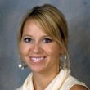
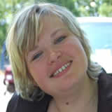
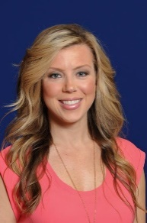
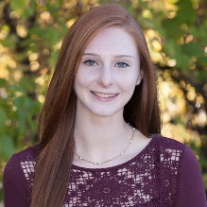
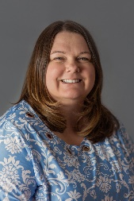
What’s next?
Working with a large, diverse, school district to study the use of these techniques at scale
(nearly 150 elementary schools)
Hutchison
Evmenova
Colwell
How can non-specialist teachers use UDL to support students with high-incidence disabilities ?
Gross
Jeff Offutt
Slides: https://bit.ly/3rKdxzD
Gutierrez

